Slide 1



Projectreport1
View in Power BI
Last data refresh:
1/7/2019 12:29:41 PM India Standard Time
Downloaded at:
1/7/2019 12:33:00 PM India Standard Time

Slide 2
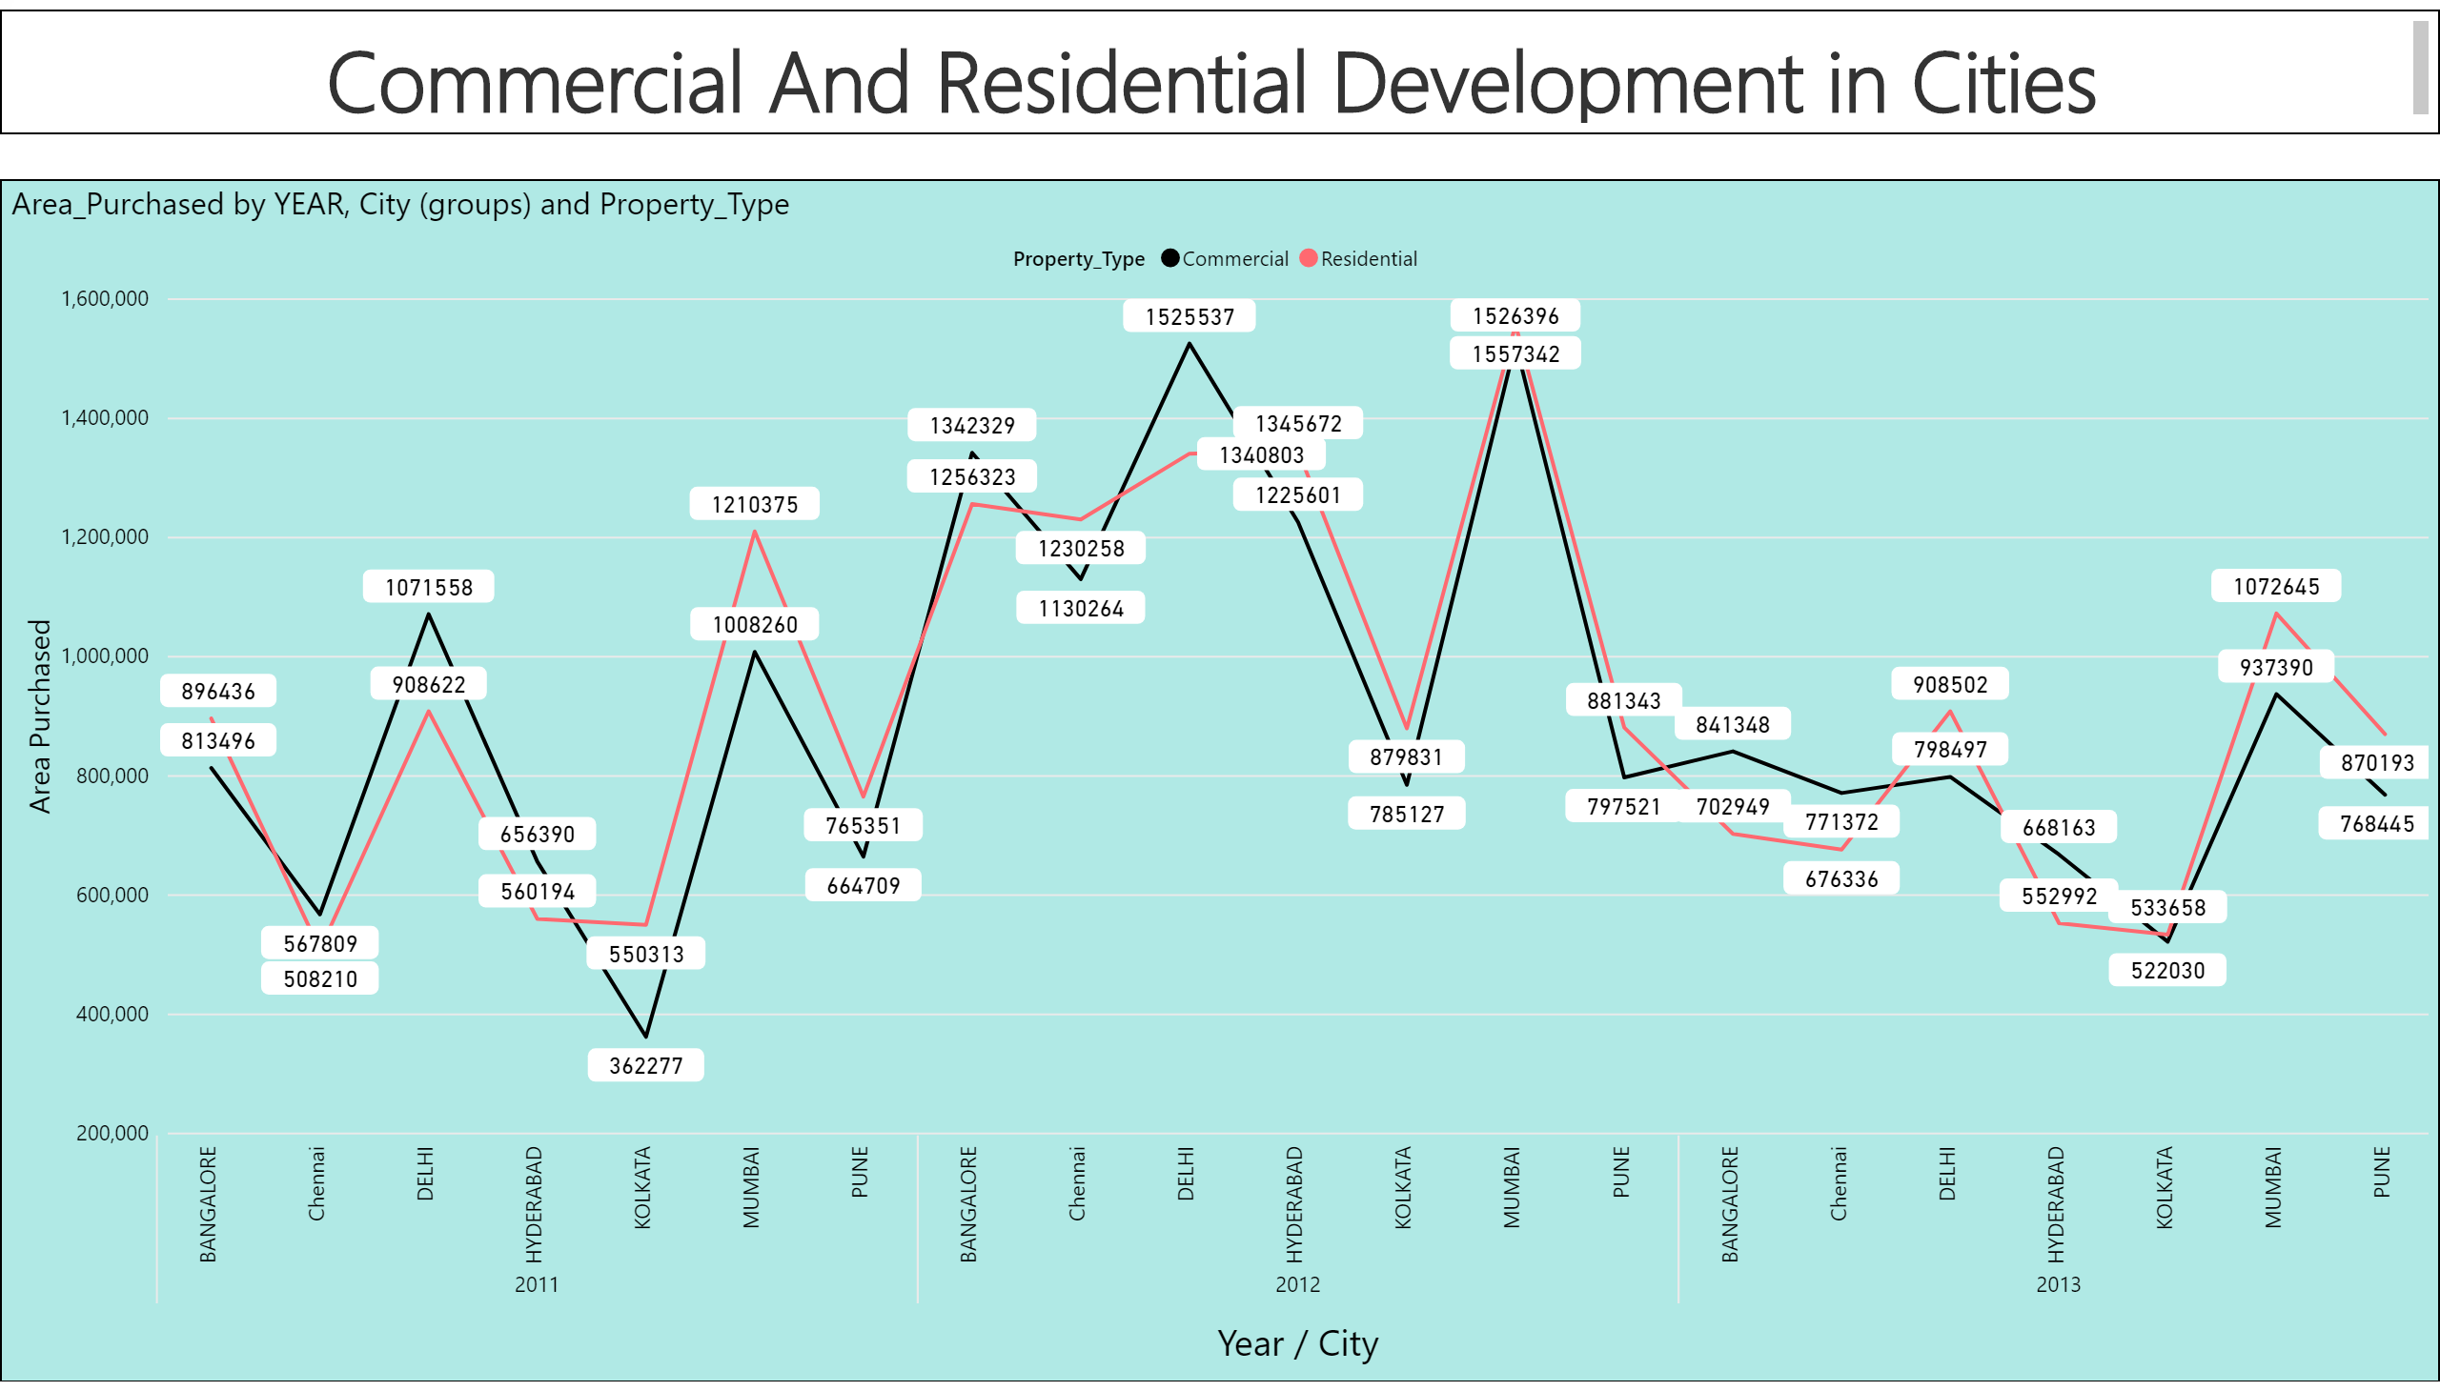

Slide 3
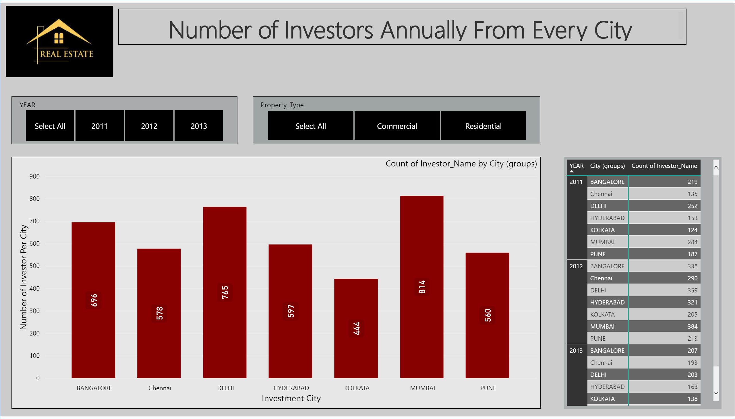

Slide 4
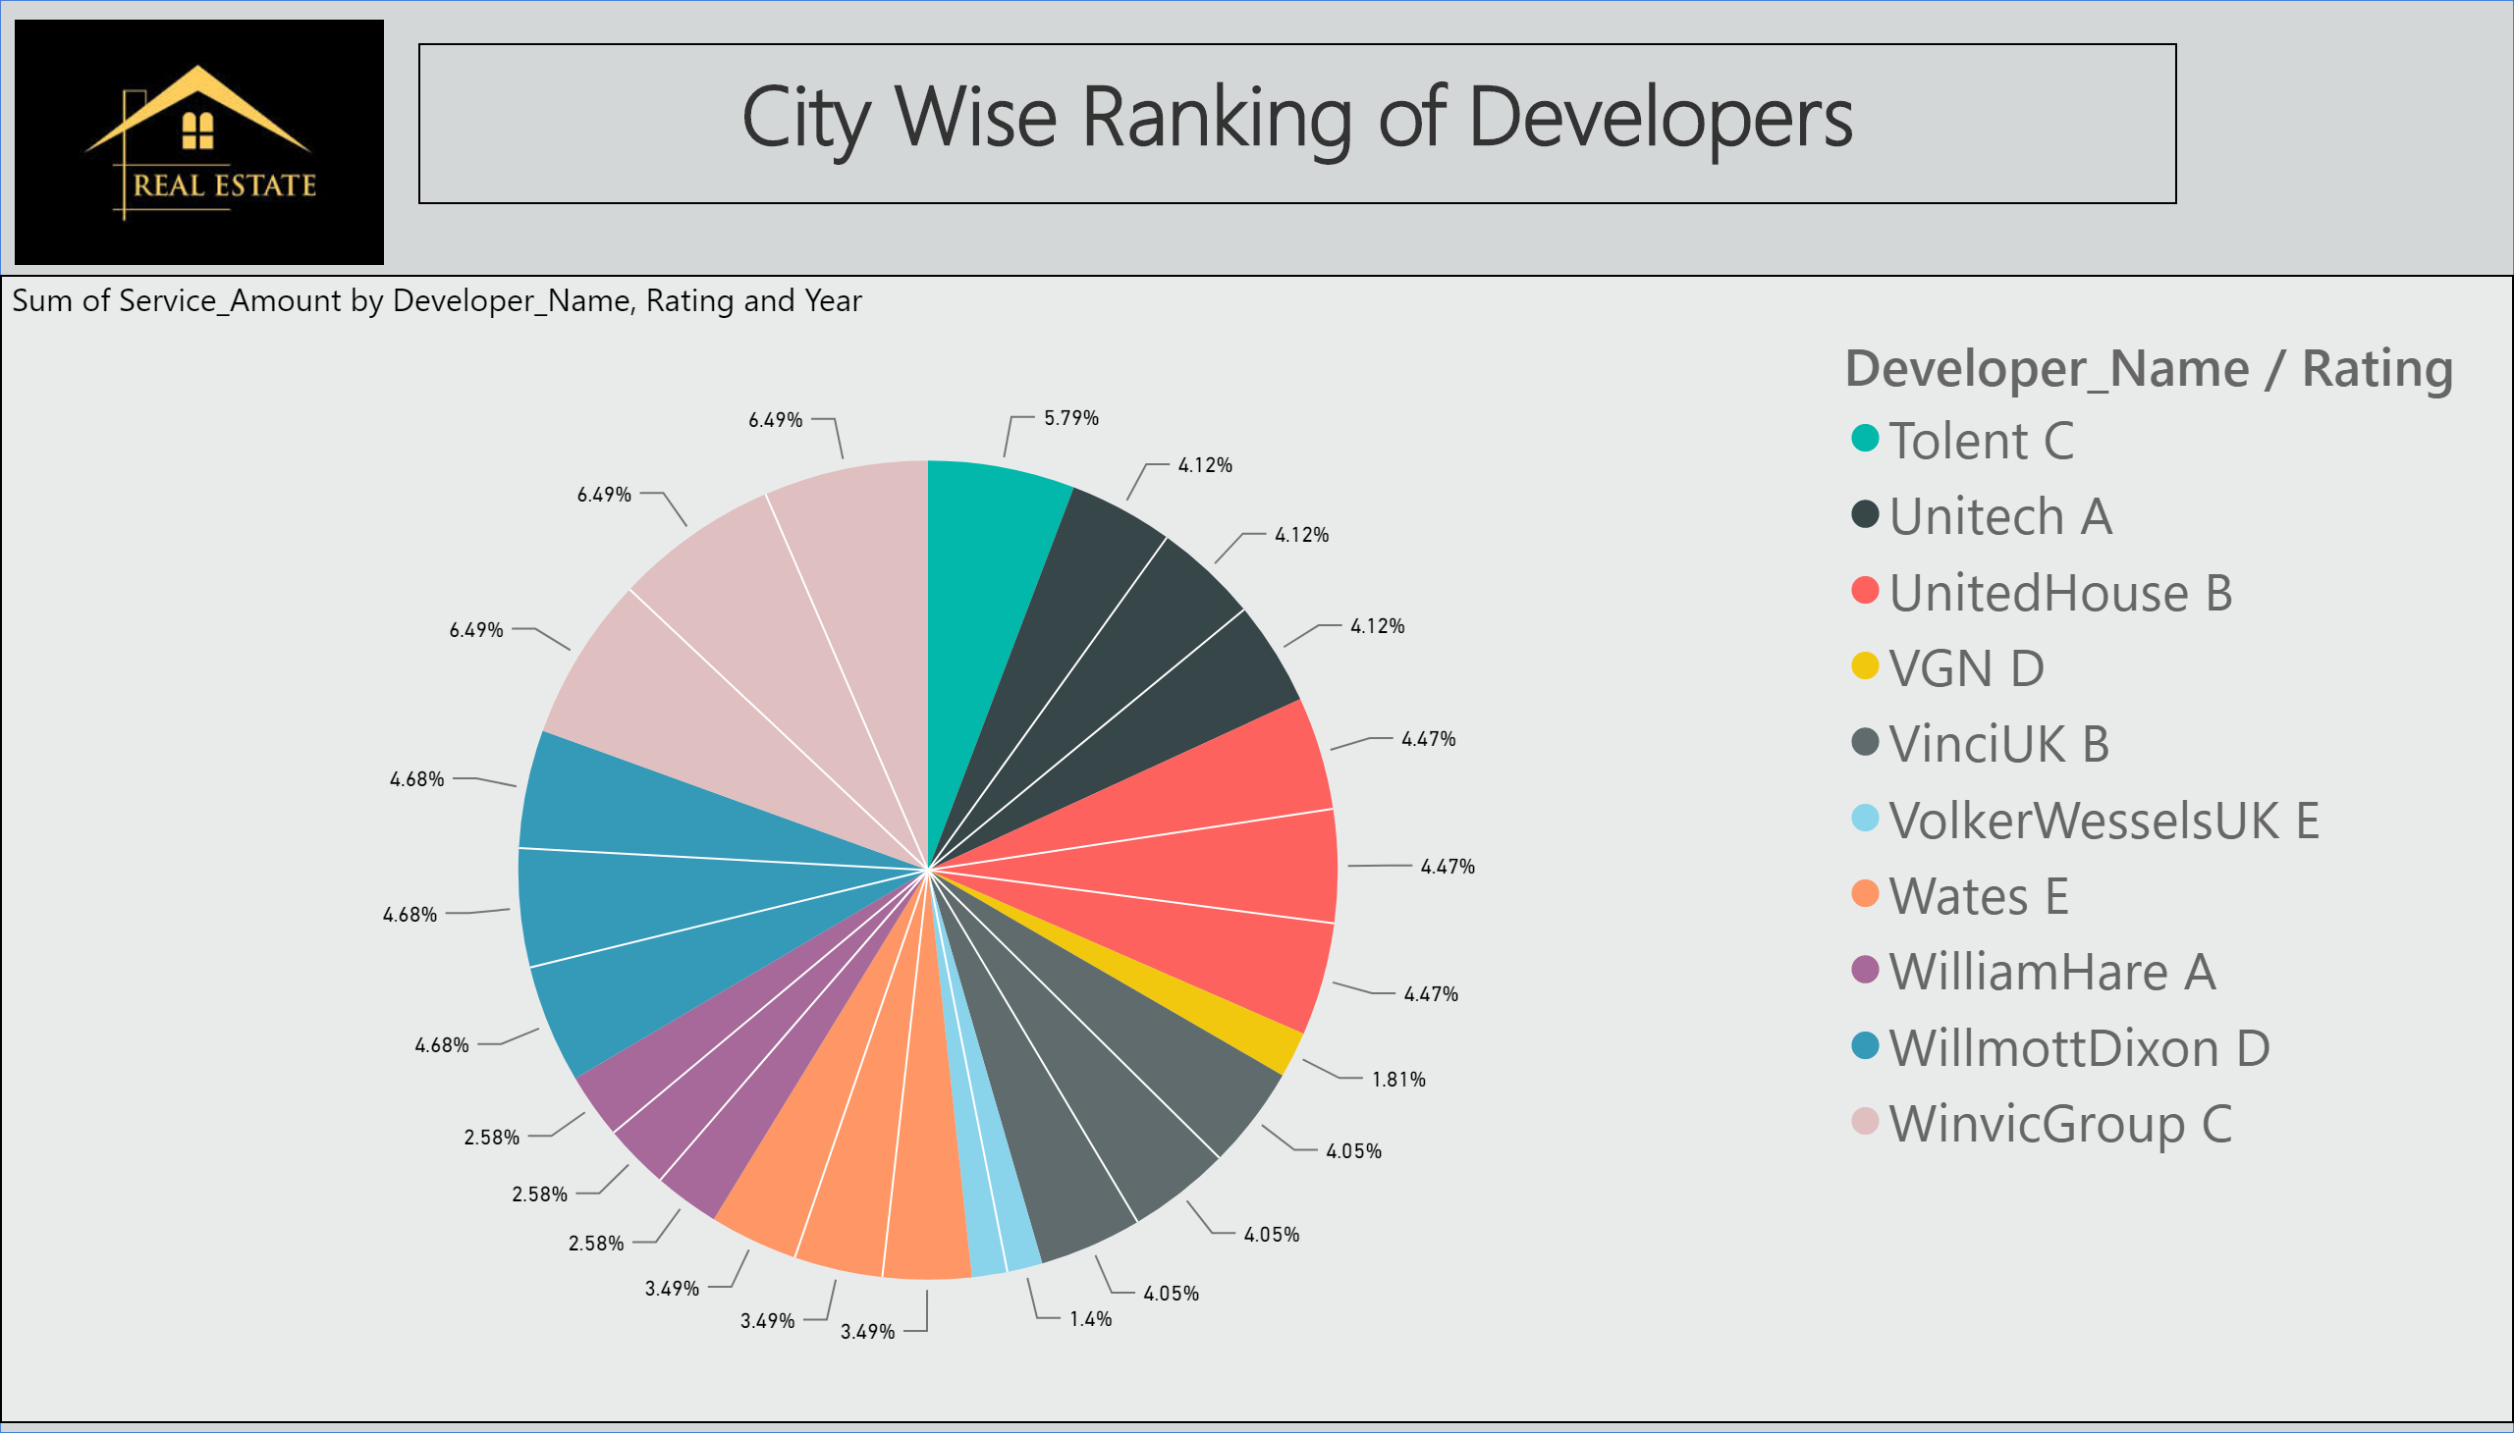

Slide 5
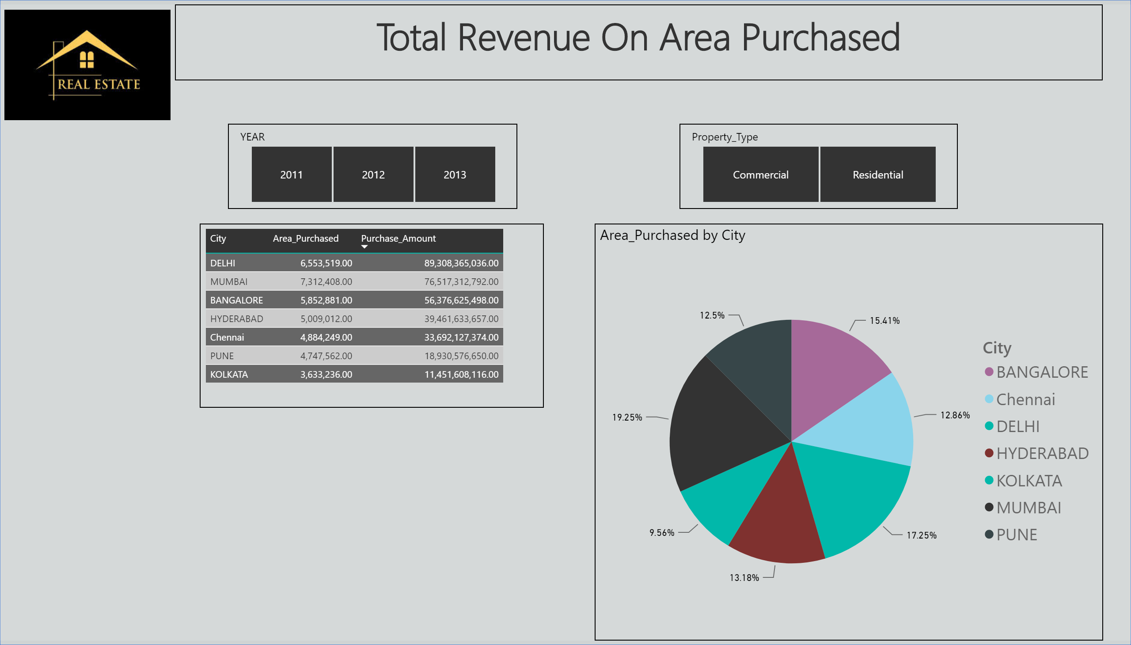

Slide 6
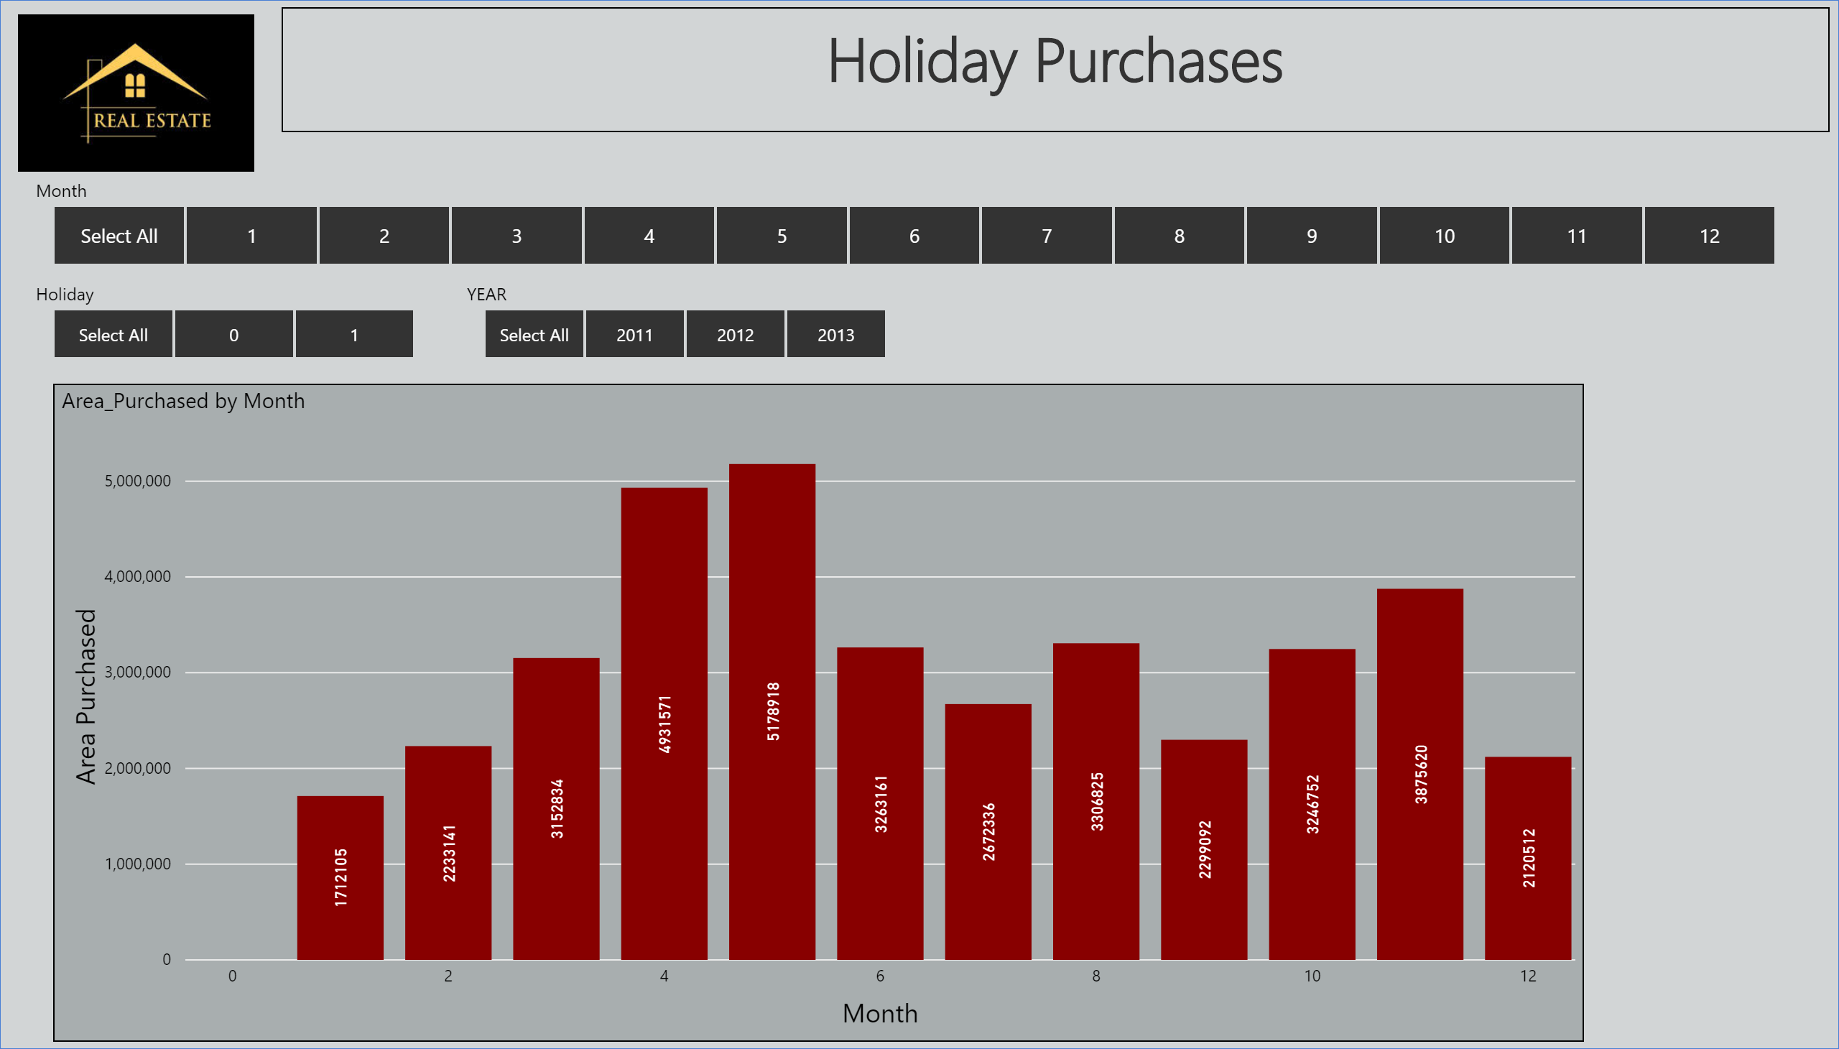

Slide 7
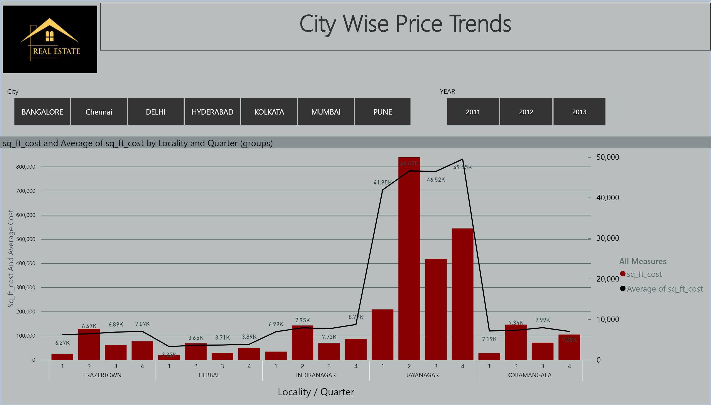

Slide 8
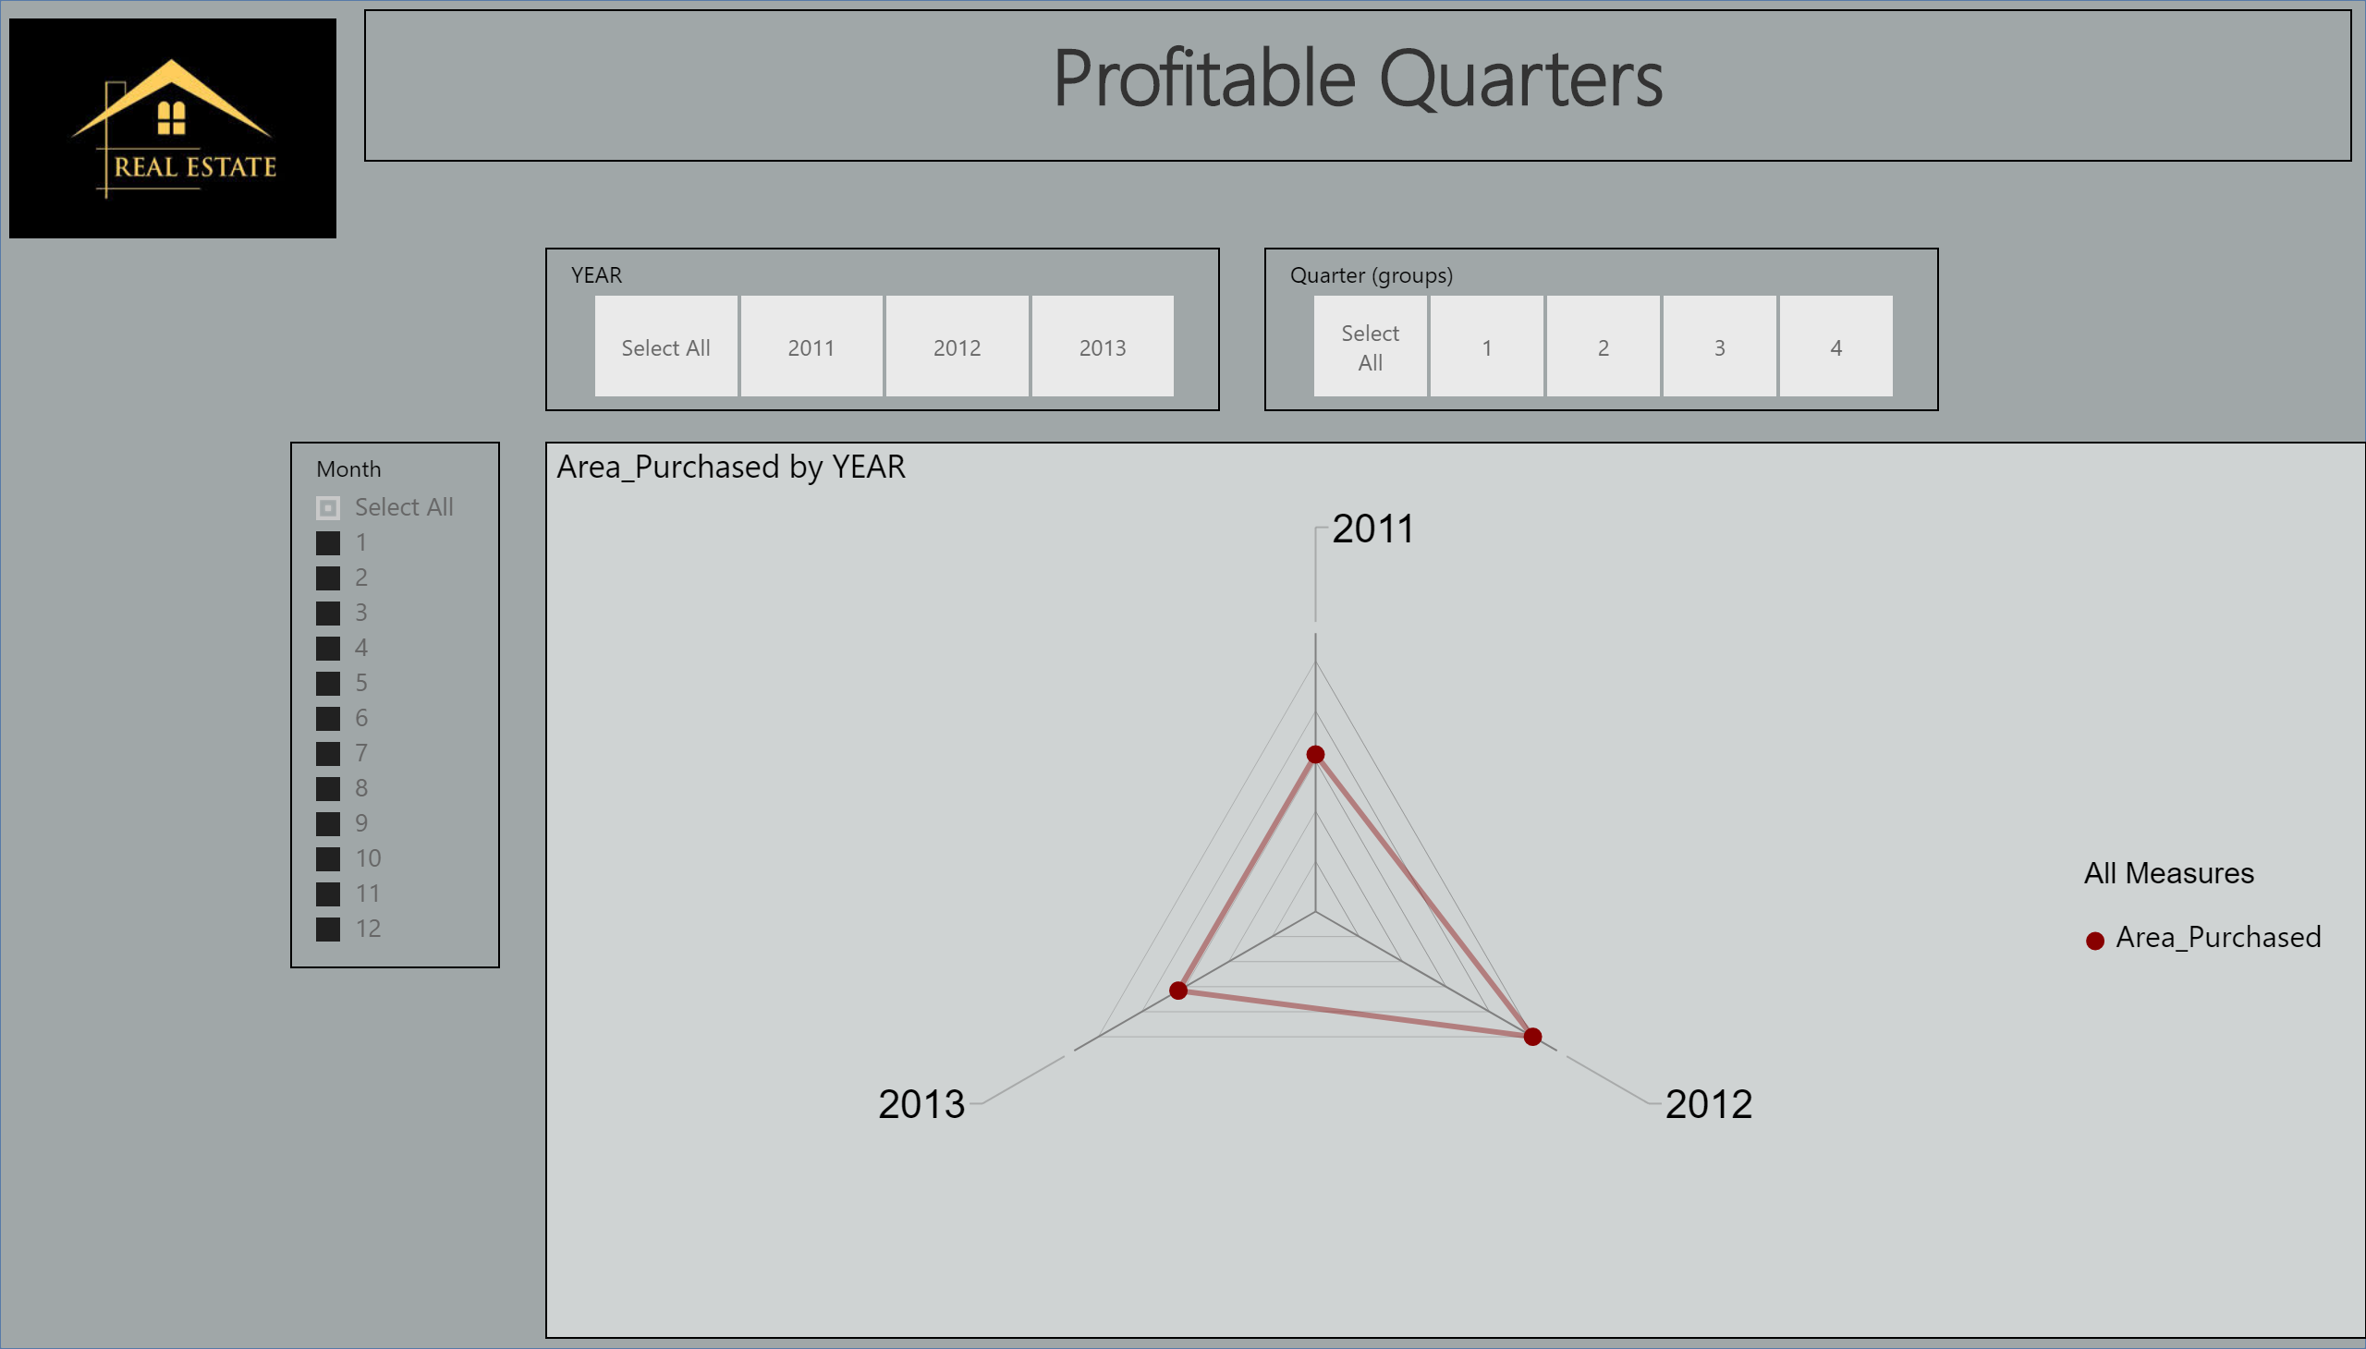

Slide 9
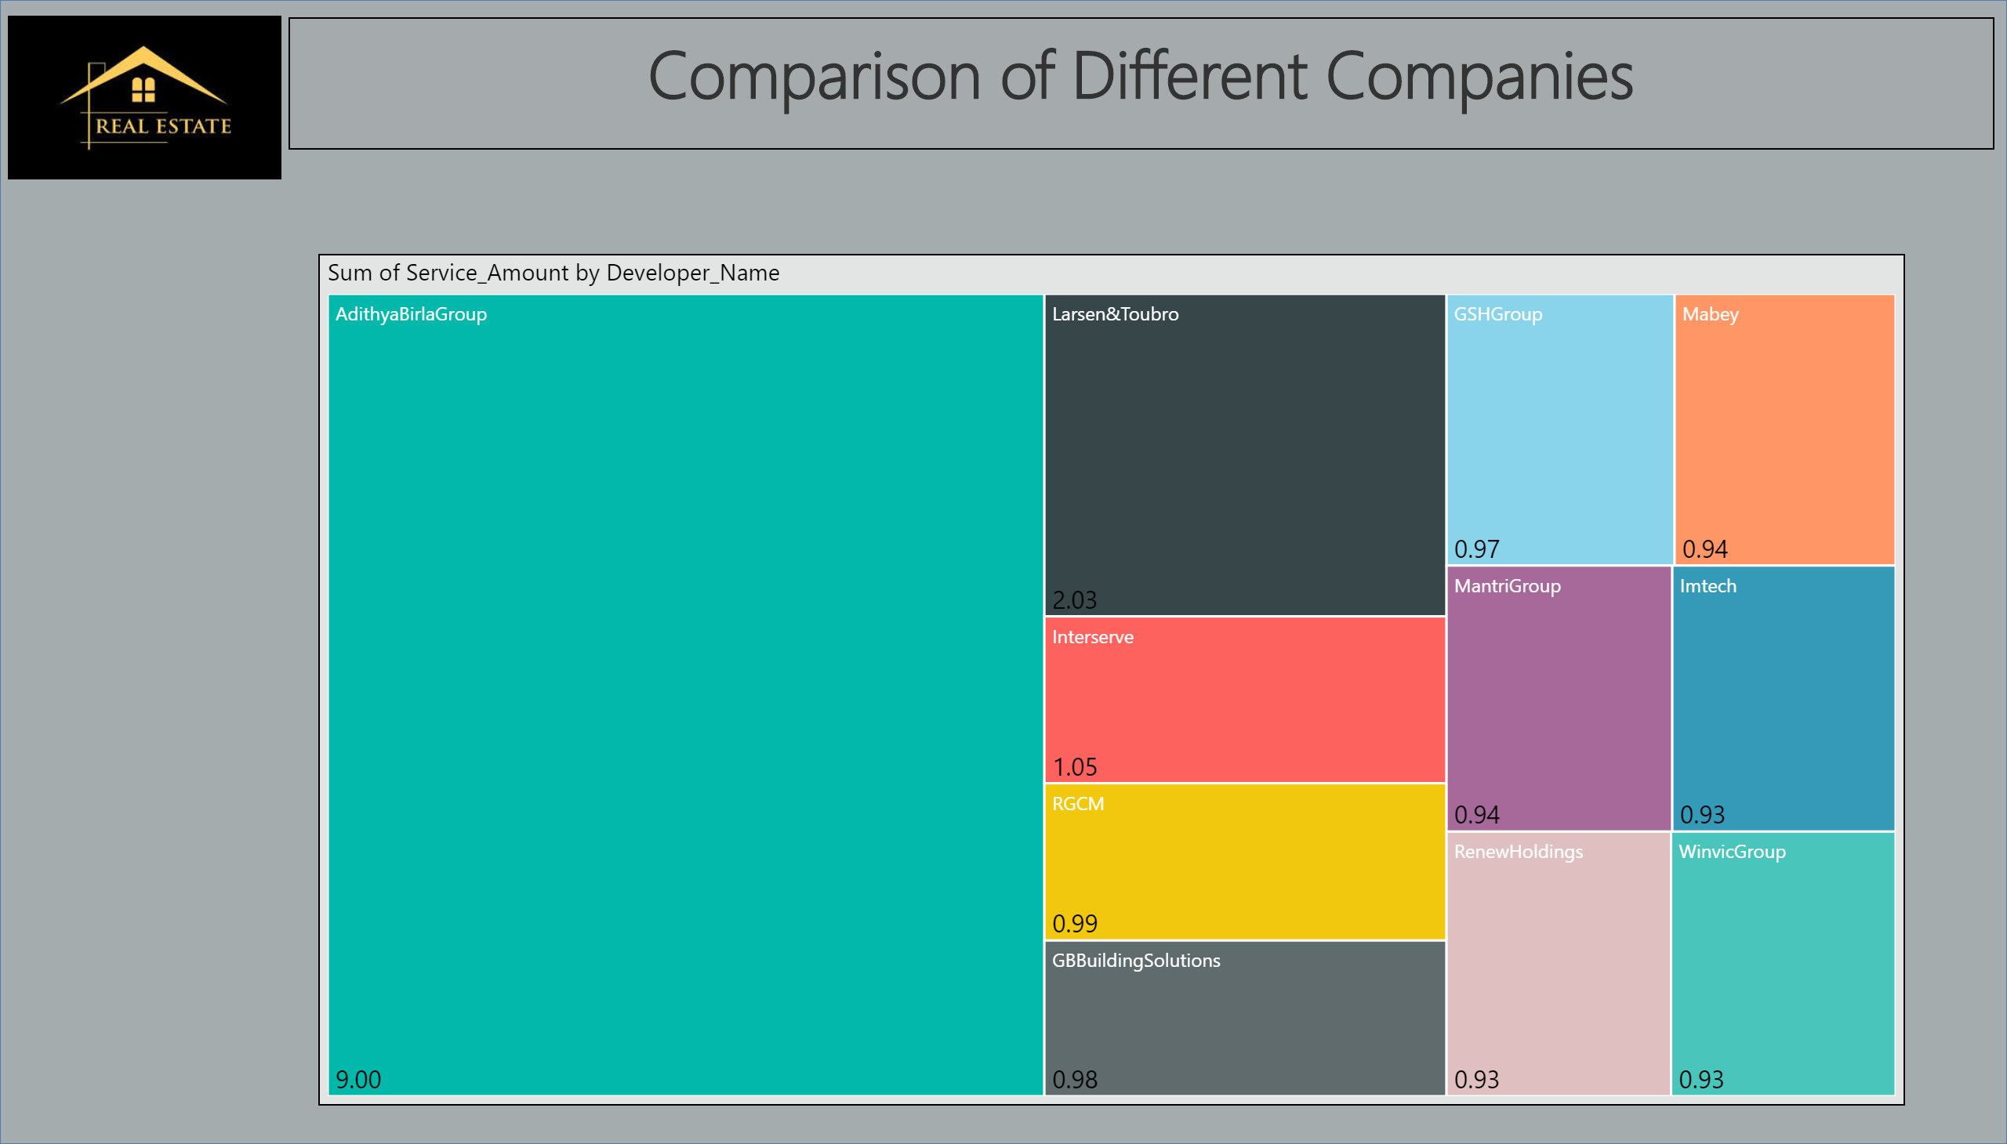

Slide 10
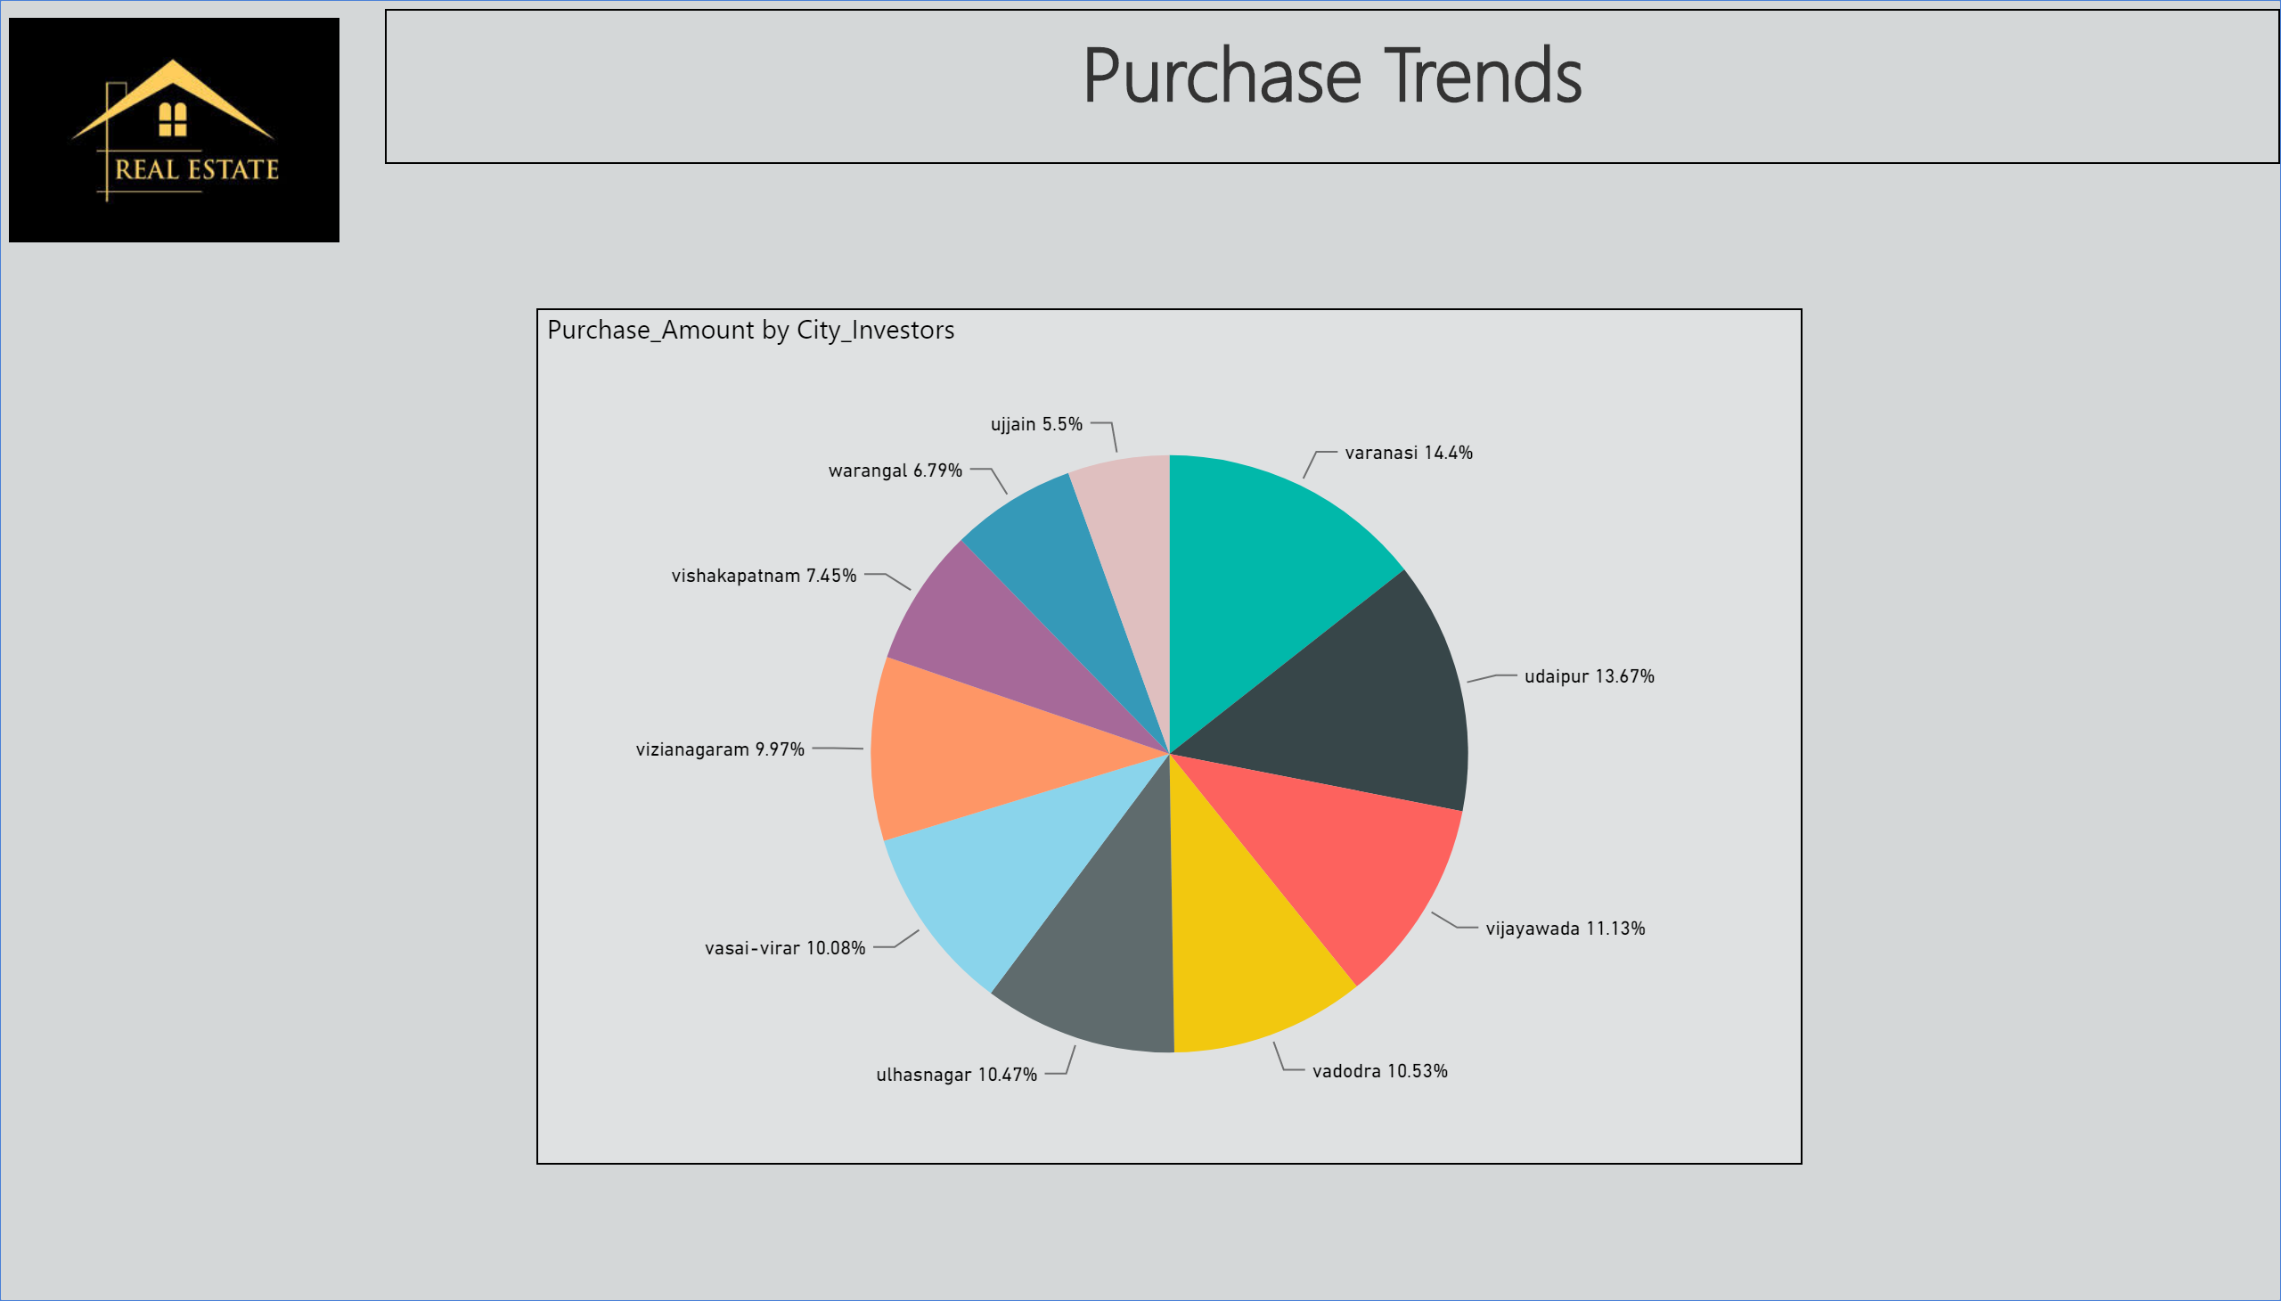

Slide 11
