Slide 1
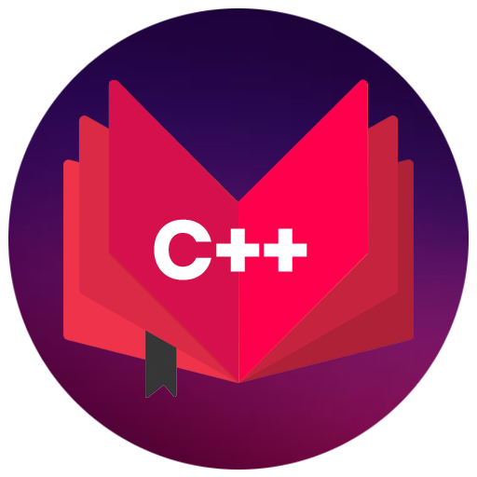
CAP455
OBJECT ORIENTED PROGRAMMING USING C++
Presented By
Kumar Vishal
Assistant Professor
SCA, LPU

Slide 2
Topics Covered:
procedural vs object oriented programming paradigms,
Input/output streams,
classes and objects,
structure vs union,
enumerations and classes,
static data members and functions

Slide 3
Unit 1
Principles of OOP and C++ essentials

Slide 4
Procedural vs object oriented programming paradigms:
Procedural programming is focused on procedures or functions which involves a series of sequential instructions for the computer to follow. C and Pascal are languages that follow the procedural programming paradigm.
Where as Object-oriented programming is focused on functions and with its related objects.
Lets take example to clear this:

Slide 5
Continued…
We move around the traffic signal and we know the working of traffic signal. There are lights :green, red and yellow which has to be on and off. Whenever light is going to be on and off vehicles are performs some action based on traffic rule. For example if red light is on all vehicles has to be stop and when it is green all vehicles has to move. So, here it showing the functionality whenever light is on and off. So, In case of Procedural programming it is focused on these functionality only but whenever we talk about Object-oriented programming paradigm in this case here not only it is focus on functionality it is also focus on objects like: different types of vehicle which is moving around traffic signal.

Slide 6
Input/output streams classes and objects:
In C++, input/output (I/O) streams are a fundamental part of the language for handling input and output operations. Streams provide a way to interact with various types of data, such as files, standard input/output (stdin/stdout), and other devices. C++ provides a rich set of classes and objects in the <iostream> library for performing I/O operations.
cin and cout: cin: Represents the standard input stream, used for reading data from the keyboard or other input sources. cout: Represents the standard output stream, used for displaying output on the screen or directing output to files.

Slide 7
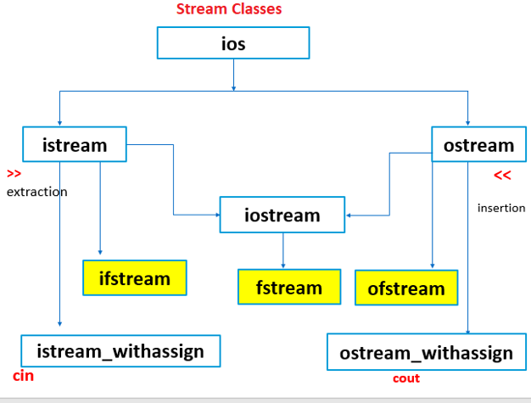

Slide 8

Class
Class is a collection of similar types of objects.
For example: Fruits is class of mango, apple , orange etc.
Fruits

Slide 9

Why class is important?

Slide 10


Slide 11
Class
Class is a collection of data members and member functions.
Example:
class Employee{
//data members
// member functions
}
Employee
employeeId employeeName
getDetails() setDetails()

Slide 12
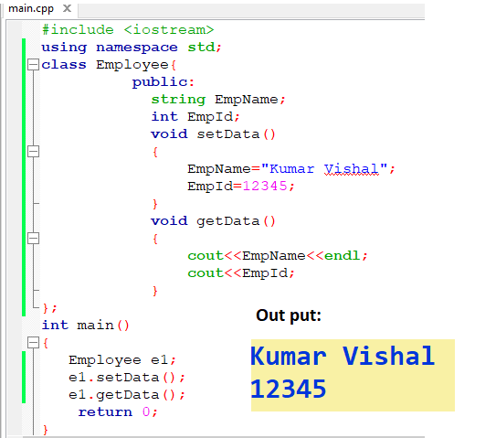

Slide 13
Object
Object is an instance of a Class.
class Employee
{
int employeeId;
char employeeName[20];
public:
void getDetails(){}
void setDetails(){}
};
int main()
{
Employee e1; // e1 is a object
return 0;
}

Slide 14
Structures in C++
We need to store a group of data whether of similar data types or non-similar data types. We have seen Arrays in C++ which are used to store set of data of similar data types at contiguous memory locations. Unlike Arrays, Structures in C++ are user defined data types which are used to store group of items of non-similar data types.

Slide 15
create a structure
The ‘struct’ keyword is used to create a structure. The general syntax to create a structure is as shown below:
struct struct_name
{
// struct members
};
struct Person
{
string name;
int age;
};

Slide 16
How to declare structure variables?
A structure variable can either be declared with structure declaration or as a separate declaration like basic types.
struct Point
{
int x, y;
} p1; // The variable p1 is declared with 'Point’
struct Point
{
int x, y;
};
int main()
{
struct Point p1; // The variable p1 is declared like a normal variable
}

Slide 17
Union
Unions are very much similar to the structures.
The member of the union, which occupies the largest memory, decides the union’s size.
The syntax of using Union:
union union_name {
Union_members;
} variable;

Slide 18
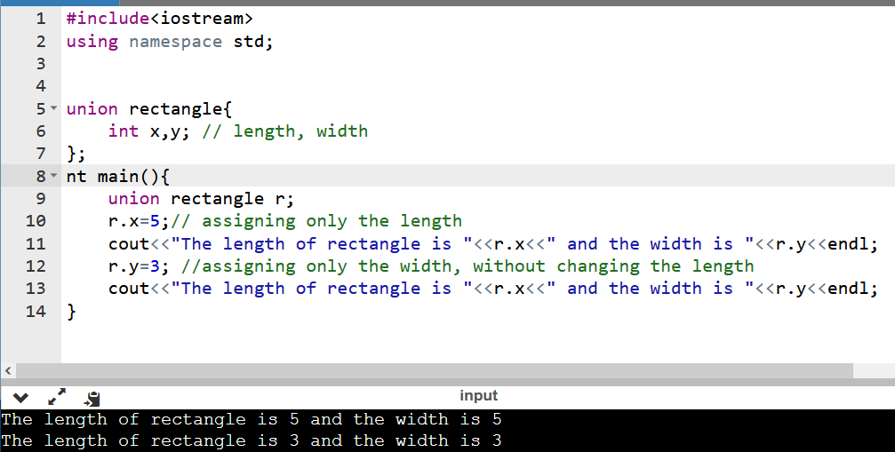

Slide 19
In the case of union, all the members share the same memory location as a result of which when we assign value to one member of the union, it affects the other members too, because of which when we assign x the value 5, y automatically gets the value 5 and same is the case when we assign y the value 3.

Slide 20
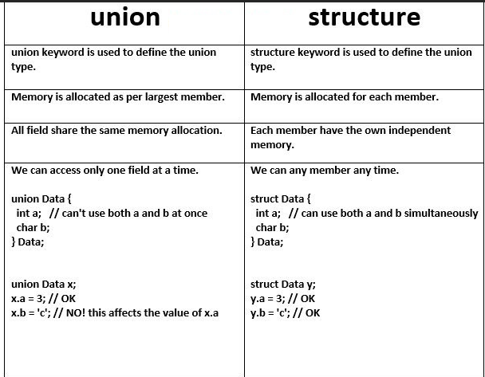

Slide 21
enumerations (enums) and classes
In C++, enumerations (enums) and classes are two essential features that allow you to define custom data types
Enumerations (Enums):
Enumerations are used to define a set of named integral constants means it’s each element is assigned by integer value.
Classes:
Classes are a fundamental concept in object-oriented programming (OOP). They allow you to define cayegory.

Slide 22

#include <iostream>
using namespace std;
enum Color {
RED,
GREEN,
BLUE
};
int main() {
Color selectedColor=GREEN;
if (selectedColor == 0) {
cout << "Selected color is red." << endl;
}
else if (selectedColor == 1) {
cout << "Selected color is green." << endl;
}
else if (selectedColor == 2) {
cout << "Selected color is blue." << endl;
}
else {
cout << "Selected color is not available" << endl;
}
return 0;
}

Slide 23
static data members and functions
Only one copy of that member is created for the entire class and is shared by all the objects of that class, no matter how many objects are created.
It is initialized before any object of this class is created.

Slide 24

static data members example
#include <iostream>
using namespace std;
class MyClass {
public:
static int x;
int y=10;
MyClass()
{
x++;
y++;
}
void disp()
{
cout<<"x="<<x<<"y="<<y<<endl;
}
};
int MyClass::x = 0;
int main() {
MyClass obj1;
obj1.disp();
MyClass obj2;
obj2.disp();
MyClass obj3;
obj3.disp();
return 0;
}

Slide 25

static functions example
#include <iostream>
using namespace std;
class MyClass {
public:
static int x;
void static disp()
{
cout<<"x="<<x<<endl;
}
};
int MyClass::x = 0;
int main() {
MyClass obj1;
MyClass::disp();
return 0;
}

Slide 26
user defined functions
A group of statements combined together to perform any task is called functions. Functions can be categorized in two ways: predefined functions and user defined functions.
Predefine functions are those which is inbuilt functions for example getline(), max(), min() etc..
User define functions are those which has to be create by user according to requirements.

Slide 27
user defined functions
To create user define function we have to follow the syntax:
returnType functionName(parameters)
{
// body of the functions
}
returnType can be void and other then void :int, float, double, char or string.

Slide 28
inline function
When the inline function is called whole code of the inline function gets injected at the point of the function call.
But there is some constraint:
If a function contains a loop. (for, while and do-while)
If a function contains static variables.
If a function is recursive.
If a function return type is other than void, and the return statement doesn’t exist in a function body.
If a function contains a switch or goto statement.
In these cases it will not work

Slide 29
Fried function
It can access all private and protected member of a class
It can be access without object of the class
It can define out side of the class scope
Rule:
Prototypes of friend function must be declare inside the class
It can be declared either in the private or the public.

Slide 30
Friend function
Syntax :
class <class_name>
{
friend <return_type> <function_name>(arguments);
};

Slide 31
Example
void setAdmin(admin &admn)
{
admn.adminName="kumar";
admn.adminId="admin1001";
}
int main()
{
admin a1;
setAdmin(a1);
a1.getAdmin();
return 0;
}
#include <iostream>
using namespace std;
class admin
{
string adminName;
string adminId;
friend void setAdmin(admin &admn);
public:
void getAdmin()
{ cout<<"Admin:"<<adminName<<endl;
cout<<"Admin Id:"<<adminId<<endl;
}
};

Slide 32
friend class
A friend class can access private and protected members of other classes in which it is declared as a friend.

Slide 33
reference variables
After declaring of variable you can declare one alternative name.
When a variable is declared as a reference, it becomes an alternative name for an existing variable.
A variable can be declared as a reference by putting ‘&’ in the declaration.
Example: int x = 10; // ref is a reference to x. Int &ref = x; // Value of x is now changed to 20 ref = 20;

Slide 34
Function calling mechanism
call by value,
call by address and
call by reference

Slide 35
To understand this we have to understand first about actual parameter and formal parameter.
Actual Parameter: the parameter which is passed during the function call
Formal Parameter : the parameter which is used in function definition. It is also called a parameter which received by function.
Formal parameter
add(int x, int y)
{
x=10;
y=20;
}
add(a,b);
Actual parameter

Slide 36
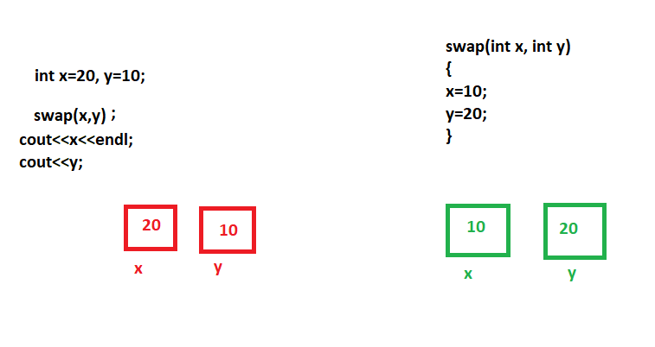

Slide 37
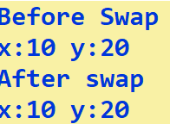
#include <iostream>
using namespace std;
int x=10;
int y=20;
void swap(int x,int y)
{
x=20;
y=10;
}
int main()
{
cout<<"Before Swap"<<endl;
cout<<"x:"<<x<<" y:"<<y;
swap(x,y);
cout<<"\nAfter swap"<<endl;
cout<<"x:"<<x<<" y:"<<y;
return 0;
}
Call By Value

Slide 38
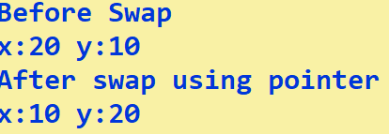
#include <iostream>
using namespace std;
int x=20;
int y=10;
void swap(int *x, int *y)
{
*x=10;
*y=20;
}
int main()
{
cout<<"Before Swap"<<endl;
cout<<"x:"<<x<<" y:"<<y;
swap(&x,&y);
cout<<"\nAfter swap using pointer"<<endl;
cout<<"x:"<<x<<" y:"<<y;
return 0;
}
Call By Pointer

Slide 39
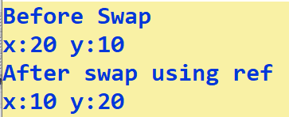
#include <iostream>
using namespace std;
int x=20;
int y=10;
void swap(int &x,int &y)
{
x=10;
y=20;
}
int main()
{
cout<<"Before Swap"<<endl;
cout<<"x:"<<x<<" y:"<<y;
swap(x,y);
cout<<"\nAfter swap using ref"<<endl;
cout<<"x:"<<x<<" y:"<<y;
return 0;
}
Call By Reference

Slide 40
Note:
If we pass parameter to a function either by pass by pointer or pass by reference it will produce the same result. Only difference is that References are used to refer an existing variable in another name whereas pointers are used to store address of variable. It is safe to use reference because it cannot be NULL.

Slide 41
Recursion
Recursion is a method in C++ which calls itself directly or indirectly until a suitable condition is satisfied.
In this method, we repeatedly call the function within the same function.
The recursive condition helps in the repetition of code again and again.

Slide 42
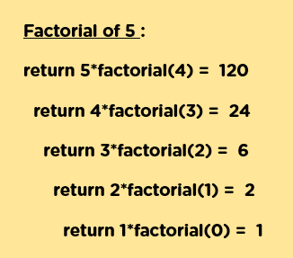
#include <iostream>
using namespace std;
int fact(int n)
{
if(n>1)
{
return n*fact(n-1);
}
if(n==1)
{
return 1;
}
if(n<1)
{
cout<<"Invalid Input"<<endl;
exit(0);
}
}
int main()
{
int num;
cout<<"Enter Num"<<endl;
cin>>num;
int res=fact(num);
cout<<"Factorial of "<<num<<" is:"<<res<<endl;
return 0;
}

