Slide 1

CAP455
OBJECT ORIENTED PROGRAMMING USING C++
Presented By
Kumar Vishal
Assistant Professor
SCA, LPU

Slide 2
Handling pointers, arrays and string Topics covered:
pointer vs reference variables
void pointer, pointer arithmetic,
pointer to pointer, dangling pointer, wild pointer,
null pointer assignment, pointers as class member, pointer to objects, pointer to data member,
array declaration and processing of multidimensional arrays (inside main and inside class), array of objects,
standard C++ string class-defining and assigning string objects, modifiers of string class

Slide 3
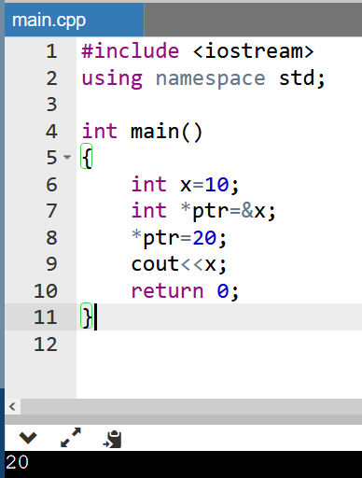
pointer vs reference variables
A pointer is a variable that holds the memory address of another variable. A pointer needs to be dereferenced with the * operator to access the memory location it points to.

Slide 4
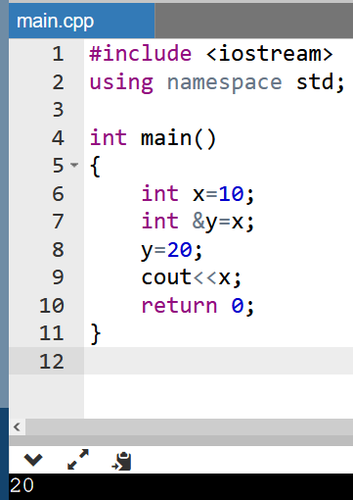
pointer vs reference variables
A reference variable is an alias, that is, another name for an already existing variable. A reference, like a pointer, is also implemented by storing the address of an object.

Slide 5


pointer vs reference variables: Differences:
Difference | Pointer | Reference
Initialization | int x = 10; int *ptr = &x; // OR int *ptr; ptr = &a; | int a = 10; int &p = a; int &p; p = a;
Reassignment | int x = 5; int y = 6; int *ptr; ptr = &x; ptr = &y; | int x = 5; int y = 6; int &z=x; int &z=y;

Slide 6
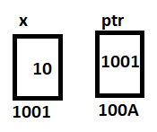
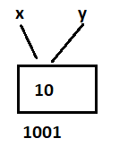
pointer vs reference variables: Differences:
Difference | Pointer | Reference
Memory Address
NULL Value | int *ptr = NULL; | int x; int &y=x; y=NULL;

Slide 7
pointer vs reference variables: Differences:
Difference | Pointer | Reference
arithmetic operations | Can perform arithmetic operations | Cannot have arithmetic operations

Slide 8
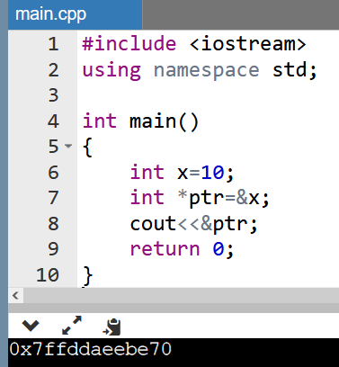
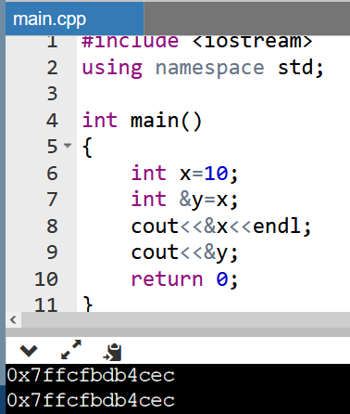
Check The Difference:

Slide 9
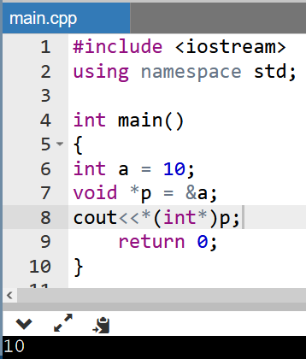
void pointer
A void pointer is a pointer that has no associated data type with it. A void pointer can hold an address of any type and can be type casted to any type.
int a = 10;
void *p = &a;

Slide 10
pointer
Pointer arithmetic means performing arithmetic operations on pointers.
Incrementing and Decrementing Pointers
Addition of Constant to Pointers
Subtraction of Constant from Pointers
Subtraction of Two Pointers of the Same Datatype

Slide 11
1. Incrementing and Decrementing Pointer in C++
Incrementing or decrementing a pointer will make it refer to the address of the next or previous data in the memory.
Incrementing a Pointer
Incrementing a pointer will depend on the type of variable address stored in the pointer. If the pointer stored the address of the integer type variable then the size of the integer pointer can be 4 bytes, if we increment an integer type variable it will be incremented by 4 bytes.

Slide 12
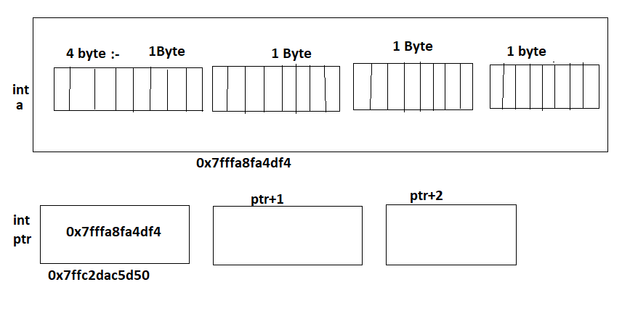
Memory Representation

Slide 13
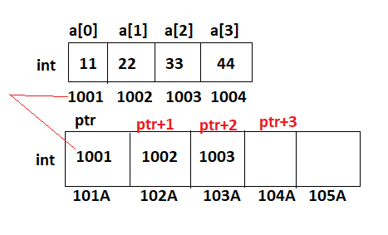

Slide 14
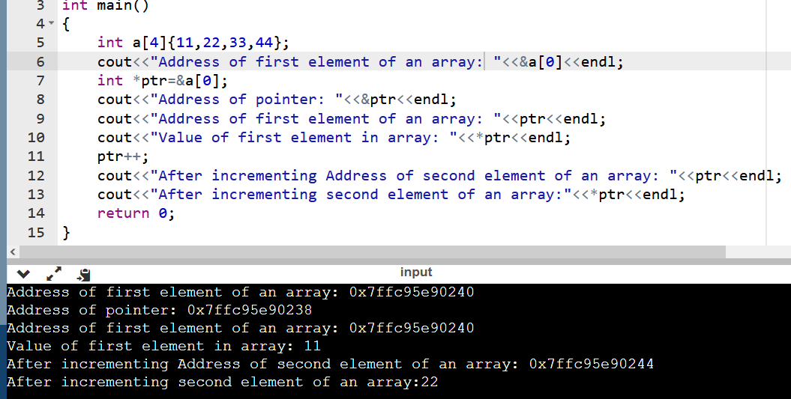

Slide 15
Decrementing a pointer: If the pointer stored the address of the integer type variable then the size of the integer pointer can be 4 bytes, if we decrement an integer type variable it will be decremented by 4 bytes.

Slide 16
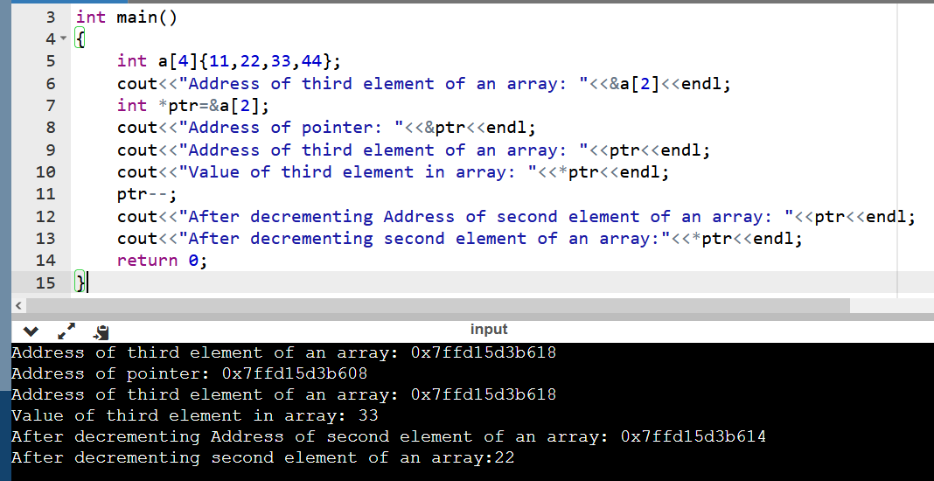

Slide 17
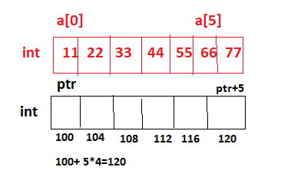
2. Addition of Constant to Pointers:
We can add integer values to Pointers and the pointer is adjusted based on the size of the data type it points to. For example, if an integer pointer stores the address 100 and we add the value 5 to the pointer, it will store the new address as:
100 + (5 * 4(size of an integer)) = 120

Slide 18
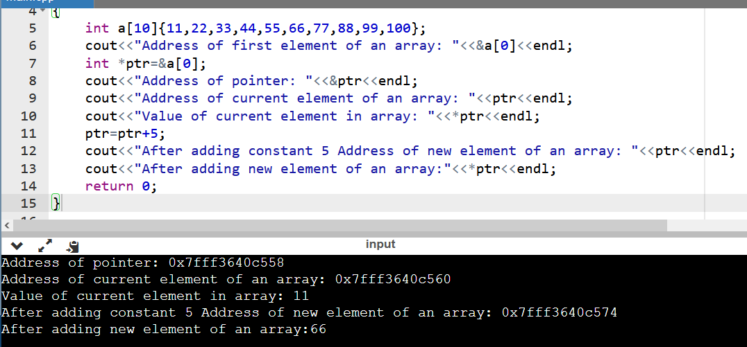

Slide 19
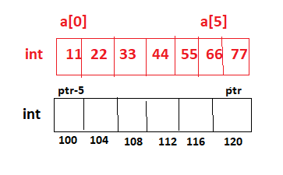
3. Subtraction of Constant from Pointers:
We can also subtract a constant from Pointers and it is the same as the addition of a constant to a pointer. For example, if an integer pointer stores the address 120 and we subtract the value 5 from the pointer, it will store the new address as:
120 - (5 * 4(size of an integer)) = 100

Slide 20
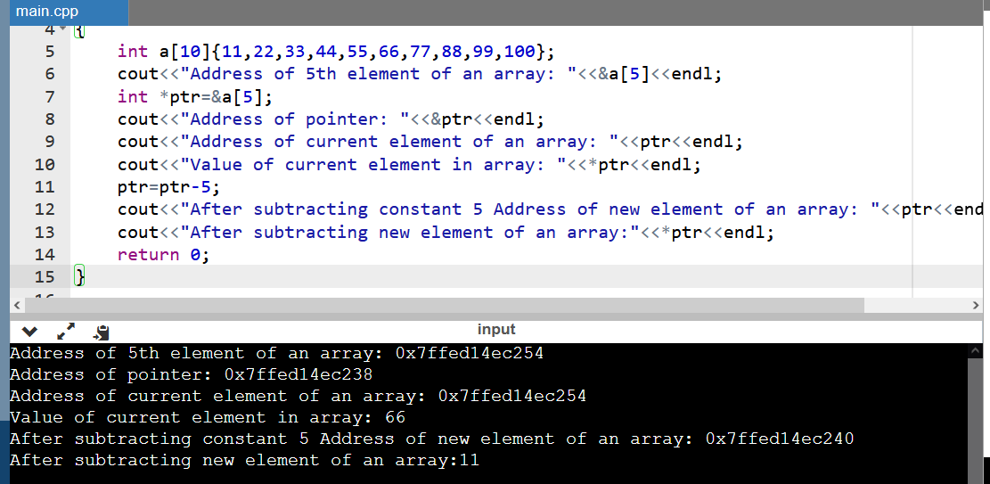

Slide 21
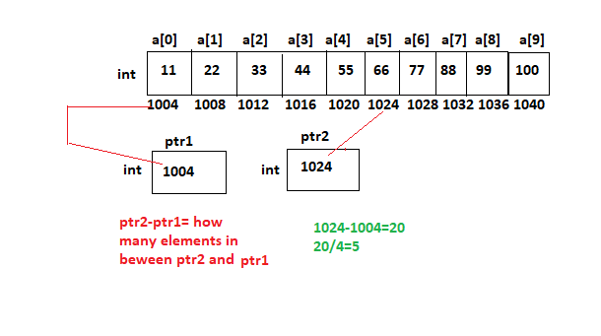
Subtraction of Two Pointers of the Same Datatype
The Subtraction of two pointers can be done only when both pointers are of the same data type.
The subtraction of two pointers gives the number of elements present between the two pointers.

Slide 22
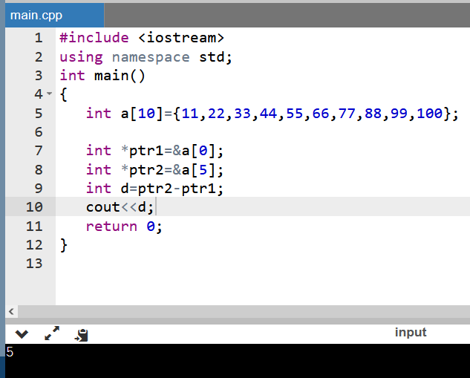

Slide 23
Important Note:
Pointer Increment (ptr++ ) | Gives Address
Pointer Decrement (ptr--) | Gives Address
Pointer add with constant (ptr+2) | Gives Address
Pointer subtract with constant (ptr-2) | Gives Address
One Pointer add with another Pointer: (ptr1+ptr) | Nothing
Pointer subtract with Pointer: (ptr1-ptr2) | Gives Values

Slide 24
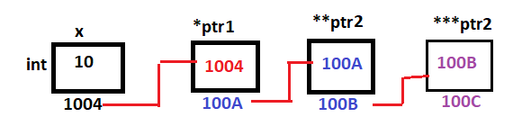
pointer to pointer
When we define a pointer to a pointer, the first pointer is used to store the address of the variables, and the second pointer stores the address of the first pointer
It is also called Double Pointer

Slide 25
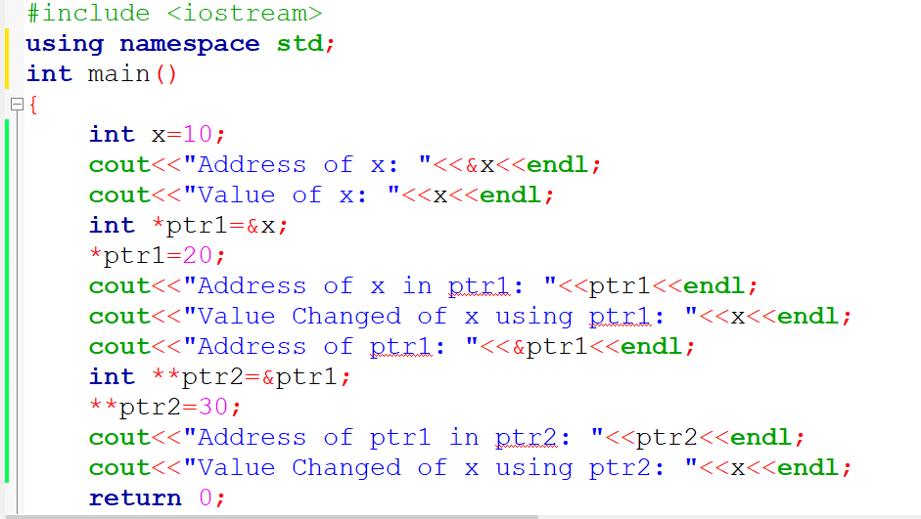
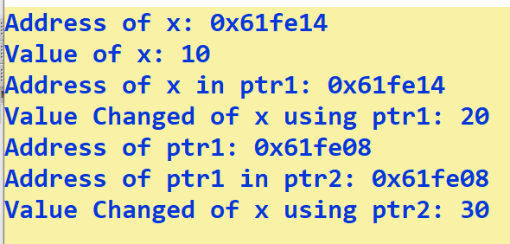

Slide 26
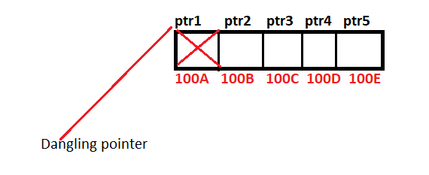
dangling pointer
Dangling pointer is a pointer pointing to a memory location that has been deleted

Slide 27
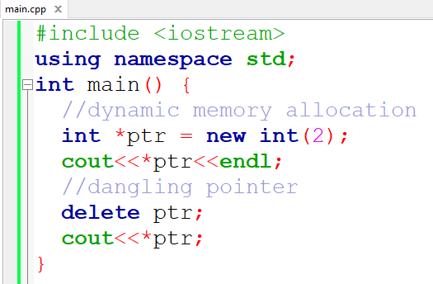
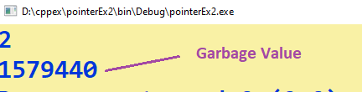

Slide 28
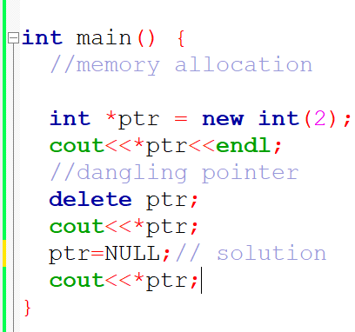
NULL Pointer
NULL Pointer is a pointer which is pointing to nothing. In case, if we don’t have address to be assigned to a pointer, then we can simply use NULL.

Slide 29
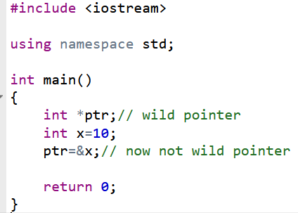
wild pointer
A pointer that has not been initialized to anything (not even NULL) is known as wild pointer.

Slide 30
pointers as class member
Class members that are pointers allow you to store addresses to objects or data dynamically allocated on the heap.

Slide 31
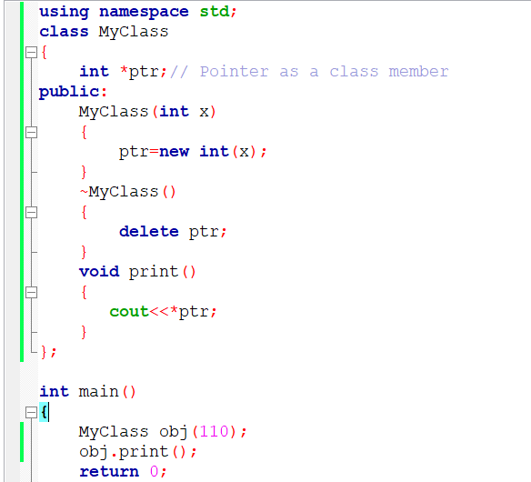


Slide 32
Pointers to objects
Pointer to object in c++ is defined as the pointer that is used for accessing objects.
Pointers to objects are used to store the memory address of an object, allowing you to indirectly access and manipulate that object.
When you have a pointer to an object, you can use the arrow operator (->) to access the members of the object through the pointer.

Slide 33

#include <iostream>
using namespace std;
class Rectangle
{
private:
int length;
int breadth;
public:
Rectangle(int l, int b)
{
length=l;
breadth=b;
}
int getArea()
{
return 2*length*breadth;
}
};
int main()
{
// creating an object of Rectangle
Rectangle obj(10,30);
Rectangle* ptr = &obj;
//calling the member function using -> symbol
int area = ptr->getArea();
cout<<"Area of rectangle is: "<<area;
return 0;
}

Slide 34
pointer to data member
Operators through we can access the data members and member functions of a class by using pointers.
These operators are known as dereferencing operators.
Dereferencing operators ::* and .* to access the data members
Dereferencing operators ::* and ->* to access the data members

Slide 35
Dereferencing operators ::* and .* to access the data members
syntax of ::* dereferencing operator is -
data-type class-name ::* pointer-name = &class-name :: data-member-name;
syntax of .* dereferencing operator is -
object-name.*pointer-to-data-member;

Slide 36
Dereferencing operators ::* and ->* to access the data members
syntax of ::* dereferencing operator is –
data-type class-name ::* pointer-name = &class-name :: data-member-name;
syntax of ->* dereferencing operator is -
pointer-to-object->*pointer-to-data-member;

Slide 37
this pointer
The this pointer in C++ points to the object that invokes the member function. This keyword is only accessible within the non-static member functions of a class/struct/union type.
There are many ways to use the this pointer:
Same instance variable and parameter names
this in constructors

Slide 38
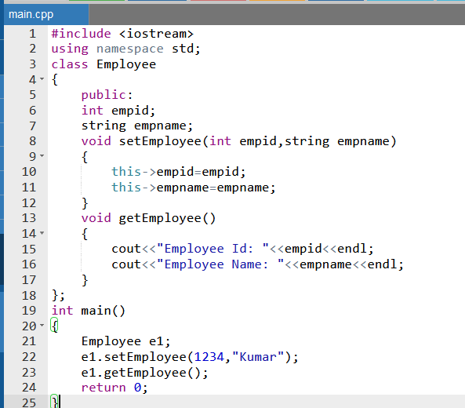


Slide 39
array declaration and processing of multidimensional arrays (inside main and inside class)
Array is a collection of similar type of elements that have contiguous memory location.
It is a data structure where we store similar elements. We can store only fixed elements in an array.
Array is index based, first element of the array is stored at 0 index.

Slide 40
array declaration
Inside main or Class:
Syntax:
ArrayType ArrayName[ArraySize];
Example:
int myArray[10];
To find Size(length) of an Array in C++:
int length = sizeof(ArrayName) / sizeof(ArrayName[index]);

Slide 41
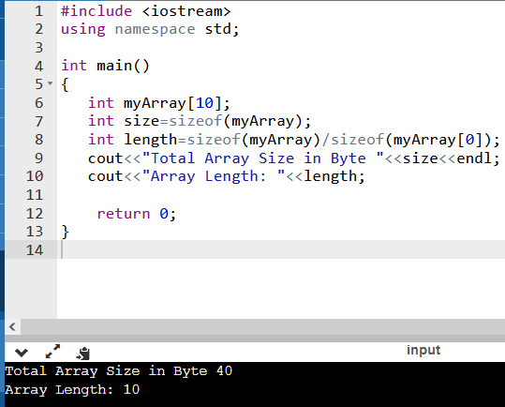

Slide 42
Types of Array: There are two types of array.
Single Dimensional Array
Multidimensional Array-
2D array
3D array
4D array
…………
…………

Slide 43
array declaration inside class
class className
{
ArrayType ArrayName[ArraySize];
};

Slide 44
Problem Statement
Suppose there is one student finding their result to clear UPSC exam. A 1-D array is used to hold the list of regno who has cleared UPSC exam. Write a program in which help the student to get the result. Define one class and method to perform this.

Slide 45
2D Array
ArrayType ArrayName[RowSize][ColSize];

Slide 46
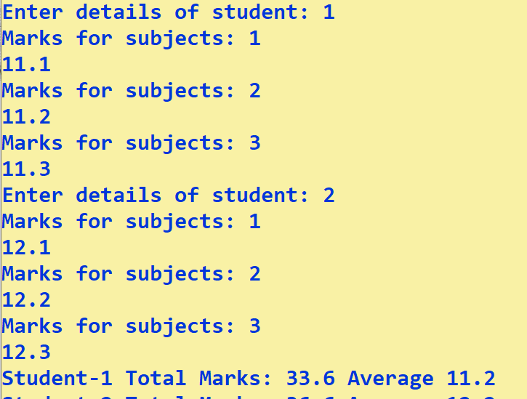
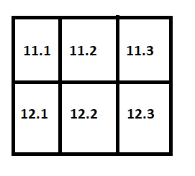
Example: Analyze Student’s Performance

Slide 47
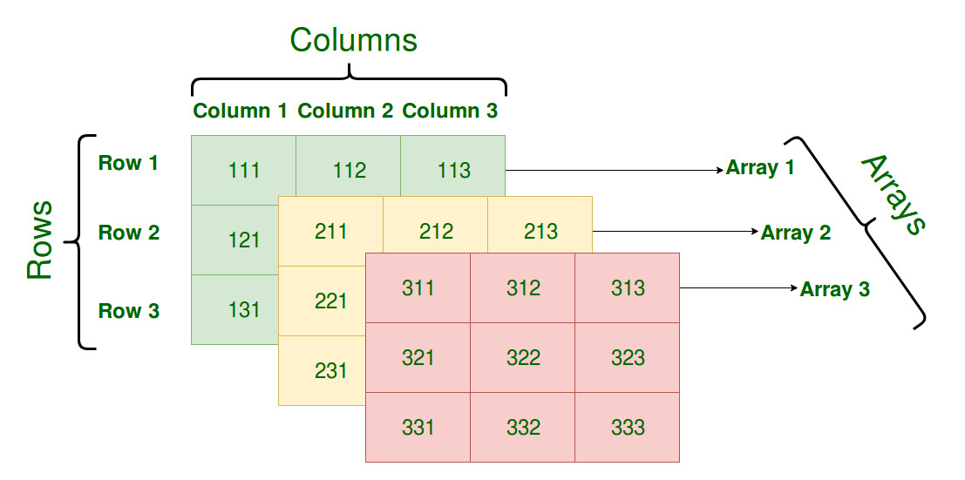
3-D Array
int num[3][3][3]

Slide 48
For example find exam scores obtained by three students of each department in 3 different subjects.
Electronics department:
student1 scores: 75, 87, 69
student2 scores: 90, 87, 85
student3 scores: 56, 67, 76
Computer Science department:
student1 scores: 78, 67, 75
student2 scores: 87, 98, 76
student3 scores: 67, 56, 65
Information Technology department:
student1 scores: 72, 63, 72
student2 scores: 82, 91, 71
student3 scores: 64, 56, 66

Slide 49
standard C++ string class-defining and assigning string objects
In C++, you can also create a string object for holding strings.
String objects has no fixed length, and can be extended as per your requirement means memory is allocated dynamically
C++ string using string data type
// Declaring a string object
string str;

Slide 50
String member functions
(constructor)
Construct string object (public member function)
(destructor)
String destructor (public member function)
operator=
String assignment (public member function)

Slide 51
String Functions
Input functions:
getline( ) : This function is used to store a stream of characters which is entered by the user
push_back( ): This function is used to input a character at the end of the string.
pop_back( ): This function is used to delete the last character from the string.

Slide 52
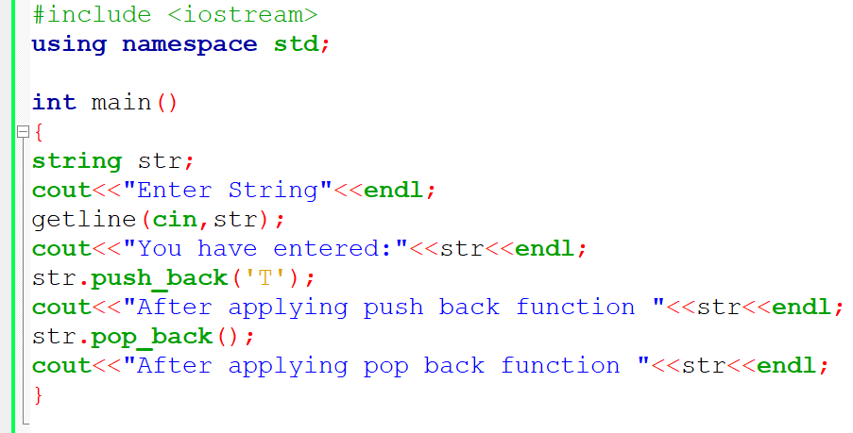
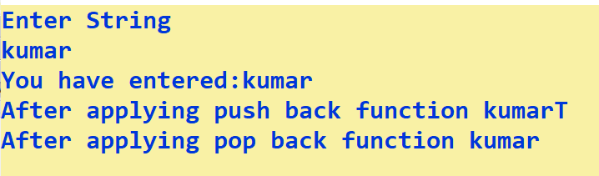

Slide 53
string::erase in C++
Syntax 1: Erases all characters in a string
// Deletes all characters
str.erase();
Syntax 2: Erases all characters after position ‘pos’
// Deletes all characters except first one
str.erase(1);
Syntax 3: Erases at most, len characters of *this, starting at index idx
// Deletes 4 characters from index number 1
str.erase(1, 4);

Slide 54
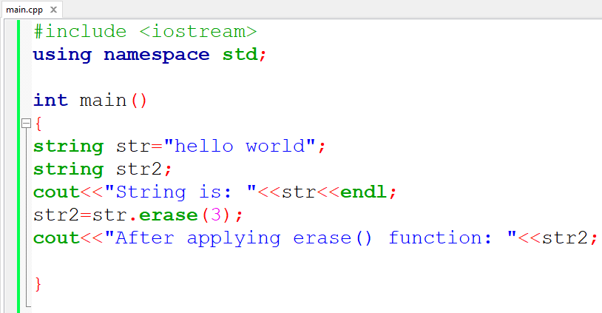


Slide 55
string::insert() in C++
insert() is used to insert string in string at specified index
Syntax : Inserts the characters of str starting from index idx.
// Inserts str2 in str1 starting
// from 6th index of str1
str1.insert(6, str2);

Slide 56
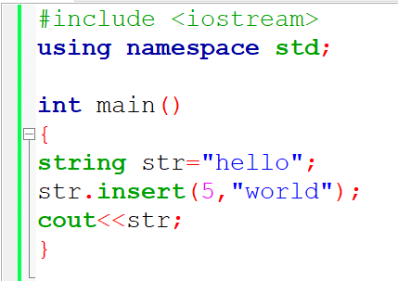


Slide 57
Capacity Functions:
capacity() :- This function returns the capacity allocated to the string, which can be equal to or more than the size of the string. Additional space is allocated so that when the new characters are added to the string, the operations can be done efficiently.
size() :- This function returns the length of the string, in terms of bytes.
length():-This function finds the length of the string
max_size(): Returns the maximum length the string can reach.

Slide 58
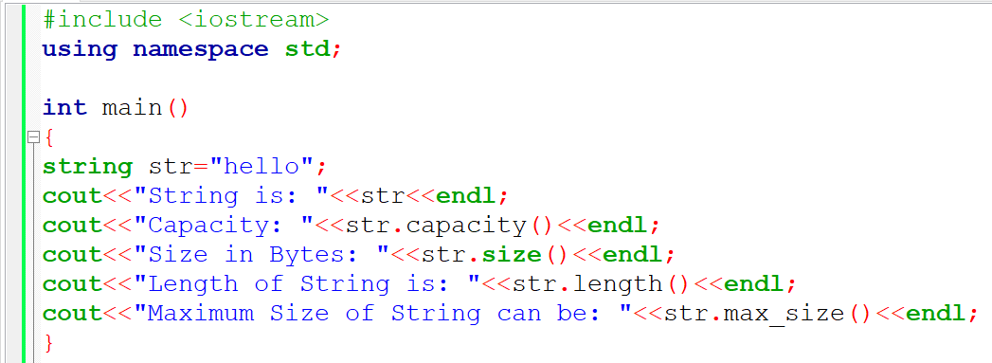
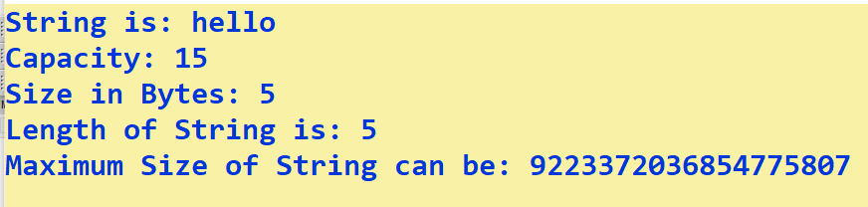

Slide 59
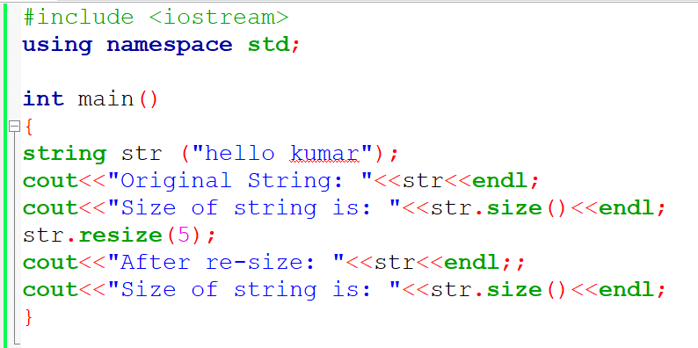
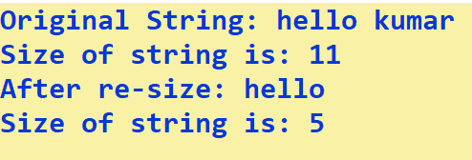
string::resize() in C++
The resize() member function is used to change the size of the string.

Slide 60
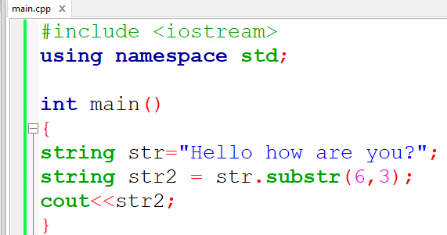

string::substr in C++
The substr() member function is used to extract a substring from the std::string starting from a specified position.

Slide 61
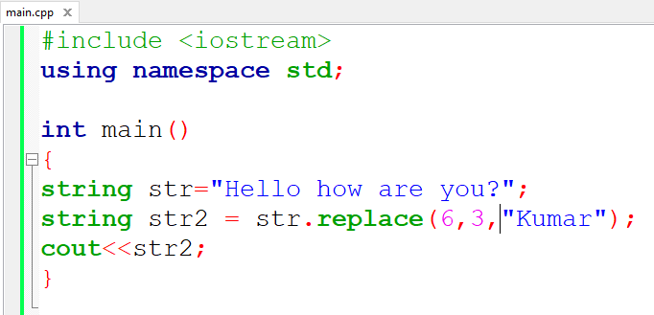
string::replace in C++
The replace() member function is used to replace a portion of the std::string with a specified substring.

