Slide 1

CAP477 PROGRAMMING IN JAVA

Slide 2
Topics Covered:
history and features of Java,
understanding JDK, JRE and JVM,
Java program structure,
writing simple Java class and main() method,
command-line arguments

Slide 3
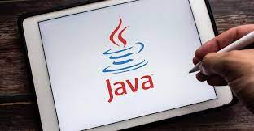
Introduction to Java
Java is object oriented programming language. All programming language following some approach. Java follow object oriented programming. Although Java is not pure object oriented programming but almost everything is object in Java except its primitive datatypes because of this reason Java is not called as a pure object oriented programming language. It supports all object oriented programming features like: class, object, encapsulation, abstraction, inheritance , polymorphism, message communications. In addition in java, it supports multithreading, exception handling, garbage collector, platform independent features which makes Java as a more powerful language.

Slide 4

History of Java
Java, originally developed by James Gosling at Sun Microsystems in the early 1990s, aimed to provide a platform-independent language for embedded devices. The language drew inspiration from C++ but aimed for simpler and more secure programming. It was initially named "Oak" and later renamed "Java" due to trademark issues. Java 1.0 was released in 1996, bringing the "Write Once, Run Anywhere" (WORA) philosophy to the forefront, allowing Java programs to run on any device with a Java Virtual Machine (JVM).

Slide 5
Version | Date
JDK Beta | 1995
JDK 1.0 | January 23, 1996
JDK 1.1 | February 19, 1997
J2SE 1.2 | December 8, 1998
J2SE 1.3 | May 8, 2000
J2SE 1.4 | February 6, 2002
J2SE 5.0 | September 30, 2004
Java SE 6 | December 11, 2006
Java SE 7 | July 28, 2011
Java SE 8 (LTS) | March 18, 2014
Java SE 9 | September 21, 2017
Java SE 10 | March 20, 2018
Java SE 11 (LTS) | September 25, 2018
Java SE 12 | March 19, 2019
Java SE 13 | September 17, 2019
Java SE 14 | March 17, 2020
Java SE 15 | September 15, 2020
Java SE 16 | March 16, 2021
Java SE 17 (LTS) | September 14, 2021
Java SE 18 | March 22, 2022
Java SE 19 | September 20, 2022
Java SE 20 | March 21, 2023
Java SE 21 (LTS) | September 19, 2023
Click here to get latest file

Slide 6
Features of Java Language
Easy to develop applications
Platform Independent
Architectural Neutral
Portable
Multithreaded
Distributed
Robust
Object Oriented
Community Support
Scalability

Slide 7
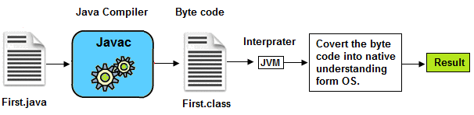
1. Easy to develop applications
As compare to C and C++ , no pointer concept
Atomatic memory allocation and deallocation which makes easy to develop applications.

Slide 8
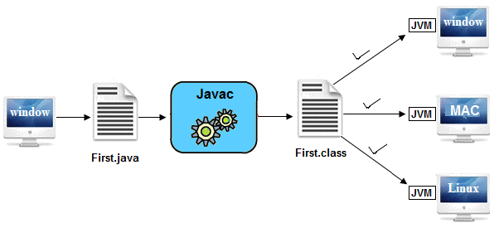
2. Platform Independent
Java's platform independence is a key feature is achieved through the concept of "Write Once, Run Anywhere" (WORA).
Java source code is compiled into an intermediate form known as bytecode.
Once compiled to bytecode, Java programs can be executed on any device that has a JVM installed.
Developers can write code on one platform (e.g., Windows) and run it on another platform (e.g., Linux) without modification.
Java programs are executed by the Java Virtual Machine (JVM).
JVM is platform-specific, but the bytecode is interpreted by the JVM, making the program platform-independent.

Slide 9
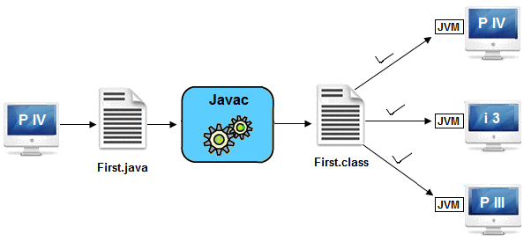
3. Architectural Neutral
One of the key features of Java is its architecture-neutral design, which enables Java programs to run on various processors without modification. This feature is achieved through a combination of bytecode compilation and the use of the Java Virtual Machine (JVM).

Slide 10

4. Portable
Java programs can be easily moved from one computer system to another, providing portability and flexibility.
Platform independent and architectural neutral features makes its portable.

Slide 11
5. Multithreaded
You can perform multiple operations at the same time.
Threads are independent, so it doesn't affect other threads.
Typing MS Word document while listening to music.

Slide 12
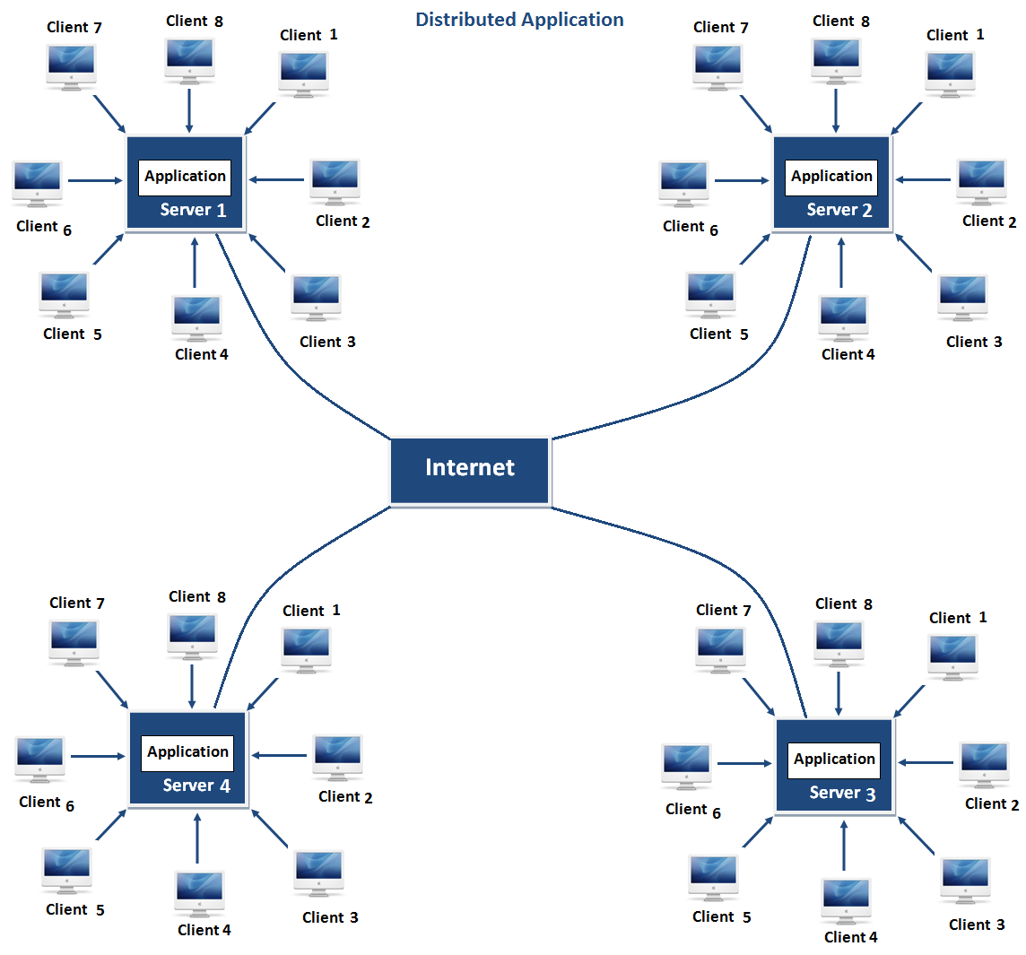
6. Distributed
Java includes features for distributed computing, making it suitable for building networked applications.
Same application can run in different different server.
Advantage: problem occurred in one server will never be reflected on any client system.

Slide 13
7. Robust
It is robust or strong Programming Language because Java's strong memory management, exception handling, and security features contribute to robust and secure applications.
Automatic Garbage Collection: Java features automatic garbage collection, where the Java Virtual Machine (JVM) automatically reclaims memory occupied by objects that are no longer in use. This helps prevent memory leaks and simplifies memory management for developers.
Dynamic Memory Allocation: Java supports dynamic memory allocation, allowing developers to create and manage objects dynamically during runtime. The JVM takes care of allocating and deallocating memory as needed.
Exception Handling: Java has a robust and structured exception handling mechanism using the try, catch, finally, and throw keywords.

Slide 14
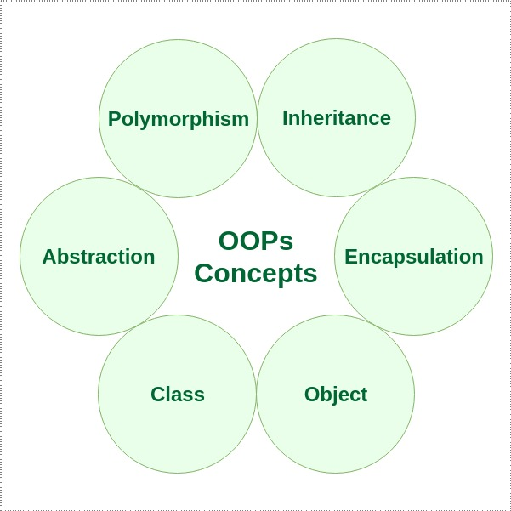
8. Object Oriented
Java is object-oriented, promoting the use of classes and objects in programming. Everything in Java is treated as an object.

Slide 15
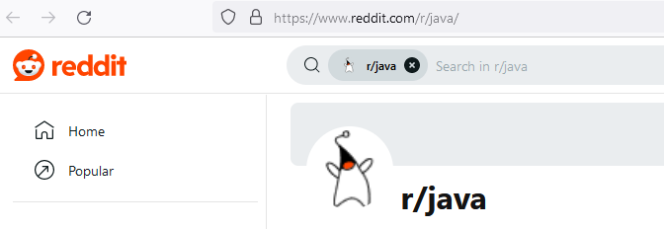
9. Community Support
Java has a large and active community of developers, providing extensive resources, libraries, and frameworks.
Numerous online forums and communities provide platforms for Java developers to seek help, share their expertise, and discuss various topics related to Java programming. Examples include Stack Overflow, Reddit (r/java), and the Oracle Community forums.

Slide 16

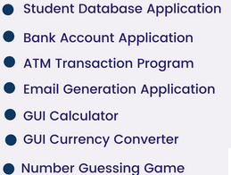
10. Scalability
Java applications can scale easily, making them suitable for both small-scale and large-scale projects.

Slide 17
Java development tools
JDK is Java Development Kit. The Java Development Kit (JDK) is a software development environment which is used to develop Java applications.
JRE (Java Runtime Environment) is an installation package that provides an environment to only run(not develop) the java program(or application)onto your machine. JRE is only used by those who only want to run Java programs.

Slide 18
JVM (Java Virtual Machine) is a very important part of both JDK and JRE because it is contained or inbuilt in both. Whatever Java program you run using JRE or JDK goes into JVM and JVM is responsible for executing the java program line by line, hence it is also known as an interpreter.

Slide 19
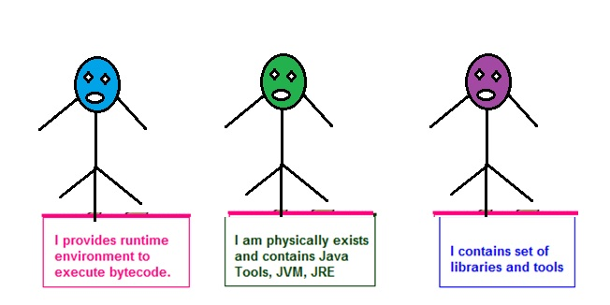
Understanding JDK, JRE and JVM

Slide 20
Java program structure
Basic structure of Java Program:
[ Documentation ]
[package declarations]
[import statements]
[class declaration]
[Main Method]

Slide 21
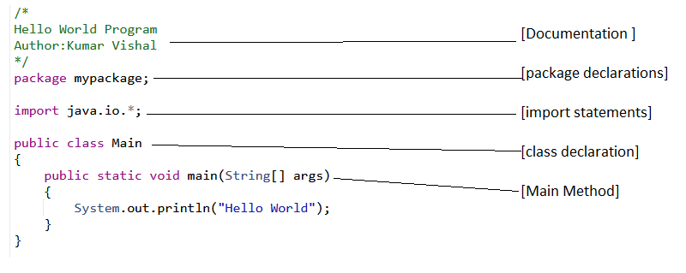

Slide 22
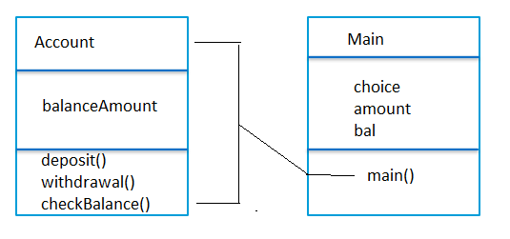
Writing simple Java class and main() method
Simple Java Class
Java Main Method

Slide 23
Main method in Java:
public static void main(String args[])
The keyword public is an access specifier.
The keyword static is a kind of modifier. Main method is static means this is calling with out any reference.
The keyword void means that the method main() does not return any value.
Main method having parameter that array of string which show command line arguments in java. We can pass any no. of argument during run time.

Slide 24
Java Command Line Arguments
The java command-line argument is an argument i.e. passed at the time of running the java program.
Ex:
class CommandLineEx{
public static void main(String args[]){
System.out.println("Your first argument is: "+args[0]);
} }
Now compile : c:\> javac CommandLineEx.java
Now run: c:\> java CommandLineEx hello world

