Slide 1

CAP477 PROGRAMMING IN JAVA

Slide 2

Abstract Class and Interface
abstract method
and abstract class
interfaces, static and default
methods
using swing components to
demonstrate inheritance

Slide 3
Abstract Class
An abstract class is a class that cannot be instantiated on its own; it serves as a template for other classes to inherit from.
It may contain both abstract and concrete methods.
Abstract methods are methods without a body that subclasses must implement.
Concrete methods are methods with a body that can be inherited by subclasses.

Slide 4


Example
Abstract Class Example

Slide 5
interface
An interface in Java is a reference type that can contain only constants, method signatures, default methods, static methods, and nested types.
An interface in java is called collection of abstract methods.
Interfaces support multiple inheritance in Java, meaning a class can implement multiple interfaces.
Syntax:
interface interface_name
{
//abstract methods//constant names
}

Slide 6
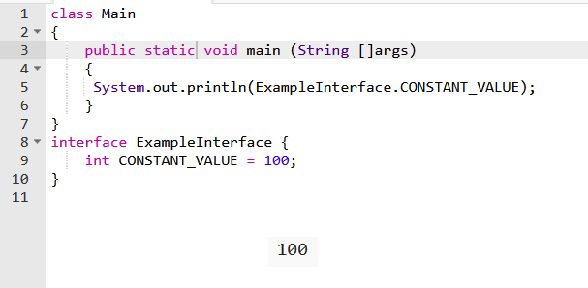
Interface with constant names

Slide 7
Example
Default method interface Example

Slide 8
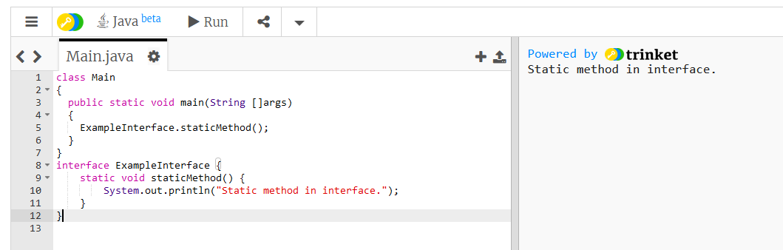
Static Methods:
Static methods in interfaces can be called using the interface name, without needing an
instance of a class that implements the interface.

Slide 9
using swing components to demonstrate inheritance

Slide 10
Java swing
Java swing is used to create window-based applications or desktop applications.
The javax.swing package provides classes : JButton, JTextField, JTextArea, JRadioButton, JCheckbox, JMenu etc.

Slide 11
JFrame
There are two ways to create a frame or window:
By creating the object of JFrame class
By extending JFrame class (inheritance)

Slide 12
Steps to create GUI By extending JFrame class :
Create a class which extends from JFrame
Set size of Jframe
Set layout managers// if no then set null
Create instance of Jbutton,JTextField etc..
Set position and size of a button,TextField etc
Add component in Frame
Set Visible True For JFrame

Slide 13
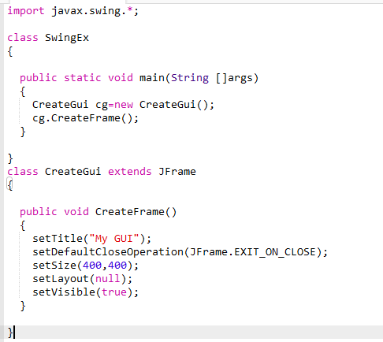


Slide 14
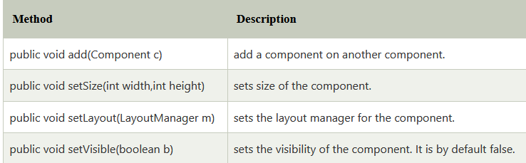
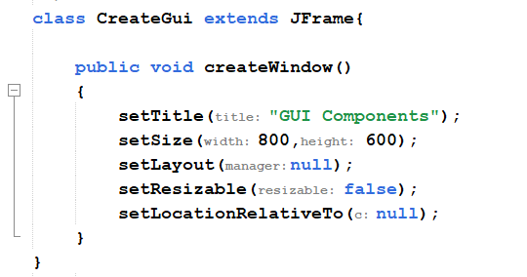
Commonly used Methods of Component class

Slide 15
JFrame
JFrame jf=new JFrame("Book Details");
//jf.setSize(400,400);
jf.setBounds(325,58,400,400);
jf.getContentPane().setBackground(Color.BLUE);
jf.setLayout(null);
jf.setVisible(true);

Slide 16
setBounds()
The setBounds() method needs four arguments. The first two arguments are x and y coordinates of the top-left corner of the component, the third argument is the width of the component and the fourth argument is the height of the component.
Syntax
setBounds(int x-coordinate, int y-coordinate, int width, int height)

Slide 17
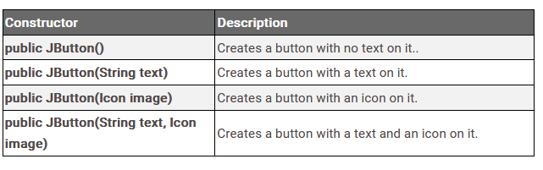
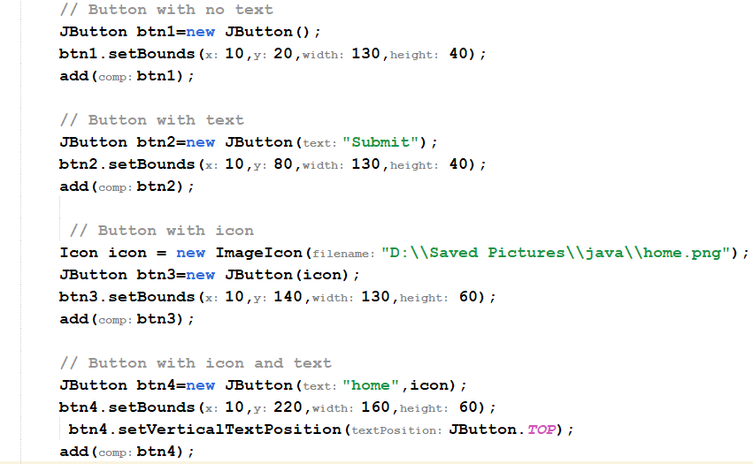
Constructors of JButton
Java JButton
The JButton class is used to create a labeled button which perform some action when the button is pushed. It inherits AbstractButton class.

Slide 18
Steps to perform action on button click
1. Importing Packages:
import javax.swing.*;
import java.awt.*;
import java.awt.event.*;
2.Create Class which Implementing ActionListener Interface: class classname implements ActionListener
3. Create Button and add in Frame:
4. Registering ActionListener to the JButton:
In this step, we will add or can say register ActionListener to the JButton. For this, we have to call addActionListener() method using the object of the JButton class.
5. Override actionPerformed() method

Slide 19
actionPerformed() method
If we have implemented the ActionListener interface in any class, then we must have to override its method which is actionPerformed(ActionEvent e) which takes a parameter ActionEvent (a class defined in package java.awt.event ). Now when someone clicks on the button the actionPerformed() method is called.

Slide 20
Java JLabel
The object of JLabel class is a component for placing text in a container. It is used to display a single line of read only text. The text can be changed by an application but a user cannot edit it directly. It inherits JComponent class.

Slide 21
JLabel:Commonly used Constructors:
Constructor | Description
JLabel() | Creates a JLabel instance with no image and with an empty string for the title.
JLabel(String s) | Creates a JLabel instance with the specified text.
JLabel(Icon i) | Creates a JLabel instance with the specified image.
JLabel(String s, Icon i, int horizontalAlignment) | Creates a JLabel instance with the specified text, image, and horizontal alignment.

Slide 22
Jlabel:Commonly used Methods:
Methods | Description
String getText() | t returns the text string that a label displays.
void setText(String text) | It defines the single line of text this component will display.
void setHorizontalAlignment(int alignment) | It sets the alignment of the label's contents along the X axis.
Icon getIcon() | It returns the graphic image that the label displays.
int getHorizontalAlignment() | It returns the alignment of the label's contents along the X axis.

Slide 23
Add image using JLabel
JLabel jl=new JLabel(new ImageIcon("bimg2.jpg"));
JPanel jp=new JPanel();
jp.add(jl);

Slide 24
Java JTextField
The object of a JTextField class is a text component that
allows the editing of a single line text. It inherits JTextComponent class.
JTextField class declaration
Let's see the declaration for javax.swing.JTextField class.
public class JTextField extends JTextComponent implements SwingConstants

Slide 25
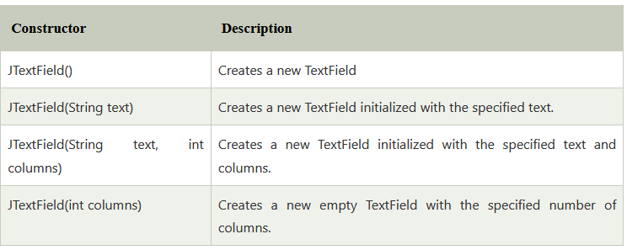
Java JTextField

Slide 26
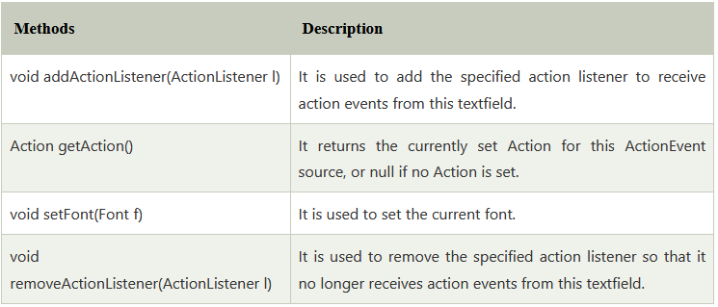
Java JTextField

Slide 27

Any Query?

