Slide 1

CAP477 PROGRAMMING IN JAVA

Slide 2

Functional Interface and Lambda Expressions
understanding the importance of static and non-static nested classes
local and
anonymous class
working with Dates

Slide 3
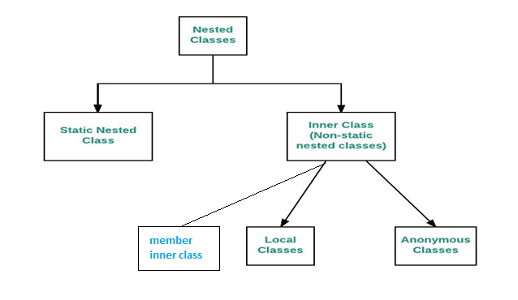
inner and nested classes
Define a class within another class, such classes are known as nested classes
Nested classes are divided into two categories:
static nested class :
Nested classes that are declared static are called static nested classes.
inner class :
An inner class is a non-static nested class.

Slide 4
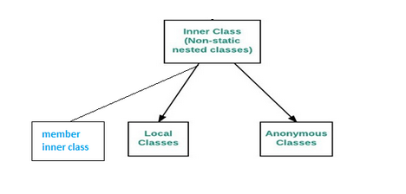
inner class
An inner class is a non-static class that is defined inside another class. It has access to the member variables and methods of the outer class, even if they are private.
Member inner class: This is a non-static inner class that is a member of the outer class. It can access all the members of the outer class.
Local inner class: This is a non-static inner class that is defined inside a method or a block of code. It has access to the final local variables of the method or block.
Anonymous inner class: This is a inner class that has no name. It is typically used to implement an interface or extend a class.

Slide 5
Member inner class
The new operator is used to create the object of member inner class with slightly different syntax.
The general form of syntax to create an object of the member inner class is as follows:
Syntax:
OuterClassReference.new InnerClass();
Example: Click here

Slide 6
Local inner class:
This is a non-static inner class that is defined inside a method or a block of code. It has access to the final local variables of the method or block.
Example: Click here
Anonymous inner class:
This is a inner class that has no name. It is typically used to implement an interface or extend a class.
Example: Click here

Slide 7
Static Nested Class:
Nested classes that are declared static are called static nested classes. In normal inner class, we cannot declare any static members but in the static nested class, we can declare a static member including the main method.
Since we cannot declare the main method in the normal inner class, therefore, we cannot run inner class directly from the command prompt.
But we can declare the main method and can also run the static nested class directly from the command prompt.
A normal inner class can access both static and non-static members of the outer class directly but from the static nested class, we can access only static members.
Example: Click here

Slide 8
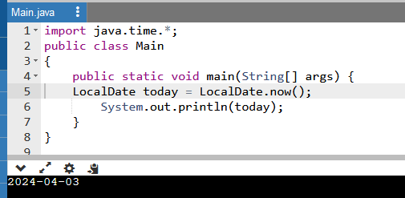
working with Dates
In Java there are some classes from the java.time package, introduced in Java 8, which provides comprehensive support for date and time operations.
Getting today’s date:
LocalDate today = LocalDate.now();
System.out.println(today);

Slide 9
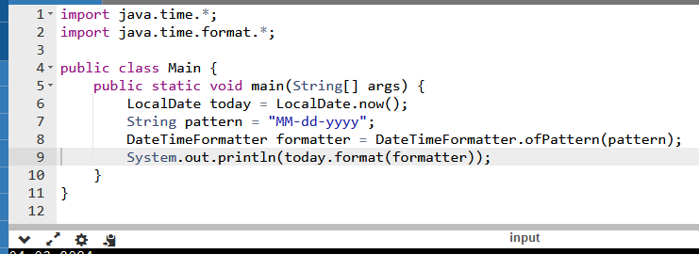
Formatting dates:
LocalDate today = LocalDate.now();
String pattern = "MM-dd-yyyy";
DateTimeFormatter formatter = DateTimeFormatter.ofPattern(pattern); System.out.println(today.format(formatter));

Slide 10
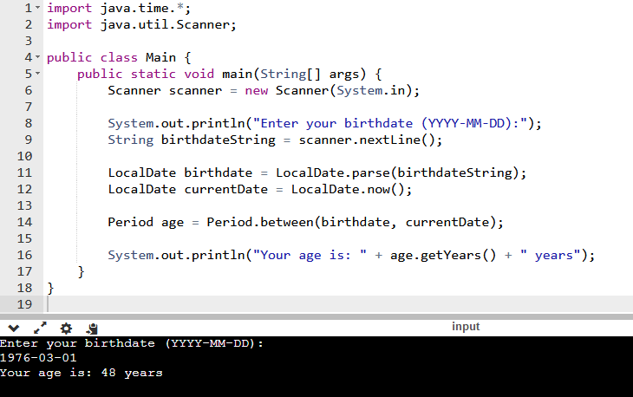
To calculate the age from a birthdate, you can use the Period class in Java's java.time package. Here's how you can calculate the age given a birthdate:

Slide 11
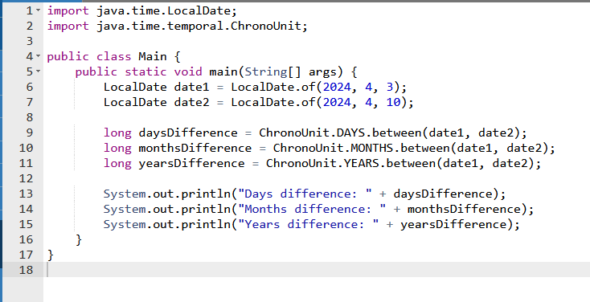
how to get the difference between two dates?
To get the difference between two dates in Java, you can use the ChronoUnit enum or the Duration class from the java.time package.
Example: Click here

Slide 12

Any Query?

