Slide 1

CAP477 PROGRAMMING IN JAVA

Slide 2

constructors and methods of String and String Builder class
StringBuilder class
Constructors and methods
of StringBuilder class
String Class
Constructors and methods
of String Class

Slide 3
String Class
String class is a part of the java.lang package and is automatically imported into every Java program. Strings in Java are immutable, meaning once a String object is created, its state cannot be changed.
Strings can be created using string literals, constructors:
String str1 = "Hello"; // String literal
String str2 = new String("World"); // Using constructor

Slide 4
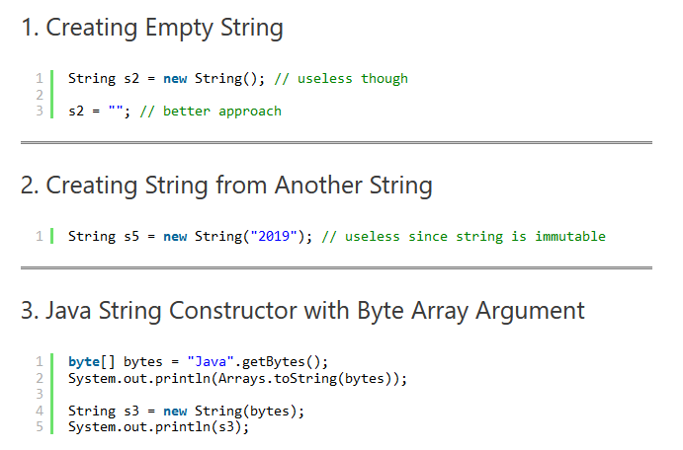
Constructors of String Class

Slide 5
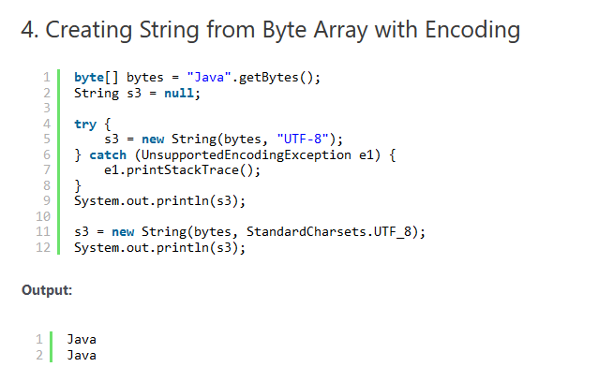
Constructors of String Class

Slide 6
ASCII (American Standard Code for Information Interchange) vs UTF(Unicode Transformation Format)
ASCII is a simple and limited character encoding primarily used for English text, Unicode provides a broader range of characters from various languages and scripts and supports multilingual text representation through its different encoding schemes (UTF-8, UTF-16, UTF-32).
ASCII: ASCII uses fixed-width encoding, with each character represented by 7 bits (or 8 bits in extended ASCII). This means that each character is encoded using a single byte. ASCII does not support characters from non-English languages or special symbols extensively.
Unicode (UTF): Unicode uses variable-width encoding, where characters can be represented using one or more bytes. UTF-8, UTF-16, and UTF-32 are different encoding schemes under the Unicode standard.

Slide 7
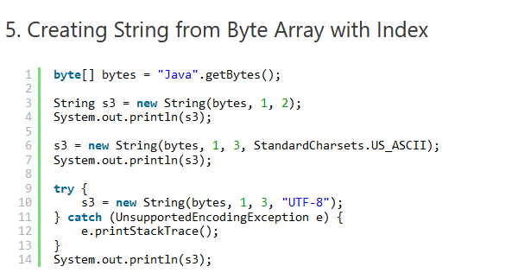
Constructors of String Class

Slide 8
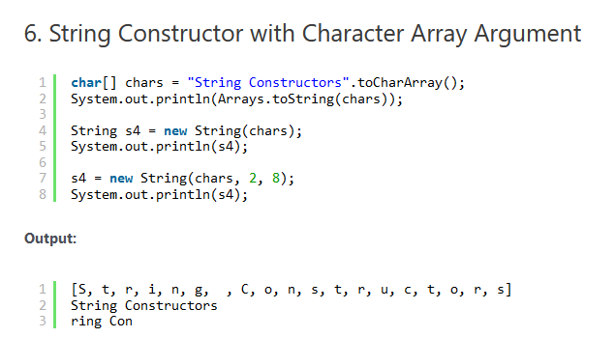
Constructors of String Class

Slide 9
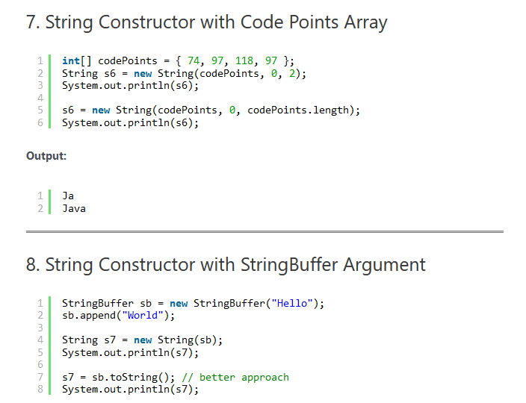
Constructors of String Class

Slide 10
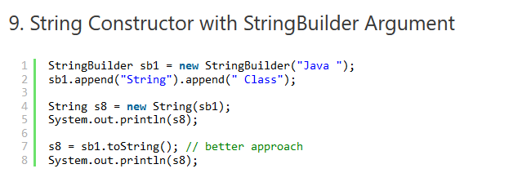
Constructors of String Class

Slide 11
Methods in String class:
length(),
charAt()
Substring()
concat
indexOf()
equals()
7. compareTo()
8. trim()
8. replace()
9. toUpperCase()
10. toLowerCase();

Slide 12
length(), charAt()
int length();
char charAt(i);
Returns the number of characters in the string
Returns the char at position i.
Character positions in strings are numbered starting from 0 – just like arrays.
Returns:
”Problem".length();
”Window".charAt (2);
7
’n'

Slide 13
substring()
Returns a new String by finding characters from an existing String.
String subs = word.substring (i, k);
returns the substring of chars in positions from i to k-1
String subs = word.substring (i);
returns the substring from the i-th char to the end
television
i k
television
i
Returns:
”television".substring (2,5);
“immutable".substring (2);
“lev"
“mutable"

Slide 14
concat()
String word1 = “re”, word2 = “think”; word3 = “ing”;
int num = 2;
String result = word1.concat (word2);
//the same as word1 + word2 “rethink“

Slide 15
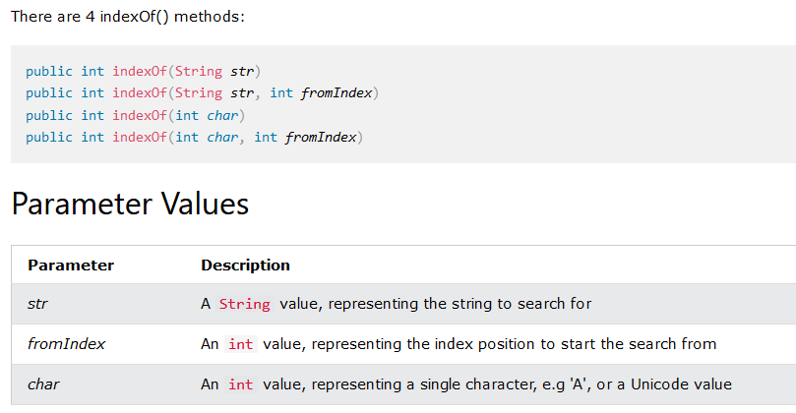
indexOf(): The indexOf() method returns the position of the first occurrence of specified character(s) in a string.

Slide 16
indexOf()
index positions
String name =“President George Washington";
name.indexOf (‘P'); 0
name.indexOf (‘e'); 2
name.indexOf (“George"); 10
name.indexOf (‘e', 3); 6
name.indexOf (“Bob"); -1
Returns:
(starts searching at position 3)
(not found)
Notes:
String has four overloaded versions of indexOf and four versions of lastIndexOf.
lastIndexOf(ch, fromPos) starts looking at fromPos and goes backward towards the beginning of the string.

Slide 17
equals()/equalsIgnoreCase()
boolean b = word1.equals(word2);
returns true if the string word1 is equal to word2
boolean b = word1.equalsIgnoreCase(word2);
returns true if the string word1 matches word2, case-blind
b = “Raiders”.equals(“Raiders”);//true
b = “Raiders”.equals(“raiders”);//false b = “Raiders”.equalsIgnoreCase(“raiders”);//true
Notes:
You cannot use relational operators for comparing the contents of strings.
word1.compareTo(word2) returns an int. Basically if word1 is “smaller” than word2, the result is negative, and if word1 is “larger” the result is positive. compareTo returns 0 whenever equals returns true.
Here is how Java docs describe compareTo:
Compares two strings lexicographically. The comparison is based on the Unicode value of each character in the strings. The character sequence represented by this String object is compared lexicographically to the character sequence represented by the argument string. The result is a negative integer if this String object lexicographically precedes the argument string. The result is a positive integer if this String object lexicographically follows the argument string. The result is zero if the strings are equal; compareTo returns 0 exactly when the equals(Object) method would return true.
This is the definition of lexicographic ordering. If two strings are different, then either they have different characters at some index that is a valid index for both strings, or their lengths are different, or both. If they have different characters at one or more index positions, let k be the smallest such index; then the string whose character at position k has the smaller value, as determined by using the < operator, lexicographically precedes the other string. In this case, compareTo returns the difference of the two character values at position k in the two string — that is, the value:
this.charAt(k)-anotherString.charAt(k)
If there is no index position at which they differ, then the shorter string lexicographically precedes the longer string. In this case, compareTo returns the difference of the lengths of the strings — that is, the value:
this.length()-anotherString.length()

Slide 18
Difference between == and .equals() method in Java
equals() is a method and == is a operator
use == operators for reference comparison (address comparison) and .equals() method for content comparison.
In simple words, == checks if both objects point to the same memory location whereas .equals() evaluates to the comparison of values in the objects

Slide 19
compareTo()
int diff = word1.compareTo(word2);
returns the “difference” word1 - word2
if string1 > string2, it returns positive number
if string1 < string2, it returns negative number
if string1 == string2, it returns 0
The java string compareTo() method compares the given string with current string . It returns positive number, negative number or 0.
It compares strings on the basis of Unicode value of each character in the strings.
Notes:
You cannot use relational operators for comparing the contents of strings.
word1.compareTo(word2) returns an int. Basically if word1 is “smaller” than word2, the result is negative, and if word1 is “larger” the result is positive. compareTo returns 0 whenever equals returns true.
Here is how Java docs describe compareTo:
Compares two strings lexicographically. The comparison is based on the Unicode value of each character in the strings. The character sequence represented by this String object is compared lexicographically to the character sequence represented by the argument string. The result is a negative integer if this String object lexicographically precedes the argument string. The result is a positive integer if this String object lexicographically follows the argument string. The result is zero if the strings are equal; compareTo returns 0 exactly when the equals(Object) method would return true.
This is the definition of lexicographic ordering. If two strings are different, then either they have different characters at some index that is a valid index for both strings, or their lengths are different, or both. If they have different characters at one or more index positions, let k be the smallest such index; then the string whose character at position k has the smaller value, as determined by using the < operator, lexicographically precedes the other string. In this case, compareTo returns the difference of the two character values at position k in the two string — that is, the value:
this.charAt(k)-anotherString.charAt(k)
If there is no index position at which they differ, then the shorter string lexicographically precedes the longer string. In this case, compareTo returns the difference of the lengths of the strings — that is, the value:
this.length()-anotherString.length()

Slide 20
Comparison Examples
//negative differences
diff = “apple”.compareTo(“berry”);//a before b
diff = “Zebra”.compareTo(“apple”);//Z before a
diff = “dig”.compareTo(“dug”);//i before u
diff = “dig”.compareTo(“digs”);//dig is shorter
//zero differences
diff = “apple”.compareTo(“apple”);//equal
diff = “dig”.compareToIgnoreCase(“DIG”);//equal
//positive differences
diff = “berry”.compareTo(“apple”);//b after a
diff = “apple”.compareTo(“Apple”);//a after A
diff = “BIT”.compareTo(“BIG”);//T after G
diff = “huge”.compareTo(“hug”);//huge is longer

Slide 21
Methods — Changing Case
String word2 = word1.toUpperCase();
String word3 = word1.toLowerCase();
returns a new string formed from word1 by converting its characters to upper (lower) case
String word1 = “HeLLo“;
String word2 = word1.toUpperCase();//”HELLO”
String word3 = word1.toLowerCase();//”hello”
//word1 is still “HeLLo“
Notes:
Note that these methods do not change the string word1 but create and return a new string.
trim() only removes whitespace at the ends of the string, not in the middle.

Slide 22
trim()
removing white space at both ends
does not affect whites space in the middle
Example:
String word1 = “ Hi Kumar “;
String word2 = word1.trim();
//word2 is “Hi Kumar” – no spaces on either end
//word1 is still “ Hi Kumar “ – with middle spaces
Notes:
Note that these methods do not change the string word1 but create and return a new string.
trim() only removes whitespace at the ends of the string, not in the middle.

Slide 23
replace()
Method returns a string replacing all the old char or Char Sequence to new char or Char Sequence.
Syntax:
String replace(char oldChar, char newChar)
String replace(CharSequence target, CharSequence replacement)
Example:
String str1="hello hello hello";
String str2="hello hello hello";
str1=str1.replace('h', 'H');
str2=str2.replace("hello", "hi");
System.out.println(str1);
System.out.println(str2);
Notes:
Note that these methods do not change the string word1 but create and return a new string.
trim() only removes whitespace at the ends of the string, not in the middle.

Slide 24
replaceAll()
The java string replaceAll() method returns a string replacing all the sequence of characters matching regular expression and replacement string.
Syntax: String replaceAll(String regex, String replacement)
Example:
replace all occurrences of white spaces in a string:
String str = "how to do in java provides java reading materials";
String newStr = str.replaceAll(“\\s", "");
System.out.println(newStr);

Slide 25
StringBuilder class
StringBuilder is mutable means one can change the value of the object .
Each method in StringBuffer is non-synchronized that is i.e. not thread safe. It means two threads can call the methods of StringBuilder simultaneously.

Slide 26
Differences between StringBuffer and StringBuilder
StringBuffer | StringBuilder
StringBuffer is synchronized i.e. thread safe. It means two threads can't call the methods of StringBuffer simultaneously. | StringBuilder is non-synchronized i.e. not thread safe. It means two threads can call the methods of StringBuilder simultaneously.
StringBuffer is less efficient than StringBuilder. | StringBuilder is more efficient than StringBuffer.

Slide 27
Constructors of String Builder class
StringBuilder():
Constructs an empty StringBuilder with initial capacity of 16 characters. If more characters are appended than the initial capacity, the capacity is automatically increased.
StringBuilder sb = new StringBuilder();
2. StringBuilder(int capacity):
Constructs an empty StringBuilder with the specified initial capacity.
StringBuilder sb = new StringBuilder(50);
// Initial capacity of 50 characters

Slide 28
Constructors of String Builder class
3. StringBuilder(CharSequence seq):
Constructs a StringBuilder containing the same characters as the specified CharSequence (which could be a String, StringBuilder, StringBuffer, etc.).
StringBuilder sb = new StringBuilder("Hello");
// Initializes StringBuilder with "Hello"
4. StringBuilder(String str):
Constructs a StringBuilder containing the characters of the specified string. The initial capacity of the StringBuilder is the length of the specified string plus 16.
StringBuilder sb = new StringBuilder("Hello");
// Initializes StringBuilder with "Hello"

Slide 29
methods of StringBuffer/StringBuilder class
append()
capacity()
ensureCapacity()
insert()
reverse()
replace()
length()
delete()
deleteCharAt()
substring()

Slide 30
append()
is used to append the string from one string to another string like concat.
Syntax:
StringBufferClassReference.append(any type)
Any type:-
append(char), append(boolean), append(int), append(float), append(double) etc.

Slide 31
capacity()
is used to return the current capacity of buffer.
The default capacity of the buffer is 16.
If the number of character increases from its current capacity, it increases the capacity by (oldcapacity*2)+2.
For example if your current capacity is 16, it will be (16*2)+2=34.

Slide 32
Condition1:
StringBuffer sb=new StringBuffer();
System.out.println("Current Capacity:"+sb.capacity());
// Current Capacity:16
Condition2:
StringBuffer sb=new StringBuffer(“hello”);
System.out.println("Current Capacity:"+sb.capacity());
// Current Capacity:21

Slide 33
ensureCapacity()
It ensures that the given capacity is the minimum to the current capacity. If it is greater than the current capacity, it increases the capacity by (oldcapacity*2)+2.
Ex:
If current capacity is:70
sb.ensureCapacity(70); // no change
But
sb.ensureCapacity(71); // cahnge now 142

Slide 34
insert()
It is used to inserts the string at the specified position.
Syntax:
StringBufferClassReference.insert(pos,string)
reverse()
It is used to reverses the current string
Syntax:
StringBufferClassReference.reverse()

Slide 35
replace():
replaces the string from the specified startingIndex and endingIndex.
Syntax:
StringBufferClassReference.replace(startingIndex, endingIndex, newstring)
e.g:
StringBuffer sb=new StringBuffer("Hello");
sb.replace(1,3,“kumar");
System.out.println(sb);//Hkumarlo

Slide 36
length() : to find the length of current string
Syntax:
StringBufferClassReference.length()
delete(): deletes the string from the specified startingIndex to endingIndex.
Syntax:StringBufferClassReference.delete(startingIndex,endingIndex)
e.g:
StringBuffer sb=new StringBuffer("Hello");
sb.delete(1,3);
System.out.println(sb);//Hlo

Slide 37
deleteCharAt():
deletes the character at the index specified by loc.
Syntax:
StringBufferClassReference.deleteCharAt(int loc)
e.g:
StringBuffer sb=new StringBuffer("Hello");
sb.deleteCharAt(3);
System.out.println(sb);//Helo

Slide 38
substring()
is used to return the substring from the specified startingIndex and endingIndex.
Syntax:
substring(int startingIndex, int endingIndex)

Slide 39


Example
String Class methods Example
StringBuilder Class methods Example

Slide 40

Any Query?

