Slide 1

CAP477 PROGRAMMING IN JAVA

Slide 2
Topics Covered:
Data In the Cart :
identifiers,
keywords,
variables,
using primitive data types,
type conversion,
access modifiers,
static keyword, wrapper class

Slide 3
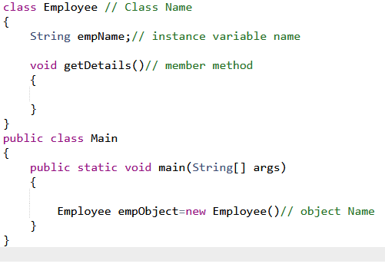
identifiers
A name which is used for identifying any entity.
Identifier can be a class name, object name, method name, variable name, property name etc..
Identifier name should be meaningful not meaningless and always it follow naming convention rule.
Now a days industry are following camel case/ Pascal Case style to define identifier name.

Slide 4
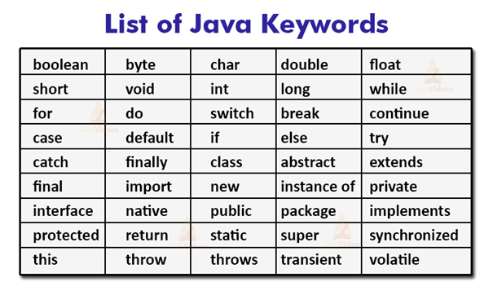
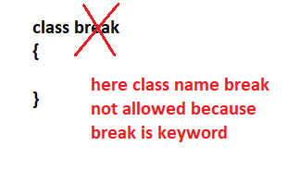
keywords
Reserve words in java is called java keywords. As we know keywords are not allow to use for any identifiers name.

Slide 5
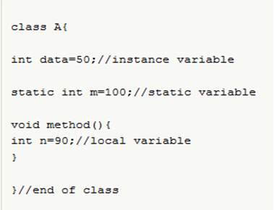
variables
A name of storage location is called variable. Variable can be defined their own scope. So, we can categorize the variable with the help of its type and its scope.
According to types:
syntax:
varibaleType variableName;
eg: int registrationNumber;
According to scope:
it can be local, instance and static

Slide 6
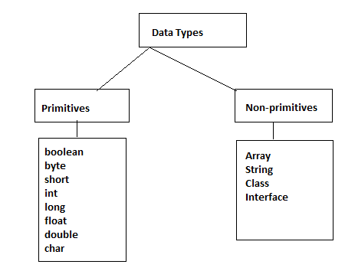
using primitive data types
Data types in Java: Data types means type of your data or user input. To define our data which will be use in our application we need to define with its type so, that our compiler can understand what operation or task we want to perform.
In java we can categorize data types in two ways : one is primitive and another one is non primitive

Slide 7
Primitive data types
Numeric Types:
Integral Types:
byte: 8-bit signed integer
short: 16-bit signed integer
int: 32-bit signed integer
long: 64-bit signed integer
Floating-Point Types:
float: 32-bit floating-point number
double: 64-bit floating-point number
Character Type:
char: 16-bit Unicode character
Boolean Type:
boolean: Represents true or false values
byte myByte = 127;
short myShort = 32000;
int myInt = 2000000000;
long myLong = 9223372036854775807L;
float myFloat = 3.14f;
double myDouble = 2.71828;
char myChar = 'A';

Slide 8
Non Primitive data types
Reference Data Types:
Object Types:
String: Represents a sequence of characters.
Arrays: Collection of elements of the same type.
Custom Objects: User-defined classes and interfaces.
// String is a reference data type
String name = "Kumar";
// Arrays are reference data types
int[] numbers = new int[] { 1, 2, 3, 4 };
// Custom classes are reference data types
class Person {
String name;
int age;
}
Person personObj = new Person();

Slide 9
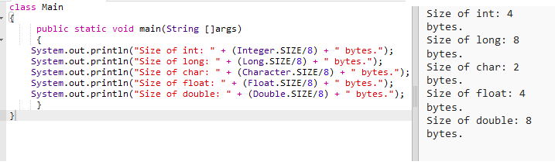
Click here to get Code

Slide 10
Wrapper class
A Wrapper class is a class whose object wraps or contains primitive data types.
Some time we need to convert primitive type to object and object to primitive type. In that case we use wrapper class.
There are different scenarios, where we need to use the wrapper classes:-
In case of Serialization, we need to convert the objects into streams to perform the serialization.
If we have a primitive value, we can convert it in objects through the wrapper classes.

Slide 11
type conversion
Type conversion refers to the process of converting a value from one data type to another.
Implicit Type Conversion (Widening Conversion):
Java automatically converts one data type to another when the destination data type can represent a larger range of values.
int intValue = 42;
long longValue = intValue; // Implicit conversion from int to long
Explicit Type Conversion (Narrowing Conversion):
When converting from a larger data type to a smaller one,
you need to explicitly cast the value.
double doubleValue = 3.14;
int intValue = (int) doubleValue; // Explicit conversion from double to int

Slide 12
Autoboxing and Unboxing:
This process is known as autoboxing (converting a primitive type to its wrapper class) and unboxing (converting a wrapper class to its primitive type).
int primitiveInt = 42;
Integer wrapperInt = primitiveInt; // Autoboxing
double primitiveDouble = wrapperInt.doubleValue(); // Unboxing
double primitiveDouble= wrapperInt; //unboxing

Slide 13
String to Primitive and Primitive to String Conversion:
parseInt, parseDouble, valueOf methods are commonly used for converting strings to numeric types.
toString method is used for converting numeric types to strings.
String strNumber = "123";
int intNumber = Integer.parseInt(strNumber); // String to int conversion
double doubleValue = 3.14;
String strValue = Double.toString(doubleValue); // Double to String conversion

Slide 14
static keyword
In Java, the keyword static is used to declare members (variables, methods, and nested classes)
Static Variables (Class Variables):
A static variable is shared among all instances of a class.
It is declared using the static keyword.
class MyClass {
static int staticVar = 42; // Static variable
}

Slide 15
Static Methods:
A static method belongs to the class rather than an instance of the class.
It can be called using the class name without creating an instance of the class.
class MathOperations {
static int add(int a, int b) {
return a + b;
}
}
// Usage
int result = MathOperations.add(5, 7);

Slide 16
Static Nested Classes:
A static nested class is a class that is defined inside another class and marked as static.
It does not have access to the instance-specific members of the outer class.
class OuterClass {
static class NestedStaticClass {
// Static nested class
}
}

Slide 17
access modifiers
There are four main access modifiers in Java:
Default (Package-Private):
If no access modifier is specified, the default access level is package-private.
Members with default access are accessible within the same package but not outside of it.
class MyClass {
int defaultVar; // Package-private variable
}

Slide 18
Public:
Members declared as public are accessible from any other class.
There are no restrictions on access.
public class PublicClass {
public int publicVar; // Public variable
}
Protected:
Members declared as protected are accessible within the same package and by subclasses (even if they are in a different package).
class ParentClass {
protected int protectedVar; // Protected variable
}

Slide 19
Private:
Members declared as private are accessible only within the same class.
They are not visible to any other class, even subclasses.
class PrivateClass {
private int privateVar; // Private variable
}

