Slide 1

CAP477 PROGRAMMING IN JAVA

Slide 2

Introduction to Java Operators
Operators in Java are special symbols or keywords that are used to perform operations on operands. Operands can be variables, literals, or expressions. Here are some common types of operators in Java:
Arithmetic operators
Assignment operator
Relational operators
Logical operators
Bitwise operators
Unary operators
Ternary operators

Slide 3

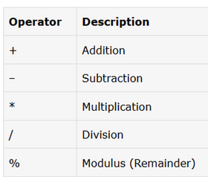
Arithmetic Operators
Scenario-Based Examples
Calculating the total cost of items in a shopping cart
Computing the average of exam scores

Slide 4

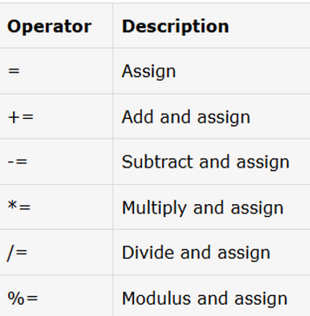
Assignment Operators
Scenario-Based Examples
Accumulating points in a game with +=
Adjusting inventory levels with -= and +=

Slide 5

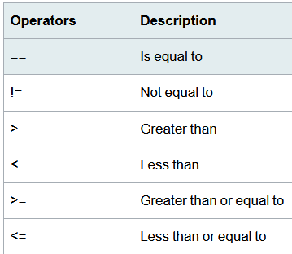
Relational Operators
Scenario-Based Examples
Checking if a user-provided password matches the stored password
Determining eligibility based on age for various services

Slide 6

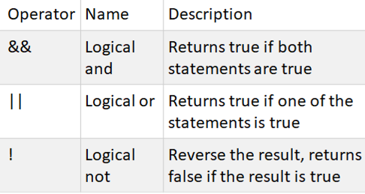
Logical Operators
Scenario-Based Examples
Implementing access control with logical AND
Validating multiple conditions using logical OR

Slide 7

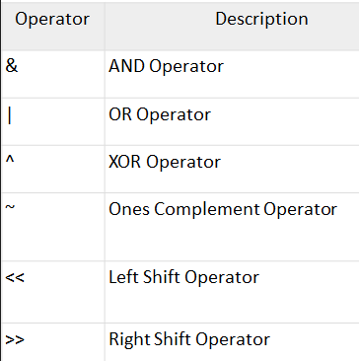
Bitwise Operators
Scenario-Based Examples
Let's consider a scenario where you have a set of user roles, and you want to use bitwise operations to manage and check these roles.

Slide 8

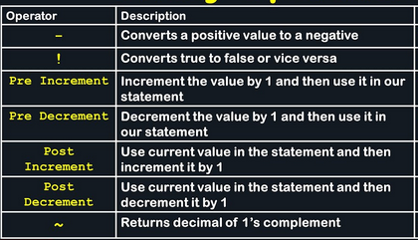
Unary Operators
Scenario-Based Examples:
A model for the progress of a task

Slide 9
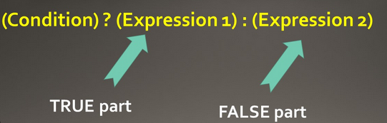
Ternary Operators
Scenario-Based Example:
Grading System

Slide 10
Operator precedence
Operator precedence in Java refers to the order in which operators are evaluated when an expression contains multiple operators. Operators with higher precedence are evaluated first. If two operators have the same precedence, their associativity determines the order of evaluation (left-to-right or right-to-left).
Precedence | Operators | Associativity
1 | () | Left-to-right
2 | ++, -- (postfix) | Left-to-right
 | +, - (unary) | Right-to-left
 | ~, ! | Right-to-left
3 | ++, -- (prefix) | Right-to-left
 | +, - (binary) | Left-to-right
4 | *, /, % | Left-to-right
5 | +, - (binary) | Left-to-right
6 | <<, >>, >>> | Left-to-right
7 | <, <=, >, >=, instanceof | Left-to-right
8 | ==, != | Left-to-right
9 | & | Left-to-right
10 | ^ | Left-to-right
11 | ` | `
12 | && | Left-to-right
13 | `
14 | ? : | Right-to-left
15 | =, +=, -=, *=, /=, %= | Right-to-left

Slide 11

Any Query?

