Slide 1

CAP477 PROGRAMMING IN JAVA

Slide 2
looping controls, nested loops
While loop
Do while loop
For loop
Enhanced or advanced for loop
Nested loops means one loop inside another loop.

Slide 3
while loop: A while loop is a control flow statement that allows code to be executed repeatedly based on a given Boolean condition. The while loop can be thought of as a repeating if statement.
Syntax :
while (boolean condition)
{
loop statements...
}

Slide 4
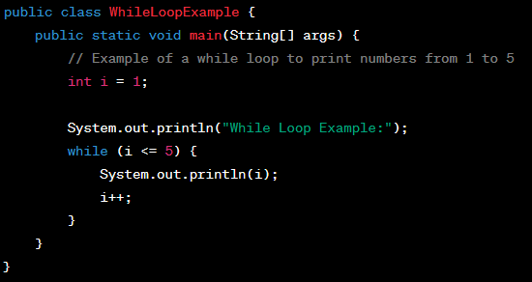
While loop

Slide 5
for loop: for loop provides a concise way of writing the loop structure. Unlike a while loop, a for statement consumes the initialization, condition and increment/decrement in one line thereby providing a shorter, easy to debug structure of looping.
Syntax:
for (initialization condition; testing condition;increment/decrement)
{
statement(s)
}

Slide 6
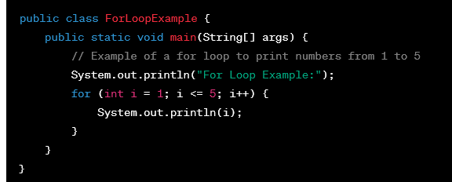
For Loop

Slide 7
do while: do while loop is similar to while loop with only difference that it checks for condition after executing the statements, and therefore is an example of Exit Control Loop.
Syntax:
do
{
statements..
}
while (condition);

Slide 8
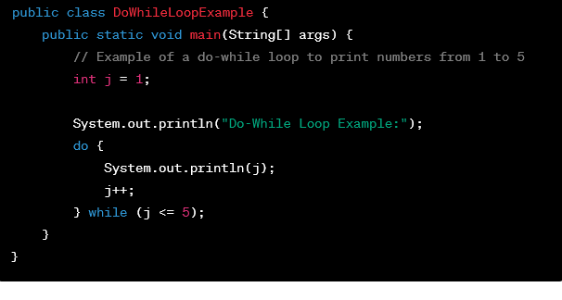
Do while loop

Slide 9
Enhanced For loop
for(data_type variable : array | collection)
{
//body of for-each loop
}

Slide 10
Example:
int myArray[]=new int[]{11,12,13,14,15};
for(int num : myArray)
{
System.out.println(num);
}

Slide 11
class Main {
public static void main(String[] args) {
// an array of numbers
int[] numbers = {3, 4, 5, -5, 0, 12};
int sum = 0;
// iterating through each element of the array
for (int number: numbers) {
sum += number;
}
System.out.println("Sum = " + sum);
}
}

Slide 12
class Main {
public static void main(String[] args) {
char[] vowels = {'a', 'e', 'i', 'o', 'u'};
// iterating through an array using the for-each loop
for (char item: vowels) {
System.out.println(item);
}
}
}

Slide 13
Nested loops
A Nested loop means a loop statement inside another loop statement. That is why nested loops are also called “loop inside loop“.
Nested For loop
for ( initialization; condition; increment ) {
for ( initialization; condition; increment ) {
// statement of inside loop
}
// statement of outer loop
}

Slide 14
import java.io.*;
class Loop {
public static void main(String[] args)
{
int weeks = 3;
int days = 7;
int i = 1;
// outer loop
while (i <= weeks) {
System.out.println("Week: " + i);
// inner loop
for (int j = 1; j <= days; ++j) {
System.out.println(" Days: " + j);
}
++i;
}
}
}

