Slide 1
CAP477 PROGRAMMING IN JAVA

Slide 2
working with arrays: Array
Array is a collection of similar type of elements that have contiguous memory location.
In java, array is an object the contains elements of similar data type.
It is a data structure where we store similar elements. We can store only fixed elements in an array.
Array is index based, first element of the array is stored at 0 index.

Slide 3
Advantage of Array
Code Optimization: It makes the code optimized, we can retrieve or sort the data easily.
Random access: We can get any data located at any index position.
Disadvantage of Array
Size Limit: We can store only fixed size of elements in the array. It doesn't grow its size at runtime. To solve this problem, collection framework is used in java.

Slide 4
Types of Array: There are two types of array.
Single Dimensional Array
Multidimensional Array-
2D array
3D array
Jagged array
working with arrays

Slide 5
Single Dimensional Array
The syntax for declaring and instantiating an array:
There are two ways to declare an array:
type[] arrayName;
type arrayName[];
working with arrays

Slide 6
How to instantiate an array
arrayName = new type[length];
How to declare and instantiate an array in one statement
type[] arrayName = new type[length];
working with arrays

Slide 7
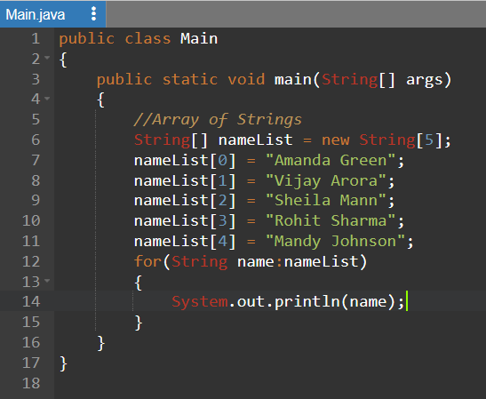
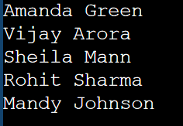
working with arrays

Slide 8
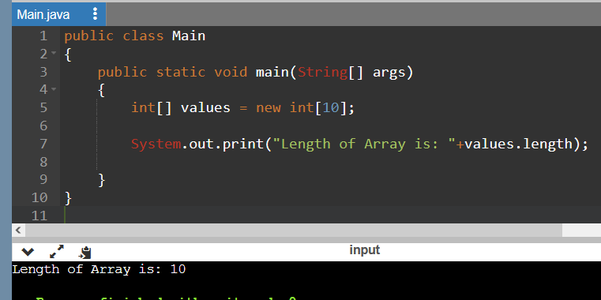
Array length
The syntax for getting the length of an array
arrayName.length
working with arrays

Slide 9
Two-dimensional arrays
The syntax for creating a rectangular array-
type[][] arrayName = new type[rowCount][columnCount];
A statement that creates a 3x2 array
int[][] numbers = new int[3][2];
3x2 array and initializes it in one statement
int[][] numbers =new int[][] { { 1, 2 }, { 3, 4 }, { 5, 6 } };
working with arrays

Slide 10
Enhanced for loop for 2D array
for (int[] num: arr)
{
for(int data: num)
{
System.out.println(data);
}
}
working with arrays

Slide 11
import java.util.Scanner;
public class Array2 {
public static void main(String[] args) {
Scanner scanner = new Scanner(System.in);
System.out.print("Enter the number of rows: ");
int rows = scanner.nextInt();
System.out.print("Enter the number of columns: ");
int cols = scanner.nextInt();
int[][] array = new int[rows][cols];
for (int i = 0; i < rows; i++) {
for (int j = 0; j < cols; j++) {
System.out.printf("Enter element at row %d, column %d: ", i + 1, j + 1);
array[i][j] = scanner.nextInt();
}
}

Slide 12
System.out.println("Entered Array:");
for (int i = 0; i < rows; i++) {
for (int j = 0; j < cols; j++) {
System.out.print(array[i][j] + " ");
}
System.out.println();
}
}
}

Slide 13
Jagged array
type[][] arrayName = new type[rowCount][];
e.g:-
int num[][]=new int[4][];
num[0]=new int[1];
num[1]=new int[2];
num[2]=new int[3];
num[3]=new int[4];

Slide 14
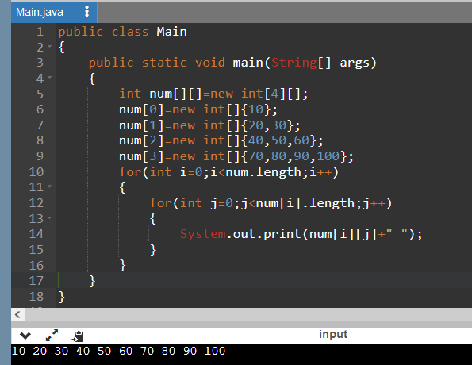
Jagged array
type[][] arrayName = new type[rowCount][];
e.g:-
working with arrays

Slide 15
Multi-dimensional array:
Multidimensional Arrays can be defined in simple words as array of arrays. Data in multidimensional arrays are stored in tabular form (in row major order).
Syntax:
data_type[1st dimension][2nd dimension][]..[Nth dimension] array_name = new data_type[size1][size2]….[sizeN];

Slide 16
3 d array:
Syntax:
array_type[][][] array_name = new array_type[x][y][z];
Ex:
int[][][] num=new int[2][3][4];
Here, num[i][j][k] where ‘i’ is the array number, ‘j’ is the row number and ‘k’ is the column number.
working with arrays

Slide 17
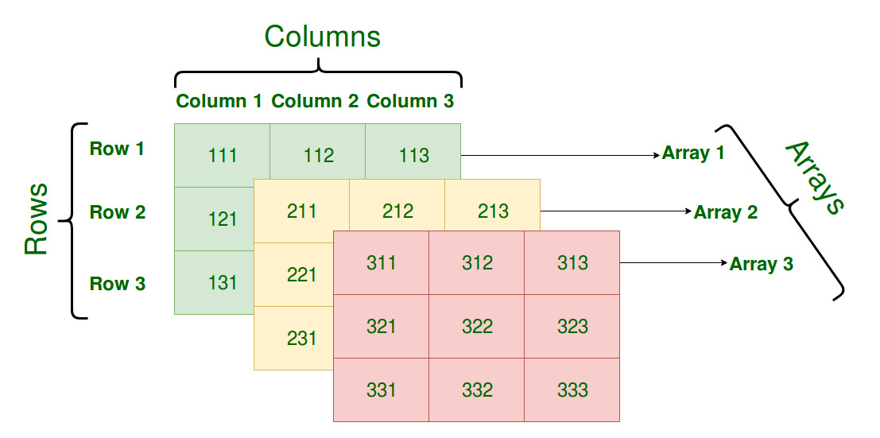
int[][][] num=new int[3][3][3];
working with arrays

Slide 18
Electronics department:
student1 scores: 75, 87, 69
student2 scores: 90, 87, 85
student3 scores: 56, 67, 76
Computer Science department:
student1 scores: 78, 67, 75
student2 scores: 87, 98, 76
student3 scores: 67, 56, 65
Information Technology department:
student1 scores: 72, 63, 72
student2 scores: 82, 91, 71
student3 scores: 64, 56, 66
To store all these exam scores, department-wise,
we will need to use three-dimensional array
int[ ][ ][ ] scores = new int[3][3][3];

Slide 19
class ThreeArray {
public static void main(String[] args)
{
// create a 3d array
int[][][] test = {
{
{1, -2, 3},
{2, 3, 4}
},
{
{-4, -5, 6, 9},
{1},
{2, 3}
}
};
// for..each loop to iterate through elements of 3d array
for (int[][] array2D: test) {
for (int[] array1D: array2D) {
for(int item: array1D) {
System.out.println(item);
}
}
}
}
}

Slide 20
Variable Arguments (Varargs) in Java
Variable Arguments (Varargs) in Java is a method that takes a variable number of arguments. Variable Arguments in Java simplifies the creation of methods that need to take a variable number of arguments.
Syntax of varargs:
The varargs uses ellipsis i.e. three dots after the data type. Syntax is as follows:
return_type method_name(data_type... variableName){}

Slide 21
class VarArgs {
static void fun(int... a)
{
System.out.println("Number of arguments: "
+ a.length);
// using for each loop to display contents of a
for (int i : a)
System.out.print(i + " ");
System.out.println();
}
public static void main(String args[])
{
fun(100);
fun(1, 2, 3, 4);
fun();
}
}

Slide 22
Passing array to function
public class PassArrayExample {
public static void main(String[] args) {
int[] numbers = {10, 20, 30, 40, 50};
int sum = calculateSum(numbers);
System.out.println("Sum of the array: " + sum);
}
public static int calculateSum(int[] array) {
int sum = 0;
for (int num : array) {
sum += num;
}
return sum;
}
}

Slide 23
Java Enums
The Enum in Java is a data type which contains a fixed set of constants.
Enums can be thought of as classes which have a fixed set of constants (a variable that does not change). The Java enum constants are static and final implicitly.
Enums are used to create our own data type like classes.

Slide 24
class EnumExample1{
public enum Season { WINTER, SPRING, SUMMER, FALL }
public static void main(String[] args) {
for (Season s : Season.values())
System.out.println(s);
}
}

Slide 25
enum Color {
RED,
GREEN,
BLUE;
}
public class Test {
// Driver method
public static void main(String[] args)
{
Color c1 = Color.RED;
System.out.println(c1);
}
}

Slide 26
enum Enum1{
SMALL, MEDIUM, LARGE, EXTRALARGE;
public String getSize() {
switch(this) {
case SMALL:
return "small";
case MEDIUM:
return "medium";
case LARGE:
return "large";
case EXTRALARGE:
return "extra large";
default:
return null;
} }
public static void main(String[] args) {
System.out.println("The size of the pizza is " + Enum1.SMALL.getSize());
}}

Slide 27
Any Query??

