Slide 1

CAP489 MOBILE APP DEVELOPMENT FRAMEWORKS

Slide 2
Topics Covered
Introduction to AngularJs :
modules,
directives,
ng-model directive,
data binding,
controllers

Slide 3
Introduction to AngularJs
AngularJS is a JavaScript framework
AngularJS is an opensource developed by Google
Angular framework helps you to develop SPA or Single Page Applications where your entire applications work with only one page and part of the page gets refreshed depending on the functionality required by the user.

Slide 4
AngularJS is a JavaScript framework. It can be added to an HTML page with a <script> tag.
AngularJS extends HTML attributes with Directives, and binds data to HTML with Expressions.

Slide 5
AngularJS CDN(content delivery network)
https://cdnjs.com/libraries/angular.js
<script src="https://ajax.googleapis.com/ajax/libs/angularjs/1.4.8/angular.min.js"></script>

Slide 6
AngularJS Directives
AngularJS directives are extended HTML attributes with the prefix ng-.
The ng-app directive initializes an AngularJS application.
The ng-init directive initializes application data.
The ng-model directive binds the value of HTML controls (input, select, textarea) to application data.
The ng-bind directive binds the innerHTML of the <p> element to the application variable name.

Slide 7
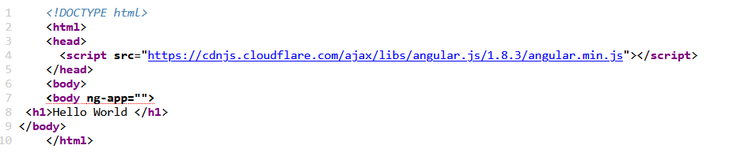

ng-app directive
The ng-app directive defines the root element of an AngularJS application.

Slide 8
data in the view
There are several ways of displaying model data in the view:
You can use the ng-bind directive, which will bind the innerHTML of the element to the specified model property:
Example
<p ng-bind="firstname"></p>
You can also use double braces {{ }} to display content from the model:
Example
<p>First name: {{firstname}}</p>

Slide 9
data in the view
Use the ng-model directive to bind data from the model to the view on HTML controls (input, select, textarea)
Example
<input ng-model="firstname">

Slide 10
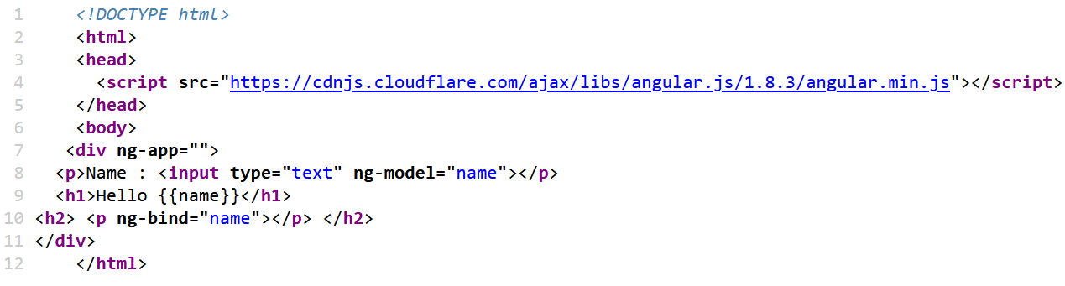
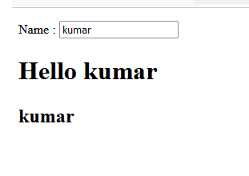

Slide 11
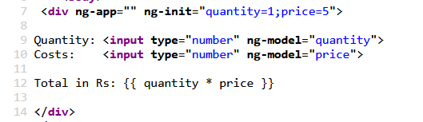

ng-init
The ng-init directive initializes application data.

Slide 13
Creating Angular Project using Visual Studio Code
First, create a folder with the name AngularProjects anywhere within your machine

Slide 14
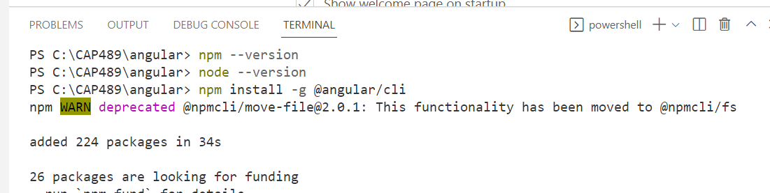
Installation process in VS Code

Slide 15
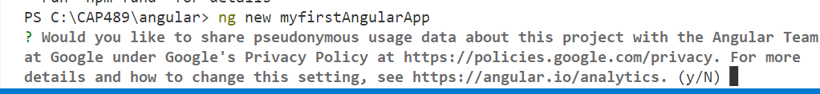
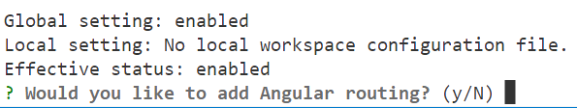

Slide 16
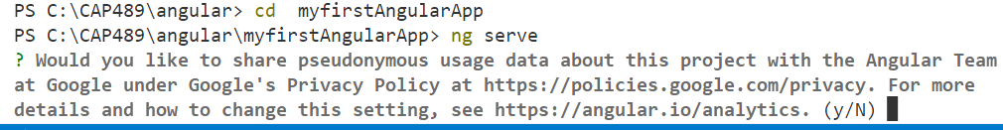

Slide 17
To stop your angular application
To stop your angular application use the following command.
ctrl +c
This command will ask you to Terminate batch job(Y/N)?. Type Y and press Enter key.

