Slide 1
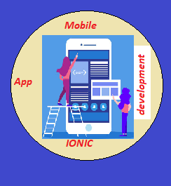
CAP489 MOBILE APP DEVELOPMENT FRAMEWORKS

Slide 2
Course details
LTP – 2 0 4 [Two lectures and Four Practical/week]
Text Book
MOBILE APP DEVELOPMENT WITH IONIC by CHRIS GRIFFITH, SHROFF PUBLISHERS & DISTRIBUTORS PVT. LTD
Reference Books:
LEARNING ANGULARJS by KEN WILLIAMSON, SHROFF PUBLISHERS & DISTRIBUTORS PVT. LTD
BEGINNING ANGULAR WITH TYPESCRIPT by GREG LIM, PAPERBACK

Slide 3
Course Assessment Model
Marks break up
Attendance 5
Continuous Assessment(3 out of 4) 45
ETP 50
Total 100

Slide 4

The hitch…
The three BURNING questions in mind…
Why are we learning MOBILE APP DEVELOPMENT FRAMEWORKS?
What would we do with it?
What will be the course outcome?

Slide 5
Course Outcomes:
CO1 :: describe the fundamentals of typescript
CO2 :: apply angularJs with ionic framework
CO3 :: categorize Ionic UI components
CO4 :: summarize backend process of Ionic with firebase
CO5 :: develop cross-platform apps from a single code base

Slide 6
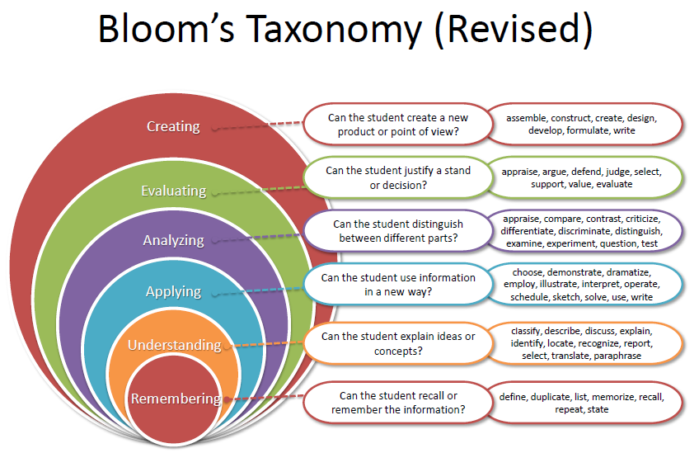

Slide 7
Programme Outcomes
PO1 Disciplinary Knowledge Demonstrate comprehensive disciplinary knowledge and utilize the information to enhance their professional skills in the workplace.
PO2 Problem Solving Apply knowledge of computer science concepts, principles, techniques and analytical skills to solve various computing problems.
PO3 Cooperation/Team work Ability to work effectively and respectfully with diverse teams and act together as a team or team leader in the interests of a common cause.
PO4 Modern tool usage Select, adapt and apply appropriate techniques, resources, and modern computing tools to computing activities, with an understanding of the limitations.
PO5 Communication Skills Express thoughts and ideas effectively in writing as well as orally, and present complex information in a clear and concise manner to diverse groups.

Slide 8
Programme Outcomes
PO6 Critical thinking and Analytical Reasoning Ability to think critically and logically towards any problem from an open-minded and reasoned perspective.
PO7 Moral and Ethical Awareness Apply moral/ethical values in sustainable societal development through objective, unbiased and truthful actions.
PO8 Life-long Learning Ability to acquire knowledge and skills through self-paced and self-directed learning aimed to adapt changing trends and demands of work place throughout life in a multicultural society.
PO9 Project Management Learn to build a successful project from pre-implementation to completion keeping in mind the resources, costs, time constraints and project scopes.

Slide 9
Mapping of POs with COs
 | CO1 | CO2 | CO3 | CO3
PO1 | 3 | 3 | 3 | 3
PO2
PO3
PO3 | 3 | 3 | 3 | 3
PO4
PO5
P06
PO7
PO8
PO9

Slide 10
Course focus identification :
Beginner Level: Introduction to Java, Java Standard Library, Introduction to AngularJs
Intermediate Level: Ionic framework, Ionic UI components, Ionic navigation and routing, Ionic with firebase

Slide 11
Assessment and evaluation model:
Course CA Category : A0304 (Total 4 tasks, out of 4 best 3 to be considered)
Exam Category : X6 (Only ETP)

Slide 12
Innovative pedagogy and evaluation strategies :
Gamification:
Introduce gamification elements, such as badges, leaderboards, or rewards, to motivate learners and make the learning journey more enjoyable.
Flipped Classroom Approach:
Use a flipped classroom model where learners engage with instructional content (videos, reading materials) outside of class and use class time for hands-on activities.
Storytelling and Scenario-Based Learning:
Create scenarios or stories that guide learners through practical problems or challenges. This narrative-based approach helps learners relate theoretical concepts to real-world situations.

Slide 13
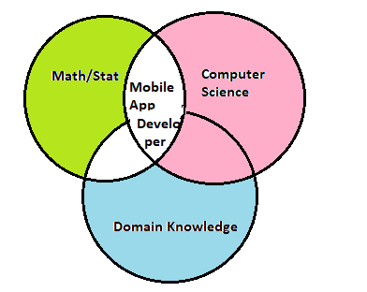
Course Cohort Mapping (mapping with skill set)
Ionic→ Mobile App Developer

Slide 14
OER(OPEN EDUCATIONAL RESOURCE)
Unit mapped | Broad topic | Sub Topic | Source Type | Source Title | *%age mapping (approx) | Source URL
Unit 1 | Introduction to TypeScript | variables, variable types, control flow statements, functions, classes, constructor, interfaces | Online Course | Learn TypeScript | 90% | https://www.coursera.org/learn/learn-typescript
Unit 2 | Introduction to AngularJs | modules, directives, ng-model directive, data binding, controllers | Online Course | Learn and Understand AngularJS | 100% | https://www.udemy.com/course/learn-angularjs/?couponCode=ST16MT70224
Unit 3 | Ionic framework | introduction, project structure, different types of app in Ionic | Official website | Introduction to Ionic | 100% | https://ionicframework.com/docs/
Unit 4 | Ionic UI components | action sheet, alert, badge, button, card, input, checkbox, radio, range, select, date and time pickers, images, list, menu | Official website | UI Components | 100% | https://ionicframework.com/docs/components

Slide 15
OER(OPEN EDUCATIONAL RESOURCE) Continued….
Unit 5 | Ionic navigation and routing | navigation between the app pages, routing work, Ionic tabs, Ionic slides | Official website | UI Components | 100% | https://ionicframework.com/docs/components
Unit 6 | Ionic with firebase | introduction ionic with backend, create operation, select or read operation, update operation, delete operation | Official website | Ionic Firebase Integration | 100% | https://ionic-5-full-starter-app-docs.ionicthemes.com/firebase-integration

Slide 16
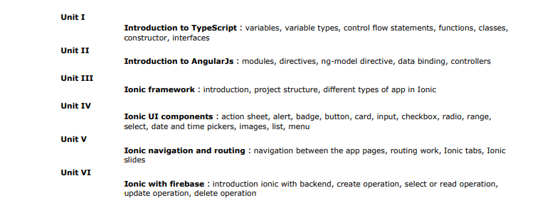
Course Content

Slide 17
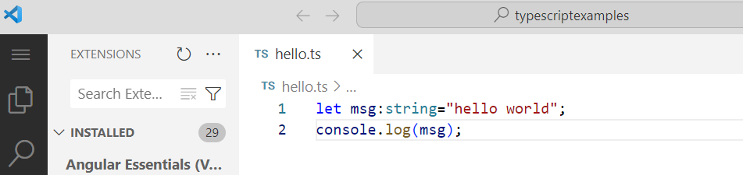
What do we need to know?
Unit 1
Typescript-basics
How to do calculations
Area = Length * Breadth
Area = 12 * 5
Area = 10 * 4
Area = 7.6 * 3.7

Slide 18
What do we need to know?
Unit 1
Classes and Objects

Slide 19
What do we need to know?
Unit 1
Constructors and Destructors

Slide 20
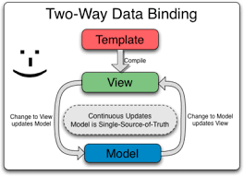
What do we need to know?
Unit 2
Introduction to AngularJs

Slide 21
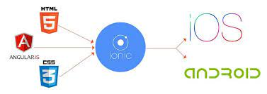
What do we need to know?
Unit 3
Ionic framework

Slide 22

What do we need to know?
Unit 4
Ionic UI components

Slide 23

What do we need to know?
Unit 5
Ionic navigation and routing

Slide 24


What do we need to know?
Unit 6
Ionic with firebase

Slide 25
Acknowledgements
Ionic academy
Pluralsight
Udemy
Coursera
And Above all…
Common Sense

Slide 26
Any query?

