Slide 1

CAP489 MOBILE APP DEVELOPMENT FRAMEWORKS

Slide 2
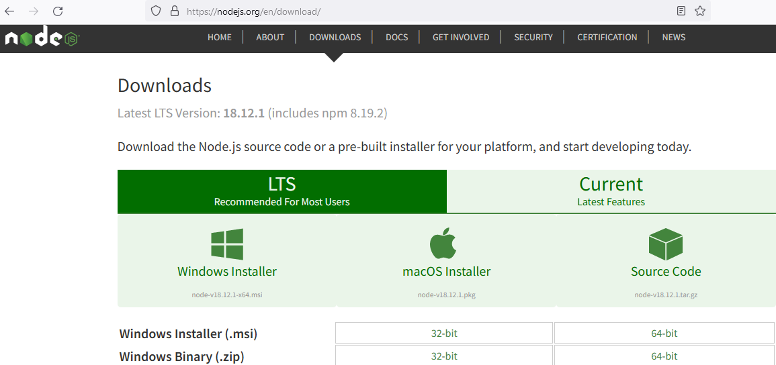
Installation steps
Install Node.js
https://nodejs.org/en/download/

Slide 3
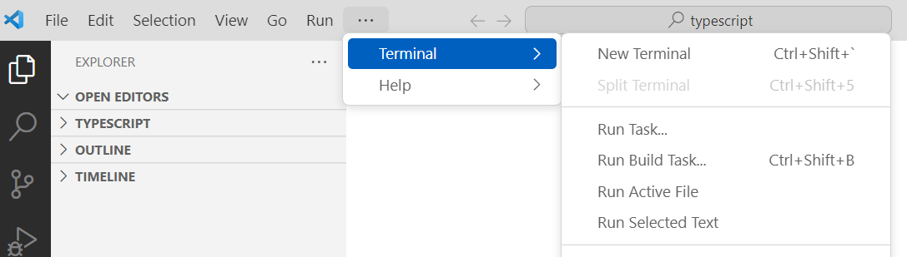
Installation steps
Install visual studio code
Open visual studio code and select menu option Terminal

Slide 4
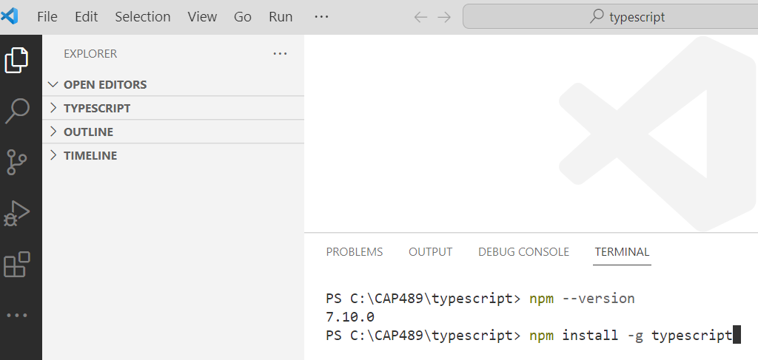
Installation steps
Open terminal and use command:
npm install -g typescript

Slide 5
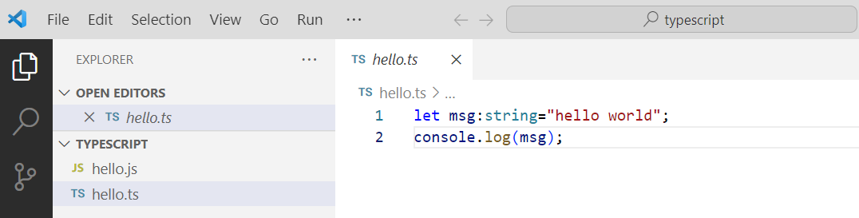
Installation steps
From the File Explorer, create a new file called helloworld.ts

Slide 6
Installation steps
To compile your TypeScript code, you can open the Integrated Terminal (Ctrl+`) and type:
tsc helloworld.ts.
This will compile and create a new helloworld.js JavaScript file.
Then type to run your program :
node helloworld.js

Slide 7
Any query?

