Slide 1

CAP489 MOBILE APP DEVELOPMENT FRAMEWORKS

Slide 2
Topics Covered
Introduction to TypeScript :
variables,
variable types,
control flow statements

Slide 3
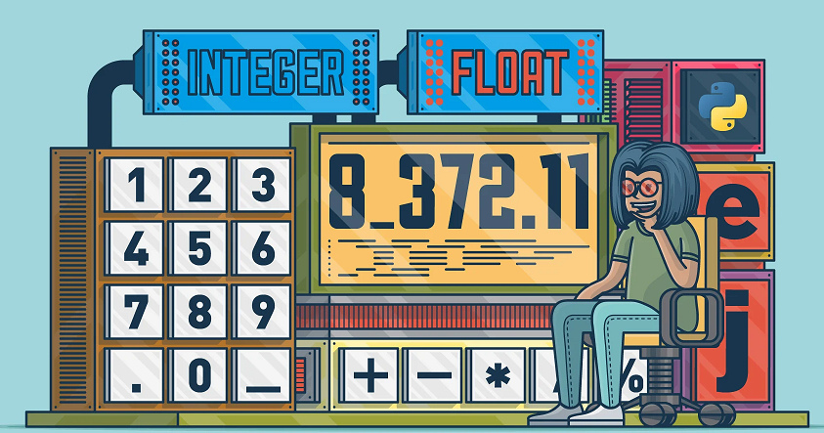

variables, variable types

Slide 4
variables
A variable is the storage location, which is used to store value/information to be referenced and used by programs.
The variable name must be an alphabet or numeric digits.
The variable name cannot start with digits.
The variable name cannot contain spaces and special character, except the underscore(_) and the dollar($) sign.

Slide 5
Variable declaration
1. Declare type and value in a single statement
let: [type-annotation] = value;
2. Declare type without value. Then the variable will be set to undefined.
let [identifier] : [type-annotation];
3. Declare its value without type. Then the variable will be set to any.
let [identifier] = value;

Slide 6
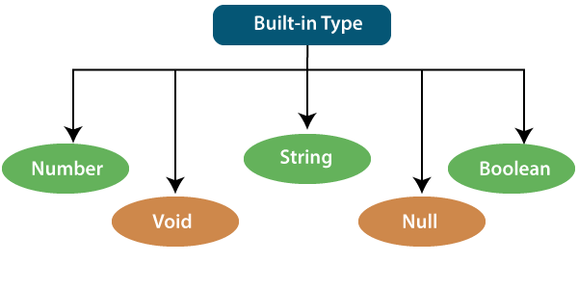
Data types

Slide 7
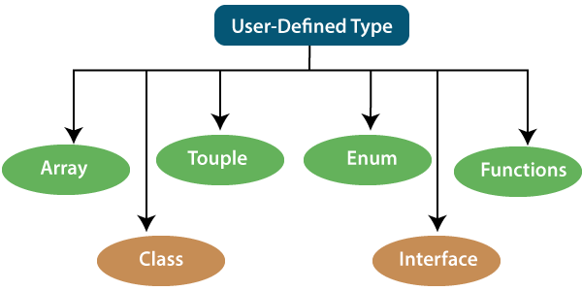
Data types continued…

Slide 8
Data types

Slide 9
example
let a:number=12;
let b:number=12.55;
let c:string="kumar";
let d:boolean=true;
console.log(a);
console.log(b);
console.log(c);

Slide 10
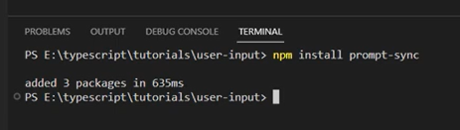
How to take input from user?
install the prompt-sync package from the npm (Node Package Manager)
prompt-sync package, which is a simple synchronous prompt for the command line. It allows you to easily get user input in a synchronous manner, making it convenient for simple command-line applications.

Slide 11
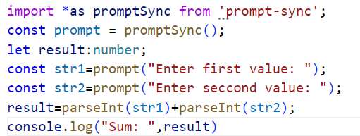
How to take input from user? Continued…..
import * as promptSync: This part of the code is importing all the exports from the 'prompt-sync' module and bundling them into an object named promptSync. The * character is a wildcard that signifies importing all exports from the module.

Slide 12
How to take input from user? Continued…..
const prompt: This declares a constant variable named prompt. The const keyword is used to create a variable that cannot be reassigned.
promptSync(): This part of the code calls the function returned by the prompt-sync module. This function is typically used for synchronous user input prompts in a console environment. The function returned by prompt-sync is used to capture input from the user in a blocking (synchronous) manner, which means the program will wait for the user to input something before proceeding.

Slide 13

operators

Slide 14
TypeScript operators
Arithmetic Operators
Comparison Operators
Bitwise Operators
Logical Operators
Assignment Operators
Conditional Operator
String Operator
typeof Operator

Slide 15
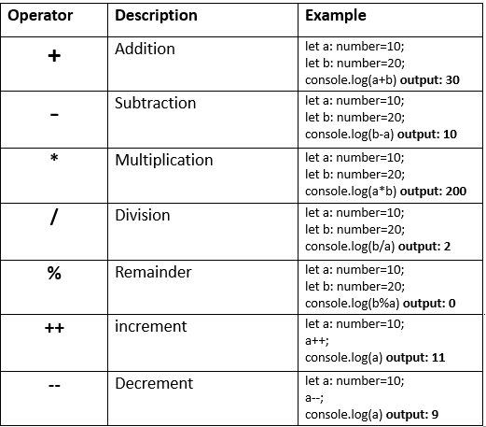
Arithmetic Operators

Slide 16
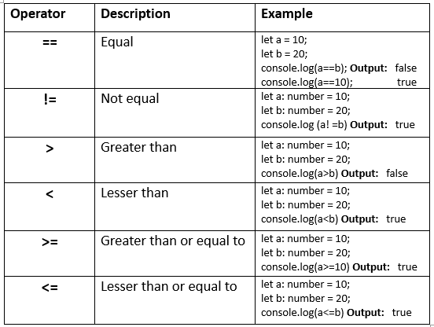
Comparison Operators

Slide 17
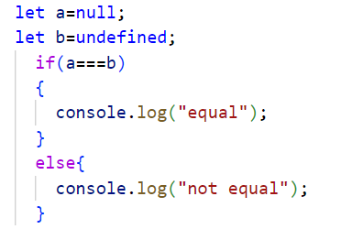

Slide 18
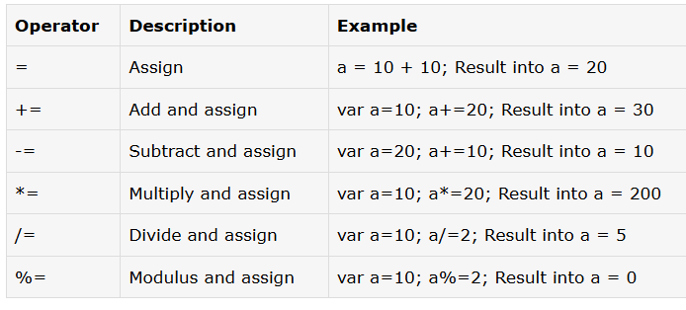
Assignment operators

Slide 19
Logical operators
Logical AND (&&), Logical OR (||), Logical NOT (!)

Slide 20
Bitwise operators
Bitwise AND (&), Bitwise OR (|), Bitwise XOR (^), Bitwise NOT (~), Left shift (<<), Right shift (>>), Zero-fill right shift (>>>)

Slide 21
AND Operator (&)
If both side bit is on result will be On
a | b | a & b
0 | 0 | 0
0 | 1 | 0
1 | 0 | 0
1 | 1 | 1

Slide 22
Steps to solve:-
a = 12 (find binary form:1100 )
b = 25 (find binary form:11001)
How to find Binary:
64 32 16 8 4 2 1
0 1 1 0 0
12
25
8
1 1 0 0 1
1 0 0 0

Slide 23
a & b=
01100 (12)
11001 (25)
01000 (8) Ans.

Slide 24
OR Operator (|)
If any side bit is on result will be On
a | b | a | b
0 | 0 | 0
0 | 1 | 1
1 | 0 | 1
1 | 1 | 1

Slide 25
Steps to solve:-
a = 12 (find binary form:1100 )
b = 25 (find binary form:11001)
How to find Binary:
64 32 16 8 4 2 1
0 1 1 0 0
12
25
29
1 1 0 0 1
1 1 1 0 1

Slide 26
a | b=
01100 (12)
11001 (25)
11101 (29) Ans.

Slide 27
XOR Operator (^)
If both side bit is opposite result will be On
a | b | a ^ b
0 | 0 | 0
0 | 1 | 1
1 | 0 | 1
1 | 1 | 0

Slide 28
Steps to solve:-
a = 12 (find binary form:1100 )
b = 25 (find binary form:11001)
How to find Binary:
64 32 16 8 4 2 1
0 1 1 0 0
12
25
21
1 1 0 0 1
1 0 1 0 1

Slide 29
a ^ b=
01100 (12)
11001 (25)
10101 (21) Ans.

Slide 30
Left Shift Operator(<<)
a=10 (1010)
a<<1
1010.0
10100(20) Ans.
a<<2
1010.00
101000(40) Ans.

Slide 31
Right Shift Operator(>>)
a=10 (1010)
a>>1
1010
101(5) Ans.
a>>2
1010
10(2) Ans.

Slide 32
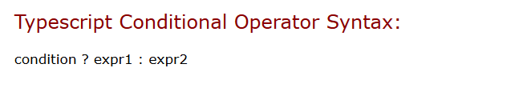
Conditional operators

Slide 33
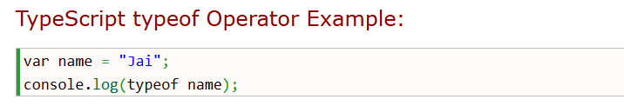
typeof operators

Slide 34
Control flow statements
If else
Switch case
For loop
While loop
Do while
Break
Continue

Slide 35
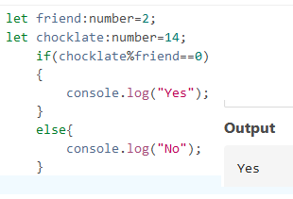
If else
if(condition) {
// if-statements
}
else {
// else statements;
}

Slide 36
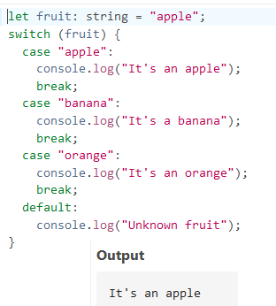
Switch case statement
switch(choice)
{
case 1:// statement
break;
case 2:// statement
break;
default:// statement
}

Slide 37
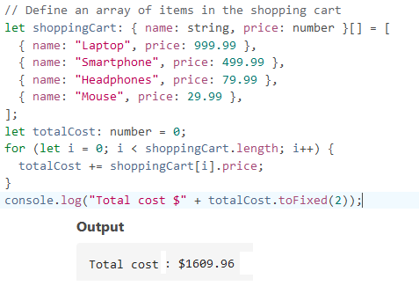
For loop
for(initialization; condition; expression)
{
// statement
}

Slide 38
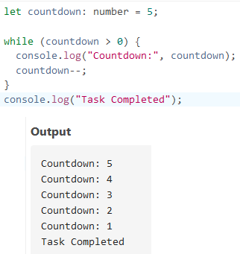
While loop
while(condition)
{
// do something
}

Slide 39
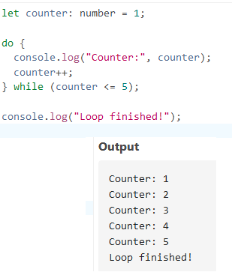
Do while
do {
// do something
}

Slide 40
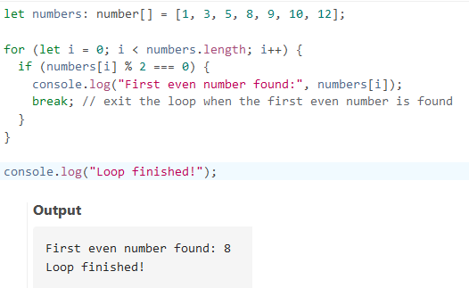
break

Slide 41
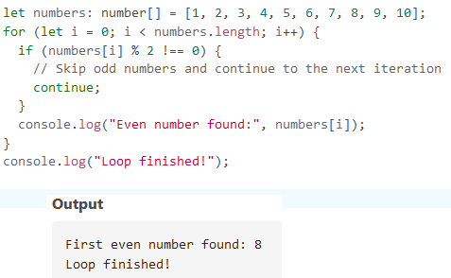
continue

Slide 42
Any query?

