Slide 1

CAP489 MOBILE APP DEVELOPMENT FRAMEWORKS

Slide 2
Topics Covered
Introduction to TypeScript :
functions, classes,
constructor

Slide 3
functions
Collection of statements to perform any task
Syntax:
function functionName( parameters )
{
//block of statements
}

Slide 4
//Function Definition
function getResult() {
console.log("Hello kumar");
}
//Function Call
getResult() ;

Slide 5
Void Return Type
void can be used to indicate a function doesn't return any value
function getResult() : void
{ console.log('Hello kumar'); }

Slide 6
Function with parameters
function multiply(a: number, b: number)
{ return a * b; }

Slide 7
Optional Parameters
We can define optional parameters in function, so if parameter is not required then no need to use.
Only we have to put ? With parameter to make parameter as optional.

Slide 8
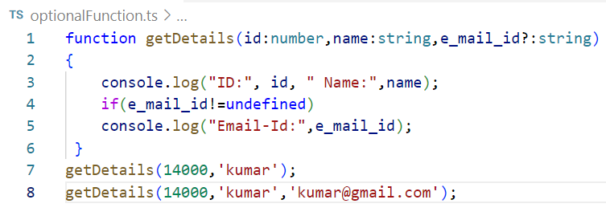
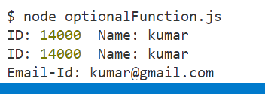
Example:

Slide 9
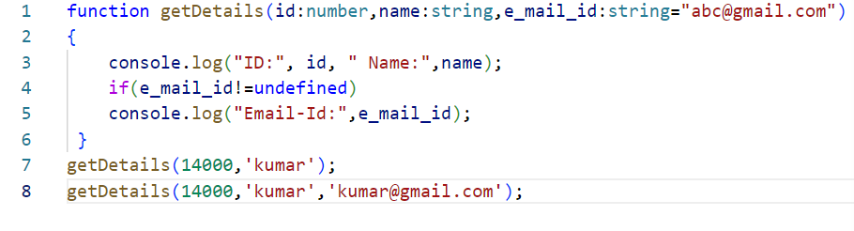
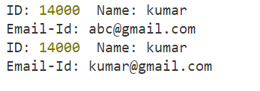
Default Parameter
An option to set default values to the function parameters.

Slide 10
Rest parameter
The rest parameter is used to pass zero or more values to a function. We can declare it by prefixing the three "dot" characters ('...') before the parameter.
The rest parameter is useful, where we have an undetermined number of parameters.
Rules to follow in rest parameter:
Only one rest parameter is allowed in a function.
It must be an array type.
It must be the last parameter in a parameter list.

Slide 11
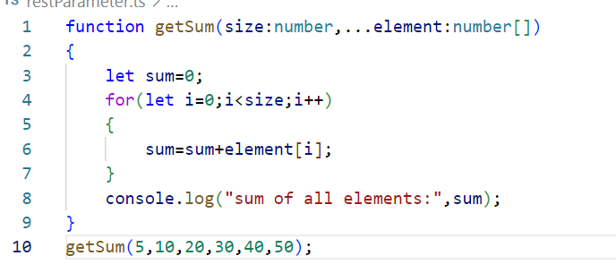
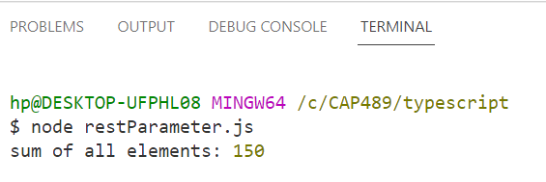
Example

Slide 12

Class
Class is a collection of similar types of objects.
For example: Fruits is class of mango, apple , orange etc.
Fruits

Slide 13

Why class is important?

Slide 14


Slide 15
Class
Class is a collection of data members and member functions.
Example:
class Employee{
//data members
// member functions
}
Employee
employeeId employeeName
getDetails() setDetails()

Slide 16
Syntax:
class <class_name>{
field;
method;
}

Slide 17
Creating an object of class
Syntax
let object_name = new class_name(parameter)

Slide 18
//creating method or function
display():void {
console.log("Student ID is: "+this.id)
console.log("Student ID is: "+this.name)
}

Slide 19
A constructor is used to initialize an object. In TypeScript, the constructor method is always defined with the name "constructor." In the constructor, we can access the member of a class by using this keyword.
//defining constructor
constructor(id: number, name:string) {
this.id = id;
this.name = name;
}

Slide 20
Any query?

