Slide 1

CAP489 MOBILE APP DEVELOPMENT FRAMEWORKS

Slide 2
Topics Covered
Introduction to TypeScript :
variables,
variable types,
control flow statements

Slide 3
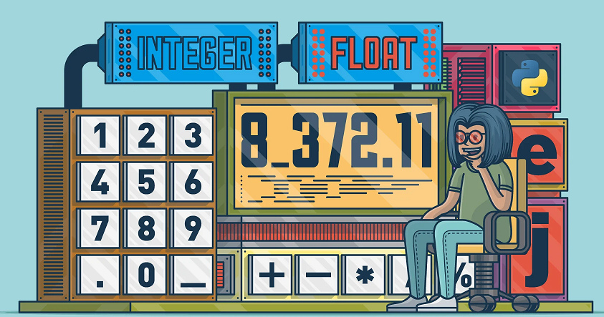

variables, variable types

Slide 4
variables
A variable is the storage location, which is used to store value/information to be referenced and used by programs.
The variable name must be an alphabet or numeric digits.
The variable name cannot start with digits.
The variable name cannot contain spaces and special character, except the underscore(_) and the dollar($) sign.

Slide 5
Variable declaration
1. Declare type and value in a single statement
var [identifier] : [type-annotation] = value;
2. Declare type without value. Then the variable will be set to undefined.
var [identifier] : [type-annotation];
3. Declare its value without type. Then the variable will be set to any.
var [identifier] = value;

Slide 6
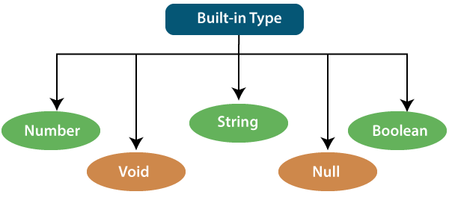
Variable types

Slide 7
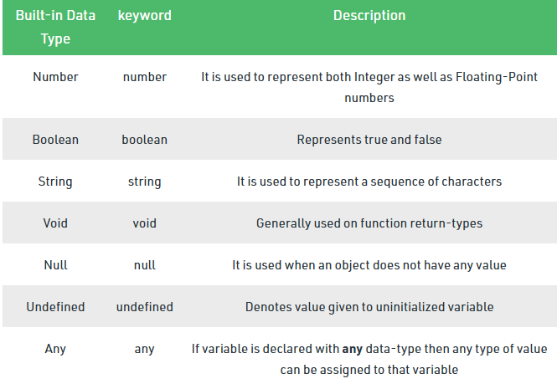
Variable types

Slide 8
example
let a:number=12;
let b:number=12.55;
let c:string="kumar";
let d:boolean=true;
console.log(a);
console.log(b);
console.log(c);

Slide 9
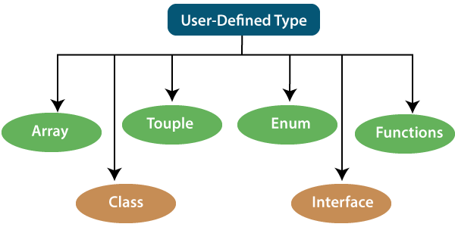
Variable types

Slide 10

operators

Slide 11
TypeScript operators
Arithmetic Operators
Comparison Operators
Bitwise Operators
Logical Operators
Assignment Operators
Conditional Operator
String Operator
typeof Operator

Slide 12
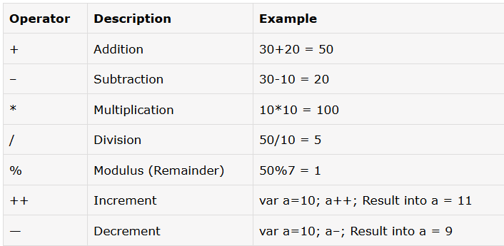
Arithmetic Operators

Slide 13
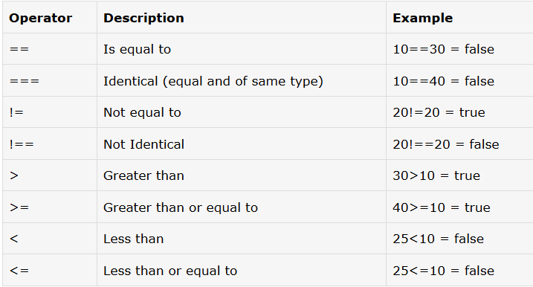
Comparison Operators

Slide 14
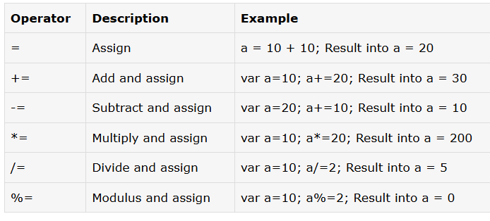
Assignment operators

Slide 15
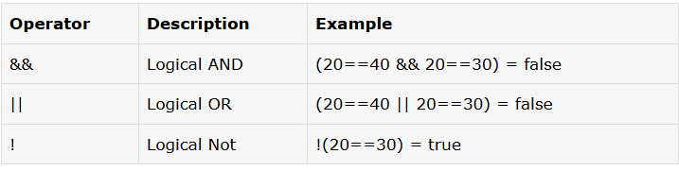
Logical operators

Slide 16
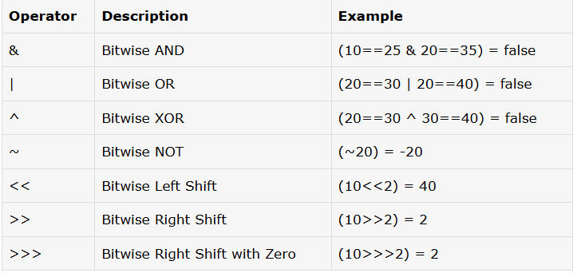
Bitwise operators

Slide 17
AND Operator (&)
If both side bit is on result will be On
a | b | a & b
0 | 0 | 0
0 | 1 | 0
1 | 0 | 0
1 | 1 | 1

Slide 18
Steps to solve:-
a = 12 (find binary form:1100 )
b = 25 (find binary form:11001)
How to find Binary:
64 32 16 8 4 2 1
0 1 1 0 0
12
25
8
1 1 0 0 1
1 0 0 0

Slide 19
a & b=
01100 (12)
11001 (25)
01000 (8) Ans.

Slide 20
OR Operator (|)
If any side bit is on result will be On
a | b | a | b
0 | 0 | 0
0 | 1 | 1
1 | 0 | 1
1 | 1 | 1

Slide 21
Steps to solve:-
a = 12 (find binary form:1100 )
b = 25 (find binary form:11001)
How to find Binary:
64 32 16 8 4 2 1
0 1 1 0 0
12
25
29
1 1 0 0 1
1 1 1 0 1

Slide 22
a | b=
01100 (12)
11001 (25)
11101 (29) Ans.

Slide 23
XOR Operator (^)
If both side bit is opposite result will be On
a | b | a ^ b
0 | 0 | 0
0 | 1 | 1
1 | 0 | 1
1 | 1 | 0

Slide 24
Steps to solve:-
a = 12 (find binary form:1100 )
b = 25 (find binary form:11001)
How to find Binary:
64 32 16 8 4 2 1
0 1 1 0 0
12
25
21
1 1 0 0 1
1 0 1 0 1

Slide 25
a ^ b=
01100 (12)
11001 (25)
10101 (21) Ans.

Slide 26
Left Shift Operator(<<)
a=10 (1010)
a<<1
1010.0
10100(20) Ans.
a<<2
1010.00
101000(40) Ans.

Slide 27
Right Shift Operator(>>)
a=10 (1010)
a>>1
1010.
101(5) Ans.
a>>2
1010.
10(2) Ans.

Slide 28
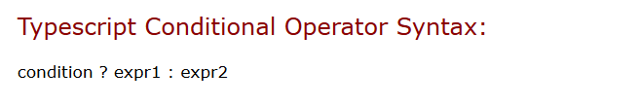
Conditional operators

Slide 29
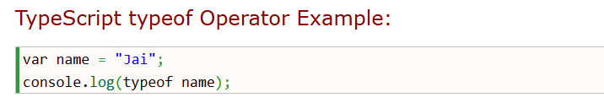
typeof operators

Slide 30
control flow statements
If else
Switch case
For loop
While loop
Do while
Break
Continue

Slide 31
if(condition) {
// if-statements
}
else {
// else statements;
}

Slide 32
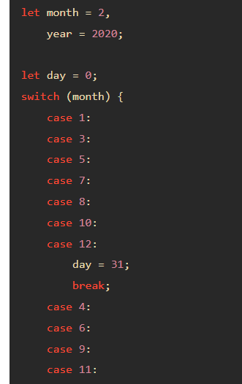
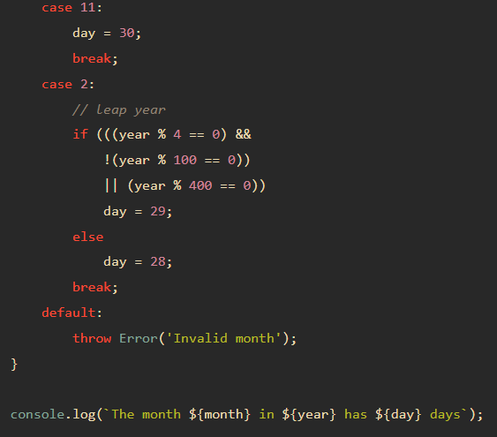


Slide 33
for(initialization; condition; expression)
{
// statement
}
for (let i = 0; i < 10; i++)
{
console.log(i);
}

Slide 34
let array = [];
for (let i = 0; i < 10; i++)
{
array.push(i);
}
console.log(array.join(','));

Slide 35
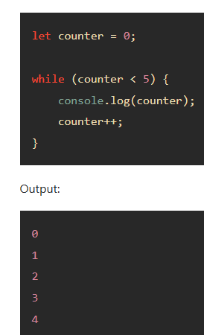
while
while(condition)
{
// do something
}

Slide 36
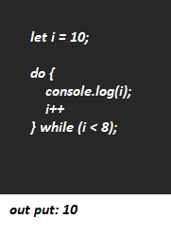
Do while
do {
// do something
} while(condition);

Slide 37
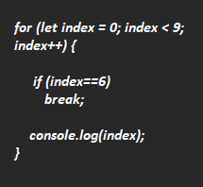
break

Slide 38
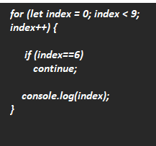
continue

Slide 39
Any query?

