Slide 1
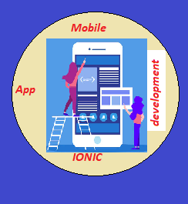
CAP489 MOBILE APP DEVELOPMENT FRAMEWORKS

Slide 2
Topics Covered
Introduction to TypeScript :
Encapsulation
Inheritance

Slide 3
Encapsulation
We can achieve this to make data members as private and to access these private data members using setter and getter accessor methods which should be public.

Slide 4



Inheritance: reusability
father
mother
child

Slide 5
Inheritance
One class can be derived from other class.
We can make the relationship between the classes.
We can re-use the functionality of classes
We can use different form of inheritance
Base Class
Derived Class

Slide 6
Inheritance: types of inheritance
A
A
A
B
B
B
Single
C
C
Multilevel
Multiple

Slide 7
A
A
B
C
B
C
Hierarchical Inheritance
D
Hybrid Inheritance

Slide 8
interface
Interfaces define properties, methods, and events, which are the members of the interface. Interfaces contain only the declaration of the members. It is the responsibility of the deriving class to define the members
An interface can be extended by other interfaces. In other words, an interface can inherit from other interface. Typescript allows an interface to inherit from multiple interfaces.

Slide 9
interface Person {
age:number
}
interface Musician extends Person {
instrument:string
}

Slide 10
interface IParent1 {
num11:number
}
interface IParent2 {
num2:number
}
interface Child extends IParent1, IParent2 {
}
var Iobj:Child = { num1:12, num2:23}
console.log("value 1: "+this.num1+" value 2: "+this.num2

Slide 11
Any query?

