Slide 1
CAP489

Slide 2
Installation steps
npm install -g @angular/cli
Set-ExecutionPolicy -Scope CurrentUser -ExecutionPolicy RemoteSigned
ng new my-app
ng serve --open

Slide 3
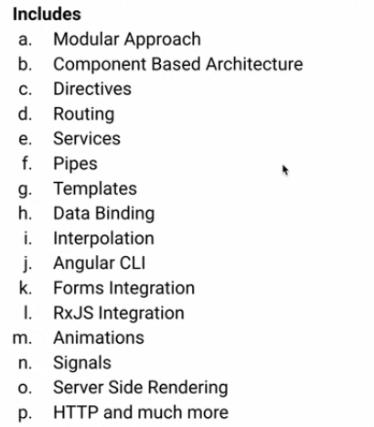
Angular 17

Slide 4
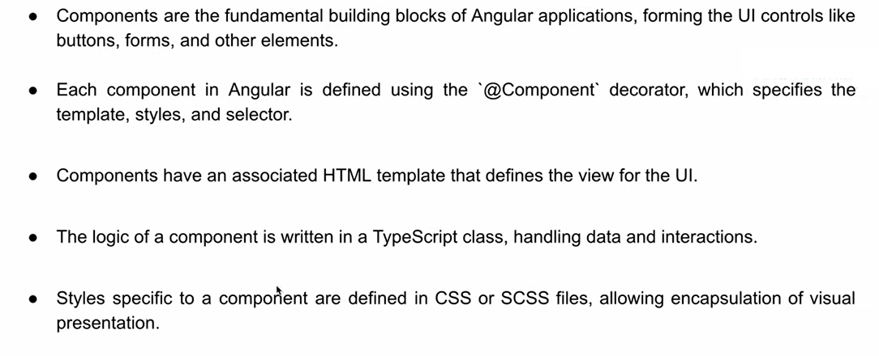
Angular: component

Slide 5
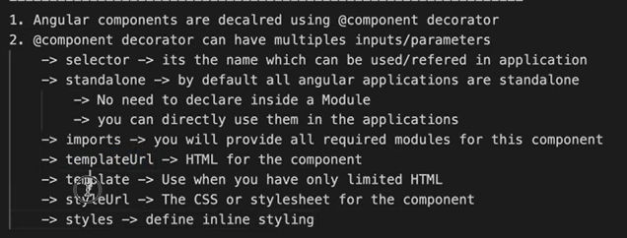
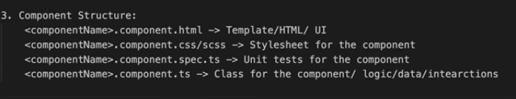

Slide 6
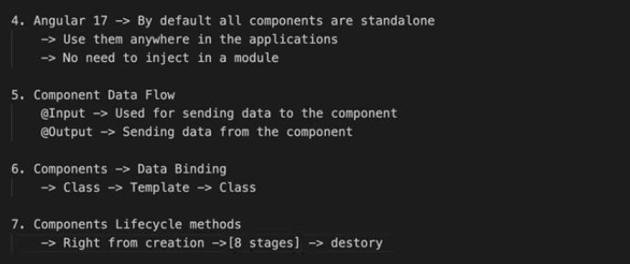

Slide 7
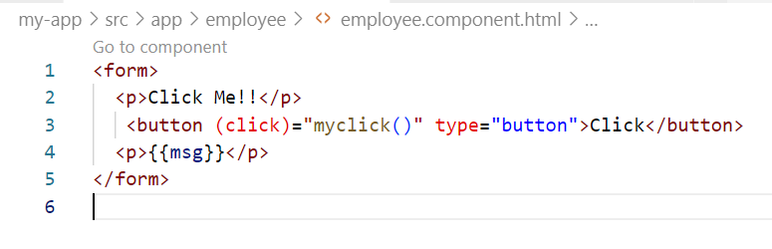
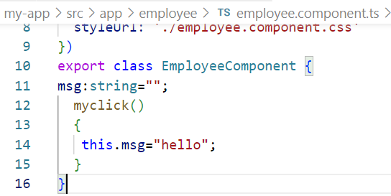
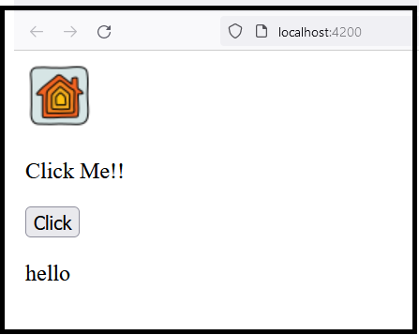
Component File

Slide 8
import { FormsModule } from '@angular/forms';
In Angular, FormsModule is a module provided by the Angular framework that allows you to work with forms in your Angular applications. When you import FormsModule into your Angular application,
import Statement: The import { FormsModule } statement is used to import the FormsModule module into your Angular application.
The from '@angular/forms' part of the import statement specifies the source of the module. FormsModule module is part of the @angular/forms package.

Slide 9
FormsModule include:
Two-way data binding: Allows data to flow both from the component to the template and from the template to the component.
NgModel directive: Enables two-way data binding for form controls, allowing you to bind form controls directly to component properties.
FormsModule also provides support for features like form validation, handling form submissions, and working with form controls like input fields, checkboxes, radio buttons, and select dropdowns.

Slide 10
import { Component } from '@angular/core';
In Angular, Component is a decorator function provided by the @angular/core module.
Components are typically defined as TypeScript classes decorated with the @Component decorator.

Slide 11
[(ngModel)]:
It is a two-way data binding syntax in Angular that allows you to bind data from a component’s.
It is typically used within Angular forms to bind form controls (like input fields) to properties in the component class.
Syntax:
The syntax [(ngModel)] is a combination of square brackets ([]) for property binding and parentheses (()) for event binding.
The expression inside [(ngModel)] refers to the property in the component class that you want to bind to the input element.

Slide 12
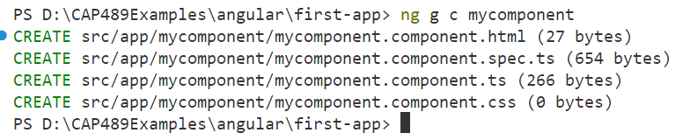
Component
ng generate component component_name

Slide 13
mycomponent.component.html: This file contains the HTML template for your Angular component. It defines the structure and layout of your component's view. You will write the HTML markup here to define how your component should render in the browser.
mycomponent.component.spec.ts: This file contains the unit tests for your Angular component. It is used to test the behavior and functionality of your component to ensure that it works as expected. Unit tests are written using testing frameworks like Jasmine, and they can be run using tools like Karma.
mycomponent.component.ts: This file contains the TypeScript code for your Angular component. It defines the component class, which contains the logic and behavior of your component. You will write TypeScript code here to define properties, methods, event handlers, and lifecycle hooks for your component.
mycomponent.component.css: This file contains the CSS styles for your Angular component. It is used to define the styles and appearance of your component's view. You can write CSS rules here to apply styles to the HTML elements within your component's template.

