Slide 1

CAP489 MOBILE APP DEVELOPMENT FRAMEWORKS

Slide 2
Topics Covered
Introduction to AngularJs :
modules,
directives,
ng-model directive,
data binding,
controllers

Slide 3
Introduction to AngularJs
AngularJS is a JavaScript framework
AngularJS is an opensource developed by Google
Angular framework helps you to develop SPA or Single Page Applications where your entire applications work with only one page and part of the page gets refreshed depending on the functionality required by the user.

Slide 4
AngularJS is a JavaScript framework. It can be added to an HTML page with a <script> tag.
AngularJS extends HTML attributes with Directives, and binds data to HTML with Expressions.

Slide 5
AngularJS CDN(content delivery network)
https://cdnjs.com/libraries/angular.js
<script src="https://ajax.googleapis.com/ajax/libs/angularjs/1.4.8/angular.min.js"></script>

Slide 6
AngularJS Directives
AngularJS directives are extended HTML attributes with the prefix ng-.
The ng-app directive initializes an AngularJS application.
The ng-init directive initializes application data.
The ng-model directive binds the value of HTML controls (input, select, textarea) to application data.
The ng-bind directive binds the innerHTML of the <p> element to the application variable name.

Slide 7
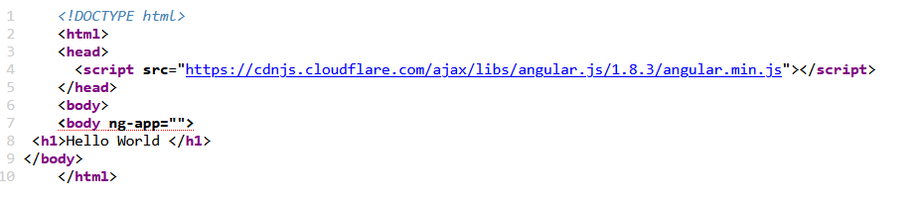

ng-app directive
The ng-app directive defines the root element of an AngularJS application.

Slide 8
data in the view
There are several ways of displaying model data in the view:
You can use the ng-bind directive, which will bind the innerHTML of the element to the specified model property:
Example
<p ng-bind="firstname"></p>
You can also use double braces {{ }} to display content from the model:
Example
<p>First name: {{firstname}}</p>

Slide 9
data in the view
Use the ng-model directive to bind data from the model to the view on HTML controls (input, select, textarea)
Example
<input ng-model="firstname">

Slide 10
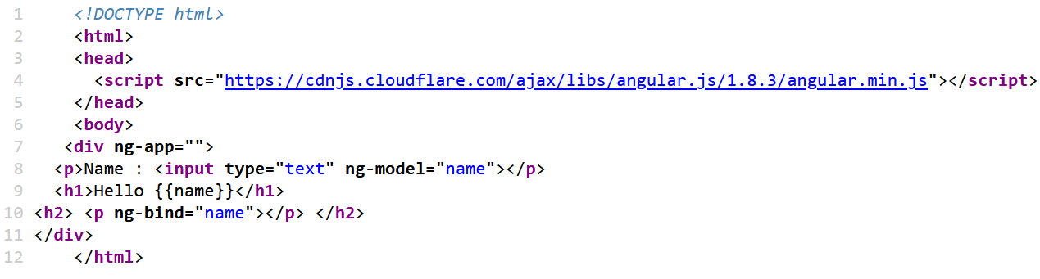
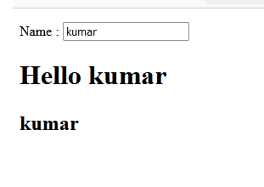

Slide 11
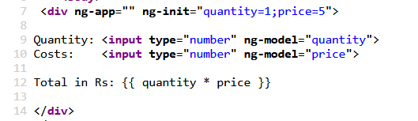

ng-init
The ng-init directive initializes application data.

Slide 12
ng-model directive
The ng-model directive binds the value of HTML controls (input, select, textarea) to application data.
The ngModel directive is a directive that is used to bind the values of the HTML controls (input, select, and textarea) or any custom form controls, and stores the required user value in a variable and we can use that variable whenever we require that value.
It also is used during form validations.
The various form input types (text, checkbox, radio, number, email, URL, date, time) can be used with the ngModel directive.

Slide 13
the list of classes for validation purposes:
ng-touched: It shows that field has been touched.
ng-untouched: It shows that field has not been touched yet.
ng-valid: It specifies that the field content is valid.
ng-invalid: It specifies that the field content is not valid.
ng-dirty: It illustrates that the field has been modified.
ng-pristine: It represents that the field has not been modified yet.
They are all properties of the input field, and are either true or false.

Slide 14
Creating Angular Project using Visual Studio Code
First, create a folder with the name AngularProjects anywhere within your machine

Slide 15
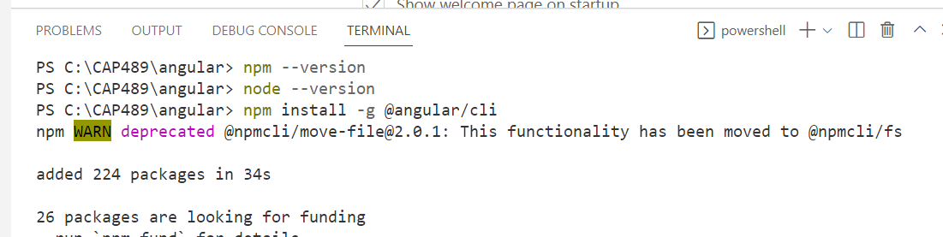
Installation process in VS Code
Use this command npm install -g @angular/cli

Slide 16
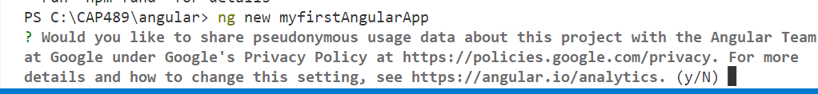
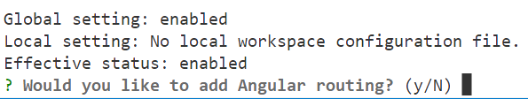
Use ng new my-angular to create new project

Slide 17
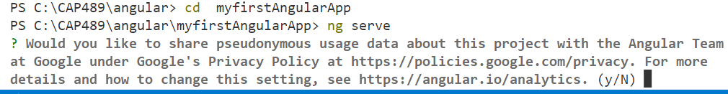

Slide 18
To stop your angular application
To stop your angular application use the following command.
ctrl +c
This command will ask you to Terminate batch job(Y/N)?. Type Y and press Enter key.

Slide 19
AngularJS application to consist of:
View, which is the HTML.
Model, which is the data available for the current view.
Controller, which is the JavaScript function that makes/changes/removes/controls the data.
Then the scope is the Model.

Slide 20
AngularJS Controllers
AngularJS controllers control the data of AngularJS applications.
A controller is a JavaScript Object, created by a standard JavaScript object constructor.
The ng-controller directive defines the application controller.
A controller is containing attributes/properties and functions. Each controller accepts $scope as a parameter which refers to the application/module that controller is to control.

Slide 21
AngularJS Modules
An AngularJS module defines an application.
The module is a container for the different parts of an application.
The module is a container for the application controllers.
Controllers always belong to a module.
A module is created by using the AngularJS function angular.module

Slide 22
Syntax:-
var mainApp = angular.module("myApp", []);
The first argument is the module name myApp. The second argument is an array of module names that this module depends on. Empty square brackets denotes that this module does not have any dependencies.
For example, if module ‘myApp’ is dependent on external module, say ‘chart.js’, then it is written as:var app = angular.module('myCompApp', ['chart.js']);

Slide 23
Steps:
Declare module:
var mainApp = angular.module("mainApp", []);
Declare controller:
app.controller('myControl',function($scope){ });
Declare scope:
$scope.firstname
$scope.names = ["Emil", "Tobias", "Linus"];

