Slide 1

CAP615 PROGRAMMING IN JAVA
Unit-3

Slide 2
Topics Covered….
implementing multithreading,
life cycle of a thread,
thread communication,
suspending, resuming,
deadlock and stopping threads,
thread synchronization,
handling exceptions during multithreading

Slide 3
Multithreading in java
Multithreading in java is a process of executing multiple threads simultaneously.
Multithreading is used to achieve multitasking.
Threads are independent, so it doesn't affect other threads if an exception occurs in a single thread.
It doesn't block the user because threads are independent and you can perform multiple operations at the same time.
You can perform many operations together, so it saves time.

Slide 4
Creating threads in Java
Create a class that extends the Thread class
Create a class that implements the Runnable interface

Slide 5
Create a class by extending Thread class and override run() method:
class MyThread extends Thread
{
public void run()
{
//The run() method is executed on the current thread
}
}

Slide 6
Steps to execute your thread
Create a thread:
MyThread thr1 = new MyThread();
Start Execution of threads:
thr1.start();// automatically call run()
Create and Execute:
new MyThread().start();

Slide 7
Constructors of Thread class
Thread()
Thread(String str)
Thread(Runnable r)
Thread(Runnable r, String str)
Thread(ThreadGroup group, Runnable target)
Thread(ThreadGroup group, Runnable target, String name)
Thread(ThreadGroup group, Runnable target, String name, long stackSize)
Thread(ThreadGroup group, String name)

Slide 8
Thread Class Methods
setName() | to give thread a name
getName() | return thread's name
getPriority() | return thread's priority
isAlive() | checks if thread is still running or not
join() | Wait for a thread to end
run() | Entry point for a thread
sleep() | suspend thread for a specified time
start() | start a thread by calling run() method

Slide 9
currentThread() | Returns a reference to the currently executing thread object.
getId() | Returns the identifier of this Thread.

Slide 10
Important points to Remember
When we extend Thread class, we cannot override setName() and getName() functions, because they are declared final in Thread class.
While using sleep(), always handle the exception it throws.
static void sleep(long milliseconds) throws InterruptedException

Slide 11
Create a class that implements the interface Runnable and override run() method:
class MyThread implements Runnable
{
.....
public void run()
{
// thread body of execution
}
}

Slide 12
Creating Class Object:
MyThread myObject = new MyThread();
Creating Thread Object:
Thread thr1 = new Thread( myObject );
Start Execution:
thr1.start();

Slide 13
The life cycle of the thread in java is controlled by JVM. The java thread states are as follows:
New: When the thread instance is created, it will be in “New” state.
Runnable: When the thread is started, it is called “Runnable” state.
Running: When the thread is running, it is called “Running” state.
Waiting: When the thread is put on hold or it is waiting for the other thread to complete, then that state will be known as “waiting” state.
Terminated: When the thread is dead, it will be known as “terminated” state.

Slide 14
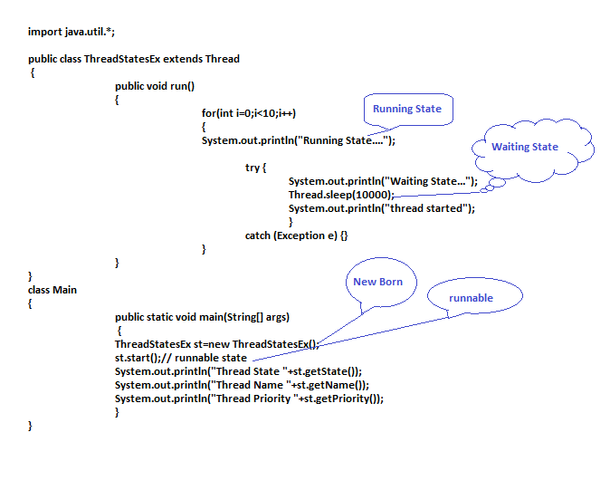

Slide 15
thread synchronization
In multithread program where multiple threads try to access the same resources then problem occurs. To overcome this concept of thread synchronization came.
problem without Synchronization
Example

Slide 16
Interthread communication
Thread communication means communication between threads which is also called Interthread communications.
Interthread communication is important when you develop an application where two or more threads exchange some information.
The inter-thread communication allows the synchronized threads to communicate with each other.
There are three methods which makes thread communication possible:
wait(), notify() and notifyAll() --All these methods belong to Object class as final
--They must be used within a synchronized block only.

Slide 17
wait()-It tells the calling thread to release the lock and go to sleep until some other thread enters the same monitor and calls notify().
notify()-It wakes up one single thread that called wait() on the same object.
notifyAll()-It wakes up all the threads that called wait() on the same object.
1. A monitor is an object which acts as a lock. It is applied to a thread only when it is inside a synchronized method.
2. Only one thread can use monitor at a time. When a thread acquires a lock, it enters the monitor.
3. When a thread enters into the monitor, other threads will wait until first thread exits monitor.
4. A lock can have any number of associated conditions.

Slide 18
Thread Priority
In Java, each thread is assigned priority, which affects the order in which it is scheduled for running.
Thread priority in Java is a number assigned to a thread that is used by Thread scheduler to decide which thread should be allowed to execute.
Java allows users to change priority:
Threadobject.setPriority(intNumber)
MIN_PRIORITY = 1
NORM_PRIORITY=5
MAX_PRIORITY=10

Slide 19
Exception Handling
Exception is an abnormal condition means result out of expectation. Exception is an event that disturbs the normal flow of the program. Actually it is unexpected result which we do not think. Suppose we have defined array with size 5 but we are trying to access array of index 6. So, in this situation exception occurs.

Slide 20
Exception Handling where exceptions may occur
int a=50/0;//ArithmeticException
String s=null; System.out.println(s.length());//NullPointerException
String s="abc";
int i=Integer.parseInt(s);//NumberFormatException
int a[]=new int[5]; a[10]=50; //ArrayIndexOutOfBoundsException

Slide 21
Five keywords used in Exception handling:
try
catch
finally
throw
throws

Slide 22
finally block
The finally block is a block that is always executed. It is mainly used to perform some important tasks such as closing connection, stream etc.
Rule: For each try block there can be zero or more catch blocks, but only one finally block.

Slide 23
Throw/throws keyword
If a method does not handle a checked exception, the method must declare it using the throws keyword. The throws keyword appears at the end of a method's signature.
The throw keyword is used to explictily throw an exception. We can throw either checked or uncheked exception. The throw keyword is mainly used to throw custom exception.

