Slide 1

CAP615 PROGRAMMING IN JAVA
Unit-4

Slide 2
Topics Covered:
Swings and Layouts :
JButton class, JRadioButton class,
JTextArea class, JComboBox class,
JTable class, JColorChooser class,
JProgressBar class, JSlider class,
layout manager, Border Layout,
Grid Layout, Flow Layout, Box Layout,
Card Layout

Slide 3
Java swing
Java swing is used to create window-based applications or desktop applications.
The javax.swing package provides classes : JButton, JTextField, JTextArea, JRadioButton, JCheckbox, JMenu etc.

Slide 4
Steps to create GUI:
Create instance of JFrame
Set size of Jframe
Set layout managers// if no then set null
Create instance of Jbutton,JTextField etc..
Set position and size of a button,TextField etc
Add component in Frame
Set Visible True For JFrame

Slide 5
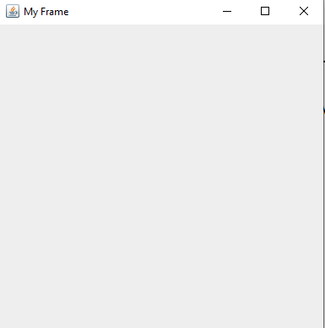
import javax.swing.*;
class CreateGui
{
public void CreateFrame()
{
JFrame jf=new JFrame("My Frame");
jf.setSize(400,400);
jf.setLayout(null);
jf.setVisible(true);
}
}
class Main
{
public static void main(String []args)
{
CreateGui cg=new CreateGui();
cg.CreateFrame();
}
}

Slide 6
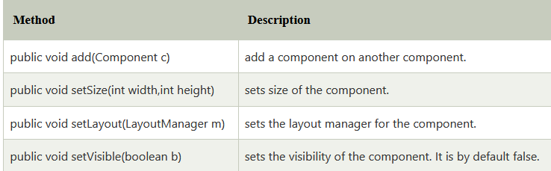
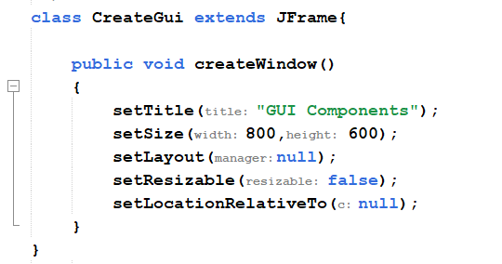
Commonly used Methods of Component class

Slide 7
setBounds()
The setBounds() method needs four arguments. The first two arguments are x and y coordinates of the top-left corner of the component, the third argument is the width of the component and the fourth argument is the height of the component.
Syntax
setBounds(int x-coordinate, int y-coordinate, int width, int height)

Slide 8
JFrame
There are two ways to create a frame or window:
By creating the object of JFrame class
By extending JFrame class (inheritance)

Slide 9
JFrame
JFrame jf=new JFrame("Book Details");
//jf.setSize(400,400);
jf.setBounds(325,58,400,400);
jf.getContentPane().setBackground(Color.BLUE);
jf.setLayout(null);
jf.setVisible(true);

Slide 10
Java Color Constants
BLACK
BLUE
CYAN
DARK_GRAY
GRAY
GREEN
LIGHT_GRAY
MAGENTA
ORANGE
PINK
RED
WHITE
YELLOW

Slide 11
Color | RGB value
Black | 0-0-0
Very light red | 255-102-102
Light red | 255-51-51
Red | 255-0-0
Dark red | 204-0-0
Very dark red | 153-0-0
Very light blue | 51-204-255
Light blue | 51-153-255
Blue | 0-0-255
Dark blue | 0-0-204
Very dark blue | 0-0-153
Very light green | 102-255-102
Light green | 0-255-51
Green | 0-204-0
Dark green | 0-153-0
Very dark green | 0-102-0
White | 255-255-25
Color c1 = new Color(102, 255, 102);
jf.getContentPane().setBackground(c1);

Slide 12
Java JButton
The JButton class is used to create a labeled button which perform some action when the button is pushed. It inherits AbstractButton class.

Slide 13
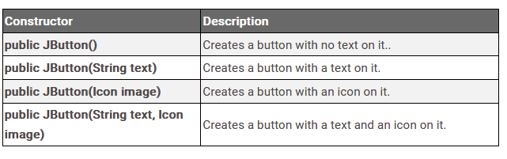
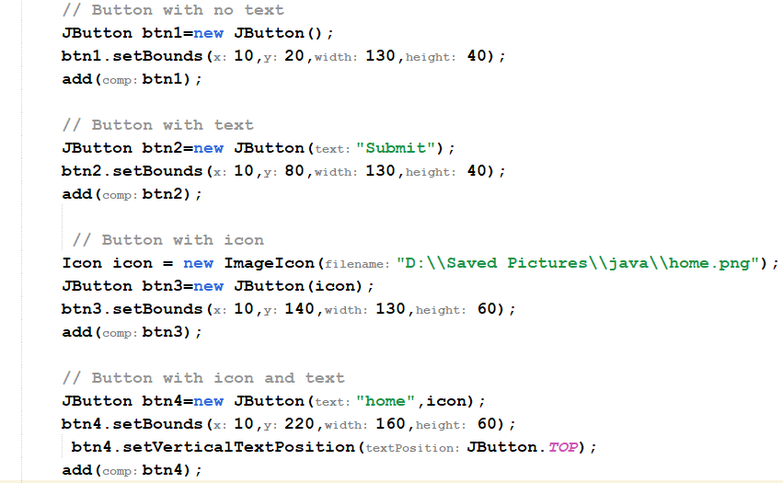
Constructors of JButton

Slide 14
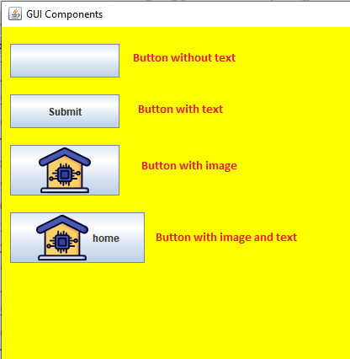
Example

Slide 15
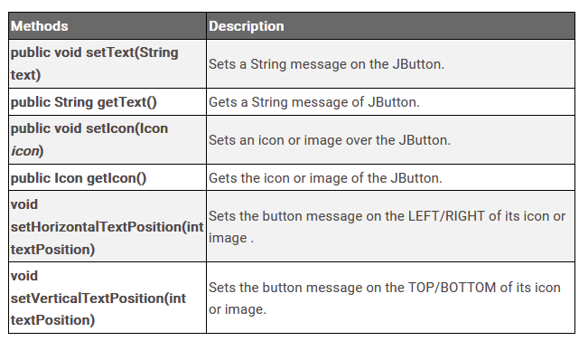
Methods of JButton class

Slide 16
Steps to perform action on button click
1. Importing Packages:
import javax.swing.*;
import java.awt.*;
import java.awt.event.*;
2.Create Class which Implementing ActionListener Interface: class classname implements ActionListener
3. Create Button and add in Frame:
4. Registering ActionListener to the JButton:
In this step, we will add or can say register ActionListener to the JButton. For this, we have to call addActionListener() method using the object of the JButton class.
5. Override actionPerformed() method

Slide 17
actionPerformed() method
If we have implemented the ActionListener interface in any class, then we must have to override its method which is actionPerformed(ActionEvent e) which takes a parameter ActionEvent (a class defined in package java.awt.event ). Now when someone clicks on the button the actionPerformed() method is called.

Slide 18
Java JLabel
The object of JLabel class is a component for placing text in a container. It is used to display a single line of read only text. The text can be changed by an application but a user cannot edit it directly. It inherits JComponent class.

Slide 19
JLabel:Commonly used Constructors:
Constructor | Description
JLabel() | Creates a JLabel instance with no image and with an empty string for the title.
JLabel(String s) | Creates a JLabel instance with the specified text.
JLabel(Icon i) | Creates a JLabel instance with the specified image.
JLabel(String s, Icon i, int horizontalAlignment) | Creates a JLabel instance with the specified text, image, and horizontal alignment.

Slide 20
Jlabel:Commonly used Methods:
Methods | Description
String getText() | t returns the text string that a label displays.
void setText(String text) | It defines the single line of text this component will display.
void setHorizontalAlignment(int alignment) | It sets the alignment of the label's contents along the X axis.
Icon getIcon() | It returns the graphic image that the label displays.
int getHorizontalAlignment() | It returns the alignment of the label's contents along the X axis.

Slide 21
Add image using JLabel
JLabel jl=new JLabel(new ImageIcon("bimg2.jpg"));
JPanel jp=new JPanel();
jp.add(jl);

Slide 22
Java JTextField
The object of a JTextField class is a text component that
allows the editing of a single line text. It inherits JTextComponent class.
JTextField class declaration
Let's see the declaration for javax.swing.JTextField class.
public class JTextField extends JTextComponent implements SwingConstants

Slide 23
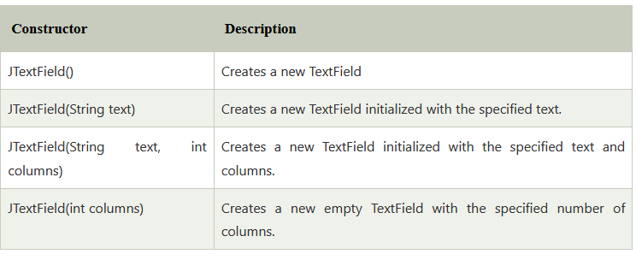
Java JTextField

Slide 24
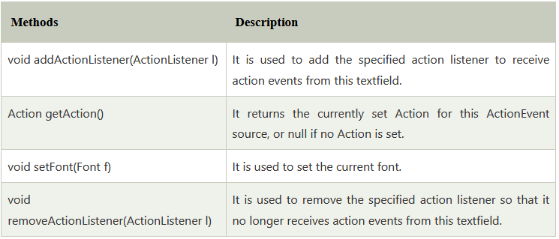
Java JTextField

Slide 25
JRadioButton class
The JRadioButton class is used to create a radio button. It is used to choose one option from multiple options.
To select single option we have to add radio buttons in a ButtonGroup.

Slide 26
Ex:-
JRadioButton r1=new JRadioButton("Male");
JRadioButton r2=new JRadioButton("Female");
r1.setBounds(75,50,100,30);
r2.setBounds(75,100,100,30);
ButtonGroup bg=new ButtonGroup();
bg.add(r1);
bg.add(r2);
f.add(r1);
f.add(r2);

Slide 27
JRadioButton Constructor
Constructor | Description
JRadioButton() | Creates an initially unselected radio button with no set text.
JRadioButton(String text) | Creates a radio button with the specified text
JRadioButton(String text, boolean selected) | Creates a radio button with the specified text and selection state.
JRadioButton(String text, Icon icon) | Creates a radio button that has the specified text and image, and which is initially unselected.

Slide 28
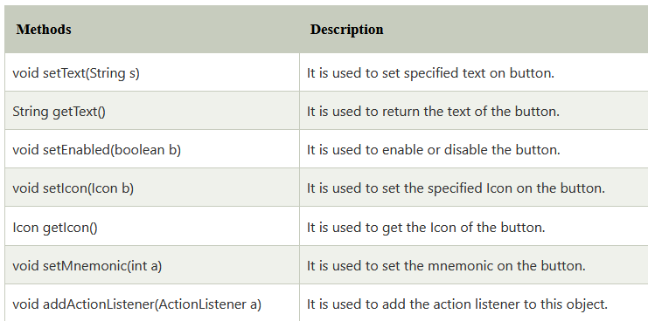
Methods belongs to JRadioButton class

Slide 29
Steps:
JRadioButton r1=new JRadioButton("Male");
JRadioButton r2=new JRadioButton("Female");
r1.setBounds(75,50,100,30);
r2.setBounds(75,100,100,30);
ButtonGroup bg=new ButtonGroup();
bg.add(r1);
bg.add(r2);
f.add(r1);
f.add(r2);

Slide 30
To check which radio button has selected
JRadioButton r1=new JRadioButton("Male");
if(r1.isSelected())
{
String gender=“Male”;
}

Slide 31
JTextArea class
It represents a multi line area that displays text. It is used to edit the text . JTextArea inherits JComponent class.

Slide 32
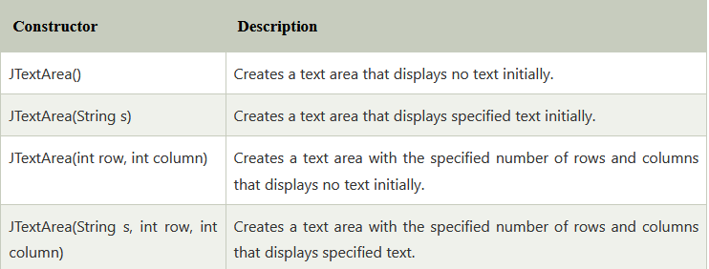
Constructor

Slide 33
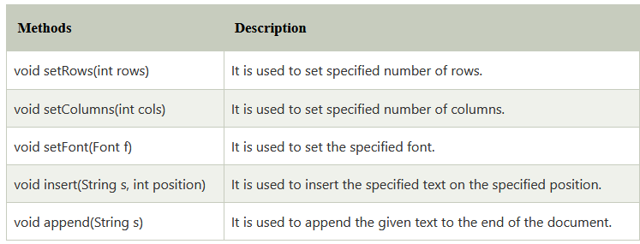
Methods

Slide 34
JComboBox class
JComboBox inherits JComponent class . JComboBox shows a popup menu that shows a list and the user can select a option from that specified list . JComboBox can be editable or read- only.

Slide 35
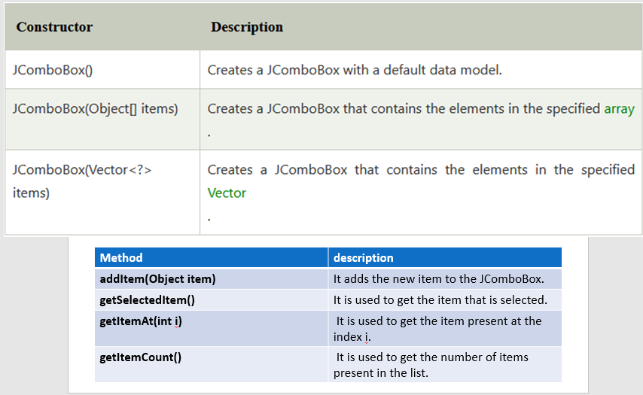
Constructor

Slide 36
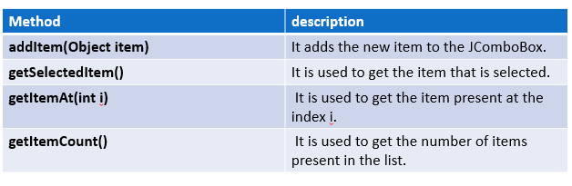
Methods
Method | description
addItem(Object item) | It adds the new item to the JComboBox.
getSelectedItem() | It is used to get the item that is selected.
getItemAt(int i) | It is used to get the item present at the index i.
getItemCount() | It is used to get the number of items present in the list.

Slide 37
Steps to perform event in JComboBox
Implement ItemListener interface
Register combobox using addItemListener()
Define itemStateChanged(ItemEvent e)
To read item from combo box:
JComboBoxobj.getSelectedItem();

Slide 38
JTable class
The JTable class is used to display data in rows and columns wise.
Constructors in JTable:
JTable(): A table is created with empty cells.
JTable(int rows, int cols): Creates a table of size rows * cols.
JTable(Object[][] data, Object []Column): A table is created with the specified name where []Column defines the column names.

Slide 39
JColorChooser class
The JColorChooser class is used to create a color chooser dialog box so that user can select any color. It inherits JComponent class.
JColorChooser.showDialog(this,"Select a color",initial_color_name);

Slide 40
JProgressBar class
he JProgressBar class is used to display the progress status of the task. It inherits JComponent class.

Slide 41
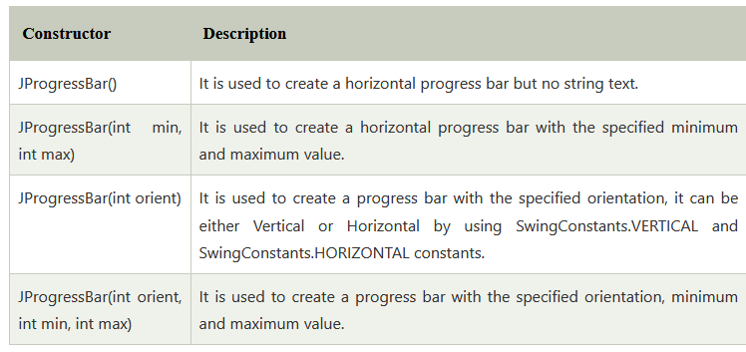

Slide 42
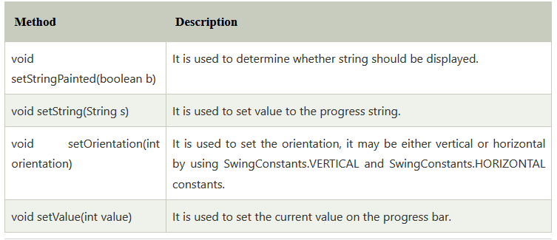

Slide 43
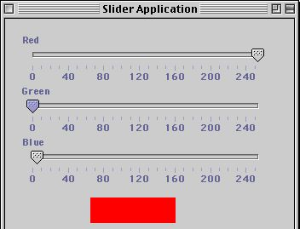
JSlider class
The Java JSlider class is used to create the slider in GUI. By using Slider we can select a value from given range.

Slide 44
common constructors used in JSlider are:
JSlider(): creates a slider with default initial value 50 and range 0-100.
JSlider( int operation): develops a slider with the specified orientation set by the user.
JSlider( int min, int max, int values): creates a horizontal slider using the given min and max.
JSlider( int min, int max): develops a horizontal slider with specified min, max, and value.
JSlider( int orientation, int min, int max, int value): develop a slider with specified orientation, that must be either JSlider.HORIZONTAL or JSlider.VERTICAL.

Slide 45
Methods:
void setMinorTickSpacing(int p): sets the minor tick spacing in the slider.
void SetMajorTickSpacing (int p): sets the major tick spacing.
void setMinimum(int p): sets the minimum value of the slider.
void setMaximum(int p): sets the maximum value of the slider.
void setPaintsTicks(boolean bl): determines that tick mark is painted.
void setPaintLabels(boolean bl); tests whether labels are painted.
void setPaintTracks(boolean bl); determines whether the track is painted.

Slide 46
The small vertical lines that calibrate a slider are called tick marks. The longer, thicker marks are major ticks and the thinner marks are minor ticks. The major ticks can be labeled.

Slide 47
LayoutManagers
A layout manager is an instance of any class that implements the LayoutManager interface.
LayoutManager is an interface that is used to arrange components in a specific manner.
It is implemented by all the classes of layout managers:
BorderLayout
FlowLayout
GridLayout
CardLayout
BoxLayout

Slide 48
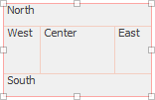
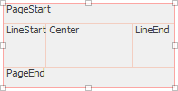
BorderLayout
The border layout places components in up to five areas: center, north, south, east and west. Each area can contain only one component.
Possible values: CENTER, NORTH, SOUTH, EAST, WEST, PAGE_START, PAGE_END, LINE_START and LINE_END.
To inserts horizontal and vertical gaps between buttons:
BorderLayout(int hgap, int gap)

Slide 49
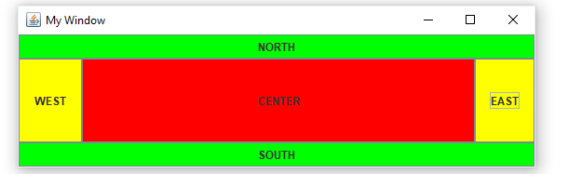

Slide 50
GridLayout
The class GridLayout arranges the components in a rectangular grid.
Constructor | Description
GridLayout() | a grid layout with one column per component in a row
GridLayout(int rows, int columns) | a grid layout with the given rows and columns but no gaps between the components.
GridLayout(int rows, int columns, int hgap, int vgap): | a grid layout with the given rows and columns along with given horizontal and vertical gaps.

Slide 51
Method | Description
int getColumns() | Gets the number of columns in this layout.
int getHgap() | Gets the horizontal gap between the components.
int getRows() | Gets the number of rows in this layout.
int getVgap() | Gets the vertical gap between the components.
void setColumns(int cols) | Sets the number of columns in this layout to the specified value.
void setHgap(int hgap) | Sets the horizontal gap between the components to the specified value.
void setRows(int rows) | Sets the number of rows in this layout to the specified value.

Slide 52


FlowLayout
The flow layout manager arranges components in a row from left to right, starting a new row if no more components fit into a row. Flow layouts are typically used to arrange buttons in a panel.

Slide 53
Note:
FlowLayout is default layout for JPanel.
If width of Jframe is less then components shits in next row.
If width of Jframe is more then it aligns component to the center.
Three constant we can define in FLowLayout: LEFT, RIGHT and CENTER

Slide 54
BoxLayout
The BoxLayout class is used to arrange the components either vertically (along Y-axis) or horizontally (along X-axis). In BoxLayout class, the components are put either in a single row or a single column. The components will not wrap so, for example, a horizontal arrangement of components will stay horizontally arranged when the frame is resized.

Slide 55
Constructor
BoxLayout(Container c, int axis): Creates a BoxLayout class that arranges the components with the X-axis or Y-axis.

Slide 56
Methods
addLayoutComponent(Component cmp, Object obj): It is not used by this class.
getLayoutAlignmentX(Container con): Returns the alignment along the X axis for the container.
getLayoutAlignmentY(Container con): Returns the alignment along the Y axis for the container.
maximumLayoutSize(Container con): Returns the maximum dimensions the target container can use to lay out the components it contains.
minimumLayoutSize(Container con): Returns the minimum dimensions needed to lay out the components contained in the specified target container.
removeLayoutComponent(Component cmp): It is not used by this class.
layoutContainer(Container tar): Called by the AWT when the specified container needs to be laid out.

Slide 57
JPanel panel = new JPanel();
// Set the BoxLayout to be X_AXIS: from left to right
BoxLayout boxlayout = new BoxLayout(panel, BoxLayout.X_AXIS);
// Set the Boxayout to be Y_AXIS from top to down
//BoxLayout boxlayout = new BoxLayout(panel, BoxLayout.Y_AXIS);
panel.setLayout(boxlayout);

Slide 58
CardLayout
The Java CardLayout class manages the components in such a manner that only one component is visible at a time.
CardLayout(): creates a card layout with zero horizontal and vertical gap.
CardLayout(int hgap, int vgap): creates a card layout with the given horizontal and vertical gap.

Slide 59
Methods
public void next(Container parent): is used to flip to the next card of the given container.
public void previous(Container parent): is used to flip to the previous card of the given container.
public void first(Container parent): is used to flip to the first card of the given container.
public void last(Container parent): is used to flip to the last card of the given container.
public void show(Container parent, String name): is used to flip to the specified card with the given name.

Slide 60
Event Listener
It is an object which is notified when an event occurs.
Java Interfaces | Event They Listen
ActionListener | Listens for and handles button clicks
KeyListener | Listens for and handles key events
MouseListener | Listens for and handles mouse events

Slide 61
Classes that represent events
vents Classes | Description
ActionEvent | Generated when an action has occured (e.g- button pressed)
AdjustmentEvent | Generated when scroll bar is manipulated
ContainerEvent | Generated when container is changed ( added or removed )

Slide 62
Event Classes and Associated Listener Interfaces
Event Classes | Associated Listener Interface
ActionEvent | ActionListener
AdjustmentEvent | AdjustmentListner
ContainerEvent | ContainerListener
FocusEvent | FocusListener
ComponentEvent | ComponentListener
ItemEvent | ItemListener
KeyEvent | KeyListener

