Slide 1
Topics Covered….
Managing data using JDBC:
introduction to JDBC,
connectivity with database,
CRUD operations,
Connection interface,
Statement interface, ResultSet interface, PreparedStatement,
ResultSetMetaData,
DatabaseMetaData

Slide 2
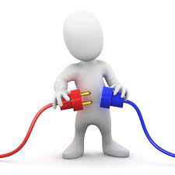
Introduction to JDBC
Java Database Connectivity
JDBC is a software tool and also known as an application programming interface(API) that is used to interact with the database.
JDBC
Java App
Databases

Slide 3
Need for Java JDBC
For establishing stable database connectivity with the application API.
To execute SQL(Structured Query Language) queries and DDL/DML commands.
For viewing and modify data records

Slide 4
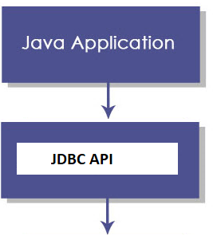
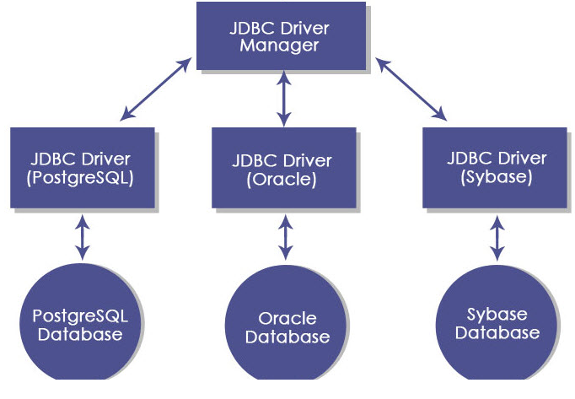
JDBC Architecture

Slide 5
JDBC API: It provides various methods and interfaces for easy communication with the database.
Interfaces of JDBC API
Driver interface
Connection interface
Statement interface
PreparedStatement interface
CallableStatement interface
ResultSet interface
ResultSetMetaData interface
DatabaseMetaData interface
RowSet interface
Classes of JDBC API
DriverManager class
Blob class
Clob class
Types class

Slide 6
JDBC Driver manager : It loads a database-specific driver in an application to establish a connection with a database.

Slide 7
JDBC Drivers
JDBC drivers are client-side adapters (installed on the client machine, not on the server) that convert requests from Java programs to a protocol that the DBMS can understand.
There are 4 types of JDBC drivers:
Type-1 driver or JDBC-ODBC bridge driver
Type-2 driver or Native-API driver
Type-3 driver or Network Protocol driver
Type-4 driver or Thin driver

Slide 8
Java Program
Type-1 driver
Type-2 driver
Type-3 driver
Type-4 driver
Java Drivers
Vendor Specific Database
SQL Server
IBM DB2
Oracle
MySQL

Slide 9
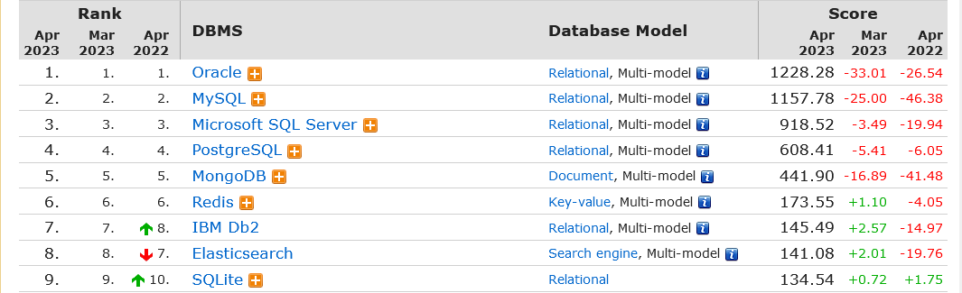
https://db-engines.com/en/ranking

Slide 10
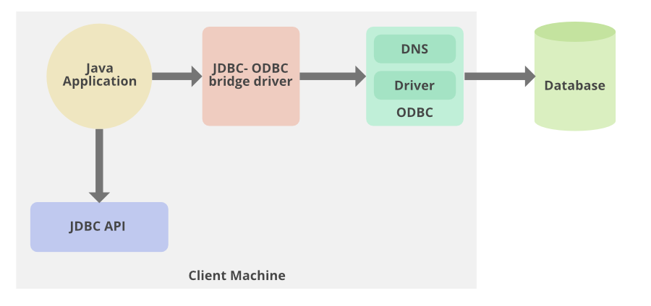
Type 1 − JDBC-ODBC Bridge Driver:
it provides a bridge to access the ODBC driver installed on each client. Using ODBC, requires configuring on your system a Data Source Name (DSN) that represents the target database.

Slide 11
Java Program
Java Drivers
Type-1 driver
ODBC
Vendor Specific Database

Slide 12
Using the JDBC-ODBC bridge driver we can access the databases which support only ODBC. Java application sends a request to the JDBC-ODBC bridge driver the request internally calls the ODBC equivalent function and the ODBC driver retrieves the result from the vendor specific database and sends it back to the JDBC-ODBC bridge driver.

Slide 13
Oracle does not support the JDBC-ODBC Bridge from Java 8. Oracle recommends that you use JDBC drivers provided by the vendor of your database instead of the JDBC-ODBC Bridge.

Slide 14
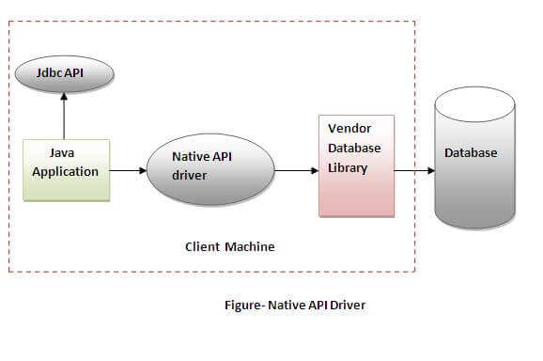
Native-API driver
The Native API driver uses the client-side libraries of the database. The driver converts JDBC method calls into native calls of the database API. It is not written entirely in java.

Slide 15
Advantage:
performance upgraded than JDBC-ODBC bridge driver.
Disadvantage:
The Native driver needs to be installed on the each client machine.
The Vendor client library needs to be installed on client machine.

Slide 16
Java Program
Java Drivers
Type-2 driver
(Native-API driver)
Vendor Specific API
Vendor Specific Database

Slide 17
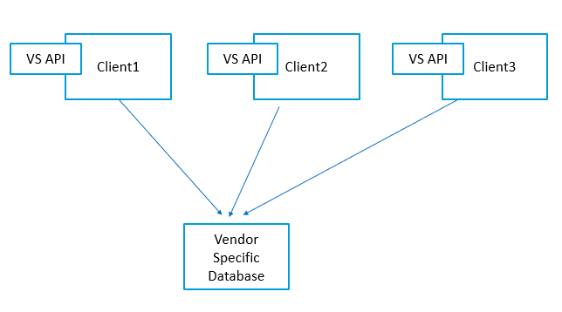

Slide 18
Client1
Client2
Client3
VS API
VS API
VS API
Vendor Specific Database

Slide 19
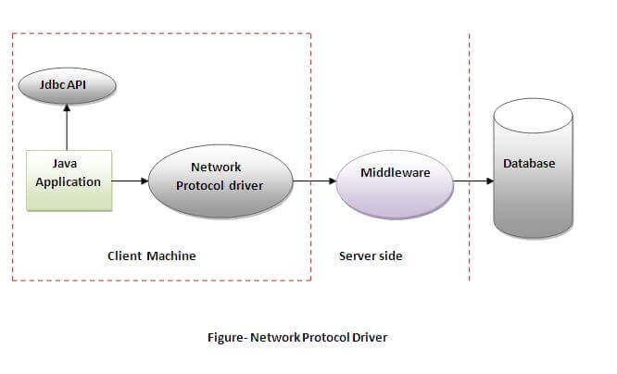
Network Protocol driver
The Network Protocol driver uses middleware (application server) that converts JDBC calls directly or indirectly into the vendor-specific database protocol. It is fully written in java.

Slide 20
Advantage:
No client side library is required because of application server that can perform many tasks like auditing, load balancing, logging etc.
Disadvantages:
Network support is required on client machine.
Requires database-specific coding to be done in the middle tier.
Maintenance of Network Protocol driver becomes costly because it requires database-specific coding to be done in the middle tier.

Slide 21
Java Program
Java Drivers
Type-3 driver(Network Protocol driver)
Server
Vendor Specific Database

Slide 22
Client1
Client2
Client3
A Server which contain VS API
So, here no need to install VS API
on each client machine. Make
a server install in server and shared
with all client machine.
Vendor Specific Database

Slide 23
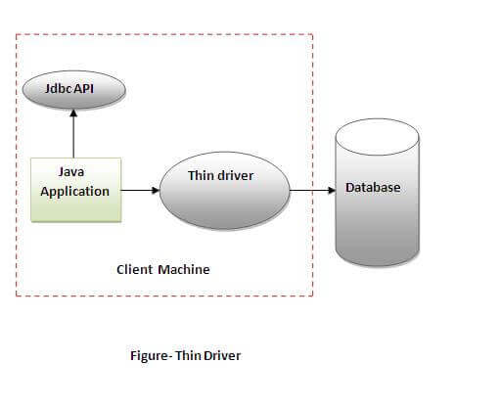
Thin driver
The thin driver converts JDBC calls directly into the vendor-specific database protocol. That is why it is known as thin driver. It is fully written in Java language.

Slide 24
Advantage:
Better performance than all other drivers.
No software is required at client side or server side.
Disadvantage:
Drivers depend on the Database.

Slide 25
Connectivity with database:
Step1: Call package
import java.sql.*;
Step2: Define Connection string:
String url="jdbc:mysql://127.0.0.1:3306/d2212db";
String username="root";
String password="";
Connection con=DriverManager.getConnection(url,username,password);

Slide 26
When you declare a variable like "Connection con=null;", you're creating a reference variable named "con" of type "Connection" and initializing it to null. This means that "con" can refer to any object that implements the "Connection" interface, but at this point, it doesn't actually refer to any object because it's null.

Slide 27
Step3:
Check Connection database connection has been establish or not?
if(con!=null)
{
JOptionPane.showMessageDialog(null, “Connected");
}

Slide 28
Step4: If connection has established then do the database operation: insert, update, delete and select. For that write the code on button click.
Complete code:
Example

Slide 29
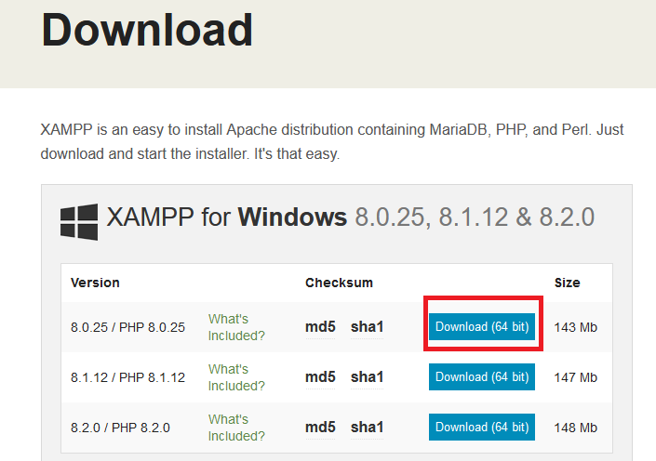
Steps for MySql Connectivity using Xampp
Step1: Download Xampp from this url:
https://www.apachefriends.org/download.html

Slide 30

Step2: After download you will get your setup file like this:
Now install this software -→follow the default option and Next button

Slide 31
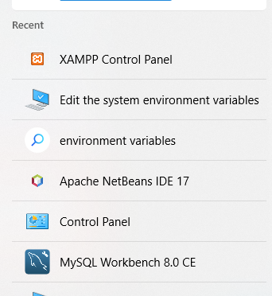
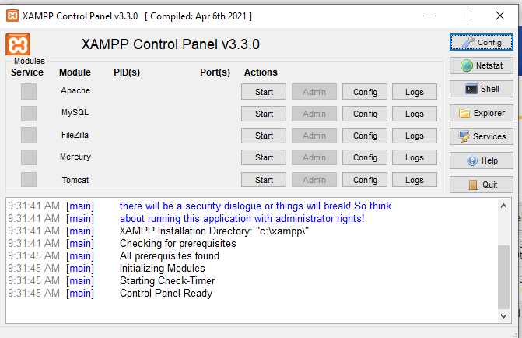
Step3: Now after installation of Xampp open Xampp control panel from your system.

Slide 32
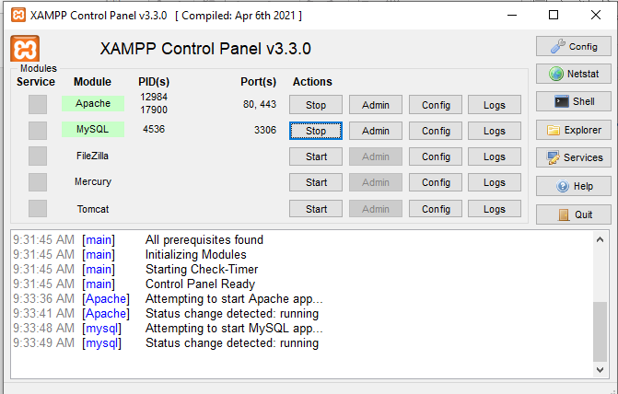
Step4: Now click on start button for Apache and MySql server after click on start button your server will be start and stop button will be appear.

Slide 33
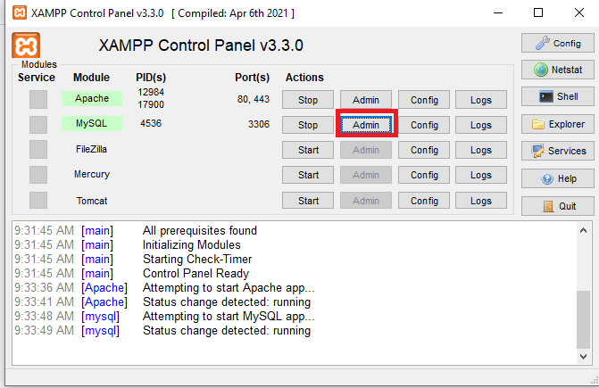
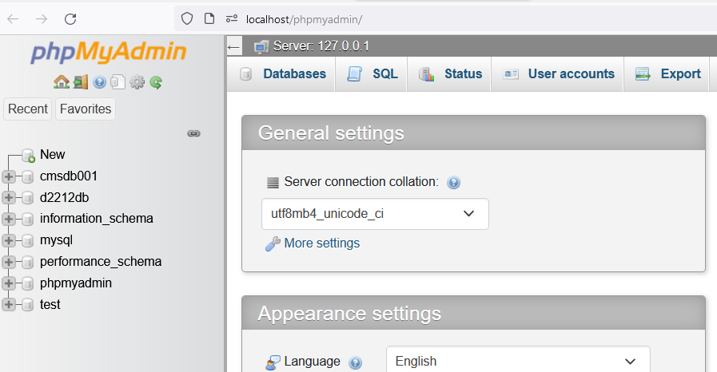
Step5: Now Click on Admin button PhpMyAdmin page
Will be open

Slide 34
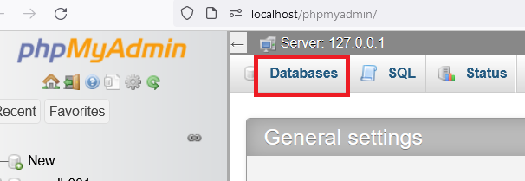
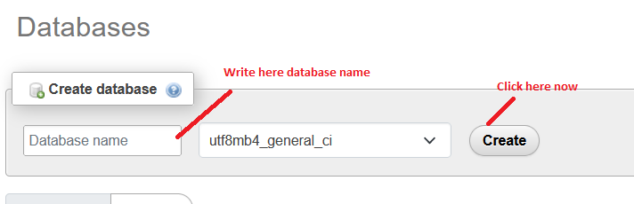
Step 6: Now create database using tab Database

Slide 35
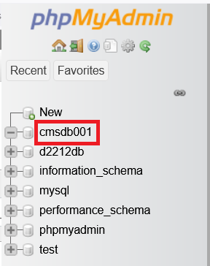
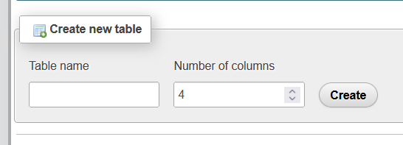
Step7:
After Creating Database It will reflect in left side
Now select your database and click then create Table
Enter here table name with total no. of columns then click on create button.

Slide 36
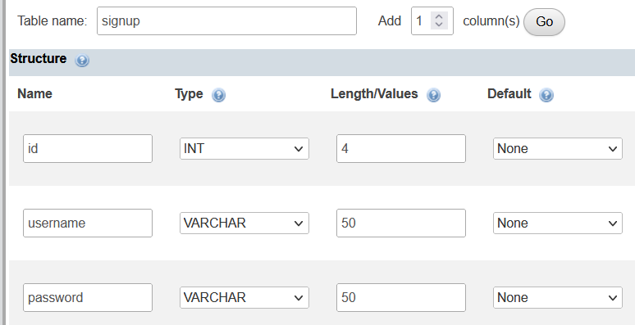
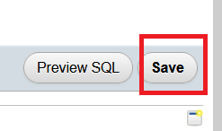
Fill all the column names with datatypes and range >> Click on save button

Slide 37
Connection Interface
Connection interface represents a layer between java application and database. All SQL statements are executed and results are returned with in the context of a Connection object.
You can also use it to retrieve the metadata of a database like name of the database product, name of the JDBC driver, major and minor version of the database etc.

Slide 38
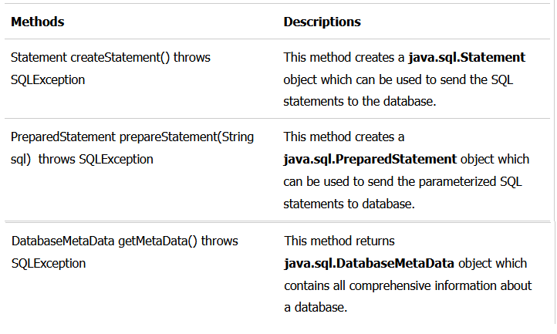
useful methods of Connection interface:

Slide 39
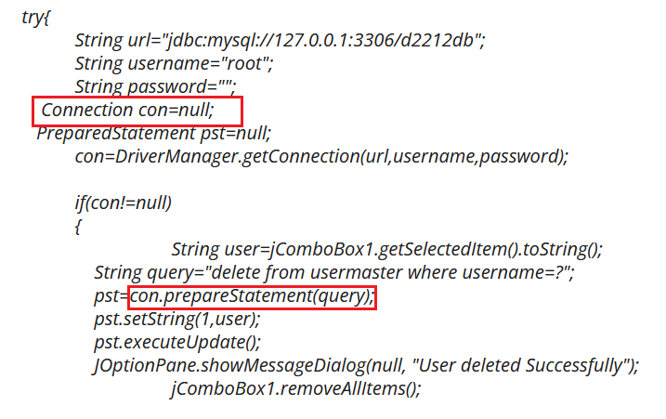

Slide 40
Statement interface
The statement interface is used to create SQL statements. It provides methods to execute queries with the database.
There are different types of statements that are used in JDBC as follows:
Create a Statement: Statement
PreparedStatement
CallableStatement

Slide 41
Create a Statement:
It is generally used for general–purpose access to databases and is useful while using static SQL statements at runtime.
Syntax:
Statement statement = connection.createStatement();
Once the Statement object is created, there are three ways to execute it:
boolean execute(String SQL)
int executeUpdate(String SQL)
ResultSet executeQuery(String SQL)

Slide 42
PreparedStatement:
Prepared Statement represents a recompiled SQL statement, that can be executed many times. This accepts parameterized SQL queries. In this, “?” is used instead of the parameter, one can pass the parameter dynamically by using the methods of PREPARED STATEMENT at run time.
Once the PreparedStatement object is created, there are three ways to execute it:
boolean execute(String SQL)
int executeUpdate(String SQL)
ResultSet executeQuery(String SQL)

Slide 43
Callable Statement :
The CallableStatement interface is used to execute the SQL stored procedure in a database. The JDBC API provides stored procedures to be called in a standard way for all RDBMS.
Syntax: To prepare a CallableStatement
CallableStatement cstmt =
con.prepareCall("{call Procedure_name(?, ?}");

Slide 44
ResultSet interface
It is used to store the data which are returned from the database table after the execution of the SQL statements. The object of ResultSet maintains cursor point at the result data. In default, the cursor positions before the first row of the result data.
The next() method is used to move the cursor to the next position in a forward direction. It will return FALSE if there are no more records. It retrieves data by calling the executeQuery() method using any of the statement objects.

Slide 45
How to use ResultSet?
Statement statemnt1 = conn.createStatement();
ResultSet rs1 = statemnt1.executeQuery(“Select * from EMPLOYEE_DETAILS”);
PreparedStatement pstatemnt1 = conn.prepareStatement(insert_query);
ResultSet rs1 = pstatemnt1.executeQuery(“Select * from EMPLOYEE_DETAILS”);

Slide 46
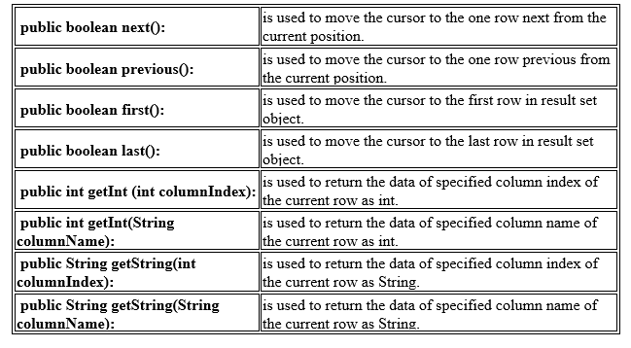
Methods in ResultSet

Slide 47
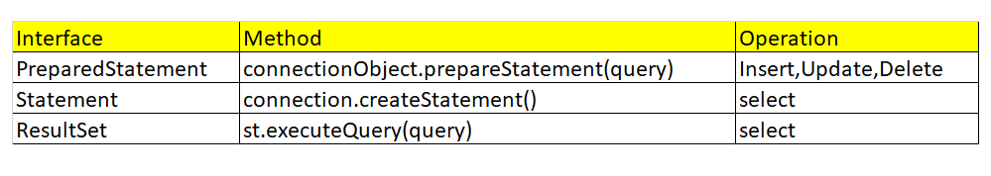
Note:

Slide 48
ResultSetMetaData Interface
The metadata means data about data i.e. we can get further information from the data.
If you have to get metadata of a table like total number of column, column name, column type etc. , ResultSetMetaData interface is useful because it provides methods to get metadata from the ResultSet object.

Slide 49
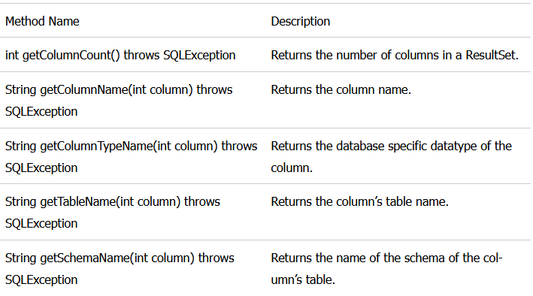
ResultSetMetaData Methods

Slide 50
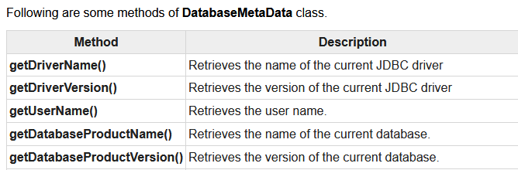
DatabaseMetaData interface
DatabaseMetaData interface provides methods to get meta data of a database such as database product name, database product version, driver name, name of total number of tables, name of total number of views etc.

