Slide 1
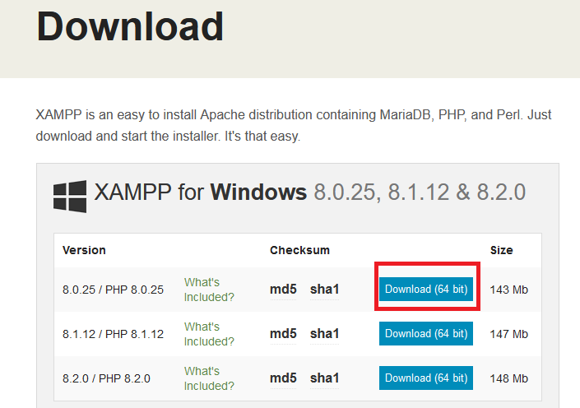
Steps for MySql Connectivity using Xampp
Step1: Download Xampp from this url:
https://www.apachefriends.org/download.html

Slide 2

Step2: After download you will get your setup file like this:
Now install this software -→follow the default option and Next button

Slide 3
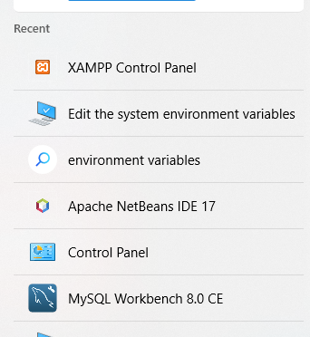
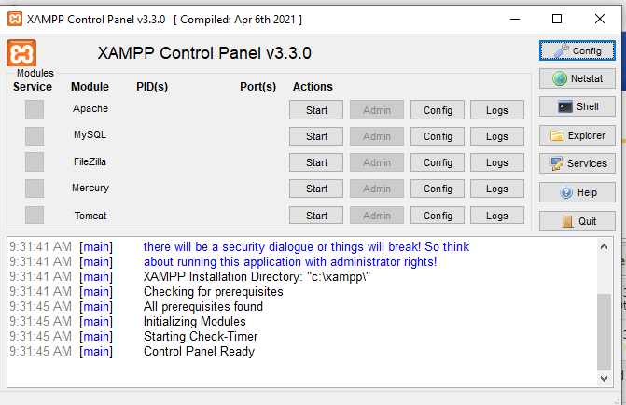
Step3: Now after installation of Xampp open Xampp control panel from your system.

Slide 4
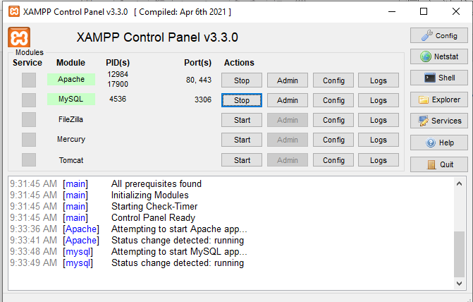
Step4: Now click on start button for Apache and MySql server after click on start button your server will be start and stop button will be appear.

Slide 5
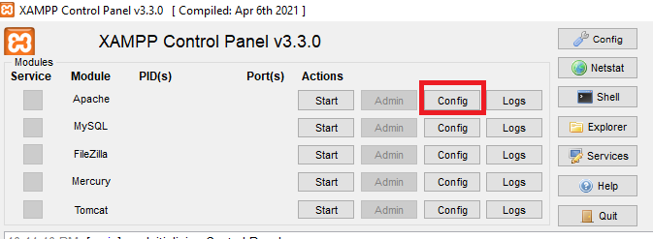
If any error you are getting after click on start button if your apache is not working or MySql is not working then select config button:

Slide 6
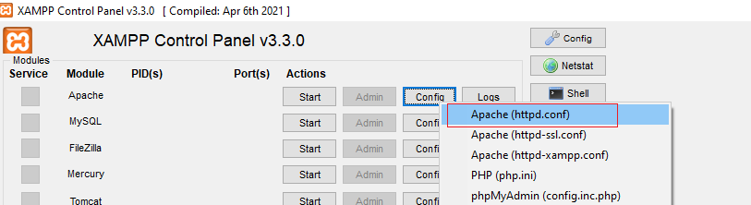
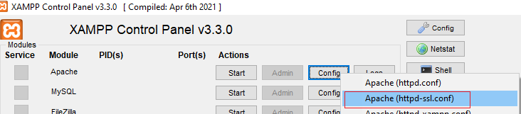
Search 80 in this file and change port no. to 8080
Now select Apache(httpd-ssl-conf) and search 443 and change into 4433.

Slide 7
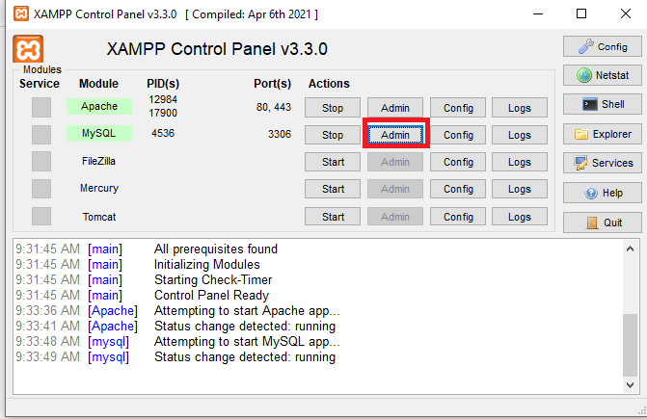
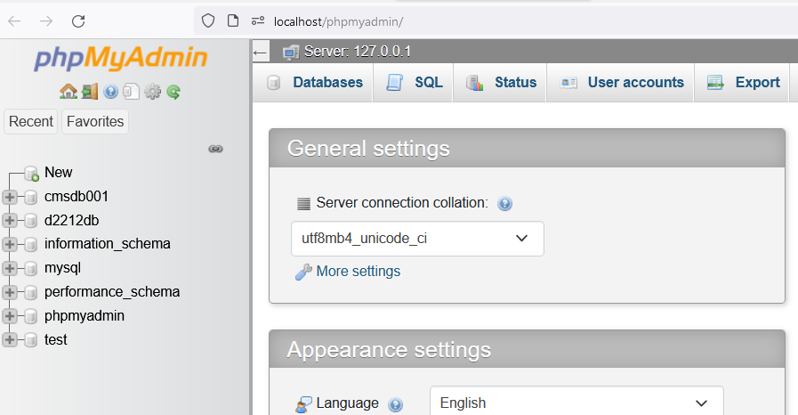
Step5: Now Click on Admin button PhpMyAdmin page
Will be open

Slide 8
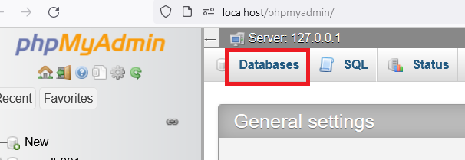
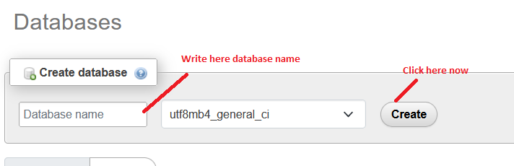
Step 6: Now create database using tab Database

Slide 9
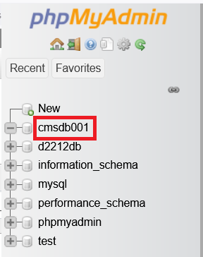
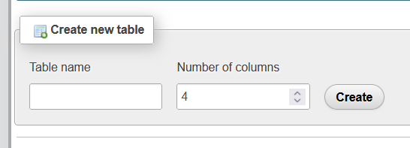
Step7:
After Creating Database It will reflect in left side
Now select your database and click then create Table
Enter here table name with total no. of columns then click on create button.

Slide 10
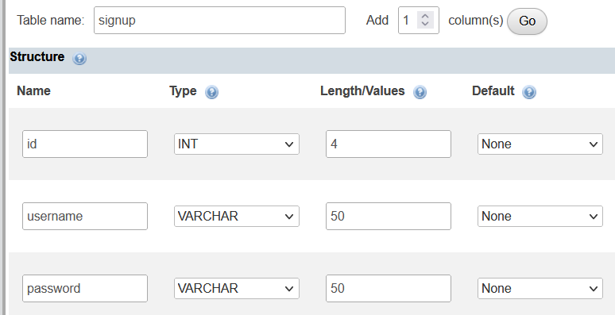
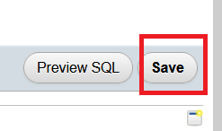
Fill all the column names with datatypes and range >> Click on save button

Slide 11
If you are getting any error in Xampp control panel
For example Apache Server not started or
MySql Server not started
Then

Slide 12
Steps for database coding:
Step1: Call package
import java.sql.*;
Step2: Define Connection string:
String url="jdbc:mysql://127.0.0.1:3306/d2212db";
String username="root";
String password="";
Connection con=con=DriverManager.getConnection(url,username,password);

Slide 13
Step3:
Check Connection database connection has been establish or not?
if(con!=null)
{
JOptionPane.showMessageDialog(null, “Connected");
}

Slide 14
Step4: If connection has established then do the database operation: insert, update, delete and select. For that write the code on button click.

