Slide 1
XAML or Xamarin.Form Controls
CAP914

Slide 2
Entry
To take input from user.
<Entry x:Name="txtVal1" Placeholder="Enter Value1"></Entry>
Attributes:
x:Name: define ID for this control which will be use in coding part.
Placeholder: will be display suggestion what input has to take

Slide 3
Label
To display any text or message on screen
<Label x:Name="valueLabel" Text="Enter Value1“ Font="Large“ HorizontalOptions="Center" VerticalOptions="CenterAndExpand" />
Attributes:
x:Name: define ID for this control which will be use in coding part.
Text: text will be appear on screen
Font: display font

Slide 4
Button
To perform some action or event
<Button x:Name=“btnsubmit” Text="Click Me!" Clicked="OnButtonClicked“ />
Attribute:
x:Name: define ID for this control which will be use in coding part.
Text: text of button will be appear on screen
Clicked: will generate event

Slide 5
Button clicked method:
async void OnButtonClicked(object sender, EventArgs args)
{
int val1 = int.Parse(txtVal1.Text);
int val2 = int.Parse(txtVal2.Text);
int res = val1 + val2;
await DisplayAlert("Addition",res.ToString(), "OK");
}

Slide 6
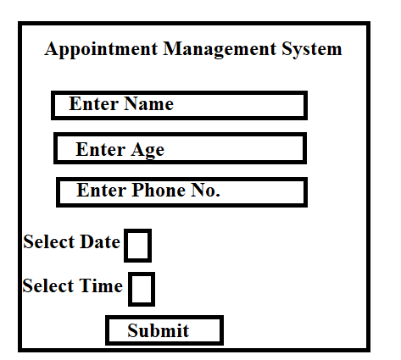

Slide 7
DatePicker control: A control that lets a user select a date.
Attributes:
x:Name="mydatepicker"
MinimumDate="01/01/1990“
MaximumDate="12/31/2030"
DateSelected="onDateSelected“//event

Slide 8
Method definition:
private void onDateSelected(object sender,DateChangedEventArgs e)
{
txtDate.Text = e.NewDate.ToString();
}

Slide 9
TimePicker control:-
:-A TimePicker is a control that allows a user to pick a time value.
<TimePicker x:Name="dttime"></TimePicker>
Attribute:
x:Name:identify ID
dttime.Time.ToString(@"hh\:mm"); // display time in this format

Slide 10
To display time syntax in C#?
dttime.Time.ToString("hh\:mm");
dttime.Time(@"hh\:mm");
dttime.Time.ToString(@"hh\:mm");
None

Slide 11
Image
Xamarin.Forms uses the Image view to display images on a page. It has two important properties:
Source - An ImageSource instance, either File, Uri or Resource, which sets the image to display
Aspect - A Aspect representing the scaling mode of the image. Default is AspectFit.
<Image HeightRequest="60" WidthRequest="100" HorizontalOptions="Center" Aspect="AspectFit" Source=“” />

Slide 12
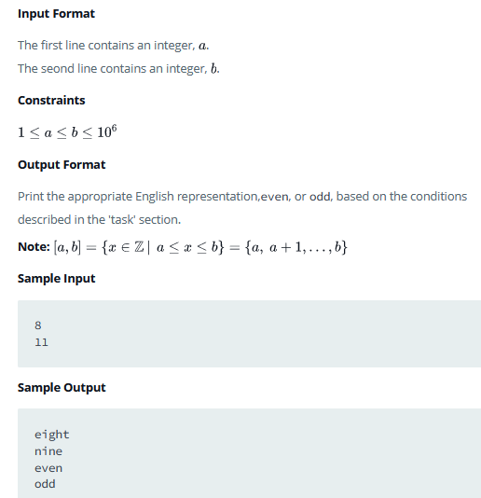
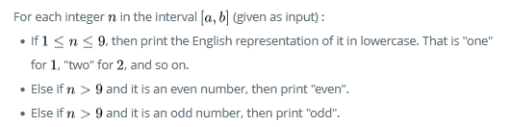
Problem Statement:

Slide 13



Create App to perform Book Issues and Book Return operation
D
Book Library App
How to find date difference?
DateTime dt = new DateTime();
// on date selected method
dt = e.NewDate;
// on submit button
var datediff = dt.Date - DateTime.Now.Date;
int days = int.Parse(datediff.Days.ToString());
Enter Book Name
Select Return Date

Slide 14
Slider Control:
Sliders are a horizontal UI control that display a single value to the user between a given range.
Attributes:
x:Name="sslider"
Minimum="0“
Maximum="50“
ValueChanged="onSlidervalue“ //event
Method definition:
public void onSlidervalue(object sender,ValueChangedEventArgs varg)
{
lblValue.Text = varg.NewValue.ToString();
}

Slide 15
BoxView
A View used to draw a solid colored rectangle.
Similar to Rectangle in Windows XAML. Used to display a box with some color on a page.
Color : Color of box
HeightRequest="100“
WidthRequest="20"

Slide 16
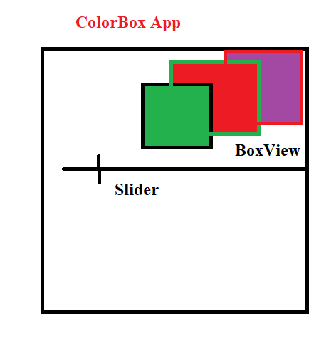

Slide 17
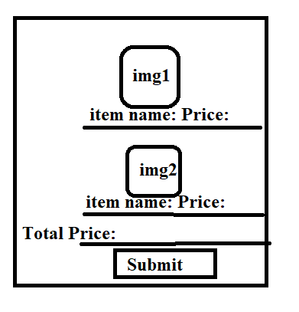


Food Delivery App
ScrollBar

Slide 18
Editor
A control that can edit multiple lines of text.
Attributes:
FontFamily: Gets the font family to which the font for the editor belongs.
FontSize: Gets the size of the font for the editor.
Text: Gets or sets the text of the entry. This is a bindable property.
TextColor: Gets or sets the text color.
<Editor FontFamily="Arial" FontSize="14" TextColor="Green">

Slide 19
Stepper Control:
A View control that inputs a discrete value, constrained to a range.
<Stepper x:Name="stpr" Value="5" Minimum="0" Maximum="10" ValueChanged="OnStepperValueChanged"></Stepper>
<Label x:Name="lblstpr" Font="Large"></Label>
void OnStepperValueChanged(object sender, ValueChangedEventArgs e)
{
lblstpr.Text = "Stepper value is "+ e.NewValue.ToString();
}

Slide 20
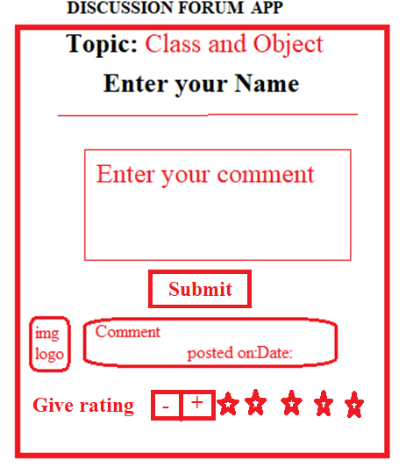
Create one Discussion Forum mobile app which takes comment from user for given topics. Post comment on UI along with date and user icon and based on comment give rating to the user.

Slide 22
ListView Control:
To display items in a List
<ListView x:Name=“ddl” />
Attributes:
HorizontalOptions="Center"
VerticalOptions="CenterAndExpand“
X:Name: Id of control

Slide 23
C# code(ListView):
Step1:Create List at first
private readonly List<string> _names = new List<string>
{ "Gaurang","Arjit","Anmol","Komal"
};
Step2: Call list on page load time
ddlist.ItemsSource = _names;

Slide 24
ProgressBar Control:
A Progress Bar is presented as a line that fills with color to indicate the state and length of a time-consuming task. Progress Bars should always be used when the length of the tasks can be computed.
<ProgressBar x:Name="progressBar1" HeightRequest="50" WidthRequest="100" BackgroundColor="Red"></ProgressBar>

Slide 25
Method to perform ProgressBar
protected override async void OnAppearing()
{
base.OnAppearing();
await progressBar1.ProgressTo(0.8, 10000, Easing.Linear);
}

Slide 26
Override the method:
OnAppearing():
allows application developers to customize behavior immediately prior to the Page becoming visible.
ProgreessBar1.ProgressTo(0.8, 10000, Easing.Linear);
// animate the progression to 80%, in 10000ms
//Easing.Linear functions that modifying the values

Slide 27
SearchBar Control:
:-To search any item in the List
Attribute:
x:Name:define ID
SearchButtonPressed: define event
E.g:
<SearchBar x:Name="searchkey" SearchButtonPressed="onSearch"></SearchBar>

Slide 28
In C# coding :
Step3: perform search
private void onSearch(object sender, EventArgs ar)
{
string key= searchkey.Text;
IEnumerable<string> res=_names.Where(name =>name.Contains(key));
ddlist.ItemsSource = res;
}
Step1:Create List at first
private readonly List<string> _names = new List<string>
{ "Gaurang","Arjit","Anmol","Komal"
};
Step2: Call list on page load time
ddlist.ItemsSource = _names;

