Slide 1
CAP914

Slide 2
The C# Introduction

Slide 3
introduction to c#
• c# program structure
• basic syntax
• class and object
• properties in c#
• user define method in c#

Slide 4
C# program structure:
async void OnButtonClicked(object sender, EventArgs args)
{
int val1 = int.Parse(txtVal1.Text);
int val2 = int.Parse(txtVal2.Text);
int res = val1 + val2;
await DisplayAlert("Addition",res.ToString(), "OK");
}
}
}
using System;
using System.Collections.Generic;
using System.Linq;
using System.Text;
using System.Threading.Tasks;
using Xamarin.Forms;
namespace App7
{
public partial class MainPage : ContentPage
{
public MainPage()
{
InitializeComponent();
}

Slide 5
basic syntax:
Data Type
Operators
Looping
Array

Slide 6
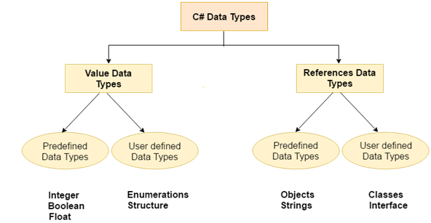

Slide 7
Types | Data Types
Value Data Type | short, int, char, float, double etc
Reference Data Type | String, Class, Object and Interface

Slide 8
Boxing/ Unboxing
C# allows us to convert a Value Type to a Reference Type, and back again to Value Types . The operation of Converting a Value Type to a Reference Type is called Boxing and the reverse operation is called Unboxing.
int Val = 1;
Object Obj = Val; //Boxing
UnBoxing
int Val = 1;
Object Obj = Val; //Boxing
int i = (int)Obj; //Unboxing

Slide 9
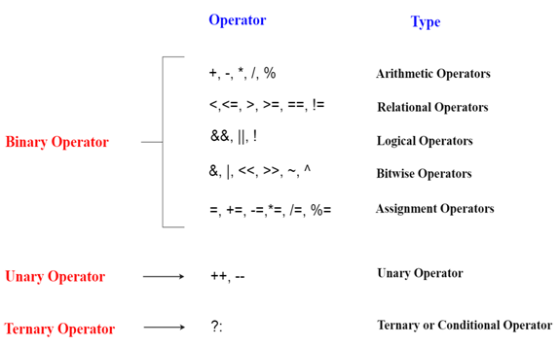
Different types of operators

Slide 10
Read input from xaml control
ControlID.Text
Ex:
<Entry x:Name=“txtvalue1”>
txtvalue1.Text

Slide 11
Display output using xaml control
ControlID.Text
Ex:
<Label x:Name=“lblresult”>
lblresult.Text

Slide 12
Variable declaration:
DataType variableName;
Ex:
int num;
double num;
string name;

Slide 13
If else:
if(condition)
{
}
else
{
}

Slide 14
Switch case:
switch(choice)
{
case 1:
break;
case 2:
break;
case 3:
break;
}

Slide 15
For loop
for(initialization;condition;increment)
{
}
Ex:
for(i=0;i<5;i++)
{
}

Slide 16
class
class className
{
public int id;
public void getid()
{
id=1234;
}
}
How to call method?
:--
className objectName=new className();
objectName.getid();

Slide 17
Enhance For Loop
string[] pets = { "dog", "cat", "bird" };
// ... Loop with the foreach keyword.
foreach (string value in pets)
{
Console.WriteLine(value);
}

Slide 18
Practice questions:
1. Create a mobile application where you have to calculate total amount in a Piggybank. A piggy bank having 10 Rs coin, 5 Rs coin, 2 Rs coin and 1 Rs coin.
2. Create a mobile application which generate electricity bill from the following conditions:
Condition 1. If meter reading is more then 100 chargeable amount will be 6.95 Rs per unit.
Condition 2. If meter reading is less then or equal to 100 chargeable amount will be 5.95 Rs per unit.

Slide 19
Practice questions:
A company insures its drivers in the following cases
1. If the driver is married
2. If the driver is unmarried, male and above 30 years of age
3. If the driver is unmarried, female and above 25 years of age
In all other cases, the driver is not insured. If the marital status, sex, age of the driver are the inputs, write a program to determine whether the driver is insured or not. (use ‘nested-if’).

Slide 20
Practice questions:
Write a program to calculate the monthly income of a person using the following
commission schedule:
(use ‘if-else-if’ statement).
Monthly sales income:
if >=50,000Rs then 375+16% Sales.
if <50,000 but>=40,000Rs then 370+14% Sales
if <40,000 but>=30,000Rs then 325+12% Sales
if <30,000 but>=20,000Rs then 300+9% Sales
if <20,000 but>=10,000Rs then 250+5% Sales
if <10,000Rs then 200+3% Sales

Slide 21
Practice questions:
A milk vendor buys milk at the rate of 3.25/- the then adds a liter of water for every 4 liters of milk and sells the water milk at the rate of 4.15/1t. calculate the gain for milk vendor?

Slide 22
Practice questions:
A vender wants to determine whether he should serve foods to someone. He only serves foods to people whose age is 18 or more and when he is not on fasting. Given the person's age, and whether fasting time is in session, create a function which returns whether he should serve foods.
Examples
should_serve_foods(17, True) ➞ False(No serve foods)
should_serve_foods(19, False) ➞ True(serve foods)
should_serve_foods(30, True) ➞ False(No serve foods)

Slide 23
Practice questions:
Create one application for banking transaction:
  Withdrawal operation and
  Deposit operation

Slide 24


Slide 25
Array
int[] arr = new int[5];//creating array
int arr[] = new int[5];//compile time error

Slide 26
properties in c#
Usually inside a class, we declare a data field as private and will provide a set of public SET and GET methods to access the data fields. since the data fields are not directly accessible out side the class. We can use the set/get methods to access the data fields.
Syntax:
<acces_modifier> <return_type> <property_name>
{
get
{
}
set
{
}
}
Example in next page

Slide 27
using System;
class MyPropertyEx
{
private int x;
public void SetX(int i)
{
x = i;
}
public int GetX()
{
return x;
}
}
class MainClass
{
public static void Main()
{
MyPropertyEx obj = new MyPropertyEx ;
obj.SetX(10);
int xVal = obj.GetX();
Console.WriteLine(xVal);
}
}

