Slide 1
Navigations
Presented By
Kumar Vishal

Slide 2
Navigations
One page call to other page
For navigations pages should be more then one
Navigation in Xamarin.Forms is different

Slide 3
Steps of basic navigation approach:
Open App.xaml.cs file
Below InitializeComponent();
MainPage = new NavigationPage(new Page1());
Here NavigationPage is predefined class
Page1 is a page in which we have to apply navigation

Slide 4
Now in page 1 design code
<Button Text=“next" Clicked="onclicked" BackgroundColor="White" ></Button>
Perform navigation on button click

Slide 5
Code behind part in page1:
On button clicck
async void onclicked(object sender, EventArgs e)
{
await Navigation.PushAsync(new Page2());
}
Here PushAsync() is used call page2.

Slide 6
passing data when navigating

Slide 7
Passing data when navigating
By using constructor
Steps:
  Create two pages :
    Page 1
    Page 2
  Make Page1 as navigation page:
In App.xaml.cs
Below InitializeComponent();
MainPage = new NavigationPage(new Page1());

Slide 8
Now design in page1:
<?xml version="1.0" encoding="utf-8" ?>
<ContentPage xmlns="http://xamarin.com/schemas/2014/forms"
xmlns:x="http://schemas.microsoft.com/winfx/2009/xaml"
x:Class="App10.Page1">
<StackLayout Padding="100">
<Entry x:Name=“txtName” Placeholder=“Enter Name”></Entry>
<Button Text="Submit" Clicked="onclicked"></Button>
</StackLayout>
</ContentPage>

Slide 9
C# Code in Page1:
using System;
using Xamarin.Forms;
namespace App10
{
public partial class Page1 : ContentPage
{
async void onclicked(object sender, EventArgs e)
{
string str1= txtName.Text;
await Navigation.PushAsync(new Page2(str1));
}
}
}

Slide 10
Page2 Design:
<?xml version="1.0" encoding="utf-8" ?>
<ContentPage xmlns="http://xamarin.com/schemas/2014/forms"
xmlns:x="http://schemas.microsoft.com/winfx/2009/xaml"
x:Class="App10.Page2">
<StackLayout Padding="100">
<Label x:Name=”txtName” FontSize="Medium" FontAttributes="Bold" />
</StackLayout>
</ContentPage>

Slide 11
C# Coding for Page2:
using System;
using Xamarin.Forms;
namespace App10
{
public partial class Page2 : ContentPage
{
public Page2(string name)
{
InitializeComponent();
txtName.Text = name;
}
}
Execute your app now

Slide 12
Name of Experiment:
Create one dashboard page which contain four different types of Button :
Button1-> after click Feed Back Page should be open
Button2->after click Contact Us Page should be open
Button3->after click Profile Page should be open
Button4->after click Image Gallery Page should be open
Create all pages with proper design

Slide 13

Name of Experiment:
Generate experience certificate take details of employee from user.
Take details from user in Page1
Generate experience certificate in Page2
After click on submit button in Page1, pass data in Page2 and generate certificate.

Slide 14
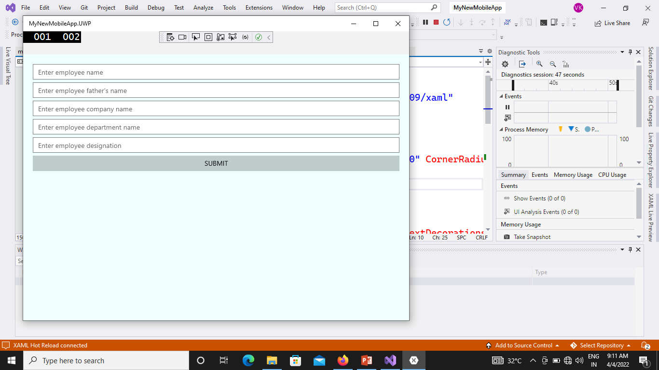


Slide 15
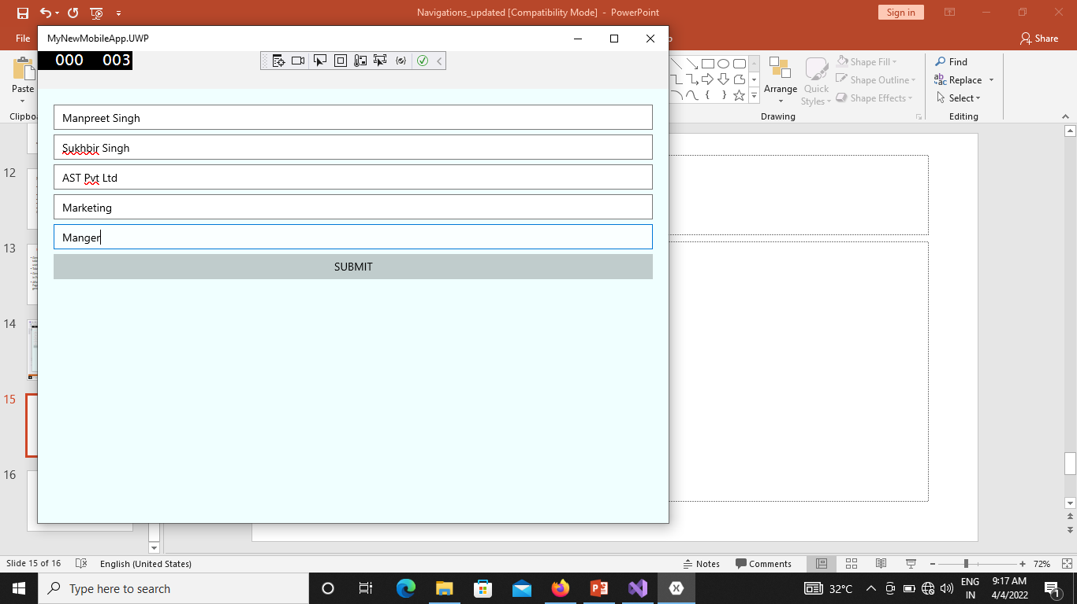

Slide 16
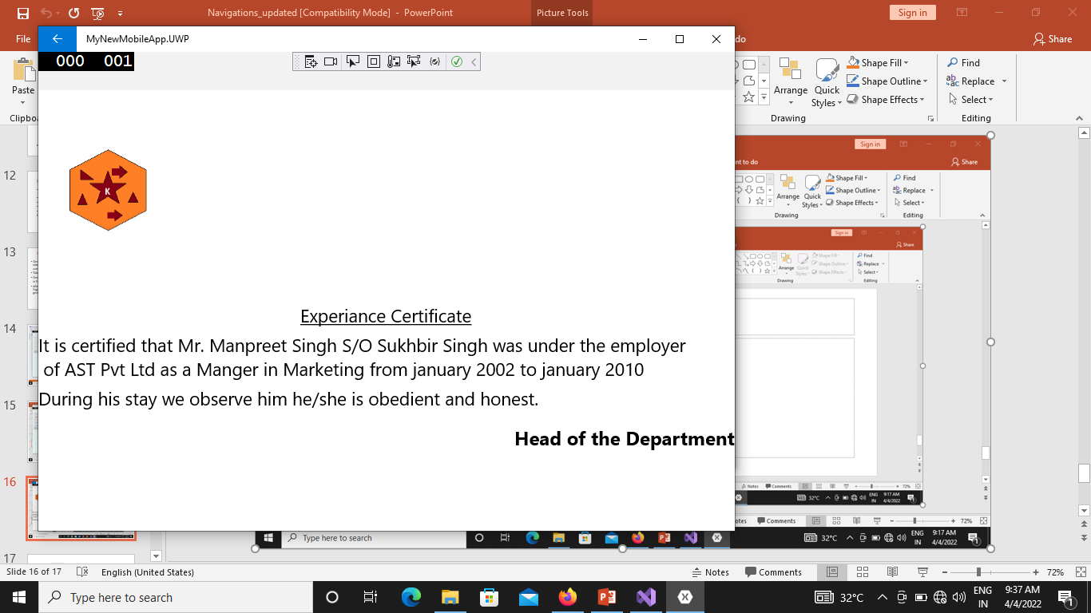

Slide 17
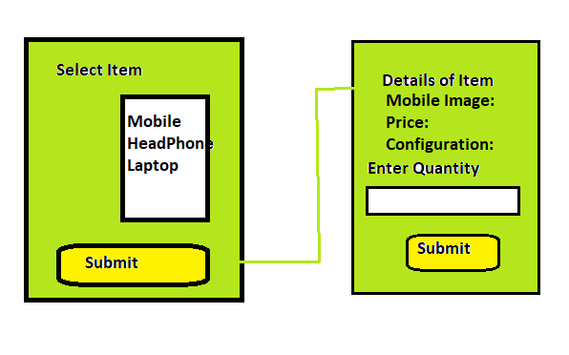

Slide 18
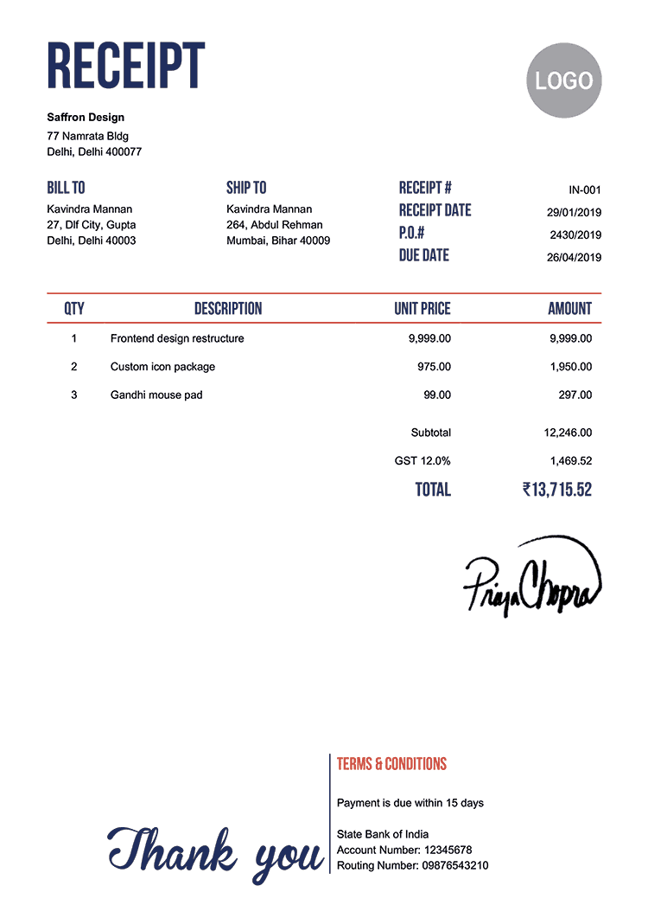

Slide 19






Create a profile page which navigate Gmail , Facebook, Instagram and linked in page
User
Details

Slide 20
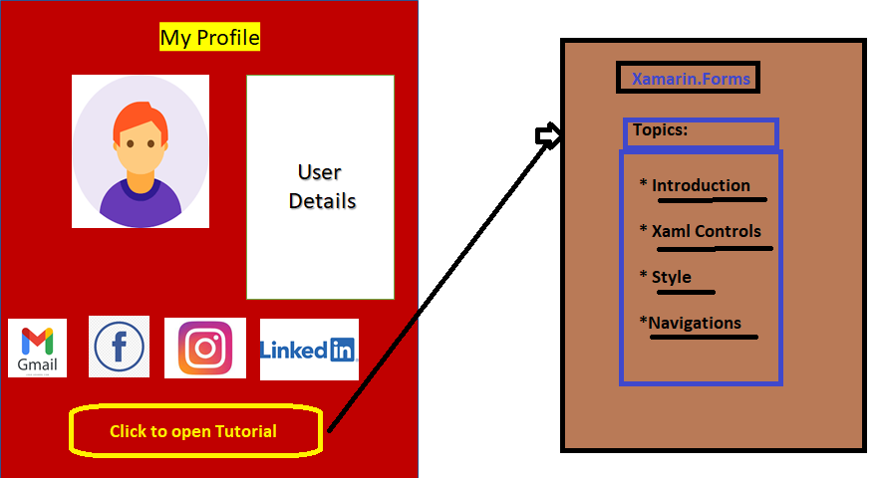

Slide 21
Carousel Page
Design Page:
<?xml version="1.0" encoding="utf-8" ?>
<CarouselPage xmlns="http://xamarin.com/schemas/2014/forms"
xmlns:x="http://schemas.microsoft.com/winfx/2009/xaml"
x:Class="App11.Page3">
<ContentPage Padding="50">
<StackLayout>
<Label Text="Red" FontSize="Medium" HorizontalOptions="Center" />
<BoxView Color="Red" WidthRequest="200" HeightRequest="200" HorizontalOptions="Center" VerticalOptions="CenterAndExpand" />
</StackLayout>
</ContentPage>
<ContentPage Padding="50">
<StackLayout>
<Label Text="Green" FontSize="Medium" HorizontalOptions="Center" />
<BoxView Color="Green" WidthRequest="200" HeightRequest="200" HorizontalOptions="Center" VerticalOptions="CenterAndExpand" />
</StackLayout>
</ContentPage>
</CarouselPage>
Navigating between pages using a swipe gesture
The Xamarin.Forms CarouselPage is a page that users can swipe from side to side to navigate through pages of content, like a gallery.
Example:App11: Page3

Slide 22
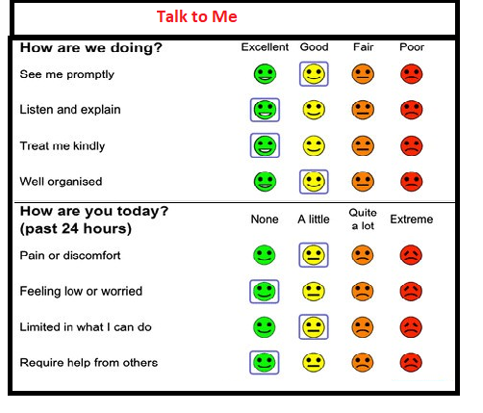
Create one Mobile App: Talk to Me which shows some questionnaires, navigate page with swipe (use carousel page) means one page at a time
Talk to Me

Slide 23
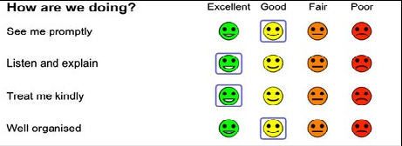

Talk to Me
Talk to Me

Slide 24
Xamarin.Forms MasterDetailPage
The Xamarin.Forms MasterDetailPage is a page that manages two related pages of information – a master page that presents items, and a detail page that presents details about items on the master page.
Menu:
First
Second
Third
First Page

Slide 25
Steps:
Step1: Define MasterDetailPage
<MasterDetailPage xmlns="http://xamarin.com/schemas/2014/forms"
xmlns:x="http://schemas.microsoft.com/winfx/2009/xaml"
x:Class="App11.Page4">
</MasterDetailPage>

Slide 26
Step2: Create Menu Bar in left panel
<MasterDetailPage.Master>
<ContentPage Title="Menu">
<StackLayout>
<Label Text="FirstPage"></Label>
<Button Text="First" Clicked="onfirst"></Button>
</StackLayout>
</ContentPage>
</MasterDetailPage.Master>

Slide 27
Step3: define content page (Container for calling page)
<MasterDetailPage.Detail>
<ContentPage></ContentPage>
</MasterDetailPage.Detail>

Slide 28
MasterDetailPage Example:
Design page:
<?xml version="1.0" encoding="utf-8" ?>
<MasterDetailPage xmlns="http://xamarin.com/schemas/2014/forms"
xmlns:x="http://schemas.microsoft.com/winfx/2009/xaml"
x:Class="App11.Page4">
<MasterDetailPage.Master>
<ContentPage Title="Menu">
<StackLayout>
<Label Text="FirstPage"></Label>
<Button Text="First" Clicked="onfirst"></Button>
</StackLayout>
</ContentPage>
</MasterDetailPage.Master>
<MasterDetailPage.Detail>
<ContentPage></ContentPage>
</MasterDetailPage.Detail>
</MasterDetailPage>
C# coding:
using System;
using Xamarin.Forms;
namespace App11
{
public partial class Page4 : MasterDetailPage
{
public Page4()
{
InitializeComponent();
}
public void onfirst(object sender,EventArgs e)
{
Detail = new Page1();
}
}
}

Slide 29
Thanks

