Slide 1
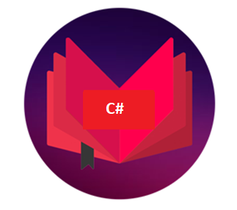
DCAP505 MODERN PROGRAMMING TOOLS & TECHNIQUES–II

Slide 2
Unit-1
Introduction: What is C#, Why C#, Evolution of C#,
Characteristics of C#,
Difference of C# from C++ and Java,
Writing a C# program

Slide 3
Introduction to C#

Slide 4
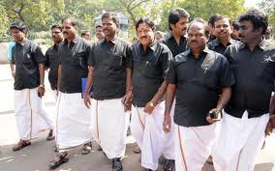




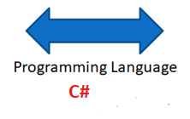
What do we need to know?
Tamil
Punjabi
Need of Language :: Introduction to programming Language

Slide 5
Daily routine
Let us look around our daily routine…
Let us see where all we do programming everyday
Simple things we do to start the day

Slide 6

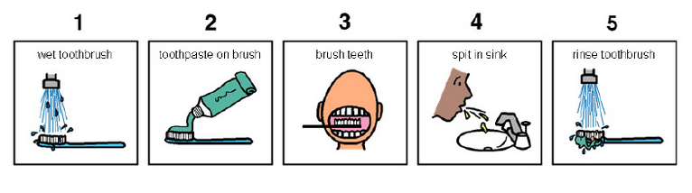
So there is ONE program you know which is there in you…

Slide 7
Daily routine
Start
There is a set procedure
Each step is defined
The occurrence is ordered
Jump is NOT permitted
A step cannot be skipped
Pick Brush
Rinse Brush
Apply Paste
Brush
Rinse Mouth
Rinse Brush
Stop

Slide 8






Daily routine
Yet another example but more complex
Vision
Sensor
Sipping TEA
Smell
Sensor
Radiation
Sensor
If all sensors
SIP
If even one is
Touch
Sensor
WAIT!!!

Slide 9




So what does this mean?
Take ANY activity of the day…
It will have a set procedure
It has to be done in a designated way
If not done the specified way will yield wrong results.
Success in doing it depends on how closer one is to the prescribed method.
This clearly shows that everything has a
Logic

Slide 10

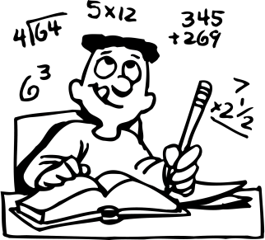
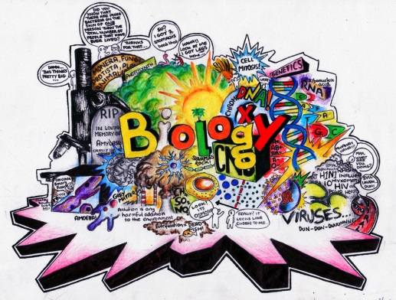
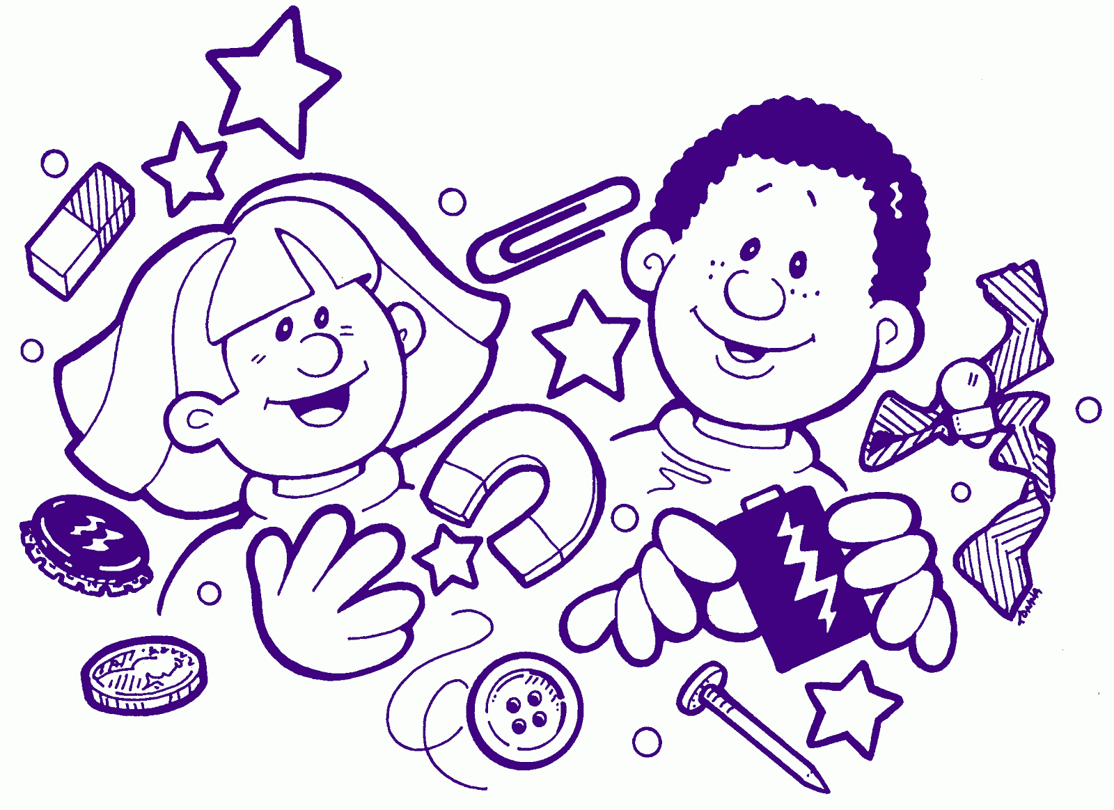




Logic, logic and logic
Logic

Slide 11
What next?
If there is logic in anything and everything
There has to be ways to represent logic
There has to be modes to modify and re-represent logic.
There should be methodology to implement and re-design logic.
And for all this…

Slide 12


What next?
There has to be logic machine to assimilate, understand, solve, store, retrieve and represent logic
There has to be a LANGUAGE to communicate with the logic machine
Otherwise….

Slide 13
object oriented languages
Procedural Programming and Object Oriented Programming:
Languages used in Procedural Programming:
FORTRAN, ALGOL, COBOL,
BASIC, Pascal and C.
Languages used in Object Oriented Programming:
Java, C++, C#, Python , Vb.net
PHP, JavaScript, Ruby, Perl,
Objective-C, Dart, Swift, Scala.

Slide 14
OOPs Features
Class
Objects
Encapsulation
Abstraction
Polymorphism
Inheritance

Slide 15
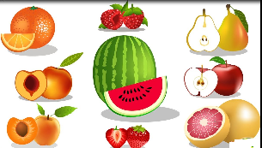
Class
Class is a collection of similar types of objects.
For example: Fruits is class of mango, apple , orange etc.
Object is an instance of a Class.
Fruits

Slide 16
Encapsulation
Wrapping up of data and information under a single unit.
Binding together the data and the functions in a single unit
Encapsulation also hides the data
We can achieve encapsulation features by making data member as a private and use get and set accessor methods to access data members.

Slide 17


Abstraction
Hiding background details and showing features or functionality only

Slide 18
You know how to drive the car but you don’t know about the internal details this is the example of ….?
Encapsulation
Abstraction
None

Slide 19


Polymorphism
The ability to perform a task in more than one form.
Good Student
Good Singer
Rahul

Slide 20



Inheritance
father
mother
child

Slide 21
"C-Sharp". It is an object-oriented programming language provided by Microsoft that runs on .Net Framework.
Anders Hejlsberg is known as the founder of C# language and its development team is currently led by Mads Torgersen. The most recent version is 8.0
first release in the year 2002

Slide 22
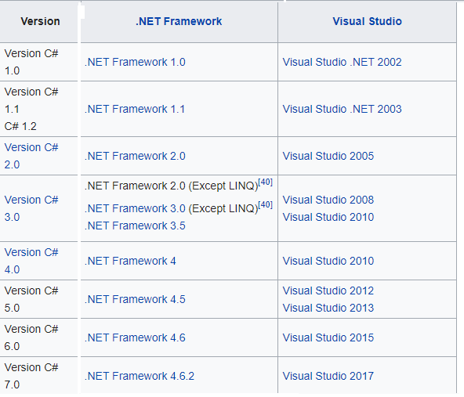
Version C# 8.0 .NET Framework 4.8 Visual Studio 2019

Slide 23
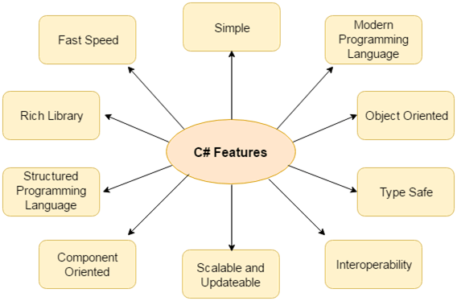
Characteristics of C#

Slide 24
Modern Programming Language
C# supports number of modem features, such as:
Automatic Garbage Collection
Error handling features
Modern debugging features
Robust Security features

Slide 25
Type Safety
Type safety promotes robust programming. Some examples of type safety are:
All objects and arrays are initialized by zero dynamically
An error message will be produced, on use of any uninitialized variable
Automatic checking of array (out of bound and etc.)

Slide 26
Inter-operability
Language interoperability is the ability of code to interact with code that is written using a different programming language. Language interoperability can help maximize code reuse and, therefore, improve the efficiency of the development process.

Slide 27
Scalable and Updateable
C# is automatic scalable and updateable programming language. The old files are regularly updated and replaced with new ones.
Component Oriented
C# is component oriented programming language. It is the main software development methodology used to develop more robust and highly scalable applications.

Slide 28
Component-oriented programming is a technique of developing software applications by combining pre-existing and new components, much the same way automobiles are built from other components. Software components are self-contained, self-describing packages of functionality containing definitions of types that expose both behavior and data.
C# supports component-oriented programming through the concepts of properties, methods, events, and attributes (or metadata), allowing self-contained and self-describing components of functionality called assemblies.

Slide 29
Any Query?

