Slide 1

DCAP505 MODERN PROGRAMMING TOOLS & TECHNIQUES–II

Slide 2
Unit-3
Handling Arrays:
Declaring Arrays.
System.Array class
Methods:
Declaring Methods,
Invoking Methods,
Pass by Value, Pass by Reference

Slide 3
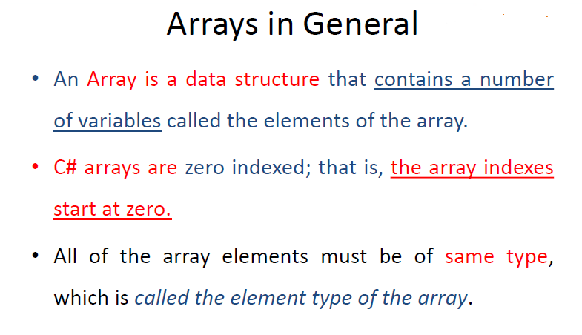

Slide 4
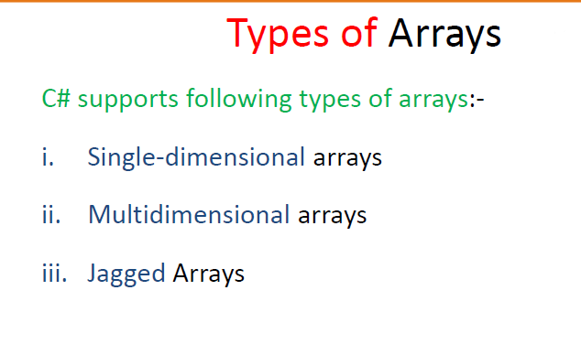

Slide 5
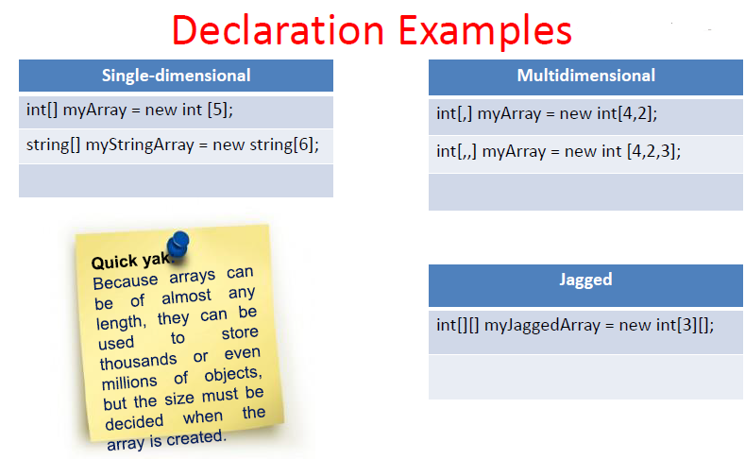

Slide 6
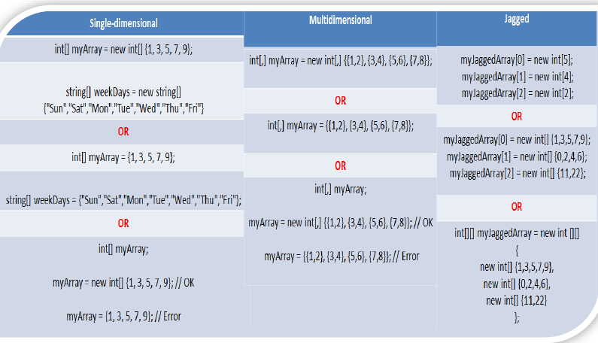

Slide 7
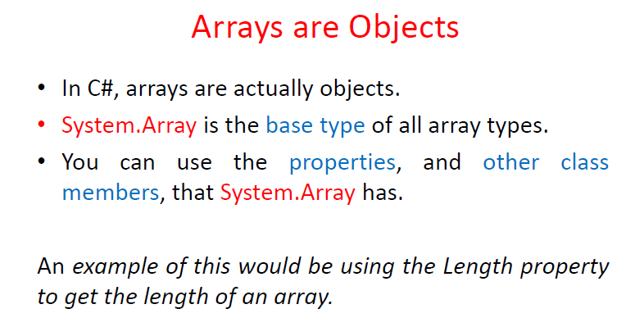

Slide 8
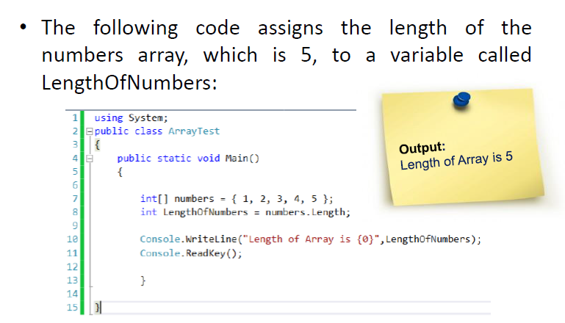

Slide 9
Methods:
Defining Methods in C#
<Access Specifier> <Return Type> <Method Name>(Parameter List)
{
Method Body
}

Slide 10
Invoking Methods:
using object

Slide 11
Passing Parameters to a Method
: Pass by Value, Pass by Reference

Slide 12
Pass by Value
In this mechanism, when a method is called, a new storage location is created for each value parameter.
The values of the actual parameters are copied into them. Hence, the changes made to the parameter inside the method have no effect on the argument.
public void swap(int x, int y) {
int temp;
temp = x;
x = y;
y = temp;
}

Slide 13
Pass by Reference
public void swap(ref int x, ref int y) {
int temp;
temp = x;
x = y;
y = temp;
}
/* calling a function to swap the values */
int a = 100;
int b = 200;
n.swap(ref a, ref b)
When you pass parameters by reference, unlike value parameters, a new storage location is not created for these parameters.
The reference parameters represent the same memory location as the actual parameters that are supplied to the method.

Slide 14
Any Query?

