Slide 1

DCAP505 MODERN PROGRAMMING TOOLS & TECHNIQUES–II

Slide 2
Unit-4
Classes & Object in C#:
Defining Classes, object, methods.
Constructors,
Using Polymorphism,
Inheritance in classes.

Slide 3
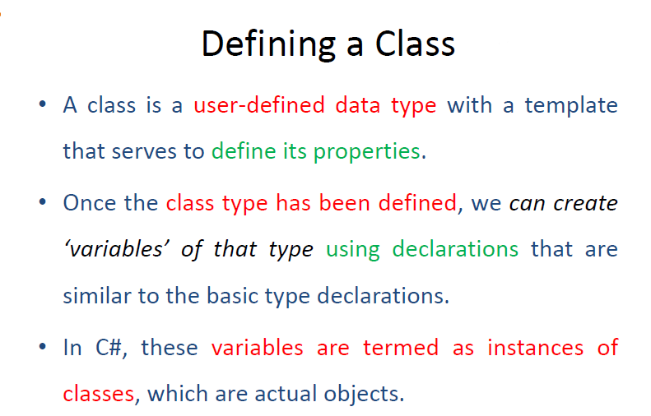

Slide 4
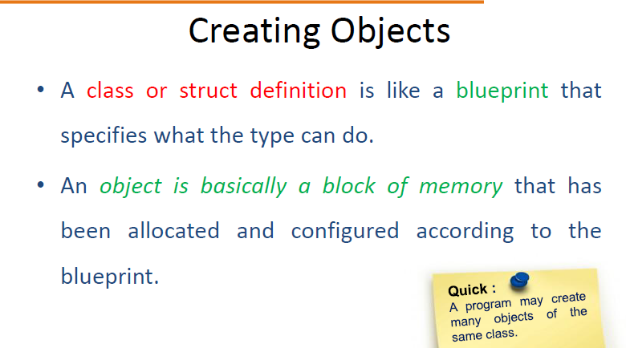

Slide 5
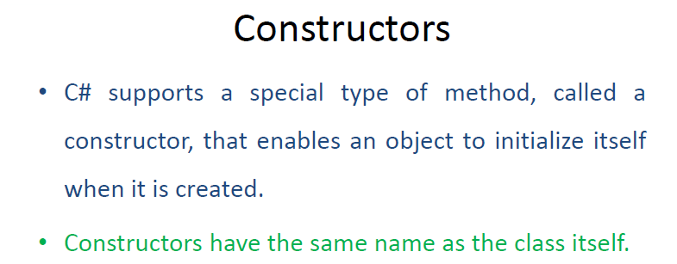

Slide 6
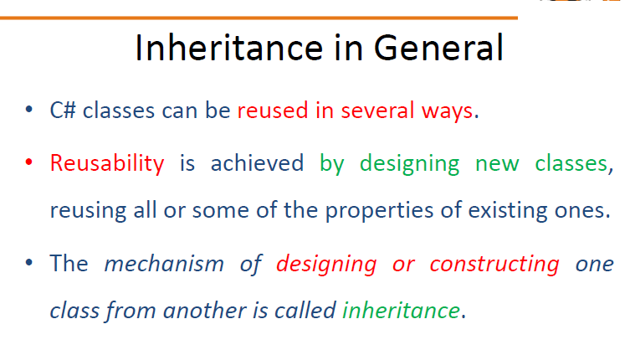

Slide 7
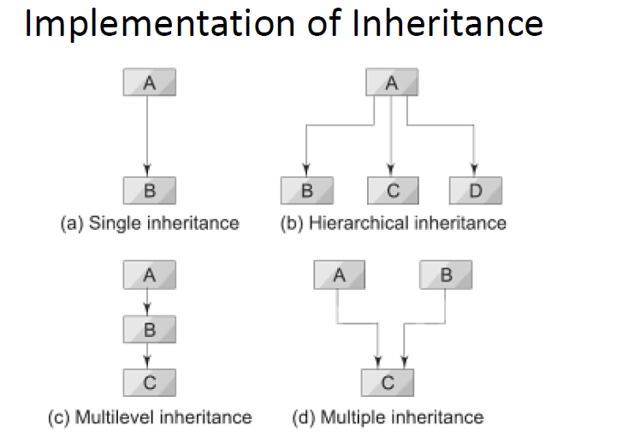

Slide 8
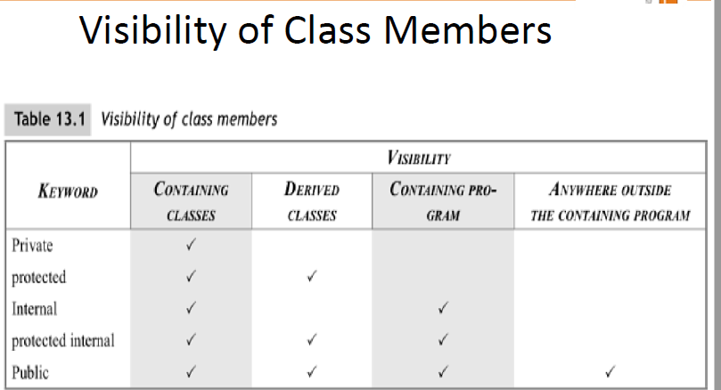

Slide 9
