Slide 1

DCAP505 MODERN PROGRAMMING TOOLS & TECHNIQUES–II

Slide 2
Unit-5
Interfaces:
Meaning and Implementation
Namespaces:
Meaning and its working.
Using System Namespace and Object class.

Slide 3
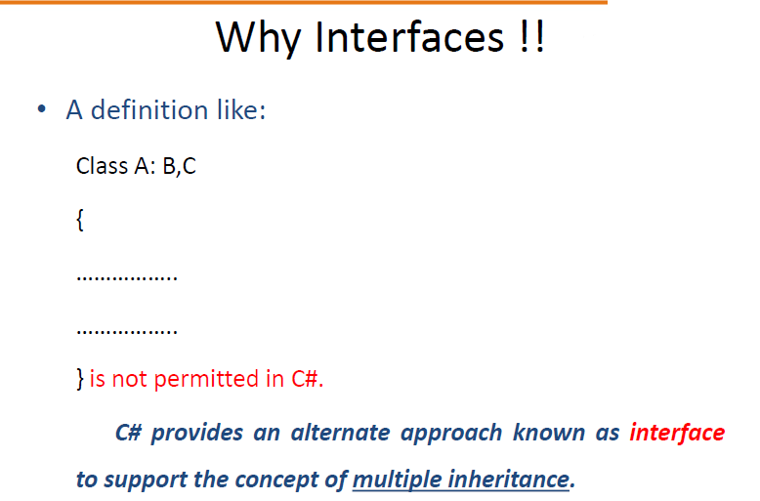

Slide 4
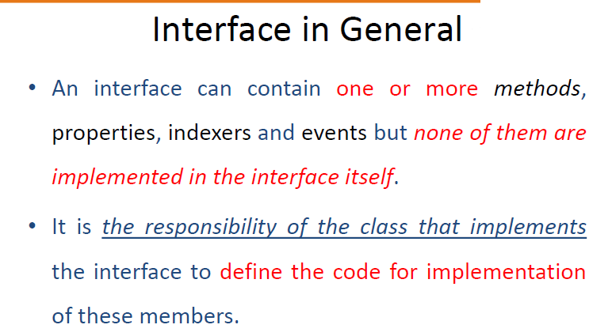

Slide 5
Namespaces
Collection of classes ,methods, properties , events etc…
It is just like a container.
A namespace definition begins with the keyword namespace followed by the namespace name as follows −
namespace namespace_name {
// code declarations
}

Slide 6
The using keyword states that the program is using the names in the given namespace. For example, we are using the System namespace in our programs.

Slide 7
Object class
The Object class is the base class for all the classes in .Net Framework. It is present in the System namespace. In C#, the .NET Base Class Library(BCL) has a language-specific alias which is Object class with the fully qualified name as System.Object. Every class in C# is directly or indirectly derived from the Object class.

