Slide 1

DCAP505 MODERN PROGRAMMING TOOLS & TECHNIQUES–II

Slide 2
Unit-6
Exception Handling:
Exceptions,
Multiple Catch Statements,
Using Finally Statement,
Nested Try Blocks

Slide 3
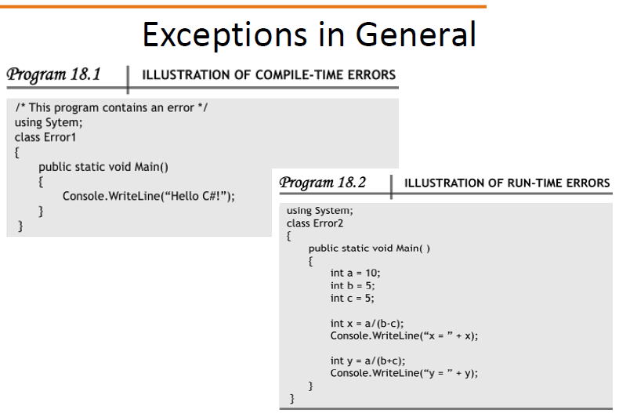

Slide 4
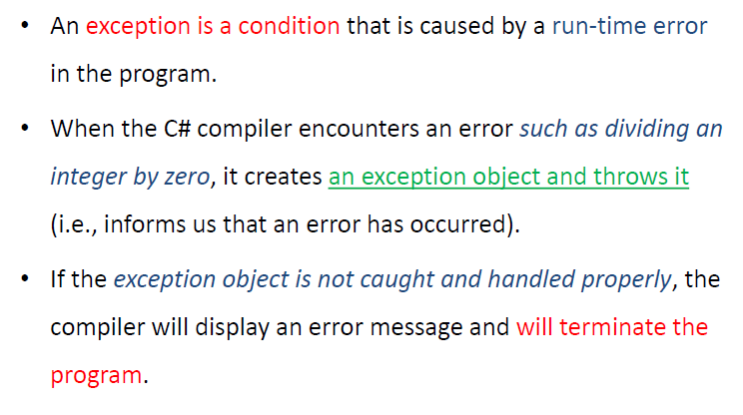

Slide 5
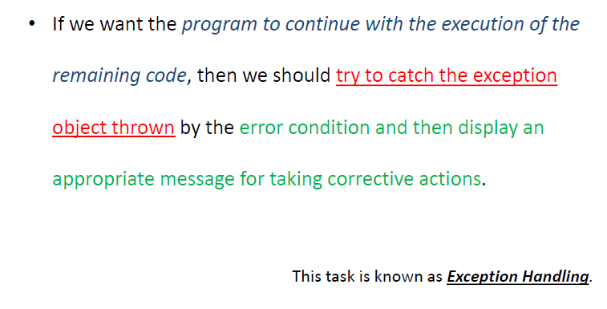

Slide 6
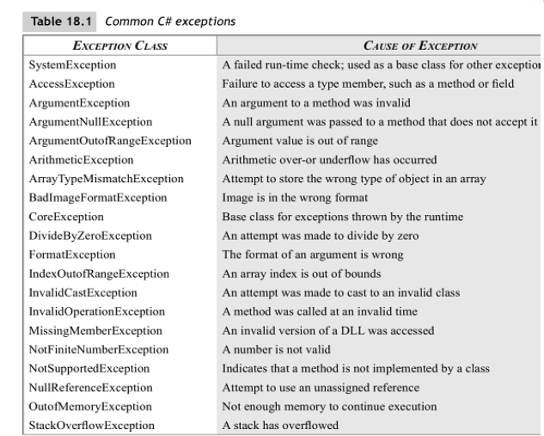

Slide 7
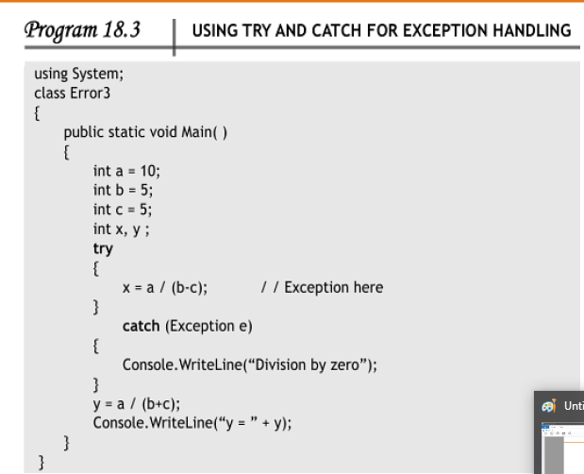

Slide 8
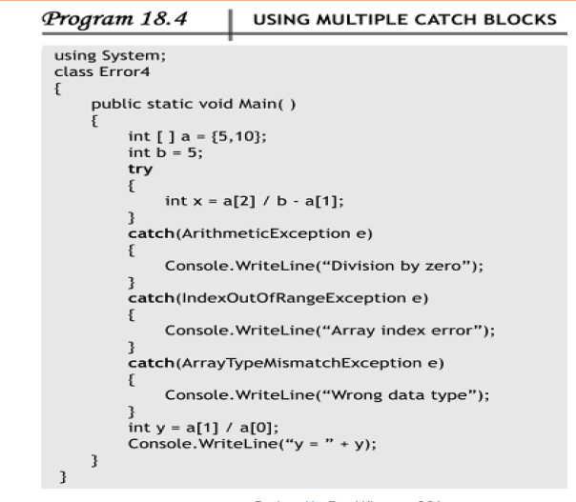

Slide 9
