Slide 1
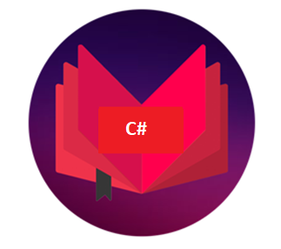
DCAP505 MODERN PROGRAMMING TOOLS & TECHNIQUES–II

Slide 2
Unit-7
Windows Programming:
Using Controls- textboxes,
listbox,
buttons,
datetime picker,
comboboxes etc
Common Dialog Boxes:
OpenFileDialog, SaveFileDialog, ColorDialog, MessageBox Class and
DialogResult Class.

Slide 3
Window form controls:
1.Label: It is used to display output or any informations to the user.
Properties:
Name:it is used to define id of the control
Size: it is used to define size of text
ForeColor: it is used to define text color
BackColor: it is used to define background color
Text: it is used display any information in window screen.

Slide 4
2.TextBox:It is used to take input from user.
Properties:
Name:it is used to define id of the control
Size: it is used to define size of text
ForeColor: it is used to define text color
BackColor: it is used to define background color
Text: it is used read input from textbox

Slide 5
3.Button:It is used to perform action on window screen.
Properties:
Name:it is used to define id of the control
Size: it is used to define size of text
ForeColor: it is used to define text color
BackColor: it is used to define background color
Text: it is used to display caption of a button.

Slide 6
4. ComboBox:it is used to display items in dropdown list.
Properties:
Name:it is used to define id of the control
Size: it is used to define size of text
ForeColor: it is used to define text color
BackColor: it is used to define background color
Text: it is used to display text on ComboBox
Items:it is used to display item on combobox

Slide 7
5. ListBox: it is used to display items in a list form.
Properties:
Name: it is used to define id of the control
Size: it is used to define size of text
ForeColor: it is used to define text color
BackColor: it is used to define background color
Items:it is used to display item on listbox

Slide 8
WindowForm Controls Example:
private void Button1_Click(object sender, EventArgs e)
{
string place = comboBox1.SelectedItem.ToString();
string name = textBox1.Text;
string course = listBox1.SelectedItem.ToString();
label5.Text = name;
label7.Text = place;
label10.Text = course;
}

Slide 9
Common Dialog Boxes
https://github.com/vishalamc/csharp/blob/master/DialogBoxControlsExample.txt

