Slide 1

DCAP505 MODERN PROGRAMMING TOOLS & TECHNIQUES–II

Slide 2
Unit-8
File Input Output:
Working with Files and Directories.
System.IO.

Slide 3
C# includes following standard IO (Input/Output) classes to read/write from different sources like files, memory, network, isolated storage, etc.
Stream: System.IO.Stream is an abstract class that provides standard methods to transfer bytes (read, write, etc.) to the source. It is like a wrapper class to transfer bytes. Classes that need to read/write bytes from a particular source must implement the Stream class.

Slide 4
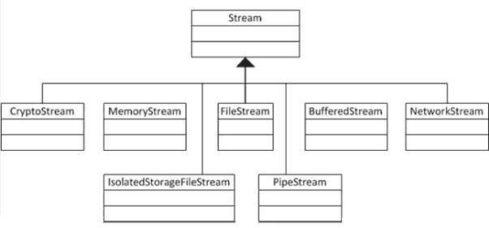
hierarchy of stream classes

Slide 5
Directory class
System.IO.Directory class in the .NET Framework class library provides static methods for creating, copying, moving, and deleting directories and subdirectories. Before you can use the Directory class, you must import the System.IO namespace.

Slide 6
Create a Folder in C#
string root = @"C:\Temp";
string subdir = @"C:\Temp\Mahesh";
// If directory does not exist, create it.
if (!Directory.Exists(root))
{
Directory.CreateDirectory(root);
}

Slide 7
reading a text file
using System;
using System.IO;
namespace FileApplication {
class Program {
static void Main(string[] args) {
try {
StreamReader sr = new StreamReader("c:/demo.txt")
string line;
while ((line = sr.ReadLine()) != null) {
Console.WriteLine(line);
}
}
} catch (Exception e) {
Console.WriteLine("The file could not be read:");
Console.WriteLine(e.Message);
}
Console.ReadKey();
}
}
}

Slide 8
writing text data into a file
using System;
using System.IO;
namespace FileApplication {
class Program {
static void Main(string[] args) {
string[] names = new string[] {"hello", "world"};
StreamWriter sw = new StreamWriter("demo.txt")
foreach (string s in names) {
sw.WriteLine(s);
}
}
// Read and show each line from the file.
string line = "";
using (StreamReader sr = new StreamReader("names.txt")) {
while ((line = sr.ReadLine()) != null) {
Console.WriteLine(line);
}
}
Console.ReadKey();
}
}
}

