Slide 1

DCAP505 MODERN PROGRAMMING TOOLS & TECHNIQUES–II

Slide 2
Unit-9
ADO.NET:
Accesing Database with ADO.NET.
Executing Insertion, deletion, updation and select
command with databases.

Slide 3
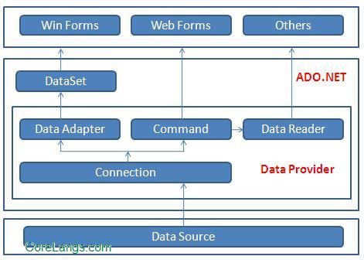
Ado.net Architecture

Slide 4
ADO.NET consist of a set of Objects that expose data access services to the .NET environment.
It is a data access technology from Microsoft .Net Framework , which provides communication between relational and non relational systems through a common set of components .
System.Data namespace is the core of ADO.NET and it contains classes used by all data providers.

Slide 5
Namespaces | Description
System.Data | Contains the definition for columns,relations,tables,database,rows,views and constraints.
System.Data.SqlClient | Contains the classes to connect to a Microsoft SQL Server database such as SqlCommand, SqlConnection and SqlDataAdapter.
System.Data.Odbc | Contains classes required to connect to most ODBC drivers. These classes include OdbcCommand and OdbcConnection.
System.Data.OracleClient | Contains classes such as OracleConnection and OracleCommand required to connect to an Oracle database.

Slide 6
The two key components of ADO.NET are
Data Providers and DataSet .
DataSet contains rows, columns, primary keys, constraints, and relations with other DataTable objects. It consists of a collection of DataTable objects that you can relate to each other with DataRelation objects. The DataAdapter Object provides a bridge between the DataSet and the Data Source.

Slide 7
Data Providers
A data provider contains Connection, Command, DataAdapter, and DataReader objects.
The .Net Framework includes mainly three Data Providers for ADO.NET. They are the Microsoft SQL Server Data Provider , OLEDB Data Provider and ODBC Data Provider . SQL Server uses the SqlConnection object , OLEDB uses the OleDbConnection Object and ODBC uses OdbcConnection Object respectively.

Slide 8
Connection
The Connection Object provides physical connection to the Data Source. Connection object needs the necessary information to recognize the data source and to log on to it properly, this information is provided through a connection string.

Slide 9
Command
The Command Object uses to perform SQL statement or stored procedure to be executed at the Data Source. The command object provides a number of Execute methods that can be used to perform the SQL queries in a variety of fashions.

Slide 10
DataReader
The DataReader Object is a stream-based , forward-only, read-only retrieval of query results from the Data Source, which do not update the data.

Slide 11
DataAdapter
DataAdapter Object populate a Dataset Object with results from a Data Source . It is a special class whose purpose is to bridge the gap between the Dataset objects and the data source.

Slide 12
The architecture of ADO.net in which data retrieved from database can be accessed even when connection to database was closed is called as disconnected architecture.
Disconnected architecture of ADO.net was built on classes connection, dataadapter, commandbuilder and dataset and dataview.

Slide 13
Example:
https://github.com/vishalamc/CSharpDotNet/blob/main/homeBudget.rar

