Slide 1
Array and its types

Slide 2
Arrays
An array stores a fixed-size sequential collection of elements of the same type.
All arrays consist of contiguous memory locations.
Dim intData() As Integer = {12, 16, 20, 24, 28, 32}
Dim names() As String = {“Karthik”, “Sandhya”}

Slide 3
Types of Arrays
Fixed-Size Arrays
Dynamic Arrays

Slide 4
This is an array that can hold any number of elements.
The array size can grow at any time.
This means that you can add new elements to the array any time we want.
a dynamic array using the ReDim keyword
If you want to keep the existing items in the Array , you can use the keyword Preserve:
ReDim Preserve arrayname(size)

Slide 5
Declaring two dimensional Array
The general syntax to declare a two dimensional array is as follow:
Dim ArrayName(Sub1,Sub2) as dataType

Slide 6
Arrays
Fixed Size Array:
Dim intData() As Integer = {12, 16, 20, 24, 28, 32}
Dim names() As String = {"Karthik", "Sandhya", _ "Shivangi", "Ashwitha", "Somnath"}

Slide 7
Dynamic Arrays
Dynamic arrays are arrays that can be dimensioned and re-dimensioned as par the need of the program. You can declare a dynamic array using the ReDim statement.
Dim marks() As Integer
ReDim marks(2)

Slide 8
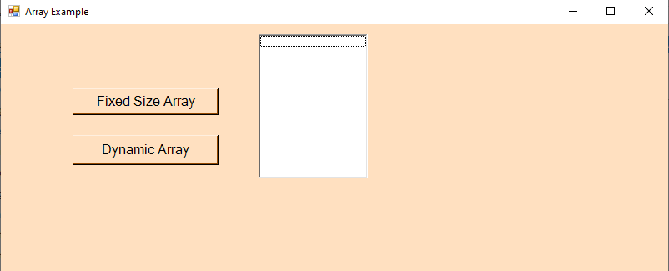
Array Example Design Output:

Slide 9
Coding:
Public Class Form9
Private Sub Button1_Click(sender As Object, e As EventArgs) Handles Button1.Click
Dim studentName(0 To 5) As String
MessageBox.Show(studentName.Length)
Dim i As Integer
For i = 0 To studentName.Length - 1
studentName(i) = InputBox("Enter value")
ListBox1.Items.Add(studentName(i))
Next
MessageBox.Show("Array Full")
End Sub
Private Sub Button2_Click(sender As Object, e As EventArgs) Handles Button2.Click
Dim myArray() As Integer
Dim i, n As Integer
n = InputBox("Enter the size of array")
ListBox1.Items.Clear()
ReDim myArray(n)
For i = 0 To n
myArray(i) = InputBox("Enter the element of array")
ListBox1.Items.Add(myArray(i))
Next
End Sub
End Class

Slide 10
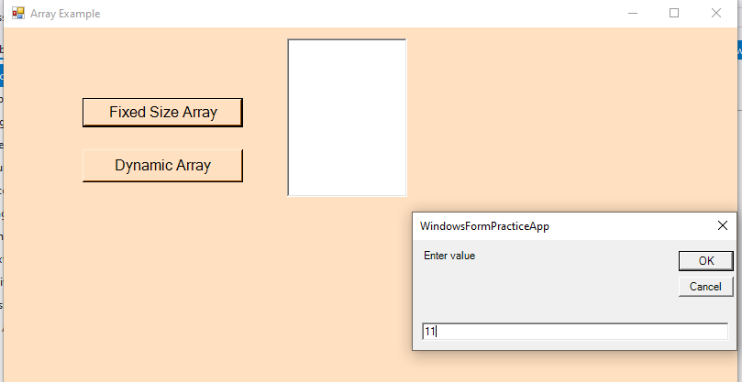
Array Example Result Output:

Slide 11
Thank You

