Slide 1
Class object and Method

Slide 2
Class in Vb.net
Class Class_Name
Access specifiers Data members
Access specifiers Member methods
End Class

Slide 3
Creating Class File
Public Class emp
Public name As String
Public id As Integer
Public Sub getDetails(ByVal x As String, ByVal y As Integer)
name = x
id = y
End Sub
Public Function getName()
Return name
End Function
Public Function getId()
Return id
End Function
End Class

Slide 4
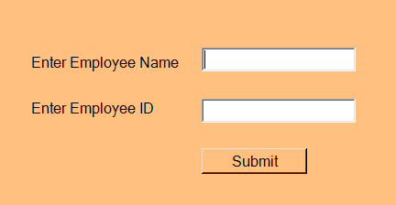
Design output for implementation of class file in window form application

Slide 5
Coding
Public Class Form13
Private Sub Button1_Click(sender As Object, e As EventArgs) Handles Button1.Click
Dim obj As emp = New emp()
Dim str1 As String = TextBox1.Text
Dim str2 As Integer = Integer.Parse(TextBox2.Text)
obj.getDetails(str1, str2)
Dim empname As String = obj.getName()
Dim empid As Integer = obj.getId()
MessageBox.Show(empname & empid)
End Sub
End Class

Slide 6
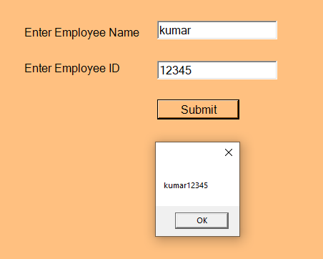
taking employee details from user using class , object and method:

Slide 7
Constructors and Destructors
A class constructor is a special member Sub of a class that is executed whenever we create new objects of that class. A constructor has the name New and it does not have any return type.
A default constructor does not have any parameter, but if you need, a constructor can have parameters. Such constructors are called parameterized constructors.

Slide 8
A destructor is a special member Sub of a class that is executed whenever an object of its class goes out of scope.
A destructor has the name Finalize and it can neither return a value nor can it take any parameters.
Public Overrides Sub Finalize()
End Sub

Slide 9
Inheritance
<access-specifier> Class <base_class>
End Class
Class <derived_class>: Inherits <base_class>
End Class

Slide 11
Thank You

