Slide 1
Database operation Insert and select in Vb.Net

Slide 2
SqlConnection
The Connection Object provides physical connection to the Data Source. Connection object needs the necessary information to recognize the data source and to log on to it properly, this information is provided through a connection string.

Slide 3
SqlCommand
The Command Object uses to perform SQL statement or stored procedure to be executed at the Data Source. The command object provides a number of Execute methods that can be used to perform the SQL queries in a variety of fashions.

Slide 4
SqlDataReader
The DataReader Object is a stream-based , forward-only, read-only retrieval of query results from the Data Source, which do not update the data.

Slide 5
SqlDataAdapter
DataAdapter Object populate a Dataset Object with results from a Data Source . It is a special class whose purpose is to bridge the gap between the Dataset objects and the data source.

Slide 6
Namespace required:
System.data
System.data.sqlCient

Slide 7
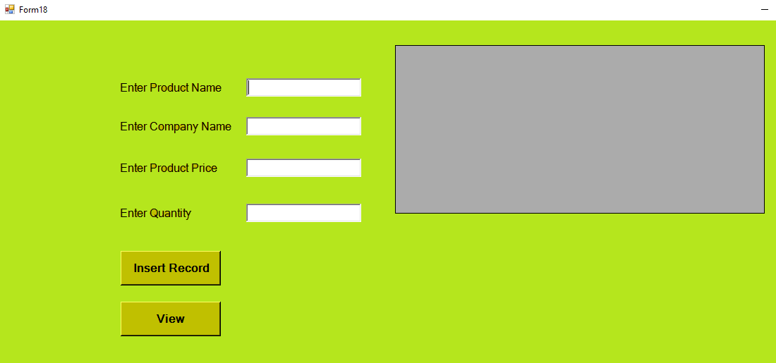
Database operations : Insert, Select design output

Slide 8
Imports System
Imports System.Data
Imports System.Data.SqlClient
Public Class Form18
Dim con As SqlConnection = New SqlConnection("Data Source=(LocalDB)\MSSQLLocalDB;AttachDbFilename=C:\Users\kumar\Documents\DB001.mdf;Integrated Security=True;Connect Timeout=30")
Private Sub Button1_Click(sender As Object, e As EventArgs) Handles Button1.Click
con.Open()
Dim cmd As SqlCommand = New SqlCommand("insert into productdetails(productname,productprice,productquantity,companyname) values(@productname,@productprice,@productquantity,@companyname)", con)
cmd.Parameters.AddWithValue("productname", TextBox1.Text)
cmd.Parameters.AddWithValue("productprice", TextBox3.Text)
cmd.Parameters.AddWithValue("productquantity", TextBox4.Text)
cmd.Parameters.AddWithValue("companyname", TextBox2.Text)
cmd.ExecuteNonQuery()
con.Close()
MessageBox.Show("Record inserted successfully")
End Sub

Slide 9
Private Sub Button4_Click(sender As Object, e As EventArgs) Handles Button4.Click
con.Open()
Dim cmd As SqlCommand = New SqlCommand("select *from productdetails", con)
Dim adpt As SqlDataAdapter = New SqlDataAdapter(cmd)
Dim dt As DataTable = New DataTable()
adpt.Fill(dt)
DataGridView1.DataSource = dt
con.Close()
End Sub
End Class

Slide 10
Thank You

