Slide 1
Update and Delete database operation in Vb.Net

Slide 2
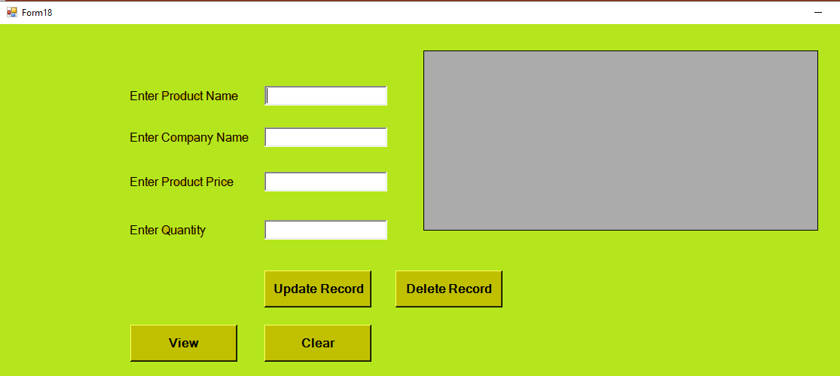
Design page for update and delete database operation:

Slide 3
Imports System
Imports System.Data
Imports System.Data.SqlClient
Public Class Form18
Dim con As SqlConnection = New SqlConnection("Data Source=(LocalDB)\MSSQLLocalDB;AttachDbFilename=C:\Users\kumar\Documents\DB001.mdf;Integrated Security=True;Connect Timeout=30")
Private Sub Button2_Click(sender As Object, e As EventArgs) Handles Button2.Click
con.Open()
Dim cmd As SqlCommand = New SqlCommand("update productdetails set productprice=@productprice,productquantity=@productquantity where productname=@productname", con)
cmd.Parameters.AddWithValue("productname", TextBox1.Text)
cmd.Parameters.AddWithValue("productprice", TextBox3.Text)
cmd.Parameters.AddWithValue("productquantity", TextBox4.Text)
cmd.ExecuteNonQuery()
con.Close()
MessageBox.Show("Record updated successfully")
End Sub
Coding

Slide 4
Private Sub Button3_Click(sender As Object, e As EventArgs) Handles Button3.Click
con.Open()
Dim cmd As SqlCommand = New SqlCommand("delete from productdetails where productname=@productname", con)
cmd.Parameters.AddWithValue("productname", TextBox1.Text)
cmd.ExecuteNonQuery()
con.Close()
MessageBox.Show("Record deleted successfully")
End Sub
Private Sub Button5_Click(sender As Object, e As EventArgs) Handles Button5.Click
TextBox1.Text = ""
TextBox2.Text = ""
TextBox3.Text = ""
TextBox4.Text = ""
End Sub
End Class

Slide 5
Thank You

