Slide 1
Dialog Box controls

Slide 2
DialogBox Control:
OpenFileDialog Control:
This control will be used to open any file from a system.
SaveFileDialog Control:
This control will be used to save any file to the system.
ColorDialog Control:
This control will be used to display font color where we can apply text color.
FontDialog Control:
This control will be used to display font like Bold, Italic etc and font size.
FolderBrowserDialog Control:
This control will be used to display the path of folder which will be located in our system.

Slide 3
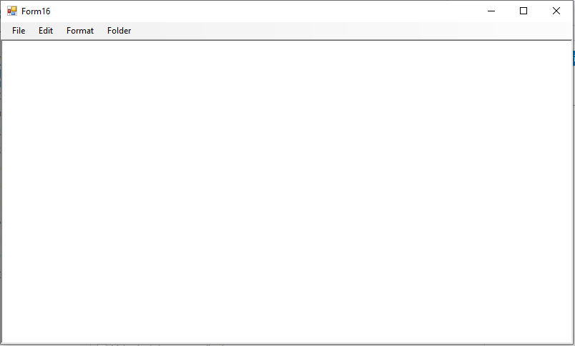
Example:-Notepad Application using dialog box controls

Slide 4
Coding:
Public Class Form16
Private Sub NewToolStripMenuItem_Click(sender As Object, e As EventArgs) Handles NewToolStripMenuItem.Click
RichTextBox1.Clear()
End Sub
Private Sub OpenToolStripMenuItem_Click(sender As Object, e As EventArgs) Handles OpenToolStripMenuItem.Click
If OpenFileDialog1.ShowDialog() = DialogResult.OK Then
RichTextBox1.LoadFile(OpenFileDialog1.FileName, RichTextBoxStreamType.PlainText)
End If
End Sub

Slide 5
Private Sub SaveToolStripMenuItem_Click(sender As Object, e As EventArgs) Handles SaveToolStripMenuItem.Click
If SaveFileDialog1.ShowDialog() = DialogResult.OK Then
RichTextBox1.SaveFile(SaveFileDialog1.FileName, RichTextBoxStreamType.PlainText)
End If
End Sub
Private Sub CutToolStripMenuItem_Click(sender As Object, e As EventArgs) Handles CutToolStripMenuItem.Click
RichTextBox1.Cut()
End Sub

Slide 6
Private Sub CopyToolStripMenuItem_Click(sender As Object, e As EventArgs) Handles CopyToolStripMenuItem.Click
RichTextBox1.Copy()
End Sub
Private Sub PasteToolStripMenuItem_Click(sender As Object, e As EventArgs) Handles PasteToolStripMenuItem.Click
RichTextBox1.Paste()
End Sub

Slide 7
Private Sub FontToolStripMenuItem_Click(sender As Object, e As EventArgs) Handles FontToolStripMenuItem.Click
If FontDialog1.ShowDialog() = DialogResult.OK Then
RichTextBox1.Font = FontDialog1.Font
End If
End Sub
Private Sub ColorToolStripMenuItem_Click(sender As Object, e As EventArgs) Handles ColorToolStripMenuItem.Click
If ColorDialog1.ShowDialog() = DialogResult.OK Then
RichTextBox1.ForeColor = ColorDialog1.Color
End If
End Sub

Slide 8
Private Sub FolderToolStripMenuItem_Click(sender As Object, e As EventArgs) Handles FolderToolStripMenuItem.Click
If FolderBrowserDialog1.ShowDialog() = DialogResult.OK Then
RichTextBox1.Text = FolderBrowserDialog1.SelectedPath
End If
End Sub
End Class

Slide 9
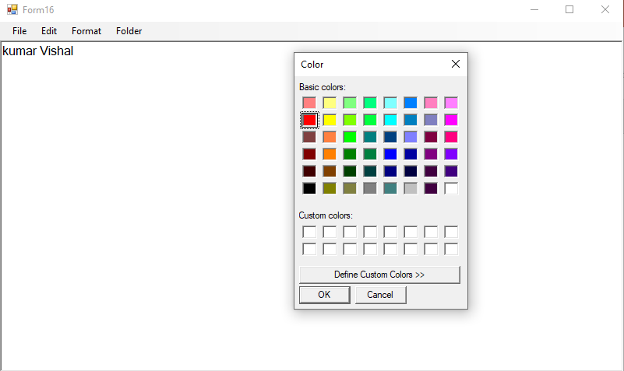
Output screen after selecting color dialog box

Slide 10
Thank You

