Slide 1
Window Form Controls: textbox, label, button, combobox, Listbox

Slide 2
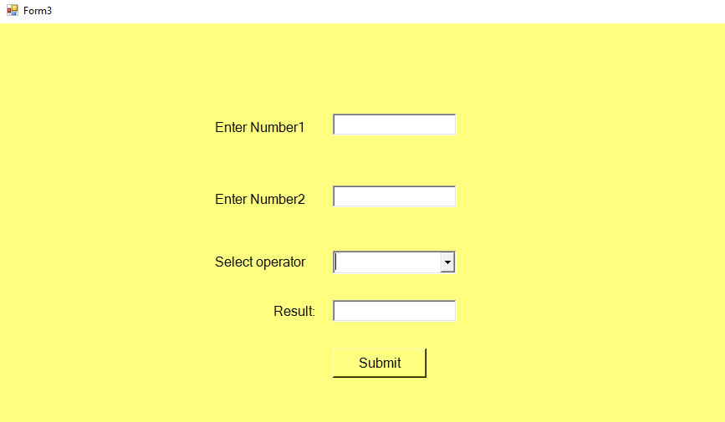
TextBox,Label,Button,ComboBox Example:
Design Page OutPut:

Slide 3
Coding
Public Class Form3
Private Sub Button1_Click(sender As Object, e As EventArgs) Handles Button1.Click
Dim num1 As Double = Double.Parse(TextBox1.Text)
Dim num2 As Double = Double.Parse(TextBox2.Text)
Dim myop As String = ComboBox1.SelectedItem.ToString()
If myop.Equals("+") Then
Dim num3 As Double = num1 + num2
TextBox3.Text = num3
End If
If myop.Equals("-") Then
Dim num4 As Double = num1 - num2
TextBox3.Text = num4
End If
If myop.Equals("*") Then
Dim num5 As Double = num1 * num2
TextBox3.Text = num5
End If
If myop.Equals("/") Then
Dim num6 As Double = num1 / num2
TextBox3.Text = num6
End If
If myop.Equals("\") Then
Dim num7 As Double = num1 \ num2
TextBox3.Text = num7
End If
If myop.Equals("^") Then
Dim num7 As Double = num1 ^ num2
TextBox3.Text = num7
End If
If myop.Equals("MOD") Then
Dim num8 As Double = num1 Mod num2
TextBox3.Text = num8
End If
End Sub
End Class

Slide 4
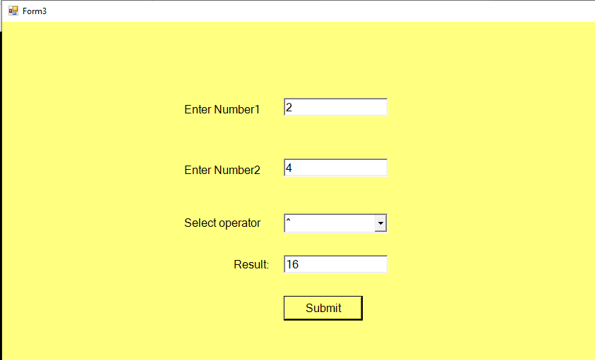
Result Out Put:

Slide 5
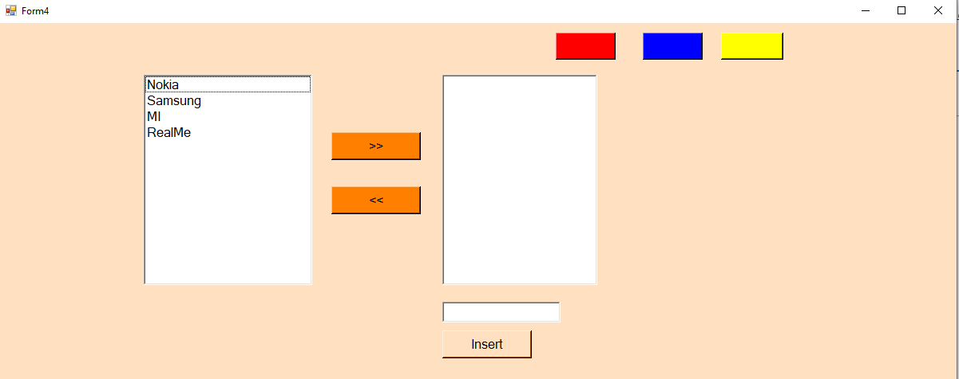
ListBox Example: Design Page OutPut:

Slide 6
Coding :
Public Class Form4
Private Sub Button1_Click(sender As Object, e As EventArgs) Handles Button1.Click
Dim myvalue As String = TextBox1.Text
ListBox2.Items.Add(myvalue)
End Sub
Private Sub Button2_Click(sender As Object, e As EventArgs) Handles Button2.Click
ListBox2.Items.Add(ListBox1.SelectedItem)
End Sub
Private Sub

Slide 7
Button3_Click(sender As Object, e As EventArgs) Handles Button3.Click
ListBox1.Items.Add(ListBox2.SelectedItem)
End Sub
Private Sub Button4_Click(sender As Object, e As EventArgs) Handles Button4.Click
Me.BackColor = Color.Red
End Sub

Slide 8
Private Sub Button5_Click(sender As Object, e As EventArgs) Handles Button5.Click
Me.BackColor = Color.Blue
End Sub
Private Sub Button6_Click(sender As Object, e As EventArgs) Handles Button6.Click
Me.BackColor = Color.Yellow
End Sub
End Class

Slide 9
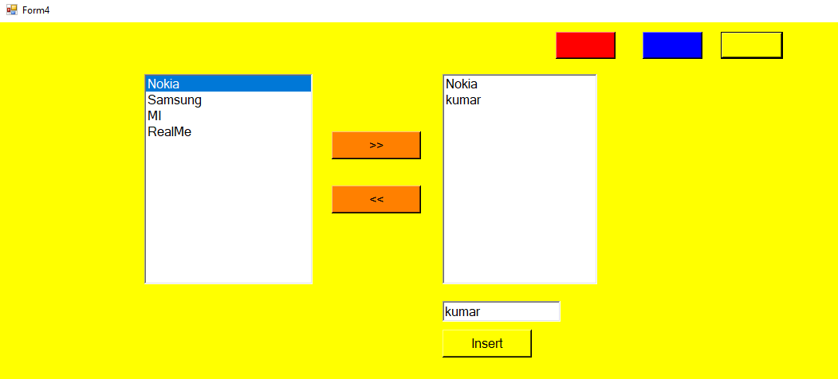
Output ListBox Operations:

Slide 10
Thank You

