Slide 1

DCAP501 MODERN PROGRAMMING TOOLS & TECHNIQUES–I

Slide 2
Unit-1
Introduction to Java: Keywords, constants, variables and Data Types,
Operators and Expressions, Control constructs,
Introducing classes, objects and methods: defining a class,adding variables and methods,
creating objects, constructors,
class inheritance

Slide 3
Introduction to Java

Slide 4
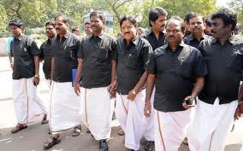




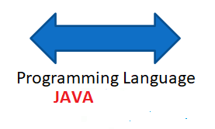
What do we need to know?
Tamil
Punjabi
Need of Language :: Introduction to programming Language

Slide 5
Daily routine
Let us look around our daily routine…
Let us see where all we do programming everyday
Simple things we do to start the day

Slide 6

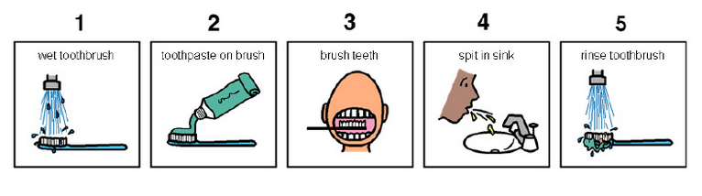
So there is ONE program you know which is there in you…

Slide 7
Daily routine
Start
There is a set procedure
Each step is defined
The occurrence is ordered
Jump is NOT permitted
A step cannot be skipped
Pick Brush
Rinse Brush
Apply Paste
Brush
Rinse Mouth
Rinse Brush
Stop

Slide 8

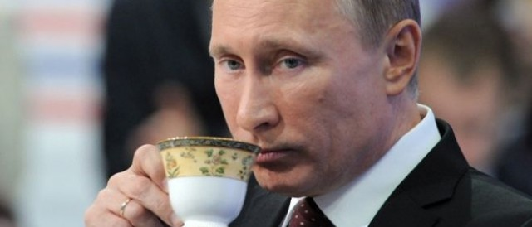




Daily routine
Yet another example but more complex
Vision
Sensor
Sipping TEA
Smell
Sensor
Radiation
Sensor
If all sensors
SIP
If even one is
Touch
Sensor
WAIT!!!

Slide 9




So what does this mean?
Take ANY activity of the day…
It will have a set procedure
It has to be done in a designated way
If not done the specified way will yield wrong results.
Success in doing it depends on how closer one is to the prescribed method.
This clearly shows that everything has a
Logic

Slide 10








Logic, logic and logic
Logic

Slide 11
What next?
If there is logic in anything and everything
There has to be ways to represent logic
There has to be modes to modify and re-represent logic.
There should be methodology to implement and re-design logic.
And for all this…

Slide 12


What next?
There has to be logic machine to assimilate, understand, solve, store, retrieve and represent logic
There has to be a LANGUAGE to communicate with the logic machine
Otherwise….

Slide 13
object oriented languages
Procedural Programming and Object Oriented Programming:
Languages used in Procedural Programming:
FORTRAN, ALGOL, COBOL,
BASIC, Pascal and C.
Languages used in Object Oriented Programming:
Java, C++, C#, Python , Vb.net
PHP, JavaScript, Ruby, Perl,
Objective-C, Dart, Swift, Scala.

Slide 14
OOPs Features
Class
Objects
Encapsulation
Abstraction
Polymorphism
Inheritance

Slide 15

Class
Class is a collection of similar types of objects.
For example: Fruits is class of mango, apple , orange etc.
Object is an instance of a Class.
Fruits

Slide 16
Encapsulation
Wrapping up of data and information under a single unit.
Binding together the data and the functions in a single unit
Encapsulation also hides the data
We can achieve encapsulation features by making data member as a private and use get and set accessor methods to access data members.

Slide 17


Abstraction
Hiding background details and showing features or functionality only

Slide 18
You know how to drive the car but you don’t know about the internal details this is the example of ….?
Encapsulation
Abstraction
None

Slide 19


Polymorphism
The ability to perform a task in more than one form.
Good Student
Good Singer
Rahul

Slide 20



Inheritance
father
mother
child

Slide 21
java technology and development environment
Java technoloy provides us to develop different type of applications it can be console based, window/desktop based or web based etc.
There are different types of Java editions are avialable to develop these applications:
Java Standard Edition (JSE)
Java Enterprise Edition(JEE)
Java Micro Edition(JME)

Slide 22
Java Standard Edition (JSE)
JSE can be used to develop client-side standalone (independant) applications or applets.
Java Enterprise Edition (JEE)
JEE can be used to develop server-side applications such as Java servlets and Java ServerPages.
Java Micro Edition (JME).
JME can be used to develop applications for mobile devices such as cell phones.

Slide 23
development environment
By using JDK(java development kit)
By using IDE(integrated development Environment) like: net beans, Eclipse, etc.

Slide 24
running/ testing a java program
class test
{
public static void main(String []args)
{
System.out.println("hello");
}
}
Steps:->
Now save this file with extension .java inside bin folder in JDK.
Note: The file name should be same as class name
Now Compile this program on command prompt, suppose jdk folder is location at c: drive, open the command prompt and go inside the jdk folder.
c:/> cd jdk
now go inside the bin folder
c:/> jdk\>cd bin
c:/>jdk\bin>
Now compile the programme with javac command
c:/>jdk\bin>javac test.java
Where test.java is our filename
After compilation now run the programme by using java filename
c:/>jdk\bin>java test
Note:here during run the program no need to give the filename with extension java.
Now, you can get the output on the command line

Slide 25
Basic structure of Java Program:
[ Documentation ]
[package declarations]
[import statements]
[class declaration]
[Main Merthod]

Slide 26
// A Simple java program
package test;
import java.lang;
class Demo
{
public static void main(String[] args)
{
Sytem.out.println("Hello! World");
}
}

Slide 27
Main method in Java:
public static void main(String args[])
The keyword public is an access specifier.
The keyword static is a kind of modifier. Main method is static means this is calling with out any reference.
The keyword void means that the method main() does not return any value.
Main method having parameter that array of string which show command line arguments in java. We can pass any no. of argument during run time.

Slide 28
variables
A name of reserved area allocated in memory
variable
n
10
num

Slide 29
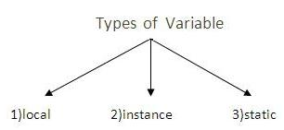
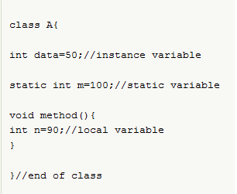

Slide 30
Instance vs static
Instance variables gets the memory at the time of object creation, each object will have the copy of instance variable, if it is incremented, it won’t reflect to other objects.
Static variable will get the memory only once, if any object changes the value of the static variable , it will retain its value.

Slide 31
working with strings
Sequence of characters , writes between “ ”.
<String_Type> <string_variable> = “<sequence_of_charcters>”;
String name=“kumar”;
Creating a String
There are two ways to create string in Java:
String literalString s = “kumar”;
Using new keywordString s = new String (“kumar”);

Slide 32
Data types in java
Data types means which define which type of data we are using in the program.
To declare the variable
Can be Categorize in primitives and non primitives
Primitives means pre define and non primitive means user has to define

Slide 33
Data types in Java
Primitive
Non primitive
Boolean
Byte
Short
Int
Long
Char
Float
Double
String
Array
Class
Interface

Slide 34
Data types and its size
Data Type | Default Value | Default size
boolean | false | 1 bit
char | '\u0000' | 2 byte
byte | 0 | 1 byte
short | 0 | 2 byte
int | 0 | 4 byte
long | 0L | 8 byte
float | 0.0f | 4 byte
double | 0.0d | 8 byte

Slide 35
Float can store 6 digit after decimal points
Double can store 15 digit after decimal points
By default decimal will store double means
If we write Pi=3.14
It will store double datatype

Slide 36
Size calculation
Formula:
- 2^{n-1} To + 2^{n-1}-1
^{Where n is no. of bits.}
For example:
Byte = 1 byte=8 bits
-2⁸⁻¹ To 2⁸⁻¹ -1
-128 to +127
byte num=-129 (not accepted)
byte num=128 (not accepted)

Slide 37
Unicode
Unique code for each character
We can use any language character
Can be categories in
UTF-8. UTF-16 and UTF-32
Unicode Transformation Format
UTF-8 means: 2⁸ =256 types of character supported
UTF-16 means: 2¹⁶ =65536 types of characters
UTF-32 means: 2³² = 4294967296 types of charcters
As compare with ASCII (American Standard Code Information Interchange) , ASCII support only 256

Slide 38
Operators
Operators are special symbols used for:
mathematical functions
assignment statements
logical comparisons
Examples of operators:
3 + 5 // uses + operator
14 + 5 – 4 * (5 – 3) // uses +, -, * operators
Expressions:
C=a+b
can be combinations of variables and operators that result in a value

Slide 39
Operators in java
Arithmetic Operators
Relational Operators
Increment/Decrement Operators
Logical Operators
Assignment Operators
Bitwise Operators

Slide 40
Arithmetic Operators
Operator | Operation
+ | addition
- | subtraction
* | multiplication
/ | division
% | modulus (remainder after division)

Slide 41
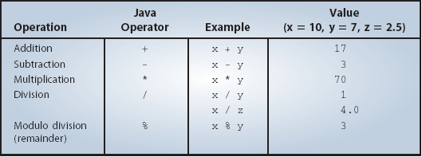
Arithmetic Operators
The following table summarizes the arithmetic operators available in Java.
This is an integer division where the fractional part is truncated.

Slide 42
Example
Example of division issues:
10 / 3 gives 3
10.0 / 3 gives 3.33333
As we can see,
if we divide two integers we get an integer result.
if one or both operands is a floating-point value we get a floating-point result.

Slide 43
Arithmetic/Assignment Operators
Java allows combining arithmetic and assignment operators into a single operator:
Addition/assignment +=
Subtraction/assignment −=
Multiplication/assignment ∗=
Division/assignment /=
Remainder/assignment %=

Slide 44
Increment/Decrement Operators
Only use ++ or − − when a variable is being incremented/decremented as a statement by itself.
x++; is equivalent to x = x+1;
x--; is equivalent to x = x-1;

Slide 45
Relational Operators
Relational operators compare two values
They Produce a boolean value (true or false) depending on the relationship
Operation | Is true when
a >b | a is greater than b
a >=b | a is greater than or equal to b
a ==b | a is equal to b
a !=b | a is not equal to b
a <=b | a is less than or equal to b
a <b | a is less than b

Slide 46
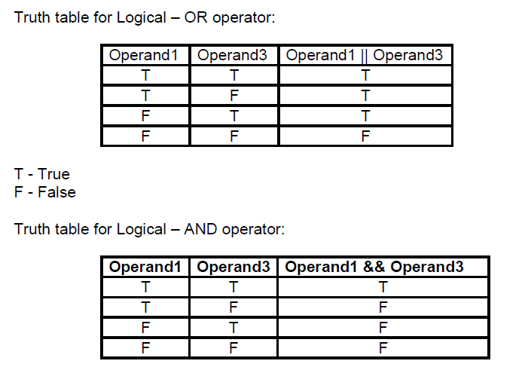
Logical Operators
Symbol Name
&& AND
|| OR
! NOT

Slide 47
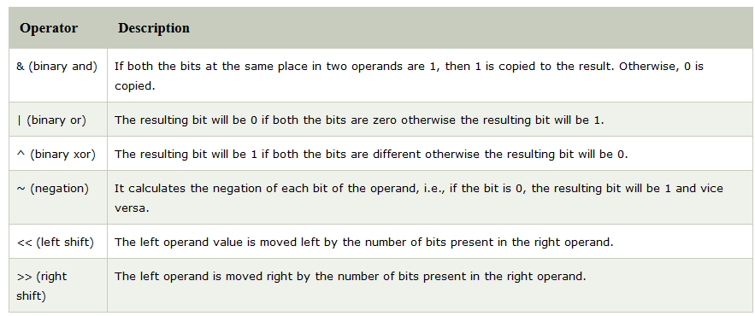

Slide 48
Bitwise OR (|) :
if either of the bits is 1, it gives 1, else it gives 0.
a = 5 = 0101 (In Binary)
b = 7 = 0111 (In Binary)
Bitwise OR Operation of 5 and 7
0101
|0111
________
0111 = 7 (In decimal)

Slide 49
Bitwise AND (&) –
if both bits are 1, it gives 1, else it gives 0.
a = 5 = 0101 (In Binary)
b = 7 = 0111 (In Binary)
Bitwise AND Operation of 5 and 7
0101
& 0111
________
0101 = 5 (In decimal)

Slide 50
Bitwise XOR (^) –
if corresponding bits are different, it gives 1, else it gives 0.
a = 5 = 0101 (In Binary)
b = 7 = 0111 (In Binary)
Bitwise XOR Operation of 5 and 7
0101
^ 0111
________
0010 = 2 (In decimal)

Slide 51
Bitwise Complement (~) –
with all bits inversed, means it makes every 0 to 1, and every 1 to 0.
a = 5 = 0101 (In Binary)
Bitwise Compliment Operation of 5
~ 0101
________
1010 = 10 (In decimal)
Note: Compiler will give 2’s complement of that number, i.e., 2’s compliment of 10 will be -6.

Slide 52
Shift operator
Right shift operator (>>) –
Shifts the bits of the number to the right and fills 0 on voids left as a result.
Example 1:
a = 10
a>>1 = 5
Example 2:
a = -10
a>>1 = -5
We preserve the sign bit.

Slide 53
Left shift operator (<<) – Shifts the bits of the number to the left and fills 0 on voids left as a result.
a = 5 = 0000 0101
b = -10 = 1111 0110
a << 1 = 0000 1010 = 10
a << 2 = 0001 0100 = 20
b << 1 = 0000 1010 = -20
b << 2 = 0001 0100 = -40

Slide 54
Control constructs
if/else, switch case constructs
Looping constructs
Jumping constructs

Slide 55
if/else constructs
If(condition)
{
// statement execute when condition true
}
else
{
// statement execute when condition false
}

Slide 56
switch statement
To select choices/options from user it used:
Switch with choice (integer value like: 1,2,..)
Switch with choice (character value like: A,B,..)
Switch with choice (String value like: “ADD”,”SUB”,..)

Slide 57
looping controls, nested loops
While loop
Do while loop
For loop
Enhanced or advanced for loop
Nested loops means one loop inside another loop.

Slide 58
Any Query?

