Slide 1
CAP770
ADVANCED DATA STRUCTURES

Slide 2
Graph Representation

Slide 3
connected components
A connected component or simply component of an undirected graph is a subgraph in which each pair of nodes is connected with each other via a path. ...
A set of nodes forms a connected component in an undirected graph if any node from the set of nodes can reach any other node by traversing edges.

Slide 4
Graph Representation
Adjacency matrix
Linked Representation

Slide 5

Adjacency matrix

Slide 6


Slide 7

Linked Representation

Slide 8


Slide 10
Spanning Tree
A connected subgraph ‘S’ of graph G(V,E) is said to be spanning if:
‘S’ should contain all vertices of G
‘S’ should contain (V-1) edges.
For example:
Consider this :
1
2
3
4

Slide 11
Properties:
Tree means no cycle.
It should be connected
1
2
1
2
3
4
3
4

Slide 12
1
2
1
2
3
4
3
4

Slide 13
Is this spanning tree?
1
2
3
4

Slide 14
For complete graph, to find out total no. of spanning tree use this formula:
n^{n-2}, where n= no. of vertex
1
2
A complete graph is a graph in which every vertex has an edge to all other vertices is called a complete graph, In other words, each pair of graph vertices is connected by an edge.
3
4

Slide 15
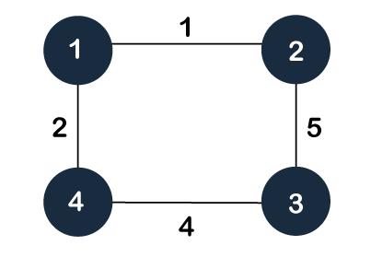
Minimum Spanning Trees
The minimum spanning tree is the tree whose sum of the edge weights is minimum.

Slide 16
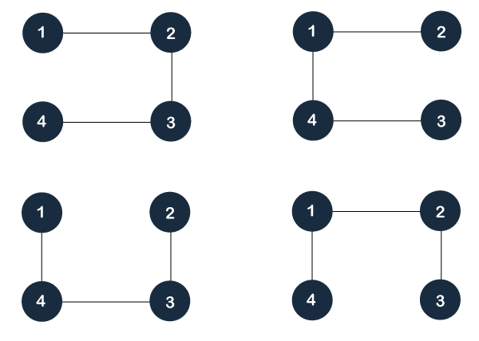

Slide 17
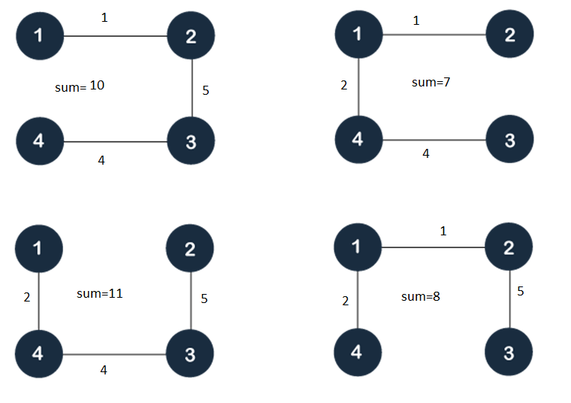

Slide 19

Any query

