Slide 1

CAP444 OBJECT ORIENTED PROGRAMMING USING C++

Slide 2
Working with files and streams
c++ streams,
c++ stream classes,
classes for file stream operations,
opening & closing files,
detection of end of file,
more about open(): file modes,
file pointer & manipulator,
sequential input & output operation,
updating a file: random access,
command line arguments

Slide 3




Slide 4
#include <iostream>
using namespace std;
int main()
{
int num;
cout<<"Enter number"<<endl;
cin>>num;
return 0;
}
Temporary Storage
RAM
aaa
5

Slide 5
Managing Output Stream/Input Stream
Hard disk
Stream: flow of data
File
RAM
Input stream
Output stream
variable
File
Data from variable to file- output stream
Data from file to variable-input stream
We have predefine classes to manage all these things

Slide 6


Keeping record of products:
using file handling mechanism

Slide 7




Slide 8
Classes for file stream
ios
istream
ostream
>>
extraction
<<
iostream
insertion
ifstream
fstream
ofstream
istream_withassign
ostream_withassign
cin
cout

Slide 9
In C++, files are mainly deal with three classes fstream, ifstream, ofstream.
ofstream: This Stream class indicates the output file stream and is applied to create files for writing information to files
ifstream: This Stream class indicates the input file stream and is applied for reading information from files
fstream: This Stream class can be used for both read and write from/to files.

Slide 10
C++ provides us with the following operations in File Handling:
Creating a file: open()
Reading data: read()
Writing new data: write()
Closing a file: close()

Slide 11
Opening Files
open() In case of creating new file:
Using ofstream class
Syntax:
ofstream fout;
fout.open(“filename”)
open() In case of reading file:
Using ifstream class
Syntax:
ifstream fin;
fin.open(“filename”)

Slide 12
Closing Files
close() In case of creating new file:
Using ofstream class
Syntax:
ofstream fout;
fout.close()
close() In case of reading file:
Using ifstream class
Syntax:
ifstream fin;
fin.close()

Slide 13
Reading and Writing into Files
Writing File: used ofstream class:
Syntax:
ofstream fout;
fout.open(“filename”);
fout<<“data”;
Reading File: used ifstream class:
Syntax:
ifstream fin;
fin.open(“filename”);
using get() or getline()
Example:
https://github.com/vishalamc/cap444/blob/main/ReadingWritingFileOperation

Slide 14
Reading Files: using get() function
The get() function is member of ifstream class. It is used to read character form the file.
while(!fin.eof())
{
fin.get(ch);
cout<<ch;
}
will read all the characters one by one up to EOF(end-of-file) reached.

Slide 15
Detecting End-of-File
While reading data from a file, if the file contains multiple rows, it is necessary to detect the end of file.
This can be done using the eof() function of ios class.
It returns 0 when there is data to be read and a non-zero value if there is no data.
Syntax:
ifstream fin;
char ch;
Ifstream.open(“filename”);
while(!fin.eof())
{
fin.get(ch);
cout<<ch;
}

Slide 16
Writing Files: using put() function
ofstream fout; // create output stream
char ch;
int i;
fout.open("filename", ios::app) ;
/* write the characters to file using put() */
fout.put(ch);
fout.close();

Slide 17
Reading Files: using getline() How to process a file line by line in C++?
In C++, you may open a input stream on the file and use the getline() function from the <string> to read content line by line into a string and process them.
Ifstream fin;
fin.open("file1.txt");
string str;
while(getline(fin,str))
{
cout<<str<<endl;
}

Slide 18
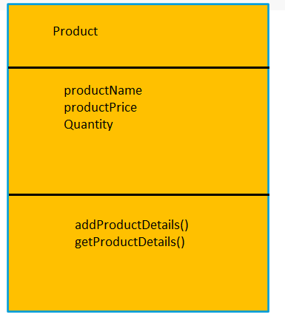
File operation using class , object and method
Example:
https://github.com/vishalamc/cap444/blob/main/StoreProductDetailsInFileUsingClassObjectMethod
Steps:
1. Create a product class
Class
Data Members
Member functions()

Slide 19
Steps:
2. Create a file and fill all product records.
3. Update your file, fill more records into file
3. Display output to the user screen with product details.

Slide 20
Read/Write Class Objects from/to File in C++
The data transfer is usually done using '>>' and <<' operators. But if you have a class with 4 data members and want to write all 4 data members from its object directly to a file or vice-versa.
Example:
https://github.com/vishalamc/cap444/blob/main/StoreProductDetailsInFileUsingClassObjectMethod

Slide 21
To write object's data members in a file :
// Here file_obj is an object of ofstream
file_obj.write((char *) & class_obj, sizeof(class_obj));
To read file's data members into an object :
// Here file_obj is an object of ifstream
file_obj.read((char *) & class_obj, sizeof(class_obj));

Slide 22
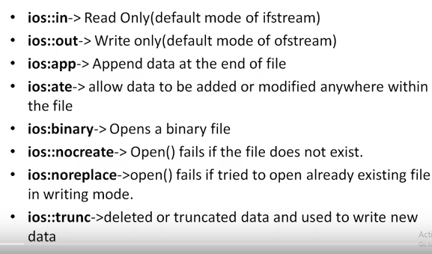
File Modes

Slide 23
To append file content
ios::app
ofstream fout;
fout.open(“filename”,ios::app);
File Mode

Slide 24
#include <iostream>
#include<fstream>
using namespace std;
ofstream fout;
ifstream fin;
int main()
{
fout.open("hello.txt", ios::in);
fout<<"hello"<<endl;
fout.close();
return 0;
}
A.
File will create and hello will be written on file
B.
Compilation Error
C.
Nothing will be happen
D.
None

Slide 25
file manipulator
Manipulators are simply an instruction to the output stream that modify the output in various ways. In other words, we can say that manipulators are operators that are used to format the data display.

Slide 26
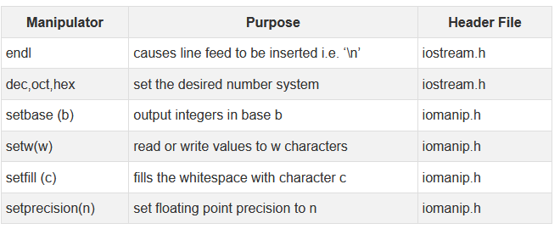

Slide 27
file manipulator Examples
Example1:
https://github.com/vishalamc/cap444/blob/main/fileManipulatorExample1
Example2:
https://github.com/vishalamc/cap444/blob/main/fileManipulatorExample2
Example3:
https://github.com/vishalamc/cap444/blob/main/fileManipulatorExample3

Slide 28
Sequential and Random I/O
C++ allows data to be read or written from a file in sequential or random fashion.
Reading data character by character or record by record is called sequential access.
Reading data in any order is known as random access.
The fstream class provides functions like get(), read() for reading data and put(), write() for writing data to a file.

Slide 29
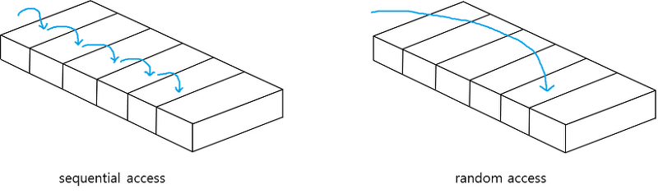

Slide 30




Slide 31
For example, if you have to modify a value in record no 21, then using random access techniques, you can place the file pointer at the beginning of record 21 and then straight-way process the record. If sequential access is used, then you'll have to unnecessarily go through first twenty records in order to reach at record 21.
In C++, random access techniques is achieved by manipulating seekg(), seekp(), tellg() and tellp() functions.

Slide 32
File Pointers:
Every file will contain two pointers: a read pointer or also known as a get pointer and a write pointer also known as a put pointer. The read pointer or a get pointer is used to read data and the write pointer or put pointer is used to write data to a file. These pointers can be manipulated using the functions from stream classes. Those functions are:
seekg() and seekp()

Slide 33
seekp() function allow us to move the output pointer to specified location for writing purpose within the file. The basic syntax for seekp() function is :
fileObject.seekp(long_num, origin);
fileObject: pointer to file
long_num: no. of bytes in file we want to skip
origin: where to begin

Slide 34
seekg() function allow us to move the Input pointer to specified location for reading purpose within the file. The basic syntax for seekg() function is :
fileObject.seekg(long_num, origin);
fileObject: pointer to file
long_num: no. of bytes in file we want to skip
origin: where to begin

Slide 35
origin:
ios::beg start of the file ios::cur current position of the pointer ios::end end of the file
Ex:
fin.seekg(0, ios::beg);

Slide 36
seekg() | moves get pointer(input) to a specified location
seekp() | moves put pointer (output) to a specified location
tellg() | gives the current position of the get pointer
tellp() | gives the current position of the put pointer

Slide 37
Examples:
seekp() and tellp() example:
https://github.com/vishalamc/cap444/blob/main/seekpAndtellpExample
seekg() and tellg()
https://github.com/vishalamc/cap444/blob/main/seekgAndtellgExample
Note: Above Both examples you can take for random access approach also.

Slide 38
Setting the EOF flag off, to allow the access of file again for reading:-
Ifstream fin;
fin.clear();

Slide 39
Which function is used to reposition the file pointer? a) moveg() b) seekg() c) changep() d) go_p()

Slide 40
Which of the following is used to move the file pointer to start of a file?
a) ios::beg
b) ios::start
c) ios::cur
d) ios::first

Slide 41
Command-line arguments
Command-line arguments are given after the name of the program in command-line shell of Operating Systems.
To pass command line arguments, we use main() with two arguments :
first argument is the total number of command line arguments and
second is list of command-line arguments.
Example: https://github.com/vishalamc/cap444/blob/main/commandLineArgumentExample

Slide 42
Syntax:
int main(int argc, char *argv[ ])
{
return 0;
}
first parameter argc holds the count of command-line arguments and the second parameter, an array of character pointers holds the list of command-line arguments.
first element in the array, i.e., argv[0] holds the filename. First command-line parameter will be available in argv[1], second parameter in argv[2] and so on.

Slide 43
First of all set the gcc compiler path in your system through environment variable:
C:\Program Files\CodeBlocks\MinGW\bin
Then compile and run in command line:
D:\>g++ abc.cpp -o obj1.exe
D:\>obj1.exe

Slide 44
Any Query?
Unit-4 End

