Slide 1

CAP444 OBJECT ORIENTED PROGRAMMING USING C++

Slide 2
Topics Covered
Inheritance and type conversion :
inheritance:
importance,
types of inheritance,

Slide 3



Inheritance: reusability
father
mother
child

Slide 4
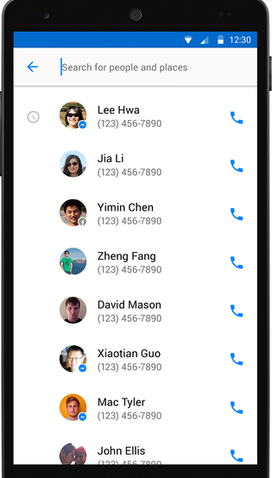
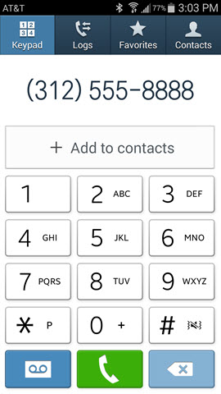
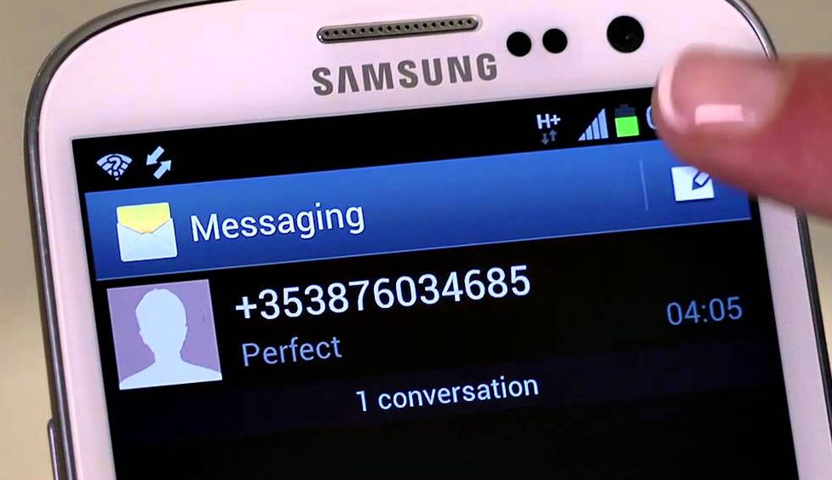
Contact List

Slide 5
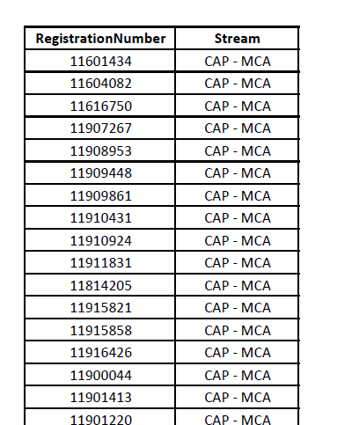
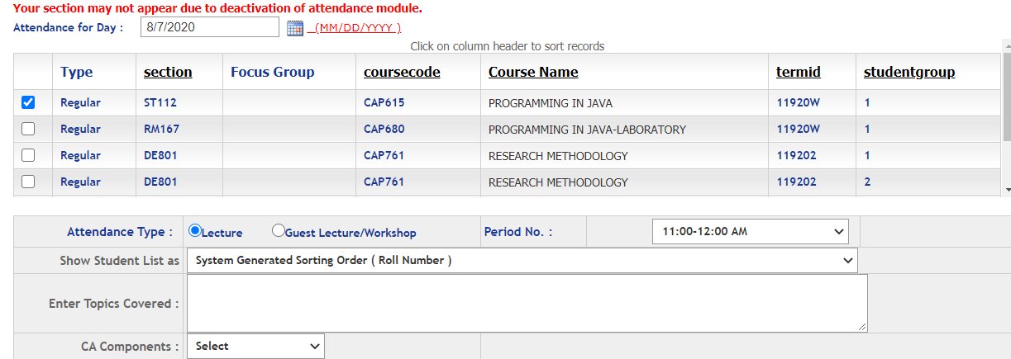
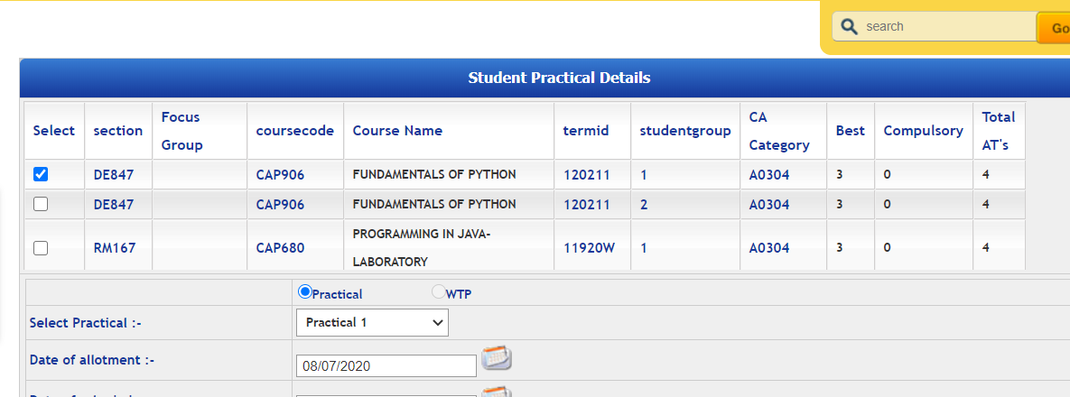
Students
Students in Attendance Module
Same Students in CA Module

Slide 6
Inheritance
One class can be derived from other class.
We can make the relationship between the classes.
We can re-use the functionality of classes
We can use different form of inheritance
Base Class
Derived Class

Slide 7
Inheritance: types of inheritance
A
A
A
B
B
B
C
C
Single
Multilevel
Multiple

Slide 8
A
A
B
C
B
C
Hierarchical Inheritance
D
Hybrid Inheritance

Slide 9
Single inheritance:
Syntax:
class derive_class_name : access_mode base_class_name
{
//body of derive_class
};

Slide 10
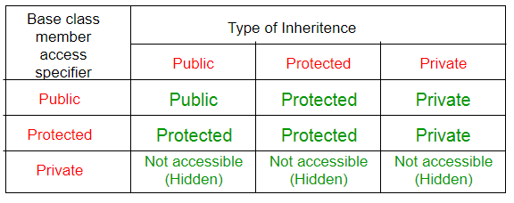
class base_class
{
//base class members (x, y)
};
class derive_class : access_Specifier base_class
{
//base class members (x, y)
//derive class members (a,b)
};

Slide 11

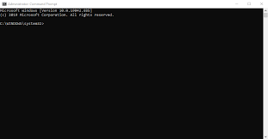
WindowColor
getColor()
ConsoleBackground
setName()

Slide 12
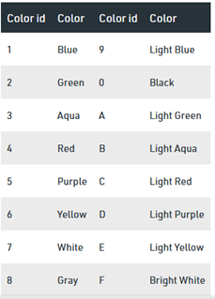
system("Color XY")
background color change the value X
text color change the value Y

Slide 13


Single inheritance Example
Result
ExamType
ExamStatus
getResult()
Student
Regno,
Name,
Marks
getStudentDetails()

Slide 14
Multilevel inheritance:
One class is going to become base class for other derived class
PMFund
FundAmount=1000
Base Class for class Bank
Bank
BankName=“SBI” IFSCCode=“SBI001”
Derived Class from PMFund and
Base Class for Customer
Customer
Cust_Name, Cust_Id, BalanceAmount
checkBalance():
Derived Class from Bank

Slide 15
Hierarchical inheritance:
One base class and multiple derived class, one –to-many relationship
Bank
rateofInterest
Bank():rateofInterest=0
SBI
Private IFSCCode
Bank():rateofInterest=4.5
PNB
Private IFSCCode
Bank():rateofInterest=5.5

Slide 16
Multiple Inheritance
class Derived(Base1, Base2, ...... BaseN):
class Base1:
class Base2:
.
.
.
class BaseN:
A
B
C

Slide 17



student

Slide 18
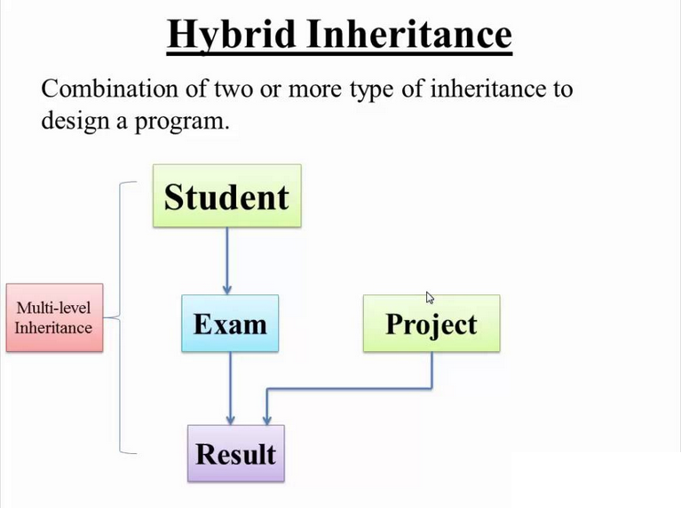

Slide 19
Any Query?

