Slide 1

CAP444 OBJECT ORIENTED PROGRAMMING USING C++

Slide 2
Topics Covered
Polymorphism :
functions overloading,
overloading unary operators,
overloading binary operators,
virtual base classes,
abstract classes,
pointer to object,
this pointer,
pointer to derived class,
virtual function,
pure virtual function

Slide 3







Slide 4
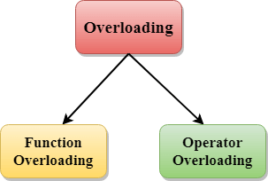
Polymorphism

Slide 5
Functions overloading
same function name but different parameters.
same function name with different signature
example of polymorphism(compile time)
overloaded functions should be there in same class.
Example:
https://github.com/vishalamc/cap444/blob/main/functionOverloadingExample

Slide 6
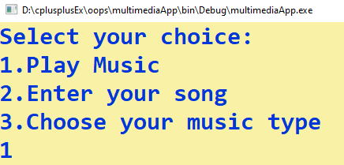
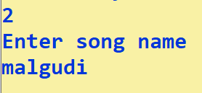

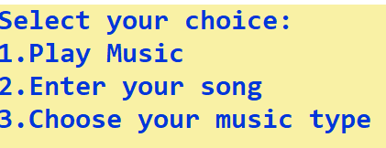
Example

Slide 7
PlaySound(TEXT(“xyz.wav"),NULL,SND_SYNC);
TEXT(“xyz.wav"):
A string that specifies the sound to play.
NULL:
(hmod) handle to the executable file that contains the resource to be loaded. This parameter must be NULL unless SND_RESOURCE is specified as 3rd parameter.
SND_SYNC:
The sound is played synchronously, and PlaySound returns after the sound event completes. This is the default behavior.

Slide 8
Operator overloading
Operator overloading is a compile-time polymorphism in which the operator is overloaded to provide the special meaning to the user-defined data type.
You can redefine built in operators except few:
Scope resolution operator (::)
sizeof
member selector(.)
member pointer selector(.*)
ternary operator(?:)

Slide 9
Examples:
Unary Operator Overloading:
https://github.com/vishalamc/cap444/blob/main/unaryOperatorOverlaodingEx
Binary Operator Overloading:
https://github.com/vishalamc/cap444/blob/main/binaryOperatorOverloading

Slide 10
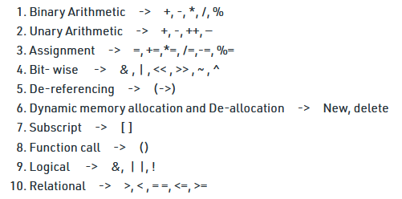
Operators which can overload

Slide 11
Consider this example
class A {
};
int main() { A a1,a2,a3;
a3= a1 + a2;
return 0; }
This is not allowed, because the addition operator “+” is predefined to operate only on built-in data types. But here, “class A” is a user-defined type, so the compiler generates an error. This is where the concept of “Operator overloading” comes in.

Slide 12
Operator Overloading Syntax:
return_type operator operator_Symbol(parameters)
{
}
Example:
class A {
public:
A operator +(A const &obj)
{
}
};

Slide 13
Operator overloading for Unary operators:
The unary operators operate on a single operand :
The increment (++) and decrement (--) operators.
The unary minus (-) operator.
The logical not (!) operator.
Example:
https://github.com/vishalamc/cap444/blob/main/unaryOperatorOverlaodingEx

Slide 14
Operator overloading for binary operators:
The binary operators operate on two operands :
+,
-,
*,
/,
%
Example:
https://github.com/vishalamc/cap444/blob/main/binaryOperatorOverloading
a+b

Slide 15
Rules for Operator Overloading
Existing operators can only be overloaded.
The overloaded operator contains at least one operand of the user-defined data type.
When unary operators are overloaded through a member function take no explicit arguments, but, if they are overloaded by a friend function, takes one argument.
When binary operators are overloaded through a member function takes one explicit argument, and if they are overloaded through a friend function takes two explicit arguments.

Slide 16
We know about Friend function
It can access all private and protected member of a class
It can be call without object of the class
It can define out side of the class scope
Rule:
Prototypes of friend function must be declare inside the class
It can be declared either in the private or the public part.

Slide 17
Overloading binary operators using friend function
Friend function takes two parameters in case when we want to overload binary operators using friend function
Ex:
friend A operator +(A &x, A &y);
Example:
https://github.com/vishalamc/cap444/blob/main/unaryOperatorOverloadingUsingFriendFunction

Slide 18




Situation
Student
regNo, Name
studentDetails()
regNo, Name
studentDetails()
Exam
Project
regNo, Name
studentDetails()
regNo, Name
studentDetails()
ambiguity arises as to which data/function member would be called?
Result

Slide 19
virtual base class introduce

Slide 20

virtual base classes
It means we are making base class as virtual
But why ???
In situation???
int b int c
Let’s assume ( int a)
A
int a
(int a)
B
C
int a
D
int d

Slide 21
Example:
Virtual Base Class:
https://github.com/vishalamc/cap444/blob/main/virtualBaseClassExample

Slide 22
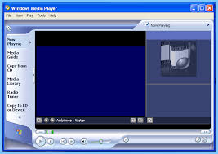



Situation
Media Player
PlayMovie()
PlaySong()
Punjabi Movie
Telugu Movie
Hindi Movie
PlayMovie()
PlaySong()
PlayMovie()
PlaySong()
PlayMovie()
PlaySong()

Slide 23
What’s meaning it….

Slide 24
Its method overriding

Slide 25
Problems in method overriding
Overriding using base class pointer compiler don’t know about pointer which address is pointing because address will be decided at run time when memory will be allocated.
To over come this problem we use virtual function
With the help of virtual function, we can override function at run time
Example:
https://github.com/vishalamc/cap444/blob/main/virtualFunctionExample

Slide 26
Abstract Class
Sometimes implementation of function is not required in a base class such a class is called abstract class.
In such cases we have to make function as abstract function by using virtual keyword that is also called pure virtual function.
A pure virtual function is declared by assigning 0 in declaration.
Example:
https://github.com/vishalamc/cap444/blob/main/abstractClassExample

Slide 27





Situation
Transportation:
Vehicle_Registration()
Himachal_Transport
Vehicle_Registration()
Karnataka_Transport
Vehicle_Registration()
Bihar_Transport
Vehicle_Registration()
Punjab_Transport
Vehicle_Registration()
PB081234
HP014567
KA023333
BR012345

Slide 28

Area
getArea()
getArea()
getArea()
Area = w × h w = width h = height
Area = π × r²

Slide 29
Important points:
A class is abstract if it has at least one pure virtual function.
If we do not override the pure virtual function in derived class, then derived class also becomes abstract class.
An abstract class can have constructors.
We cannot create objects of abstract classes.

Slide 30
What will be the output of the following C++ code?
#include<iostream>
using namespace std;
class Mobile
{
long int contactno;
public:
virtual void getStatus() = 0;
Mobile()
{
contactno=9898989890;
cout<<contactno;
}
};
class Person: public Mobile
{
public:
void getDetails() { cout << "Blocked"; }
};
int main()
{
Person p;
p.getDetails();
return 0;
}
A. 9898989890
B. Blocked
C.9898989890Blocked
D. Error

Slide 31
What will be the output of the following C++ code?
#include<iostream>
using namespace std;
class Mobile
{
long int contactno;
public:
virtual void getStatus() = 0;
Mobile()
{
contactno=9898989890;
cout<<contactno;
}
};
class Person: public Mobile
{
public:
void getStatus(){ cout <<"Blocked"; }
void getDetails(){cout<<"Kumar";}
};
int main()
{
Person p;
p.getDetails();
return 0;
}
A. 9898989890
B. kumar
C. 9898989890kumar
D. Error

Slide 32
Pointer to object
A variable that holds an address value is called a pointer variable
Object can also have an address , so there is also a pointer that can point to the address of an object.
class Date
{
};
Date d1;
Date *d2;
d2=&d1;
d2->functions()
Example:
https://github.com/vishalamc/cap444/blob/main/pointerToObjectExample
object pointer

Slide 33
this pointer
It can be used to refer current class instance variable.
Syntax:
this-> instance variable=value
Example:
https://github.com/vishalamc/cap444/blob/main/thisPointerExample

Slide 34
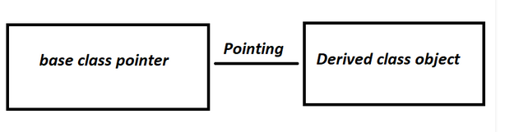
pointer to derived class
A pointer of one class can point to other class, but classes must be a base and derived class, then it is possible.
To access the variable of the base class, base class pointer will be used.

Slide 35
Pointer to derived class
class base{};
class derive: public base{};
base b1,*b2;
derive d1;
b2=&d1;
Example:
https://github.com/vishalamc/cap444/blob/main/pointertoDerivedClassExample

Slide 36
What will be the output of the following C++ code?
class realme:public mobile
{
void playRingTone()
{
cout<<"real me ringtone"<<endl;
}
};
int main()
{
mobile *mptr;
samsung s1;
mptr=&s1;
mptr->playRingTone();
return 0;
}
mobile ring tone
samsung ring tone
real me rington
Error
#include <iostream>
using namespace std;
class mobile
{
public:
void playRingTone()
{
cout<<"mobile ring tone"<<endl;
}
};
class samsung:public mobile
{
void playRingTone()
{
cout<<"samsung ring tone"<<endl;
}
};

Slide 37
Any Query?

