Slide 1
CAP776 PROGRAMMING IN PYTHON

Slide 2
Machine learning :
introduction,
types of machine learning,
linear regression,
k-nearest neighbours,
decision trees,
random forests,
k-means clustering

Slide 3
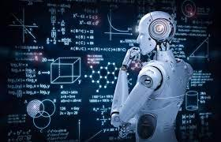
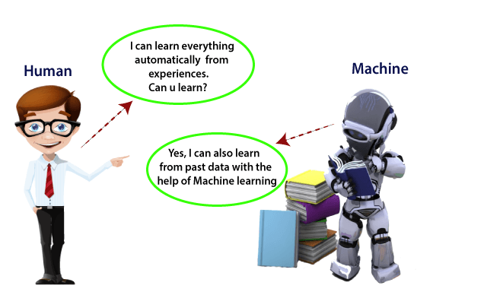
Machine learning

Slide 4
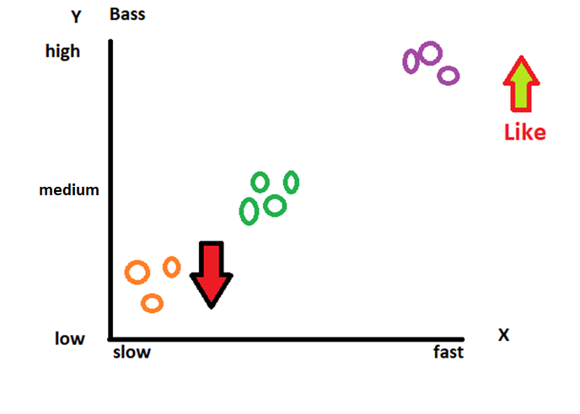
?
Suppose I like song based on songs type and music intensity.
Now one new song introduce which is having medium bass then I will like the song?

Slide 5
Machine learning
Machine learning is a growing technology which enables computers to learn automatically from past data. Machine learning uses various algorithms for building mathematical models and making predictions using historical data or information.
Currently, it is being used for various tasks such as image recognition, speech recognition, email filtering etc.

Slide 6
How does Machine Learning work
A Machine Learning system learns from historical data, builds the prediction models, and whenever it receives new data, predicts the output for it.

Slide 7
types of machine learning
Machine learning can be classified into three types:
Supervised learning
Unsupervised learning
Reinforcement learning

Slide 8
Supervised learning is a type of machine learning method in which we provide sample labeled data to the machine learning system in order to train it, and on that basis, it predicts the output.

Slide 9
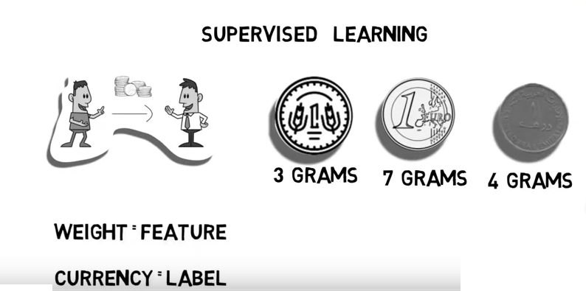

Slide 10
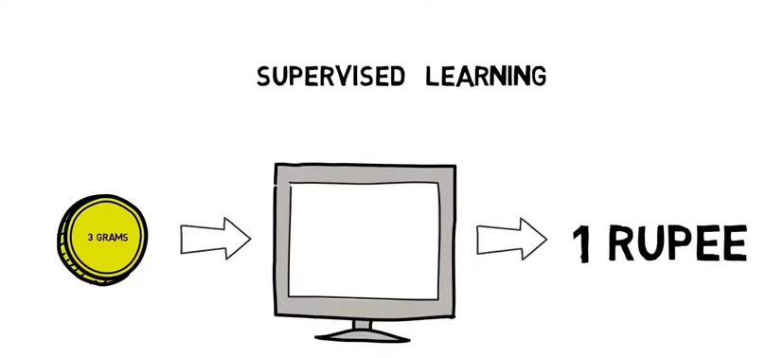

Slide 11
Unsupervised learning is a learning method in which a machine learns without any supervision. The training is provided to the machine with the set of data that has not been labeled, classified, or categorized, and the algorithm needs to act on that data without any supervision.

Slide 12
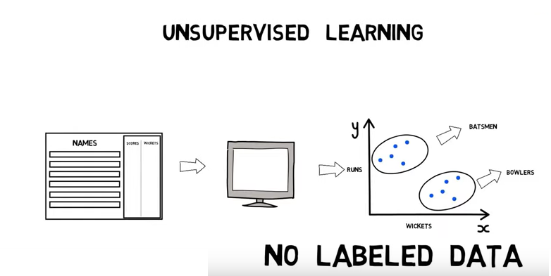

Slide 13
Reinforcement learning is a feedback-based learning method, in which a learning agent gets a reward for each right action. The agent learns automatically with these feedbacks and improves its performance.

Slide 14
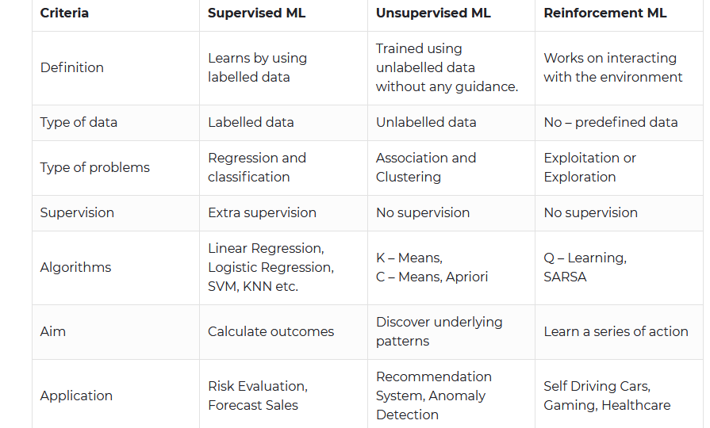

Slide 15
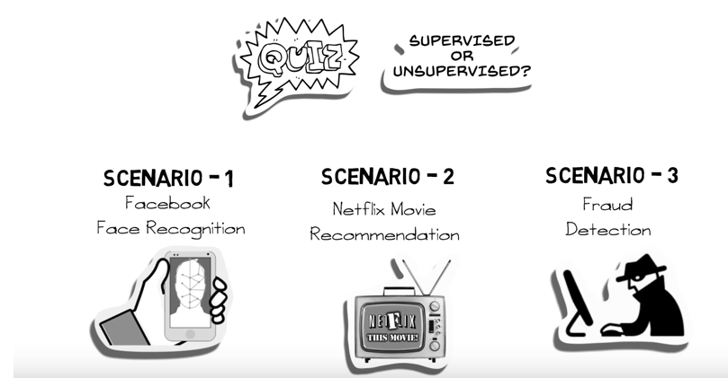

Slide 16
linear regression
The term regression is used when you try to find the relationship between variables.
In Machine Learning, and in statistical modeling, that relationship is used to predict the outcome of future events.
Linear regression algorithm shows a linear relationship between a dependent (y) and one or more independent (x) variables, hence called as linear regression.
Linear regression can be further divided into two types of the algorithm: Simple Linear Regression and Multiple Linear regression

Slide 17
Simple Linear Regression
Suppose you want to predict weight of a person from his height. So here, one dependent and one independent variable is used.
So, here weight is dependent variable and height is independent variable.
If a single independent variable is used to predict the value of a dependent variable, then such a Linear Regression algorithm is called Simple Linear Regression.

Slide 18
Multiple Linear regression
If more than one independent variable is used to predict the value of dependent variable, then such a Linear Regression algorithm is called Multiple Linear Regression.
Suppose you want predict house rent then there will multiple independent variables based on that you can predict house rent.

Slide 19
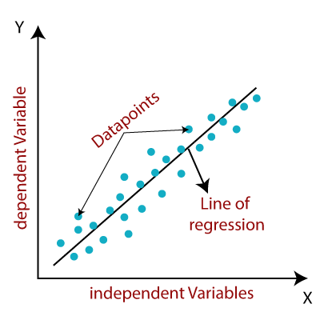
Since linear regression shows the linear relationship, which means it finds
how the value of the dependent variable is changing according to the value of the
independent variable.

Slide 20
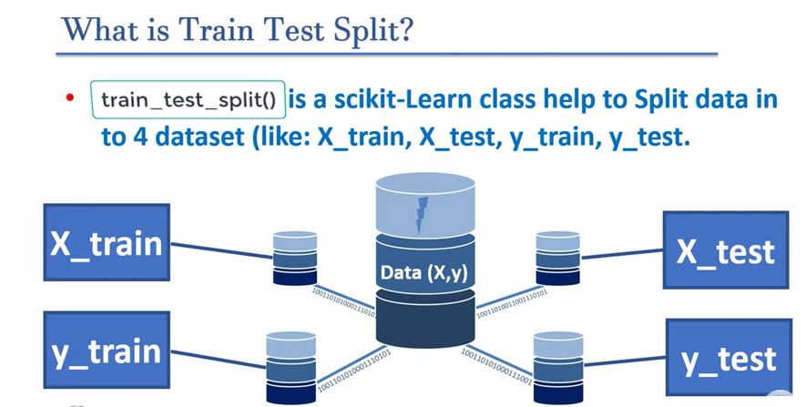

Slide 21
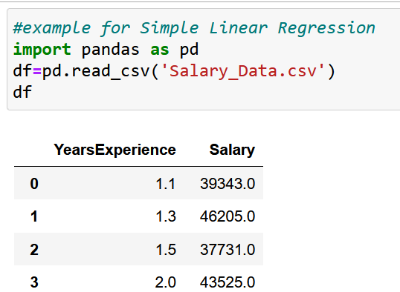
example for Simple Linear Regression
Import your dataset

Slide 22
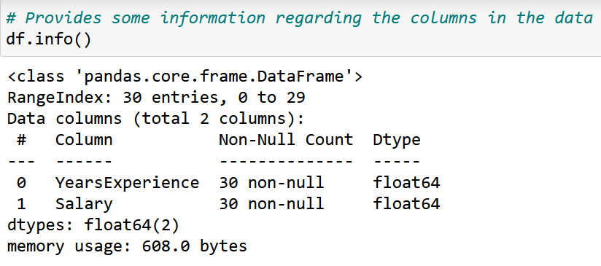

Slide 23
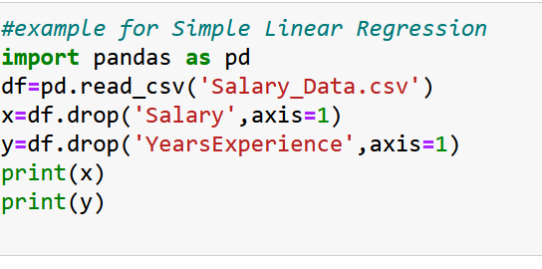
Define your dataset with dependent and independent variables

Slide 24
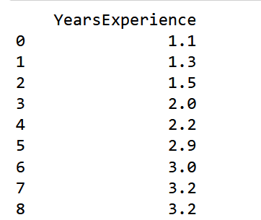
independent variable:

Slide 25
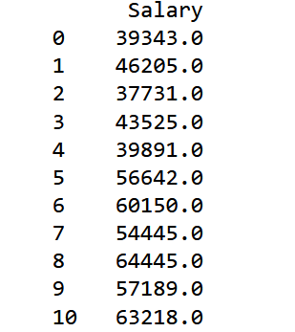
dependent variable:

Slide 26
Splitting the dataset into training and test set.
For that use scikit-learn
Install scikit-learn
Import now:

Slide 27
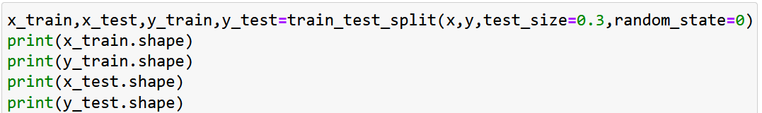
Use train_test_split()
test_size: define size of data set 0.3 means 30%
random_state=0 means value will be not shuffled

Slide 28
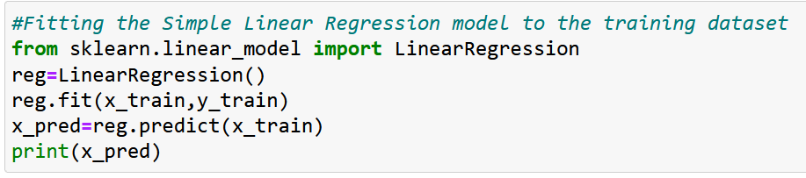
Fitting the Simple Linear Regression model to the training dataset

Slide 29
Now visualize your prediction for that we need to plot the regression line, we will use the plot() function. In this function, we will pass the years of experience for training set and predicted salary for training set x_pred

Slide 30
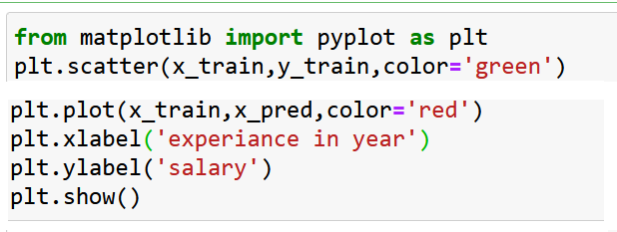
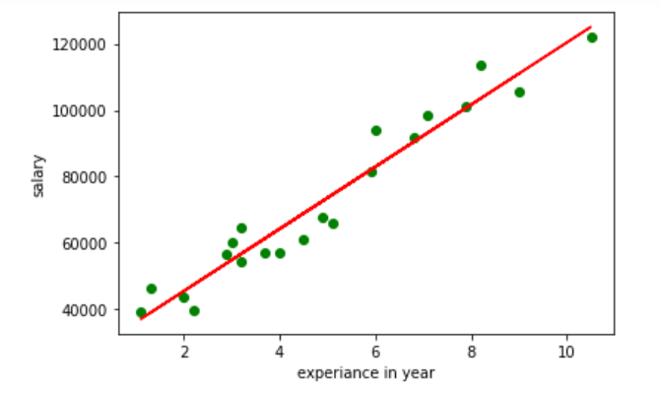

Slide 32
In the above plot, we can see the real values observations in green dots and predicted values are covered by the red regression line. The regression line shows a correlation between the dependent and independent variable.
The good fit of the line can be observed by calculating the difference between actual values and predicted values. But as we can see in the above plot, most of the observations are close to the regression line, hence our model is good for the training set.

Slide 33
k-nearest neighbours
k-nearest neighbor algorithm is supervised ML algorithm that can perform for both classification and regression tasks using numbers(k) of neighbors.

Slide 34
Both Regression and Classification algorithms are known as Supervised Learning algorithms and are used to predict in Machine learning and work with labeled datasets.
The main difference between Regression and Classification algorithms that Regression algorithms are used to predict the continuous values such as price, salary, age, etc. and Classification algorithms are used to predict/Classify the discrete values such as Male or Female, True or False, Spam or Not Spam, etc.

Slide 35
Suppose there is a dataset and we have to predict for one new student’s result?
Q1 | Q2 | Result
4 | 3 | Fail
6 | 7 | Pass
7 | 8 | Pass
5 | 5 | Fail
8 | 8 | Pass
S6 | Q1:6 | Q2:8
S1
S2
S3
S4
S5
Predict Result ?

Slide 36
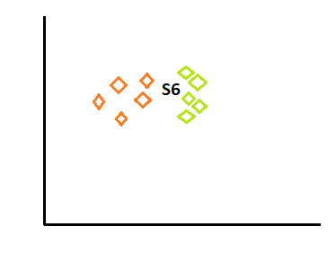

Slide 37
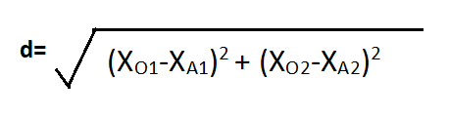
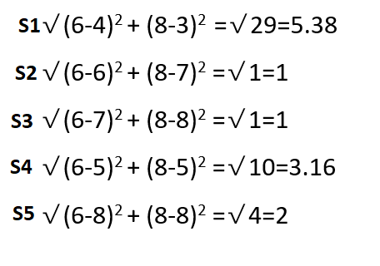
Find Euclidean distance
If k=3 then 3 nearest distance is 1,1, 2 i.e.: S2,S3 and S5

Slide 38
In the above table S2,S3 and S5 Result is Pass, Pass, Pass
So here total Pass is 3
And Fail is 0 so, 3>0
Prediction will be pass

Slide 39
decision trees
Decision Tree is a Supervised learning technique that can be used for both classification and Regression problems, but mostly it is preferred for solving Classification problems. It is a tree-structured classifier, where internal nodes represent the features of a dataset, branches represent the decision rules and each leaf node represents the outcome.
Taking decision and making tree

Slide 40
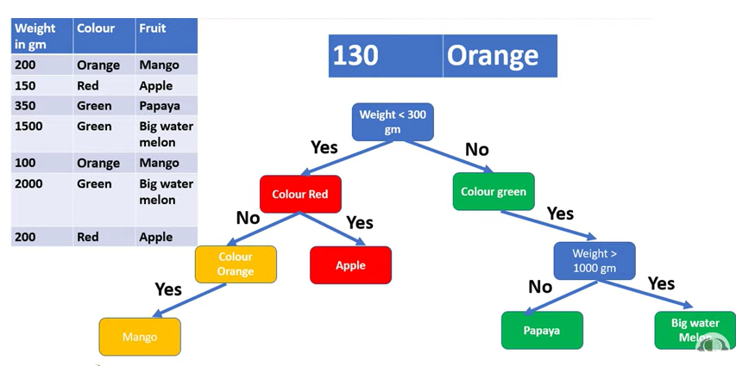
Example

Slide 41
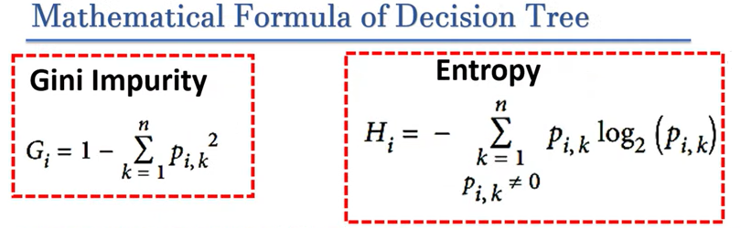
To create root node

Slide 42
Random forests
Random forests is the supervised learning technique. It is based on the concept of ensemble learning, which is a process of combining multiple classifiers to solve a complex problem and to improve the performance of the model.
"Random Forest is a classifier that contains a number of decision trees on various subsets of the given dataset and takes the average to improve the predictive accuracy of that dataset."

Slide 43
Example
Let’s suppose you have decided to ask your friends, and talked with them about their past travel experience to various places. You will get some recommendations from every friend. Now you have to make a list of those recommended places. Then, you ask them to vote (or select one best place for the trip) from the list of recommended places you made. The place with the highest number of votes will be your final choice for the trip.

Slide 44
In the above decision process, there are two parts. First, asking your friends about their individual travel experience and getting one recommendation out of multiple places they have visited. This part is like using the decision tree algorithm. Here, each friend makes a selection of the places he or she has visited so far.

Slide 45
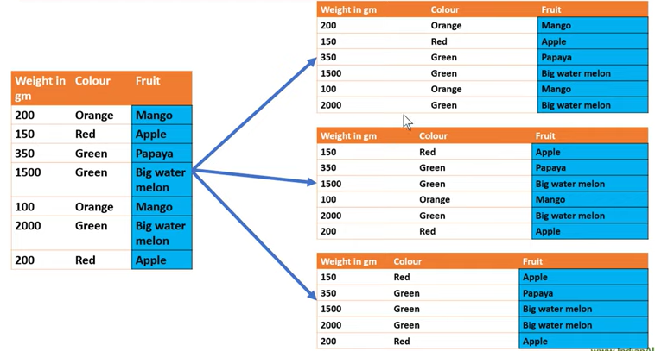

Slide 46
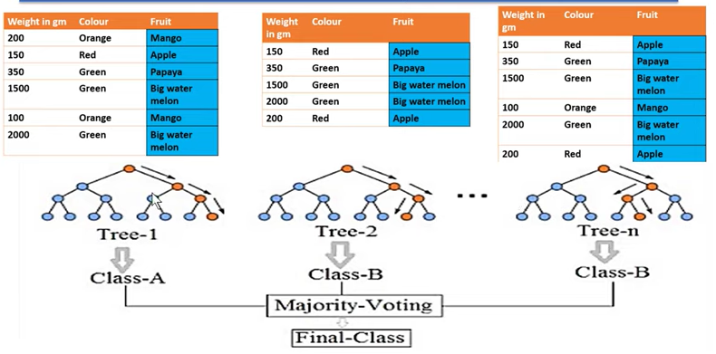

Slide 47
#Fitting Decision Tree classifier to the training set
from sklearn.ensemble import RandomForestClassifier
classifier= RandomForestClassifier(n_estimators= 10, criterion="entropy")
classifier.fit(x_train, y_train)
n_estimators= The required number of trees in the Random Forest.
#Predicting the test set result
y_pred= classifier.predict(x_test)

Slide 48
k-means clustering
K-Means Clustering is an unsupervised learning algorithm that is used to solve the clustering problems in machine learning or data science.
K-Means Clustering is an Unsupervised Learning algorithm, which groups the unlabeled dataset into different clusters. Here K defines the number of pre-defined clusters that need to be created in the process, as if K=2, there will be two clusters, and for K=3, there will be three clusters, and so on.

Slide 49
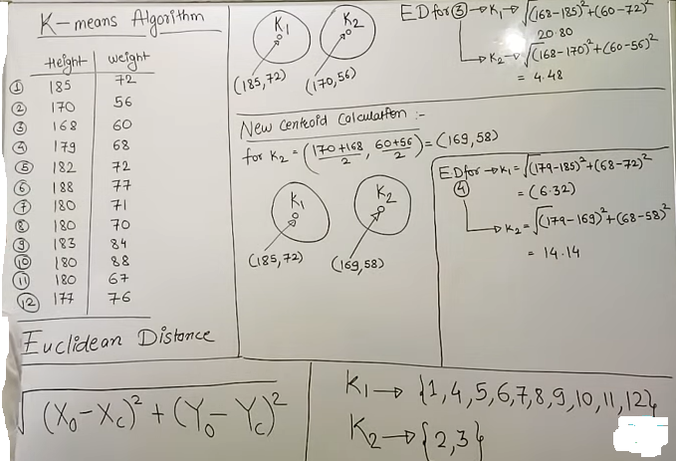

Slide 50
Pick any two rows make two centroid
Now take 3rd row and find Euclidean distance for k1 and k2
If distance is less value then take tat row in that cluster and find new centroid
k1
k2
K=2 | height | wt
1 | 185 | 72
2 | 170 | 56
3 | 168 | 60
4
5
6
7
8
9
10
11
12
(185,72)
(170,56)

Slide 51
from sklearn.cluster import Kmeans
kmeans = KMeans(n_clusters=2) kmeans.fit(data)

Slide 52
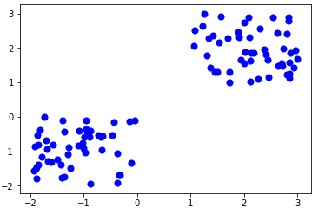

Slide 53
Thanks!!!

