Slide 1
CAP776
PROGRAMMING IN PYTHON

Slide 2
Introduction to NumPy
arrays vs lists,
array creation routines,
arrays from existing data,
indexing and slicing,
Operations on NumPy arrays,
array manipulation,
broadcasting,
binary operators,
NumPy functions: mathematical functions, statistical functions, sort, search and counting functions

Slide 3
arrays vs lists
An array is also a data structure that stores a collection of items. Like lists, arrays are ordered, mutable, enclosed in square brackets, and able to store non-unique items.
A list in Python is a collection of items which can contain elements of multiple data types.
A array in Python is a collection of items which can contain elements of same data types
The Python array module requires all array elements to be of the same type.
On the other hand, NumPy arrays support different data types.

Slide 4

NumPy stands for Numerical Python
NumPy is a Python library used for working with arrays.
In Python we have lists that serve the purpose of arrays, but they are slow to process.
NumPy aims to provide an array object that is up to 50x faster than traditional Python lists.
The array object in NumPy is called ndarray, it provides a lot of supporting functions

Slide 5
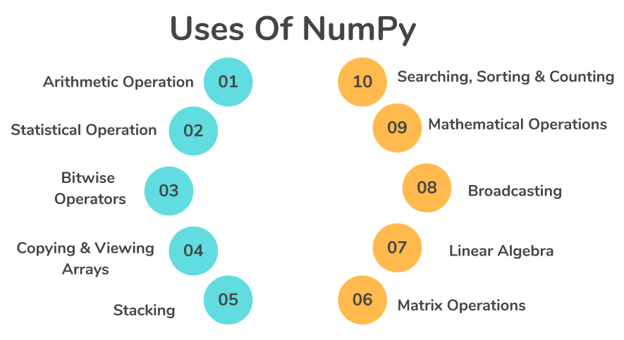

Slide 6
Python, you'll need to import this data structure from the NumPy package or the array module.

Slide 7
Installation of NumPy
!pip install numpy
Once NumPy is installed, import it in your applications by adding the import keyword:
import numpy
Create an alias with the as keyword while importing:
import numpy as np
Checking NumPy Version
The version string is stored under __version__ attribute
import numpy as np
print(np.__version__)

Slide 8
What are Modules in Python?
In python a module means a saved python file. This file can contain a group of classes, methods, functions and variables.
What is import keyword in python?
If we want to use other members(variable, function, etc) of a module in your program, then you should import that module by using the import keyword. After importing you can access members by using the name of that module.
from keyword in python:
We can import some specific members of the module by using the from keyword. The main advantage of the from keyword is we can access members directly without using module names.

Slide 9
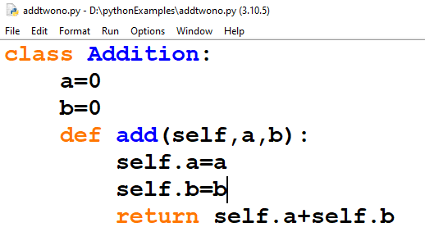
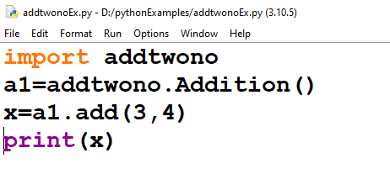

Slide 10
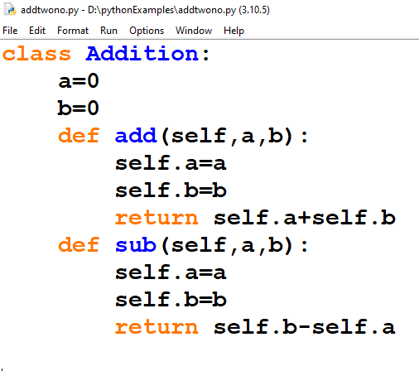
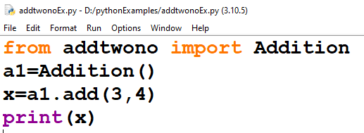

Slide 11
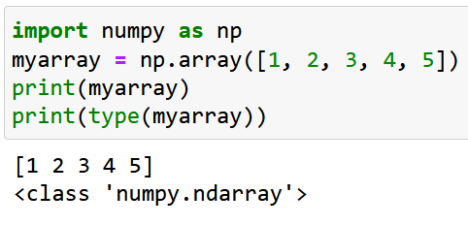
N-Dimensional array(ndarray) in Numpy
NumPy is used to work with arrays.
The array object in NumPy is called ndarray.
We can create a NumPy ndarray object by using the array() function.
To create an ndarray, we can pass a list, tuple or any array-like object into the array() method, and it will be converted into an ndarray

Slide 12
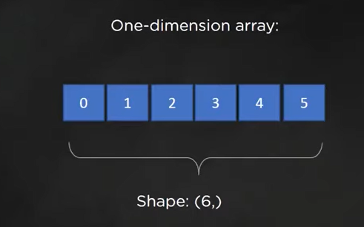
Create a 1-D array containing the values 0,1,2,3,4,5:
In numpy dimensions are called rank or axes.
Size of the array along each dimension is known as shape of the array

Slide 13
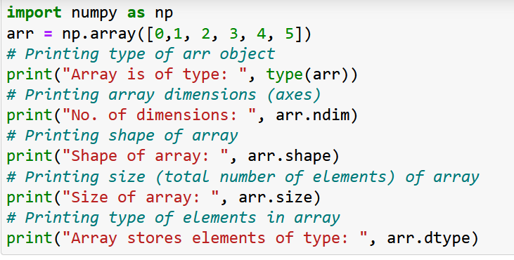
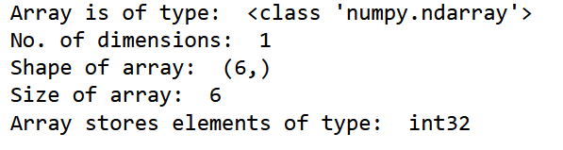

Slide 14
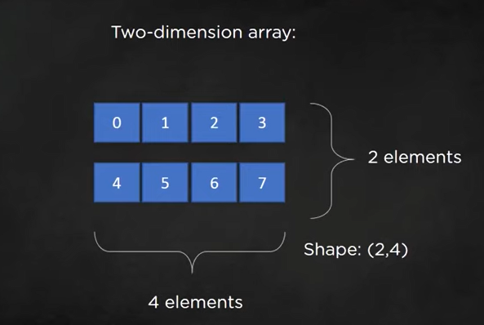

Slide 15
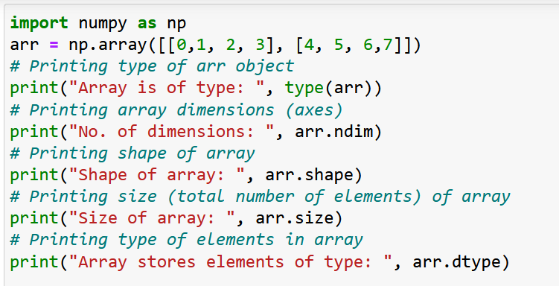
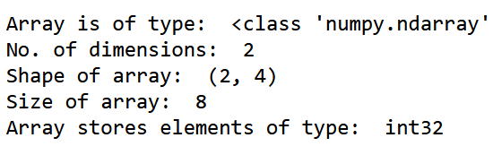

Slide 16
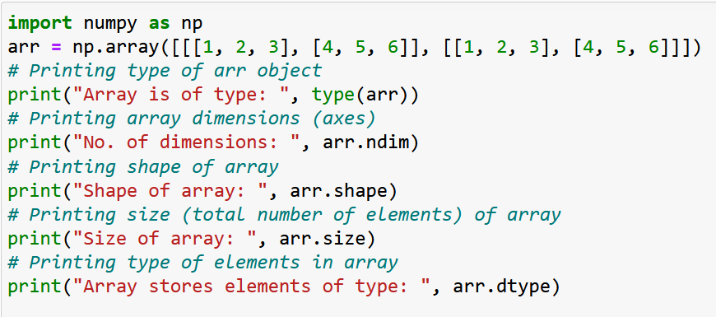
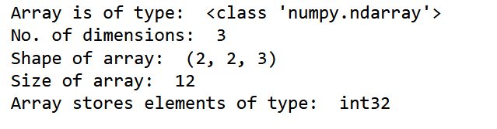

Slide 17
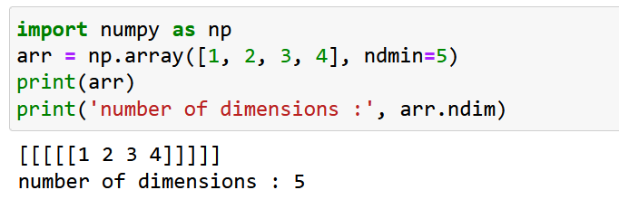
An array can have any number of dimensions.
When the array is created, you can define the number of dimensions by using the ndmin argument.

Slide 18
There are various ways to create arrays in NumPy:
You can create an array from a regular Python list or tuple using the array function.
Functions to create arrays:
Using arange() function to create a Numpy array.

Slide 19
Using arange() function to create a Numpy array:
arange(start, end, step)
Example:
arange_array = np.arange(0,11,2)
print(arange_array)

Slide 20
Reverse Array
arr2 = np.arange(20,0,-1)
print("Reverse Array", arr2)

Slide 21
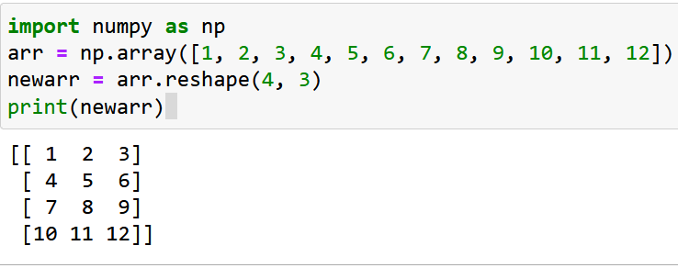
Reshaping arrays
Reshaping means changing the shape of an array.
The shape of an array is the number of elements in each dimension.
By reshaping we can add or remove dimensions or change number of elements in each dimension.

Slide 22
array creation routines
The ndarray object can be constructed by using the following routines:
Numpy.empty
The empty routine is used to create an uninitialized array of specified shape and data type.
The syntax is given below.
numpy.empty(shape, dtype = data_type)

Slide 23
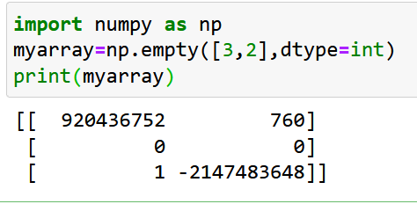
import numpy as np
arr = np.empty([3,2], dtype = int)
print(arr)

Slide 24
NumPy.Zeros
This routine is used to create the numpy array with the specified shape where each numpy array item is initialized to 0.
import numpy as np
arr = np.zeros((3,2), dtype = int)
print(arr)

Slide 25
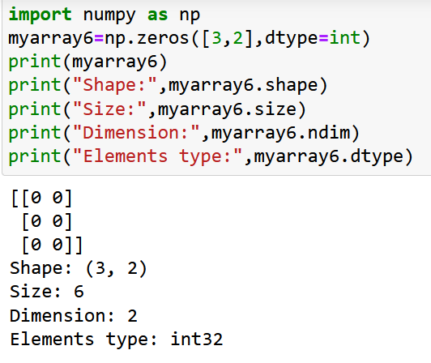

Slide 26
NumPy.ones
This routine is used to create the numpy array with the specified shape where each numpy array item is initialized to 1.
import numpy as np
arr = np.ones((3,2), dtype = int)
print(arr)

Slide 27
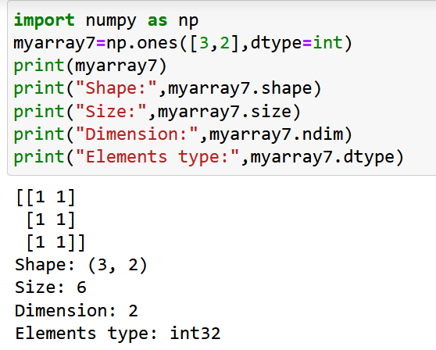

Slide 28
Array From Existing Data numpy.asarray()
Difference array() and asarray() function:
The main difference is that when you try to make a numpy array using np.array, it would create a copy of the object array and not reflect changes to the original array. On the other hand, when you use numpy asarray, it would reflect changes to the original array.

Slide 29
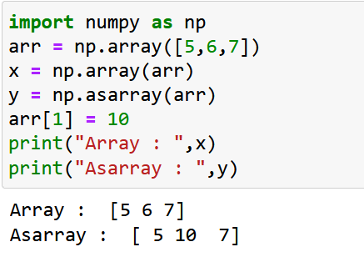

Slide 30
NumPy Bitwise Operators
bitwise_and
bitwise_or
invert
left_shift
right_shift

Slide 31
bitwise_and
import numpy as np
a = 10
b = 12
print("binary representation of a:",bin(a))
print("binary representation of b:",bin(b))
print("Bitwise and of a and b: ",np.bitwise_and(a,b))

Slide 32
If both side bit is on result will be On
a | b | a & b
0 | 0 | 0
0 | 1 | 0
1 | 0 | 0
1 | 1 | 1

Slide 33
Steps to solve:-
a = 12 (find binary form:1100 )
b = 25 (find binary form:11001)
How to find Binary:
64 32 16 8 4 2 1
0 1 1 0 0
12
25
8
1 1 0 0 1
1 0 0 0

Slide 34
bitwise_or Operator
import numpy as np
a = 50
b = 90
print("binary representation of a:",bin(a))
print("binary representation of b:",bin(b))
print("Bitwise-or of a and b: ",np.bitwise_or(a,b))

Slide 35
If any side bit is on result will be On
a | b | a | b
0 | 0 | 0
0 | 1 | 1
1 | 0 | 1
1 | 1 | 1

Slide 36
Steps to solve:-
a = 12 (find binary form:1100 )
b = 25 (find binary form:11001)
How to find Binary:
64 32 16 8 4 2 1
0 1 1 0 0
12
25
29
1 1 0 0 1
1 1 1 0 1

Slide 37
Invert operation
It is used to calculate the bitwise not operation

Slide 38
left_shift()
import numpy as np
a = 10
print ('Left shift of 10 by two positions:')
print (np.left_shift(10,2))

Slide 39
a=10 (1010)
a<<1
1010.0
10100(20) Ans.
a<<2
1010.00
101000(40) Ans.

Slide 40
right_shift
import numpy as np
print 'Right shift 40 by two positions:'
print np.right_shift(40,2)

Slide 41
a=10 (1010)
a>>1
1010.
101(5) Ans.
a>>2
1010.
10(2) Ans.

Slide 42
String functions
numpy.char.add()
import numpy as np
print ('Concatenate two strings:’ )
print (np.char.add(['hello'],[' xyz’]))

Slide 43
numpy.char.multiply()
import numpy as np
print( np.char.multiply('Hello ‘,3))

Slide 44
numpy.char.center()
This function returns an array of the required width so that the input string is centered and padded on the left and right with fillchar.
import numpy as np
# np.char.center(arr, width,fillchar)
print (np.char.center('hello', 20,fillchar = '*’))

Slide 45
numpy.char.capitalize()
This function returns the copy of the string with the first letter capitalized.
import numpy as np
print( np.char.capitalize('hello world’))

Slide 46
Operations on NumPy arrays
You can perform arithmetic directly on NumPy arrays, such as addition and subtraction.
For example, two arrays can be added together to create a new array where the values at each index are added together.

Slide 47
import numpy as np
a = np.array([1, 2, 3])
b = np.array([1, 1, 1])
c = a + b
print(c)
[1,2,3,1,1,1]
[1,1,1,1,2,3]
[2,3,4]
None

Slide 48
import numpy as np
a = np.array([1, 2, 3])
b = np.array([1, 1, 1])
c = a + b
print(c)
a = [1, 2, 3]
b = [1, 1, 1]
c = a + b
c = [1 + 1, 2 + 1, 3 + 1]

Slide 49
Limitation with Array Arithmetic
Arithmetic may only be performed on arrays that have the same dimensions and dimensions with the same size.
Arrays with different sizes cannot be added, subtracted, or generally be used in arithmetic.
A way to overcome this use array broadcasting and is available in NumPy

Slide 50
arithmetic operations
For performing arithmetic operations such as add(), subtract(), multiply(), and divide() must be of the same shape.
import numpy as np
a = np.array([10,20,30])
b = np.array([1,2,3])
print(a.shape)
print(b.shape)
print(np.add(a,b))
print(np.subtract(a,b))
print(np.multiply(a,b))
print(np.divide(a,b))

Slide 51
Example:
import numpy as np
a1=np.array([10,20,30])
b1=np.array([1,2,3,4])
print(a1+b1)

Slide 52
You can perform arithmetic operations with different dimension using broadcasting rule :
Main rule:
Size of each dimension should be same
Size of one of the dimension should be 1.

Slide 53
array broadcasting rule
Rule1: If the two arrays differ in their number of dimensions, the shape of the one with fewer dimensions is padded with ones on its leading (left) side.
Rule2: If the shape of the two arrays does not match in any dimension, the array with shape equal to 1 in that dimension is stretched to match the other shape.
Rule3: If in any dimension the sizes disagree and neither is equal to 1, an error is raised.

Slide 54
Check with example:
a1=[10,20,30]
shape:3
dimension:1D
b1=[1,2,3,4]
shape:4
dimension:1D
Rule1: not satisfied
Rule2:not satisfied
import numpy as np
a1=np.array([10,20,30])
b1=np.array([1,2,3,4])
print(a1+b1)

Slide 55
Check with another example2
import numpy as np
a1=np.array([[1,2],[3,4],[5,6]])
b1=np.array([10,20])
print(a1+b1)
a1:
Shape: 3,2
Dimension:2D
b1:
Shape:2
Dimension:1D

Slide 56
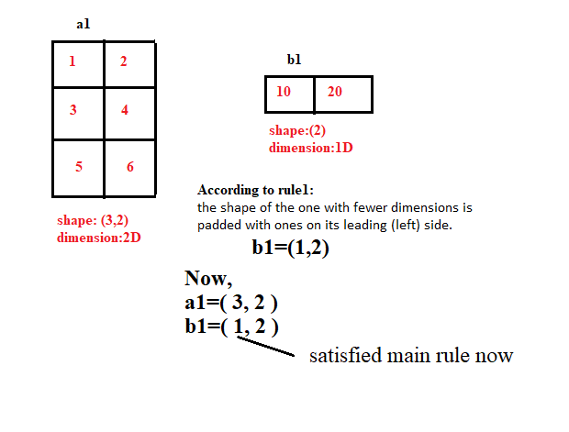

Slide 57
Check with another example3
import numpy as np
a1=np.array([[1,2],[3,4],[5,6]])
b1=np.array([10,20,30])
print(a1+b1)
a1:
Shape: 3,2
Dimension:2D
b1:
Shape:3
Dimension:1D

Slide 58
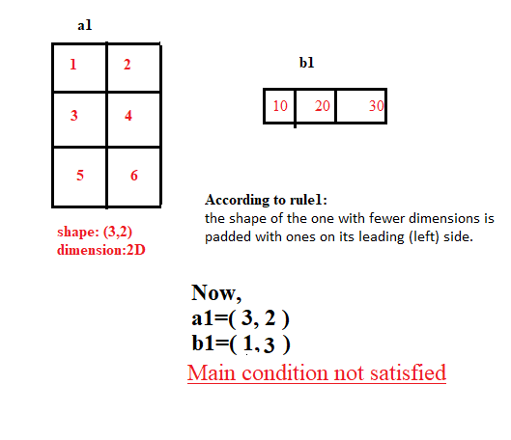

Slide 59
Check with another example4
import numpy as np
a1=np.array([[1,2],[3,4],[5,6]])
b1=np.array([[10,20],[30,40]])
print(a1+b1)
a1:
Shape: 3,2
Dimension:2D
b1:
Shape:2,2
Dimension:2D

Slide 60
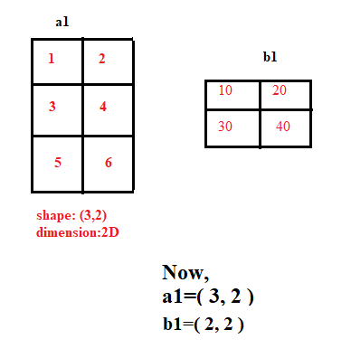

Slide 61
mathematical functions
1. Arithmetic Functions
2. Trigonometric Functions
3. Logarithmic and Exponential Functions
4. Rounding Functions

Slide 62
1. Arithmetic Functions
NumPy Add function
add()
This function is used to add two arrays. If we add arrays having dissimilar shapes we get “Value Error”.
NumPy Subtract function
subtract()
We use this function to output the difference of two arrays. If we subtract two arrays having dissimilar shapes we get “Value Error”.

Slide 63
1. Arithmetic Functions
NumPy Multiply function
multiply()
We use this function to output the multiplication of two arrays. We cannot work with dissimilar arrays.
NumPy Divide Function
divide()
We use this function to output the division of two arrays. We cannot divide dissimilar arrays.

Slide 64
1. Arithmetic Functions
NumPy Mod and Remainder function:
mod()
remainder()
We use both the functions to output the remainder of the division of two arrays.

Slide 65
2. Trigonometric Functions
np.sin()- It performs trigonometric sine calculation element-wise.
np.cos()- It performs trigonometric cosine calculation element-wise.
np.tan()- It performs trigonometric tangent calculation element-wise.
np.arcsin()- It performs trigonometric inverse sine element-wise.
np.arccos()- It performs trigonometric inverse of cosine element-wise.
np.arctan()- It performs trigonometric inverse of tangent element-wise.

Slide 66
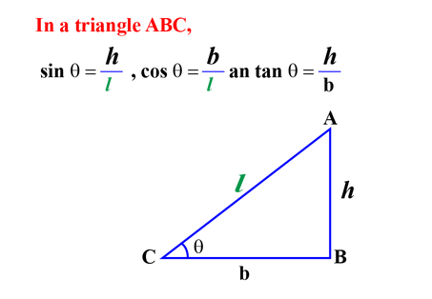
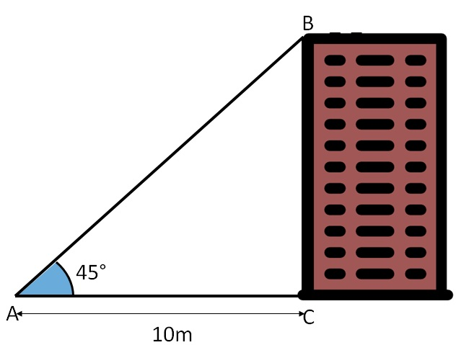
Real life applications of trigonometry
Trigonometry can be used to measure the height of a building or mountains.
if you know the distance from where you observe the building and the angle of elevation you can easily find the height of the building.

Slide 67
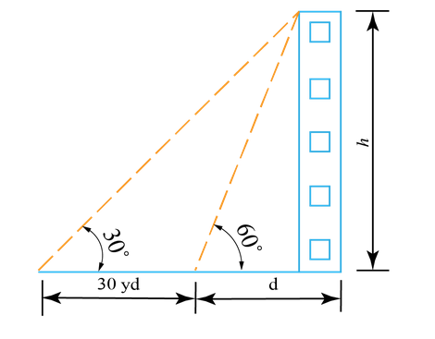
Problem statement
A man standing at a certain distance from a building, observe the angle of elevation of its top to be 60∘. He walks 30 yds away from the building. Now, the angle of elevation of the building’s top is 30∘. How high is the building?

Slide 68
tan 60= h/d
√3 =h/d
d=h/√3

Slide 69
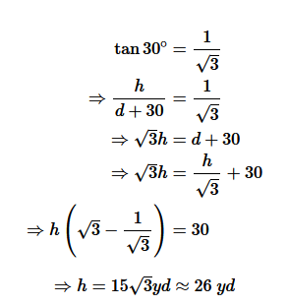

Slide 70
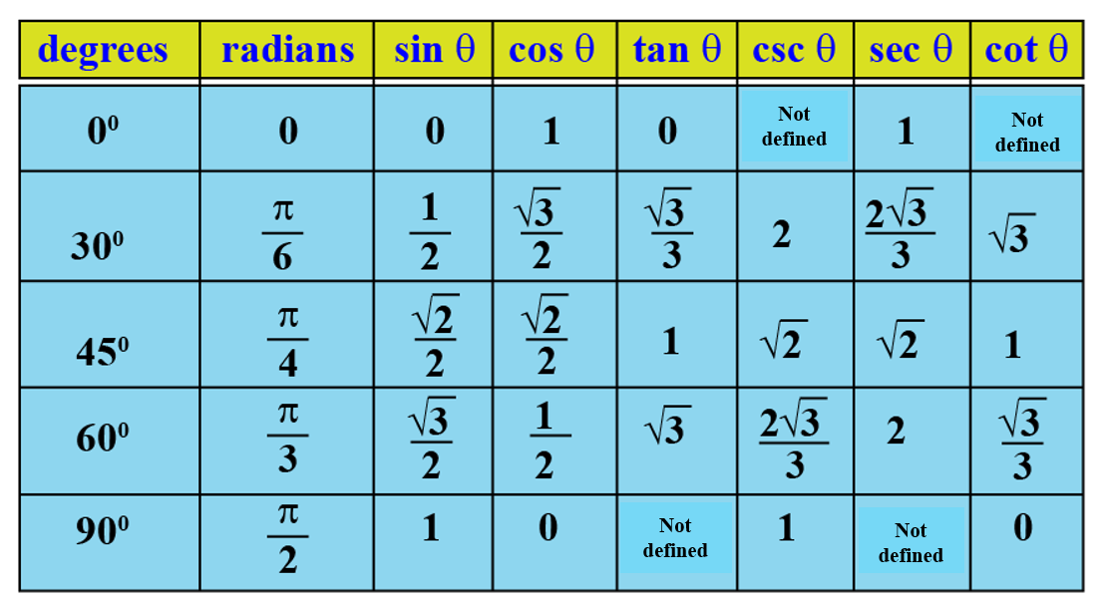

Slide 71
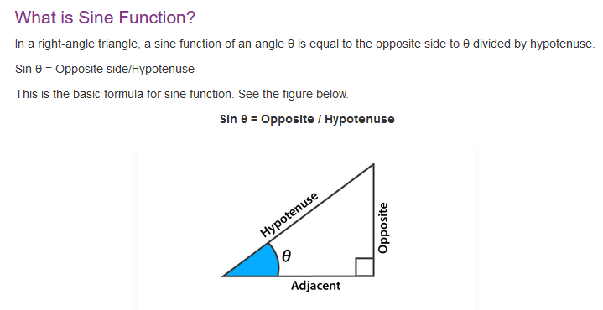

Slide 72
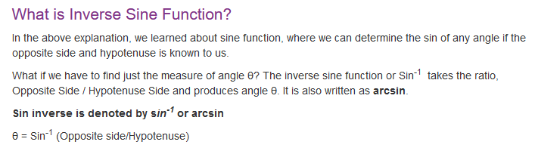

Slide 73
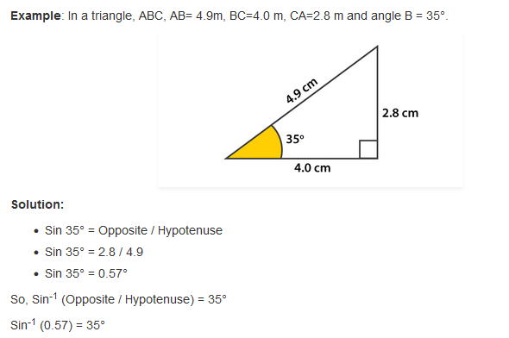

Slide 74
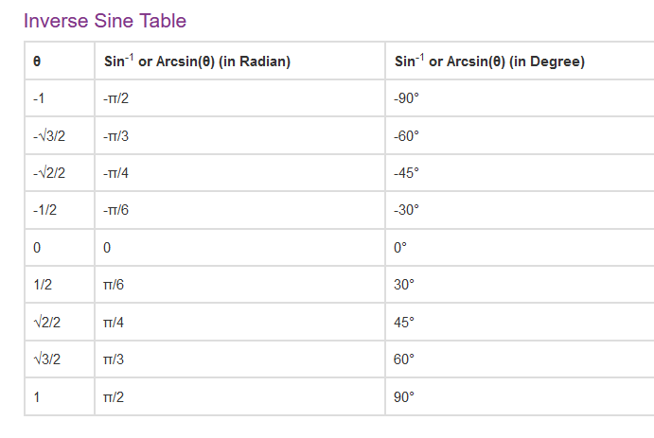

Slide 75
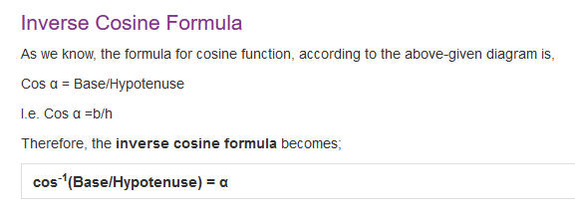

Slide 76
Conversion function
degrees(arr) rad2deg(arr) | Covert input angles from radians to degrees
radians(arr) deg2rad(arr) | Covert input angles from degrees to radians

Slide 77
Exponential and Logarithmic Functions
np.exp()- This function calculates the exponential of the input array elements.
np.log()- This function calculates the natural log of the input array elements. Natural Logarithm of a value is the inverse of its exponential value.

Slide 78
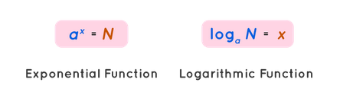

Exponential and Logarithmic Functions
John Napier
John Napier is best known as the discoverer of logarithms in 1614

Slide 79
In mathematics, the logarithm is the inverse function to exponentiation.
Exponentiation is a mathematical operation, written as b^{n}, involving two numbers, the base b and the exponent or power n, and pronounced as "b (raised) to the (power of) n". When n is a positive integer, exponentiation corresponds to repeated multiplication of the base.

Slide 80
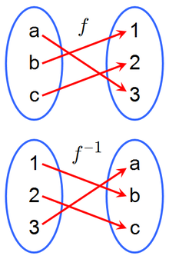
Inverse function

Slide 81
Logarithmic function is of the form
f(x) = log_{a}x
or,
y = log_{a}x,
where a > 0 and a!=1
x we can take (0 to ∞)
based on x value y value will be have range(- ∞ to ∞)
It is the inverse of the exponential function a^{y} = x

Slide 82




Real life examples:
Suppose these values indicating salary, distance from earth to sun and
Molecules. You want to plot the graph for these values

Slide 83
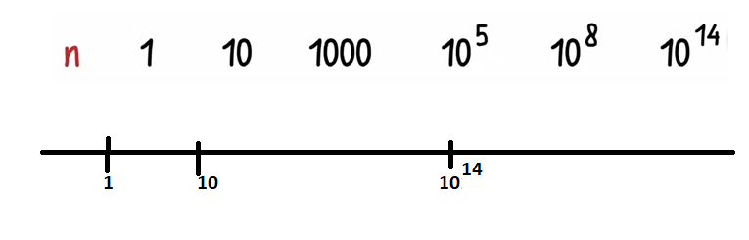
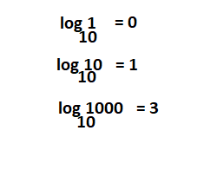
If we will plot graph like this:
No’s will be seems like very closer, we can solve this using logarithmic

Slide 84
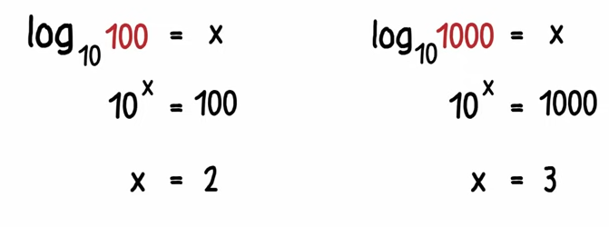

Slide 85
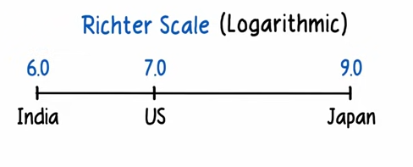
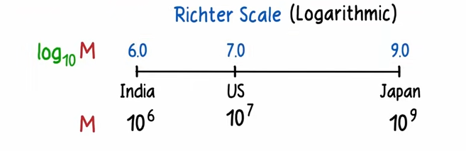
The Richter scale is a base-10 logarithmic scale, meaning that each order of
magnitude is 10 times more intensive than the last one.

Slide 86
Rounding Functions
np.around()- This function is used to round off a decimal number to desired number of positions. The function takes two parameters: the input number and the precision of decimal places.
np.floor()- This function returns the floor value of the input decimal value. Floor value is the largest integer number less than the input value.

Slide 87
Sort, Search & Counting Functions
There are various sorting algorithms like quicksort, merge sort and heapsort which is implemented using the numpy.sort() function.
Syntax:
numpy.sort(input, axis, kind, order)
input: It represents the input array which is to be sorted.
axis: It represents the axis along which the array is to be sorted. If the axis is not mentioned, then the sorting is done along the last available axis.
kind: It represents the type of sorting algorithm which is to be used while sorting. The default is quick sort.
order: It represents the filed according to which the array is to be sorted in the case if the array contains the fields.

