Slide 1

CAP776
PROGRAMMING IN PYTHON
The Kick Start Session

Slide 2
Python?
Python is a general purpose high-level programming language which supports Object Oriented programming approach to develop applications.

Slide 3
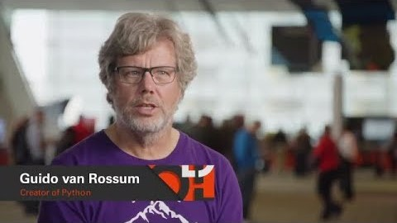
Who developed?
Python was developed in 1989 by Guido Van Rossum

Slide 4
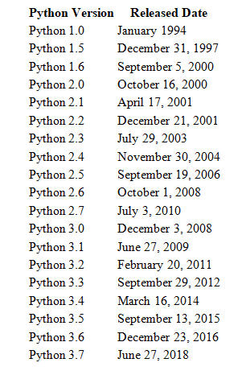
Python 3.8.0 Oct. 14, 2019
Python 3.8.5 July 20, 2020

Slide 5
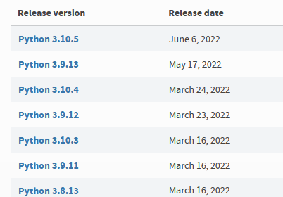

Slide 6
Introduction to python
installation and setting up path

Slide 7
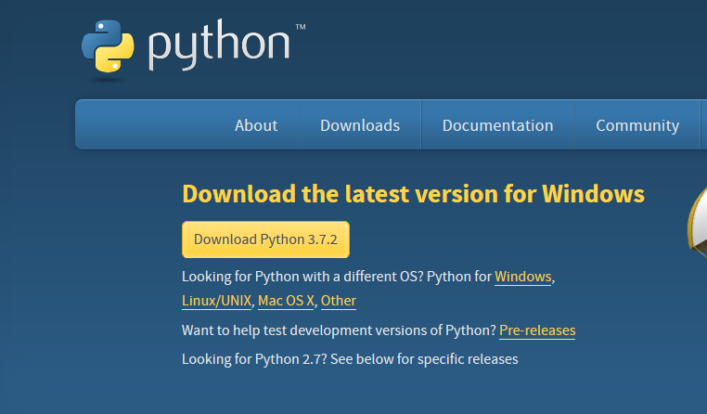
installation and setting up path
Installation on Windows
Visit the link https://www.python.org/downloads/ to download the latest release of Python.

Slide 8
To check python has installed properly or not
  Open Python CLI
  Type
  >>> print(“hello world”) <Enter Key>
  Out put:
  >>>hello world

Slide 9
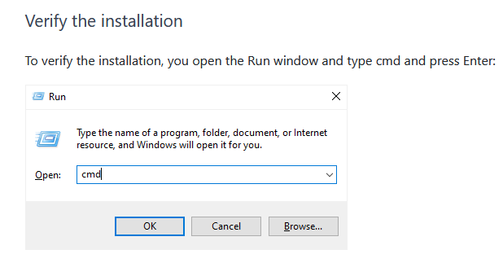

Slide 10
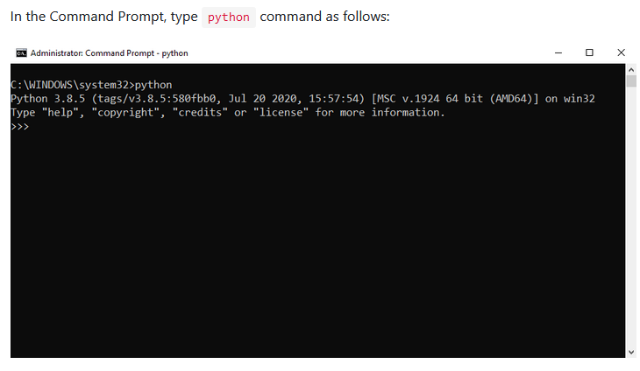

Slide 11
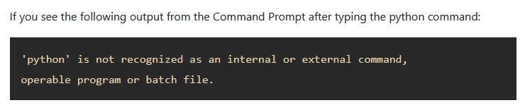

Slide 12
setting up path
Steps:
Check your python installed path
In shell script
>>> import os
>>> print(os.getcwd())
Example:
C:\Users\work\AppData\Local\Programs\Python\Python37-32
Now copy this path and open System properties

Slide 13
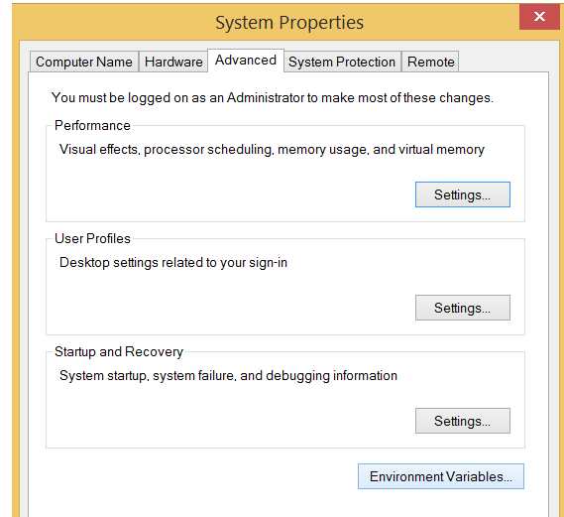

Slide 14
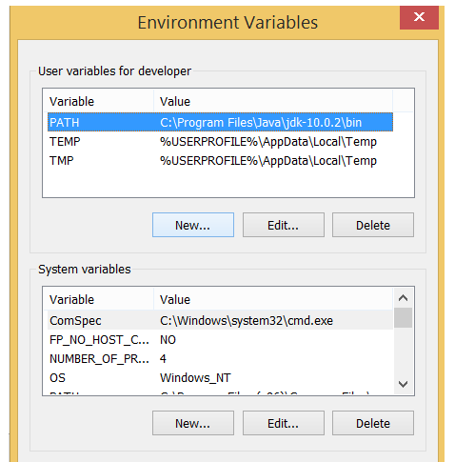
Select Environment Variable

Slide 15
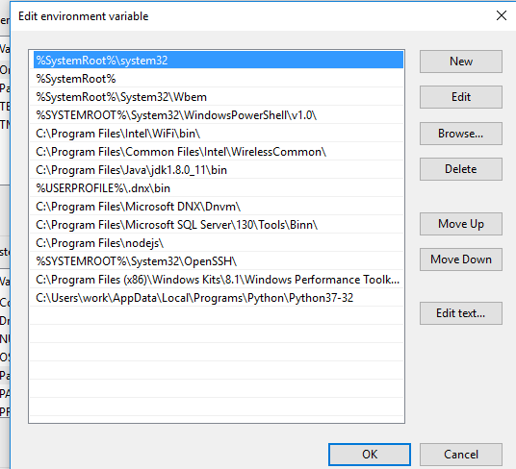
Inside System variable select path and edit

Slide 16
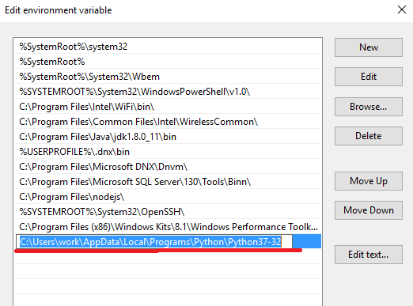
Click on New button and paste python file path

Slide 17
Now open command prompt
Use window +R
On run type cmd + <Enter key>
To check path set correctly or not use command python in command prompt
C:\> python <Enter key>
Out put: you will get python interpreter
>>>

Slide 18
Use simple editor to run python file
python filename.py

Slide 19
IDLE Python
IDLE (Integrated Development and Learning Environment) is an integrated development environment (IDE) for Python. The Python installer for Windows contains the IDLE module by default.

Slide 20
basic syntax
Comments :
Python supports two types of comments:
1) Single Line Comment:
# This is single line comment.
2) Multi Line Comment:
Multi lined comment can be given inside triple quotes.
“”” (This is also called docstring in python)

Slide 21
Indentation
To define a block of code. Python uses indentation.
A code block (body of a function, loop etc.) starts with indentation and ends with the first un-indented line.
ifor i n range(1,11):
print(i)
for i in range(1,11):
print(i)
Error
Correct

Slide 22
Python Keywords
Keywords are the reserved words in Python
In Python, keywords are case sensitive
All the keywords except True, False and None are in lowercase
We cannot use a keyword as variable name, function name or any other identifier.

Slide 23
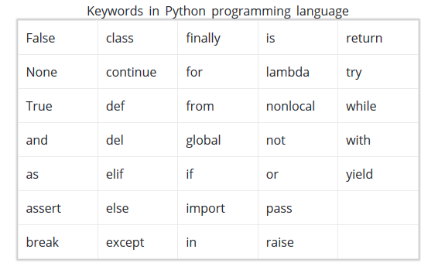

Slide 24
Identifiers
Identifier is the name given to entities like class, functions, variables etc. in Python.
Python is a case-sensitive language. This means, Variable and variable are not the same. Always name identifiers that make sense.
We can also use camel-case style i.e., capitalize every first letter of the word except the initial word without any spaces. For example: camelCaseExample

Slide 25
Rules for naming identifiers
An identifier cannot start with a digit
Do not use any keyword as identifier name
Identifiers can be a combination of letters in lowercase (a to z) or uppercase (A to Z) or digits (0 to 9) or an underscore (_).

Slide 26
Variable
A variable is a named location used to store data in the memory.
In Python, variables do not need declaration to reserve memory space.
The "variable declaration" or "variable initialization" happens automatically when we assign a value to a variable.

Slide 27
Declaring and assigning a value to a variable
name = “kumar“
print(name)
Assigning multiple values to multiple variables
a, b, c = 5, 3.2, "Hello“
print (a)
print (b)
print (c)

Slide 28

Any Query??

