Slide 1
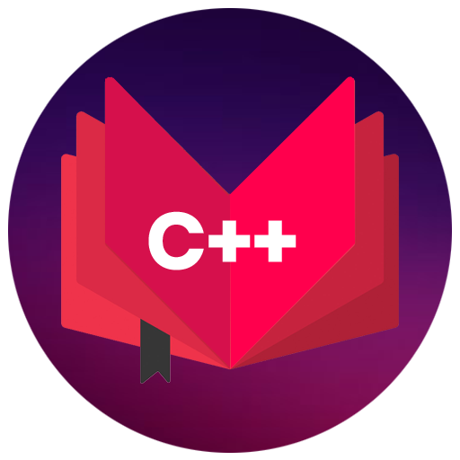
CAP202
OBJECT ORIENTED PROGRAMMING
Unit1

Slide 2
Unit-1
OOP Principles and C++ Basics :
introduction,
procedural vs object oriented programming,
basic concepts of object oriented programming,
object oriented languages,
benefits of OOP’s,
C Vs C++,
a simple C++ program,
compiling & linking,
tokens, keywords, identifiers & constants,
data types,
reference variables

Slide 3



Slide 4
object oriented languages
Procedural Programming and Object Oriented Programming:
Languages used in Procedural Programming:
FORTRAN, ALGOL, COBOL,
BASIC, Pascal and C.
Languages used in Object Oriented Programming:
Java, C++, C#, Python,
PHP, JavaScript, Ruby, Perl,
Objective-C, Dart, Swift, Scala.

Slide 5
OOPs Features
Class
Objects
Encapsulation
Abstraction
Polymorphism
Inheritance
Dynamic Binding
Message Passing

Slide 6

Class
Class is a collection of similar types of objects.
For example: Fruits is class of mango, apple , orange etc.
Fruits

Slide 7
Class
Class is a collection of data members and member functions.
Example:
class Employee{
//data members
// member functions
}
Employee
employeeId employeeName
getDetails() setDetails()

Slide 8
class student
{
public:
int regno;
void getStudentDetails();
}
In this code which option is correct?
A: regno is data member
B. getStudentDetails() is member function
C. above both options are correct

Slide 9
Object
Object is an instance of a Class.
class Employee
{
int employeeId;
char employeeName[20];
public:
void getDetails(){}
void setDetails(){}
};
int main()
{
Employee e1; // e1 is a object
return 0;
}

Slide 10
Encapsulation
Wrapping up of data and information under a single unit.
Binding together the data and the functions in a single unit
Encapsulation also hides the data
We can achieve encapsulation features by making data member as a private and use get and set accessor methods to access data members.

Slide 11


Abstraction
Hiding background details and showing features or functionality only

Slide 12
You know how to drive the car but you don’t know about the internal details this is the example of ….?
Encapsulation
Abstraction
None

Slide 13
How to achieve abstraction in C++ ?

Slide 14
An abstraction can be achieved using classes.
A class has the responsibility to determine which data member is to be visible outside and which is not.
Access specifiers is used to follow this access mechanism within class

Slide 15


Polymorphism
The ability to perform a task in more than one form.
We use Function overloading and Function overriding to achieve polymorphism.
Good Student
Good Singer
Rahul

Slide 16



Inheritance
father
mother
child

Slide 17
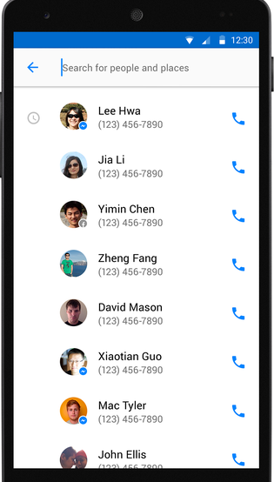
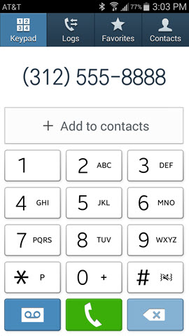
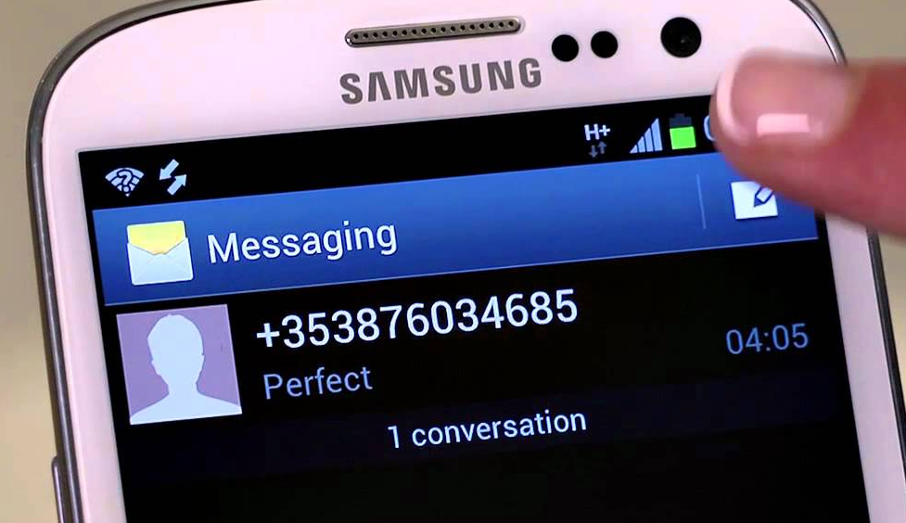
More examples of inheritance:
Contact List

Slide 18
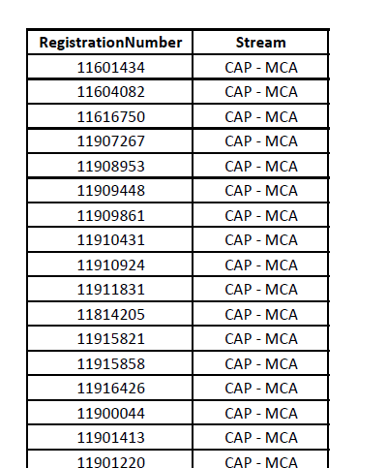
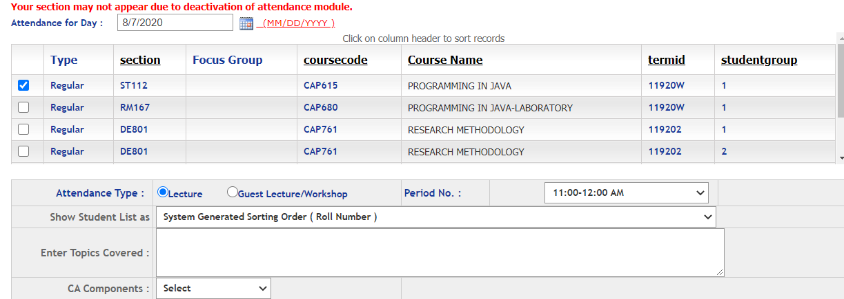
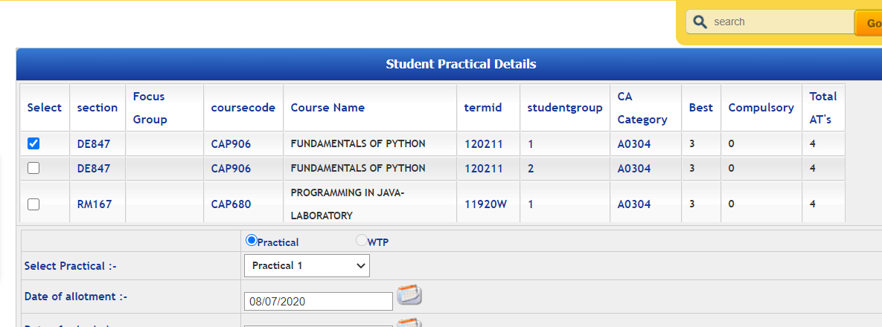
Students
More examples of inheritance:
Students in Attendance Module
Same Students in CA Module

Slide 19
basic concepts of object oriented programming

Slide 20
Variable declaration and initialization
A name of storage location which holds some value
1001
Syntax:
Var_type var_name;// declaration
Var_type var_name=value;//initialization
Ex: int num;
int num=10;
A

Slide 21
Data types
User-define type
Built-in-type
Derived type
Integer
Character
Boolean
Floating Point
Double
Void
Class
Structure
Union
Enumeration
Function
Array
Pointer

Slide 22
Data type modifiers are:
Signed
Unsigned
Short
Long

Slide 23
Data type | Size(in byte) | Range
char | 1 =8 bits ( 2⁸ ) | -127 to 127 or 0 to 255
unsigned char | 1 | 0 to 255
signed char | 1 | -127 to 127
int | 4=32 bits ( 2³² ) | -2,147,483,648 to 2,147,483,647
short int | 2 | -32,768 to 32,767
unsigned short int | 2 | 0 to 65,535
unsigned int | 4 | 0 to 4,294,967,295
float | 4
double | 8
long double | 12

Slide 24
Memory representation
1 Byte= 8 Bits
128 0 | 64 1 | 32 0 | 16 0 | 8 0 | 4 0 | 2 0 | 1 1
A(65)=01000001
char ch=65;
Or
char ch=‘A’
Char is occupying 1 Byte memory

Slide 25
Size of int is?
8 bits
16 bits
32 bits
64 bits

Slide 26
Operators
Arithmetic operators
Assignment operators
Comparison operators
Logical operators
Bitwise operators

Slide 27
Arithmetic operators
Operator | Name | Example
+ | Addition | x + y
- | Subtraction | x - y
* | Multiplication | x * y
/ | Division | x / y
% | Modulus | x % y
++ | Increment | ++x
-- | Decrement | --x

Slide 28
Example:
Select Your Choice
Add
Subtract
Multiplication
Division

Slide 29
Assignment Operators
Operator | Example | Same As
= | x = 5 | x = 5
+= | x += 3 | x = x + 3
-= | x -= 3 | x = x - 3
*= | x *= 3 | x = x * 3
/= | x /= 3 | x = x / 3
%= | x %= 3 | x = x % 3
&= | x &= 3 | x = x & 3
|= | x |= 3 | x = x | 3
^= | x ^= 3 | x = x ^ 3
>>= | x >>= 3 | x = x >> 3
<<= | x <<= 3 | x = x << 3

Slide 30
Example

Slide 31
Comparison operators
Operator | Name | Example
== | Equal to | x == y
!= | Not equal | x != y
> | Greater than | x > y
< | Less than | x < y
>= | Greater than or equal to | x >= y
<= | Less than or equal to | x <= y

Slide 32
Example

Slide 33
Logical operators
Operator | Name | Description | Example
&& | Logical and | Returns true if both statements are true | x < 5 && x < 10
|| | Logical or | Returns true if one of the statements is true | x < 5 || x < 4
! | Logical not | Reverse the result, returns false if the result is true | !(x < 5 && x < 10)

Slide 34
Write a program for shopping mall, In shopping mall, there is a mobile shop, in this mobile shop you are getting offer if you will purchase mobile phone with power bank you will get 10% discount , but if you purchase any mobile or power bank you will get only 5 % discount. Display this offer to the user screen whenever user is selecting the option.
Select option :
1. Mobile
Select option:
1. Only mobile
2. Only power bank
3. mobile with power bank
4. not any

Slide 35
Any Query?
Unit-1 End

